Slide 1
The Star Llama

Slide 2
https://www.youtube.com/watch?v=9M09MwB-NMk

Slide 3
LET’S BEGIN WITH THE END IN MIND
By the end of today's class, students will: ​
To identify the new genre
To answer questions about the story and predict what will happen next

Slide 4
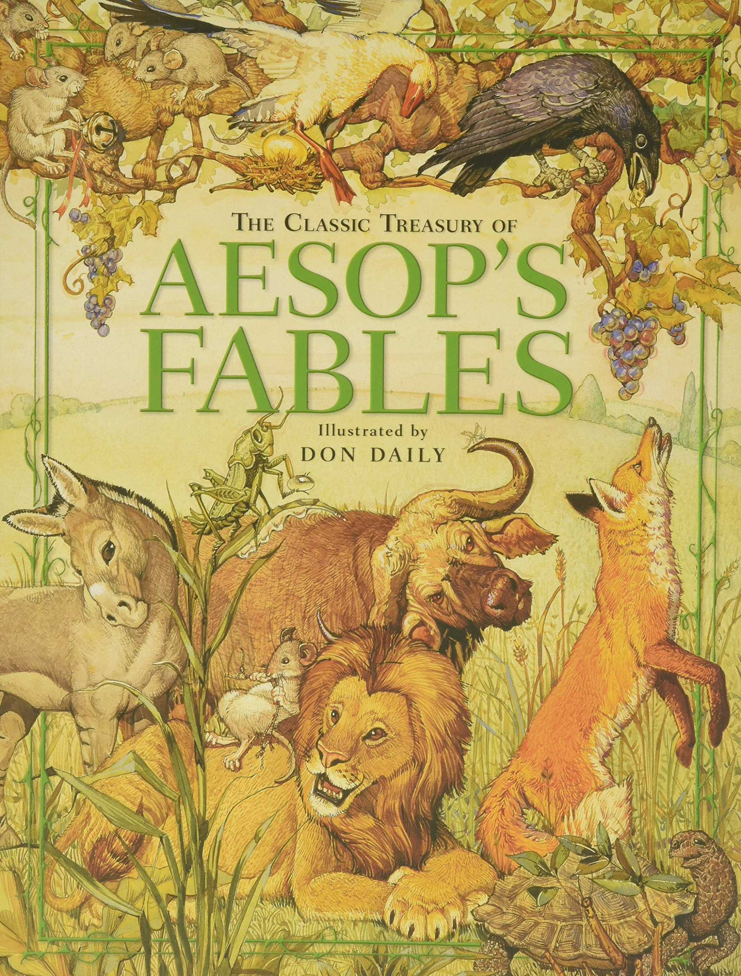
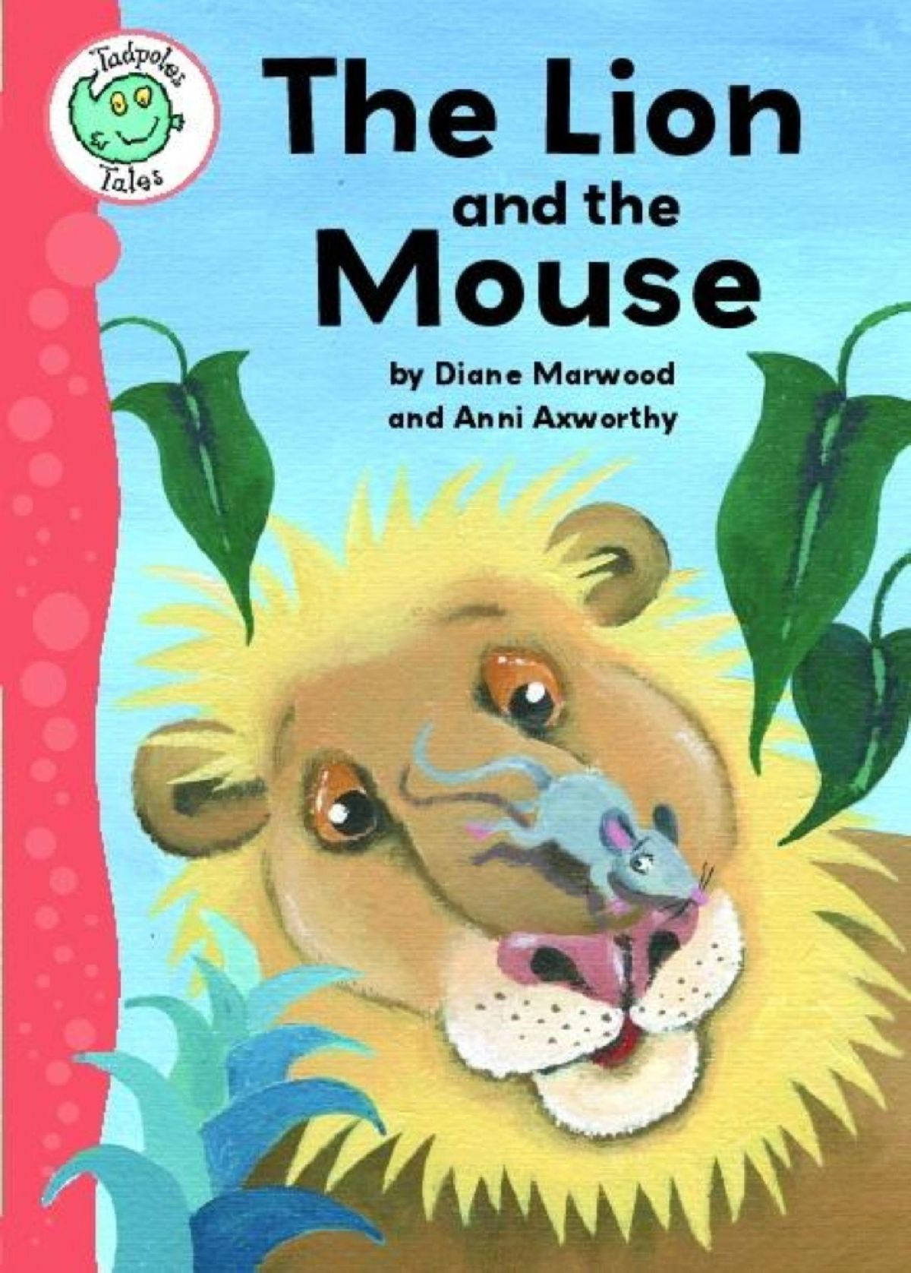
Lead in
Task 1:
1- Look at the pictures and describe what do you see?

Slide 5

Pre assessment
Think of stories you’ve read before!
Try to remember as much as you can and write them on sticky notes

Slide 6
A Fable is:
a short fictional story that teaches a lesson. The characters are often animals.

Slide 7
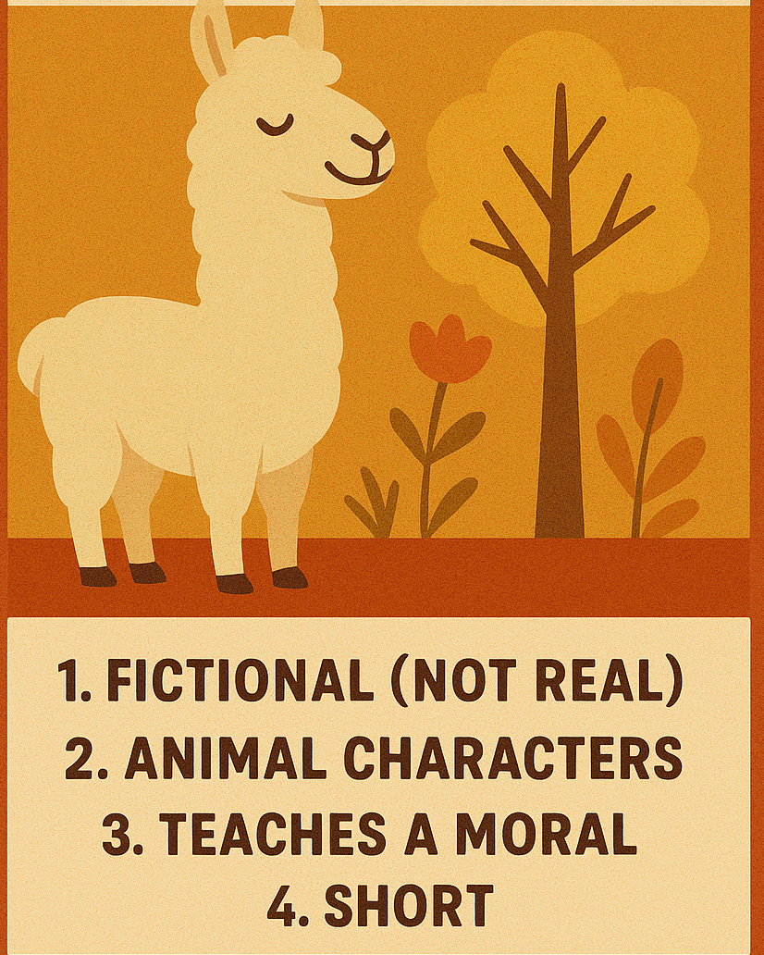
A Fable is:

Slide 8
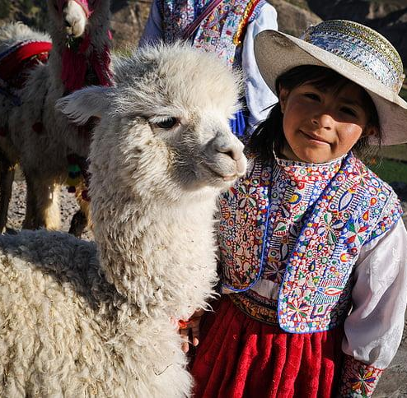
Task 3: Build Vocabulary
Inca
(noun)
Example
Most Inca people were farmers and looked for llamas
Meaning
A person from an ancient culture in the Andes mountains in South America.

Slide 9
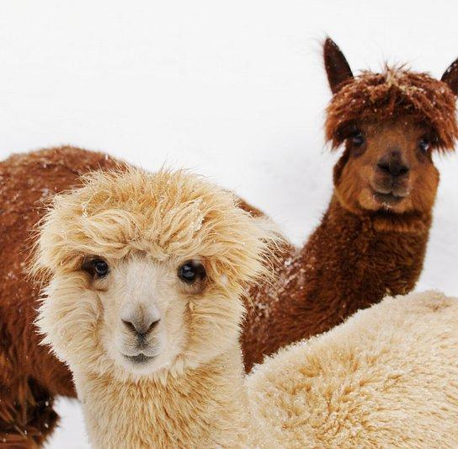
Task 3: Build Vocabulary
Llama
(noun)
Example
I saw a llama in the zoo.
Meaning
South American animal with thick hair like wool and a long neck.

Slide 10
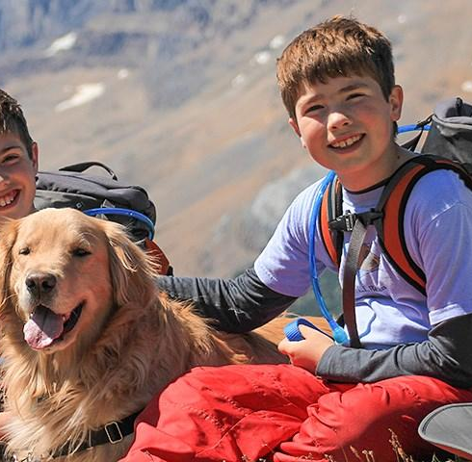
Task 3: Build Vocabulary
Companion
(noun)
Example
A dog is a good companion for people.
Meaning
A friend or a playmate.

Slide 11
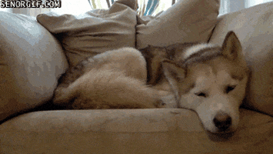
Task 3: Build Vocabulary
Curl up
(verb)

Slide 12
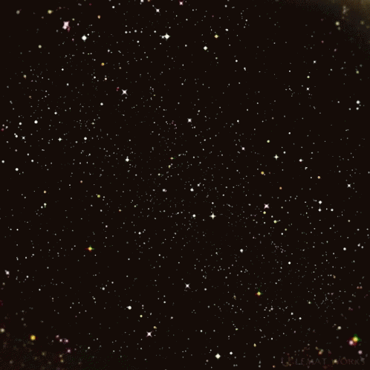
Task 3: Build Vocabulary
Starry
(adj)

Slide 13
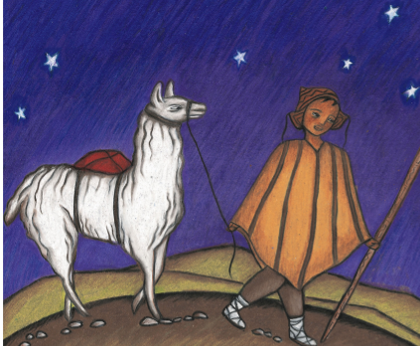
Rally Robin​
Look at the picture and answer:
1- What do you see in the picture?
2- Describe the appearance of the boy?
3- Why is he wearing those clothes?

Slide 14
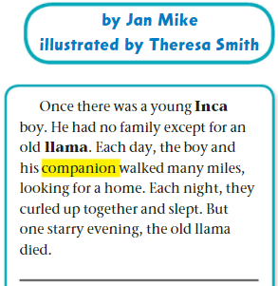

Page 32
Listen:

Slide 15
Formative assessment l Rally Robin l 3 mins​
Read and answer:
1- Who are the main characters?
2- Describe the relationship between the boy and the Llama.
3- Describe the setting of the story.
4- In your opinion, why did the llama die?

Slide 16
Critical thinking
1
How would the death of the llama affect the boy?

Slide 17
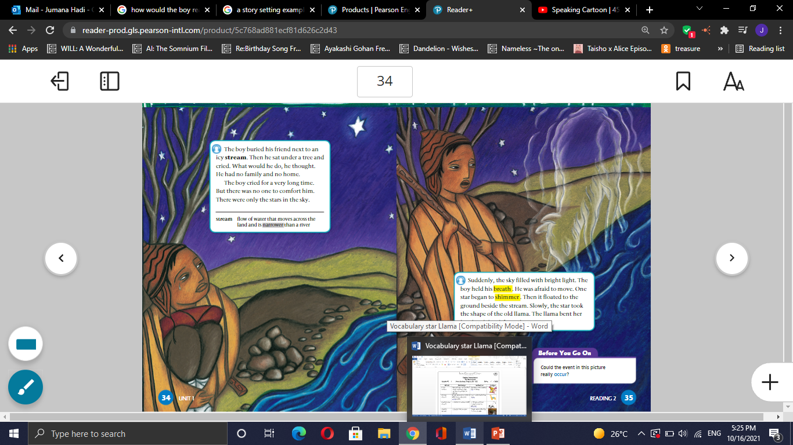
Mention one time you were sad and started crying
Real life Application I Buzz in

Slide 18
DIFFERENTIATION I 2 MIN
Student 3 :
How is the Star Llama different than Taking Care of the Young?
Students 4:
Who is the author of the story?
What is the name of the illustrator?
Students 2:
Think:
Where is the boy’s family?
Students 1:
True or false
The genre of the text is an informational text.
The inca boy is the main character of the story.

Slide 19
SUMMATIVE ASSESSMENT I IRS I
1 MIN
The genre of the text is an informational text.
1. True
2. False
The inca boy is the main character of the story.
  1. True
  2. False
There’s a bond between the boy and the llama
  1. True
  2. False

Slide 20
CLOSURE 1 MIN
What did you like the most about the story?

Slide 21
The Star Llama

Slide 22
LET’S BEGIN WITH THE END IN MIND
By the end of today's class, students will: ​
To identify the new genre
To answer questions about the story and predict what will happen next

Slide 23
Lead in ( Round Robin)
If you face a difficult situation, what would you do?
Would you cry or try to find a solution?

Slide 24
Pre-assessment
Mention one sad event from the previous part.

Slide 25
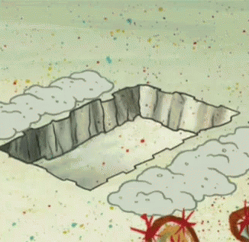
Task : Build Vocabulary
bury
(verb)
Example
He buried the box in the back garden
Meaning
to put something in the ground

Slide 26
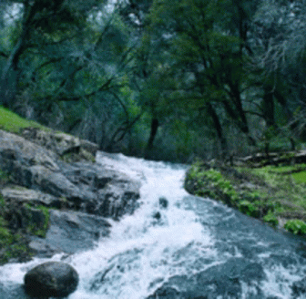
Task : Build Vocabulary
stream
(noun)
Example
There were little fish in the stream
Meaning
a small narrow river

Slide 27
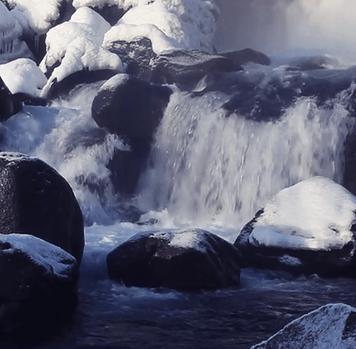
Task : Build Vocabulary
Icy stream
(noun)

Slide 28

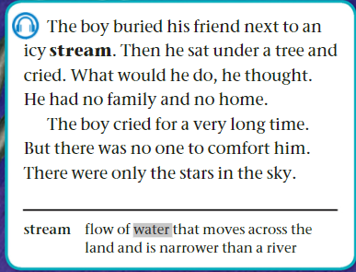
Page 34 I 1 minute
Listen

Slide 29
Formative assessment Rally Robin l 3 mins​
Read and answer
Where did the boy bury the llama?
Why was the inca boy so sad?
The boy has no family and no home. Why? What happened to his family?
What does the pronoun "he" line 2 refer to?

Slide 30
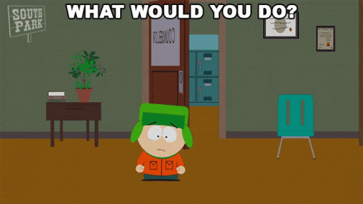
What would you do if you were in his shoes?
Critical Thinking l Buzz in

Slide 31
Mention one time you were sad and started crying
Real life Application I Buzz in

Slide 32
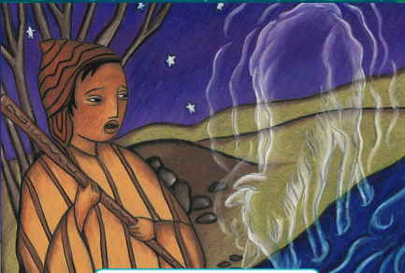
What do you think will happen next?
Look and say.

Slide 33
DIFFERENTIATION I 2 MIN
Students 3:
What is the llama’s importance in the boy's life?
Students 2:
Where did the boy bury the llama?
Students 4:
Why do you think the Inca boy was so sad when he lost the llama?
Students 1:
True or false
The boy had many friends who helped him bury the llama.
The Inca boy was happy because he had a new home.

Slide 34
SUMMATIVE ASSESSMENT I IRS I
1 MIN
The boy buried his friend next to an icy stream.
1. True
2. False
The boy cried for a very long time.
  1. True
  2. False
The boy had no family and no home.
  1. True
  2. False

Slide 35
CLOSURE 1 MIN
What did you like the most about the story?

Slide 36
The Star Llama

Slide 37
LET’S BEGIN WITH THE END IN MIND
By the end of today's class, students will: ​
read and comprehend
answer questions about the story and predict what will happen next

Slide 38
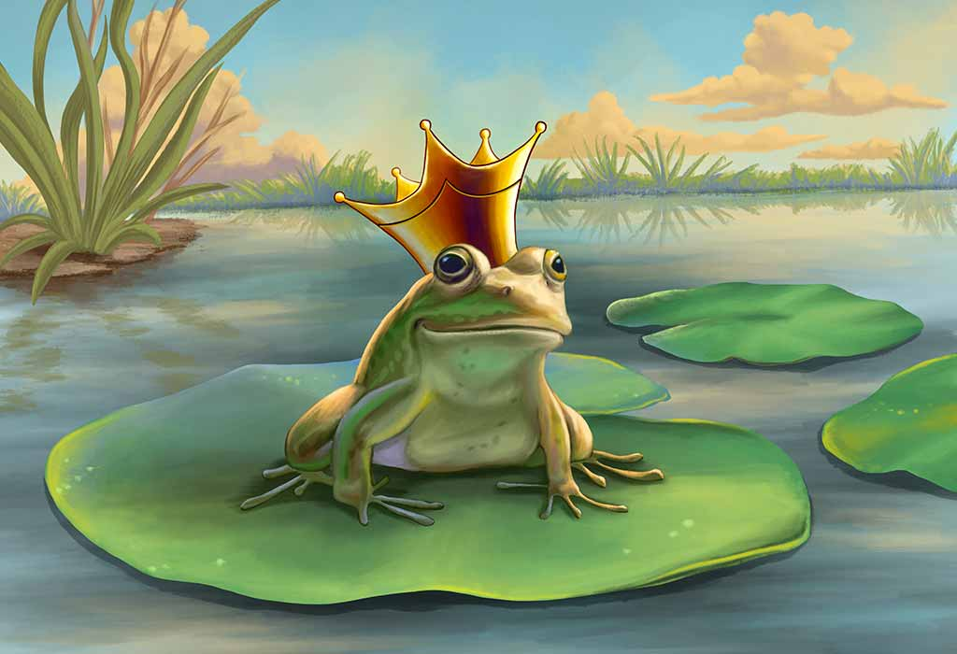
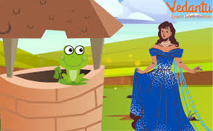
Lead in ( Round Robin)
Do you remember any story in which the main character transforms to a different thing?

Slide 39
Pre-assessment
Write one sentence you remember from the previous part.

Slide 40
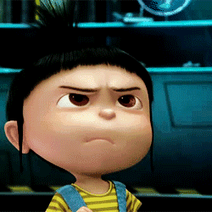
Task : Build Vocabulary
Hold breath
(verb)

Slide 41
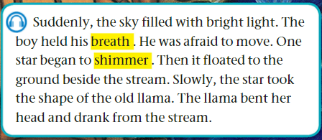
Page 35 I 1 minute
Listen:

Slide 42
Formative assessment l Rally Robin 2 mins​
Read and answer:
1- Why was the boy afraid?
2- What happened to the star?
3- How did the llama appear again?

Slide 43
DIFFERENTIATION I 2 MIN
Students 3:
How did the llama appear again?
Students 2:
What happened to the star after it began to shimmer?
Students 4:
Why was the boy afraid to move?
Students 1:
True or false
The star floated to the ground beside the stream.
The llama did not drink from the stream.

Slide 44
SUMMATIVE ASSESSMENT I IRS I
1 MIN
The star transformed (took the shape) into a young llama.
1. True
2. False
The boy ran away when he saw the star floating to the ground.
  1. True
  2. False
The boy was very happy.
  1. True
  2. False

Slide 45
CLOSURE I 1 MIN
Choose a word you learnt today and write a sentence.
Mini-Boards

