Slide 1

Unit: 2 “ PROVIDING Light in the Darkness”
Lesson: 1
Subject: KEY WORDS + ACADEMIC WORDS .
Grade: 9

Slide 2



SUBJECT: Grammar
GRADE: 9
UNIT: 4
Lesson: 1
LESSON
OBJECTIVES
00:30 minute
WARM UP
Objectives
PREASSESSMENT
1. Discuss the big question.
2. Recognize the genre of “Providing light to the darkness”
3. To use the new words in context.
PRESENTATION
FORMATIVE ASSESSMENT
FEEDBACK
DIFFERENTIATION
REAL LIFE APPLICATION
CRITICAL THINKING
EXIT TICKET

Slide 3
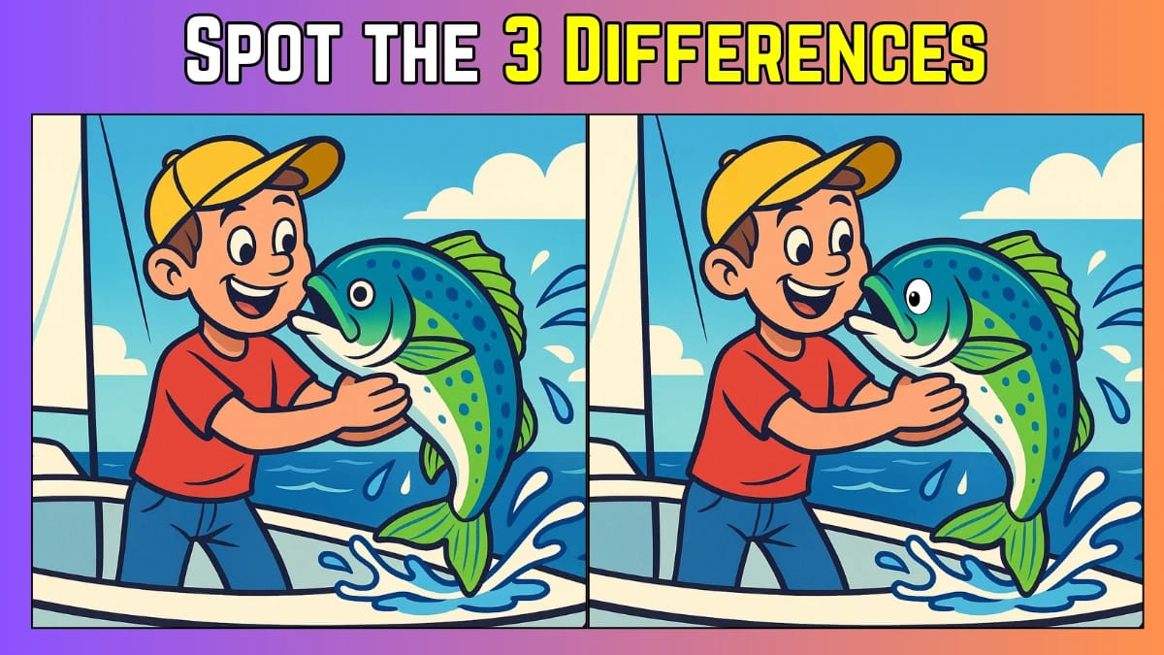
SUBJECT: Grammar
GRADE: 9
UNIT: 4
Lesson: 1
OUTCOMES
WARM UP
01:30 minutes
WARM UP
Real Life Application
PRESENTATION
FORMATIVE ASSESSMENT
FEEDBACK
DIFFERENTIATION
REAL LIFE APPLICATION
CRITICAL THINKING
EXIT TICKET

Slide 4

PRESENTATION
Listening practice : work-life balance
05:00 minutes
Read the questions , listen then circle the correct answer.

Slide 5


ISLAMIC EDUCATIONAL COLLEGE DATE: / 5/ 2025
SUBJECT: Grammar
GRADE: 9
UNIT:4
Lesson: 1
OUTCOMES
03:00 minutes
What is the main purpose of an informational text?
To entertain the reader with a story
To give facts and explain a topic
To share someone’s feelings
d) To persuade the reader to buy something
WARM UP
REAL LIFE APPLICATION
CRITICAL THINKING
PREASSESSMENT
PRESENTATION
DIFFERENTIATION
FORMATIVE ASSESSMENT
FEEDBACK
EXIT TICKET

Slide 6
ISLAMIC EDUCATIONAL COLLEGE DATE: / 5/ 2025
SUBJECT: Grammar
GRADE: 9
UNIT:4
Lesson: 1
OUTCOMES
03:00 minutes
WARM UP
Which of the following is an example of an informational text?
a) A fairy tale
b) A science article
c) A mystery novel.
REAL LIFE APPLICATION
CRITICAL THINKING
PREASSESSMENT
PRESENTATION
DIFFERENTIATION
FORMATIVE ASSESSMENT
FEEDBACK
B
EXIT TICKET

Slide 7
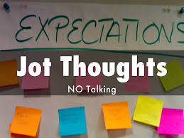
01:00 minutes
What is light ?

Slide 8

CRITICAL THINKING
Q1. How is natural light (sunlight) different from artificial light (lamps, screens)?
Q2. Which one is more important for health? Why?

Slide 9
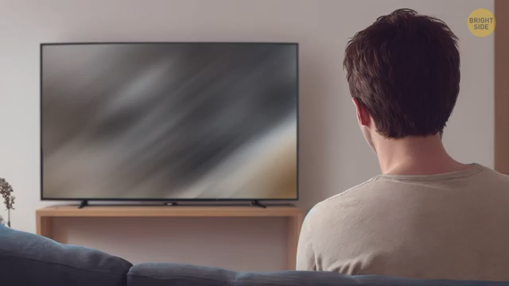
What was life like before electricity?

Slide 10
REAL LIFE APPLICATION
Tell us about a day when the electricity went off.
Did the darkness make you feel safe or unsafe? Why?
How did you adapt to the situation?
What tools or technology could help when there’s no electricity?

Slide 11
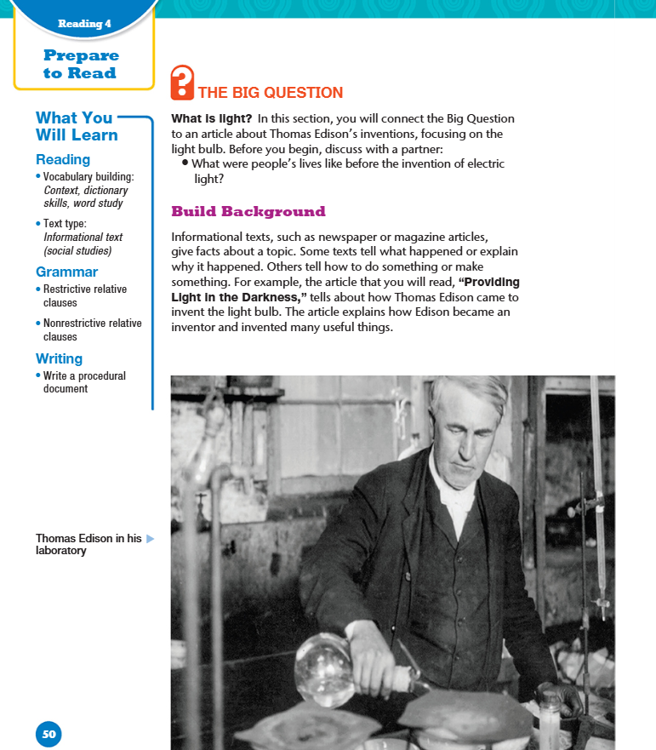
What is meant by informational texts

Slide 12
PRESENTATION
Listening practice : motivation
05:00 minutes
Read the questions , listen then tell whether the sentences are true or false.

Slide 13
LESSON 1

Slide 14
SUBJECT: Grammar
GRADE: 9
UNIT: 4
Lesson: 1
LESSON
OBJECTIVES
00:30 minute
WARM UP
Objectives
PREASSESSMENT
1- To use the new words in context.
PRESENTATION
FORMATIVE ASSESSMENT
FEEDBACK
DIFFERENTIATION
REAL LIFE APPLICATION
CRITICAL THINKING
EXIT TICKET

Slide 15

01:00 minutes
Warm-Up
Is it better to work in a group or alone

Slide 16
PRESENTATION
Listening practice : work-life balance
05:00 minutes
Read the questions , listen then circle the correct answer.

Slide 17
Question: Choose the correct answer
Q1. How popular is Chris Svensson's book? 1..Top of Form
Not very popular 2. Very popular 3.It's new. People don't know it yet.
Bottom of Form
Q2. What is the work–life balance like in traditional workplaces? 1. Top of Form
Work lives and private lives are clearly divided.
2. People work too much overtime and so they have no private life.
3. People are free to manage the balance themselves.
Q3.Bottom of Form
How often do people do overtime? 1. Top of Form
Often 2. Sometimes 3. They don't.
Q4. How has technology helped people work with more flexibility? 1. Top of Form
They can send and receive emails from their phones from home.
2. Their working hours can be easily tracked.
3. Robots can do their work for them.
Q5. Bottom of Form
Traditional divisions between work and life are fading. What does this mean for employees? Top of Form
Everyone has to do overtime, all the time.
People have to work while they're on holiday.
They can be flexible to work when and where it suits them.

Slide 18
ISLAMIC EDUCATIONAL COLLEGE DATE: / 5/ 2025
SUBJECT: Grammar
GRADE: 9
UNIT:4
Lesson: 1
OUTCOMES
03:00 minutes
What is an invention?
a) A new idea or creation that has never been made before
b) A tool used in factories.
c) A place where machines are built
WARM UP
REAL LIFE APPLICATION
CRITICAL THINKING
PREASSESSMENT
PRESENTATION
DIFFERENTIATION
FORMATIVE ASSESSMENT
FEEDBACK
EXIT TICKET

Slide 19
ISLAMIC EDUCATIONAL COLLEGE DATE: / 5/ 2025
SUBJECT: Grammar
GRADE: 9
UNIT:4
Lesson: 1
OUTCOMES
03:00 minutes
WARM UP
Who are the people that provide financial support to inventors and startups?
a) Lawyers.
b) Investors.
c) Scientists.
REAL LIFE APPLICATION
CRITICAL THINKING
PREASSESSMENT
PRESENTATION
DIFFERENTIATION
FORMATIVE ASSESSMENT
FEEDBACK
B
EXIT TICKET

Slide 20
ISLAMIC EDUCATIONAL COLLEGE DATE: / 5/ 2025
SUBJECT: Grammar
GRADE: 9
UNIT:4
Lesson: 1
OUTCOMES
Which word best describes an economic activity related to making things in factories?
a) Industry
b) Device
c) Equipment
03:00 minutes
WARM UP
REAL LIFE APPLICATION
CRITICAL THINKING
PREASSESSMENT
PRESENTATION
DIFFERENTIATION
FORMATIVE ASSESSMENT
FEEDBACK
A
EXIT TICKET

Slide 21
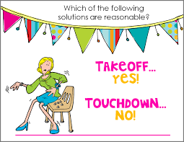
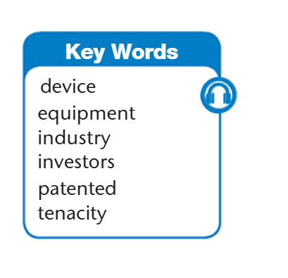

Slide 22
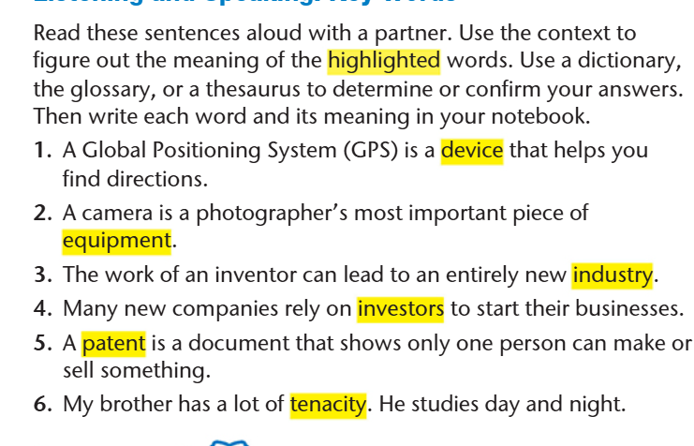

Slide 23

ISLAMIC EDUCATIONAL COLLEGE DATE: /2/ 2025
SUBJECT: Grammar
GRADE: 9
Unit: 4
Lesson: 1
OUTCOMES
CRITICAL THINKING
WARM UP
REAL LIFE APPLICATION
Imagine that you just invented a device that helps students stay focused while studying. In 60 seconds, decide:
What does the device do?
What problem does it solve?
Who would invest in it?
CRITICAL THINKING
PREASSESSMENT
FEEDBACK
FORMATIVE ASSESSMENT
PRESENTATION
DIFFERENTIATION
BUZZ IN
EXIT TICKET

Slide 24

ISLAMIC EDUCATIONAL COLLEGE DATE: / 5/ 2025
SUBJECT: Grammar
GRADE: 9
UNIT:4
Lesson: 1
OUTCOMES
03:00 minutes
SPEAKING
WARM UP
REAL LIFE APPLICATION
(1) What is the greatest invention of the year?
(2 ) What do you think an inventor’s life is like?
(3) What is the world’s most dangerous invention?
What is the coolest invention ever?
Have you ever thought about inventing anything?
CRITICAL THINKING
PREASSESSMENT
PRESENTATION
DIFFERENTIATION
FORMATIVE ASSESSMENT
FEEDBACK
EXIT TICKET

Slide 25

ISLAMIC EDUCATIONAL COLLEGE DATE: 19 / 2/ 2025
SUBJECT: Grammar
GRADE: 9
UNIT: 4
Lesson: 1
OUTCOMES
Equipment Vs Device
01:30 minutes
WARM UP
REAL LIFE APPLICATION
CRITICAL THINKING
PREASSESSMENT
PRESENTATION
DIFFERENTIATION
FEEDBACK
FORMATIVE ASSESSMENT
EXIT TICKET

Slide 26
ISLAMIC EDUCATIONAL COLLEGE DATE: 19 / 2/ 2025
SUBJECT: Grammar
GRADE: 9
UNIT: 4
Lesson: 1
OUTCOMES
02:30 minutes
WARM UP
Equipment → refers to a set or group of tools or machines used for a specific purpose.
🧰 Example: The gym has new fitness equipment.
(It includes several things: treadmills, weights, mats, etc.)
Device → means a single tool or machine, usually electronic, made for a specific function.
📱 Example: A smartphone is an electronic device.
✅ In short:
Equipment = a collection of tools.
Device = one specific tool.
REAL LIFE APPLICATION
CRITICAL THINKING
PREASSESSMENT
PRESENTATION
DIFFERENTIATION
FEEDBACK
FORMATIVE ASSESSMENT
EXIT TICKET

Slide 27


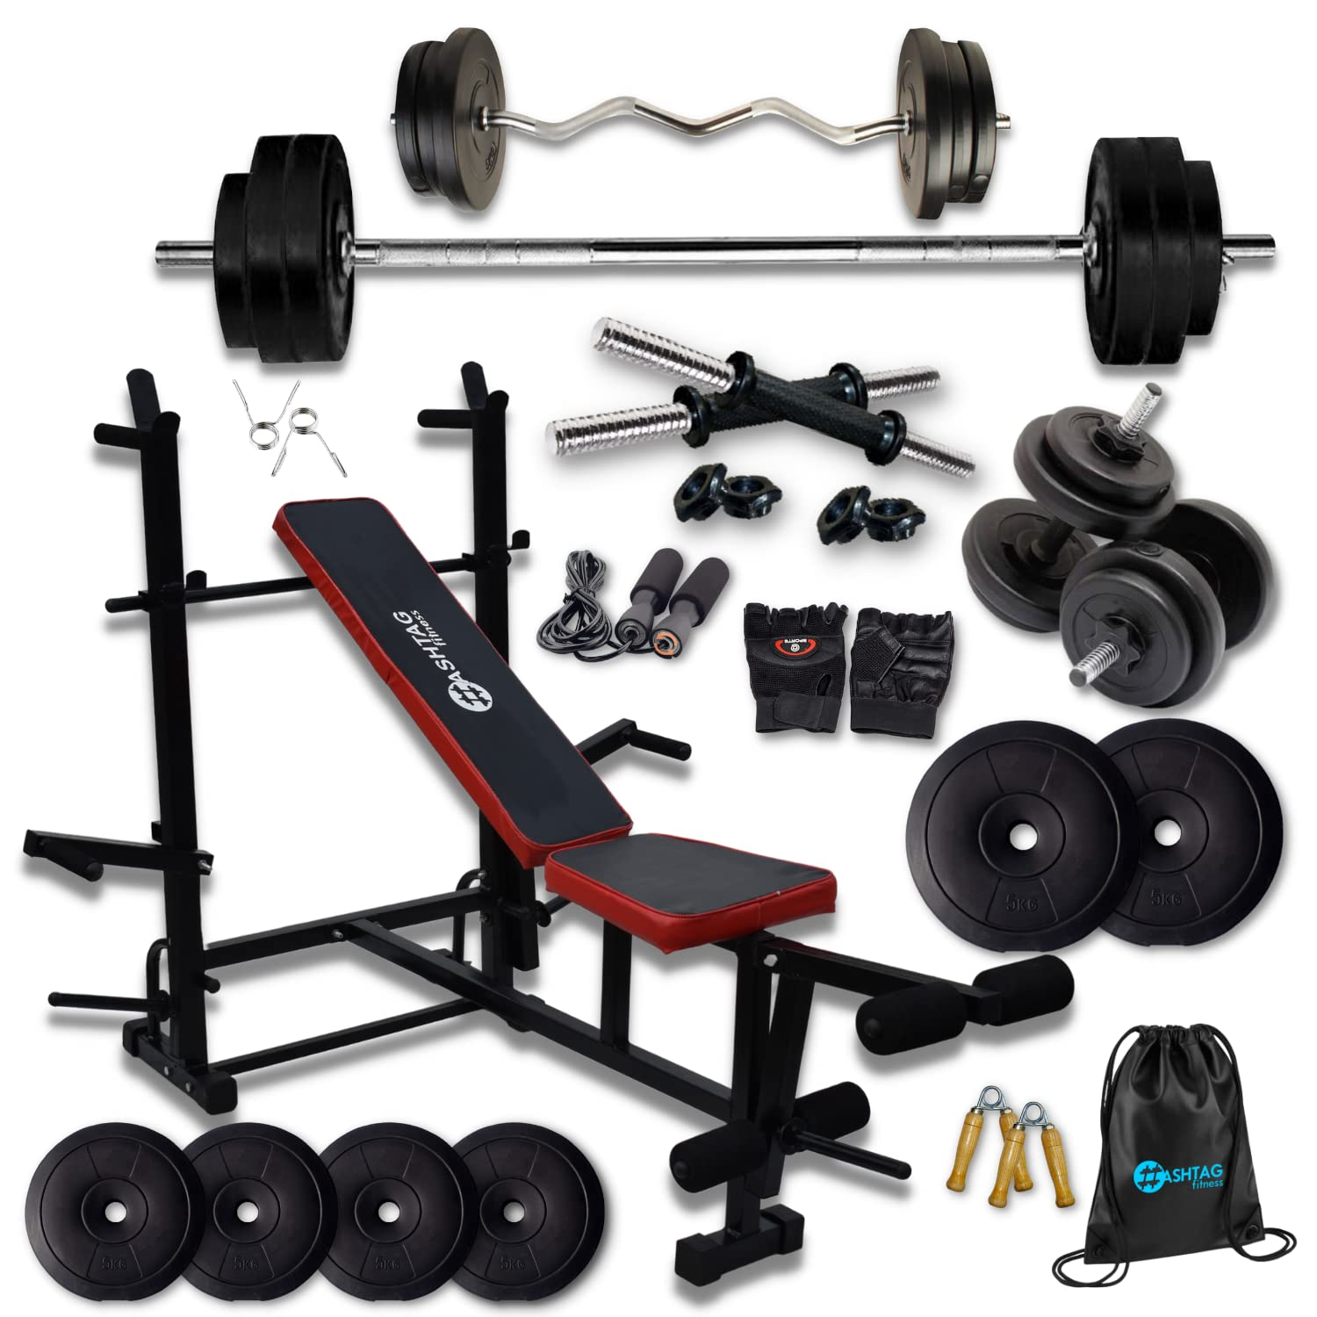
ISLAMIC EDUCATIONAL COLLEGE DATE: 19 / 2/ 2025
SUBJECT: Grammar
GRADE: 9
UNIT: 4
Lesson: 1
OUTCOMES
02:30 minutes
WARM UP
REAL LIFE APPLICATION
Here are examples of equipment
CRITICAL THINKING
PREASSESSMENT
Constructions
Gym
Kitchen
PRESENTATION
DIFFERENTIATION
FEEDBACK
FORMATIVE ASSESSMENT
EXIT TICKET

Slide 28
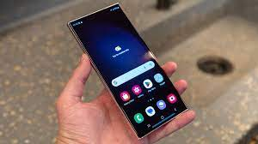
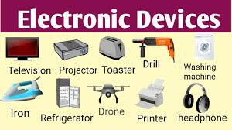

ISLAMIC EDUCATIONAL COLLEGE DATE: 19 / 2/ 2025
SUBJECT: Grammar
GRADE: 9
UNIT: 4
Lesson: 1
OUTCOMES
02:30 minutes
WARM UP
DEVICES
REAL LIFE APPLICATION
CRITICAL THINKING
PREASSESSMENT
PRESENTATION
DIFFERENTIATION
FEEDBACK
You can speak a bit about this person here
FORMATIVE ASSESSMENT
EXIT TICKET

Slide 29




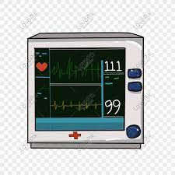

ISLAMIC EDUCATIONAL COLLEGE DATE: / / 2025
SUBJECT: Grammar
GRADE: 9
UNIT: 4
Lesson: 1
OUTCOMES
WARM UP
1- The company developed a new security ________ to protect their data .
3- The photographer packed his _____________ for the photo shoot.
4- The doctor used a medical _________ to monitor the patient’s heart rate.
5- The hearing aid is a _________ that helps people with hearing loss hear better.
device
PREASSESSMENT
equipment
PRESENTATION
FORMATIVE ASSESSMENT
device
FEEDBACK
DIFFERENTIATION
device
REAL LIFE APPLICATION
CRITICAL THINKING
EXIT TICKET

Slide 30
What’s the difference?
She patented her idea to prevent others from copying it.
2. The company applied for a patent to protect its invention

Slide 31

Tenacity
Her ____________helped her finish the marathon despite the pain
The climbers held on _____________ to the rocky edge
He’s a ____________ negotiator who never accepts the first offer
Tenacious
Tenacity
Tenaciously
Tenaciously
Tenacious

Slide 32
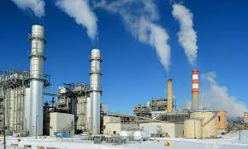

industrial investors invest industry
Many _______________are interested in the ______________sector because they want to ___________in companies that are part of the growing______________, which produces goods for both local and international markets.
investors
industrial
invest
industry

Slide 33
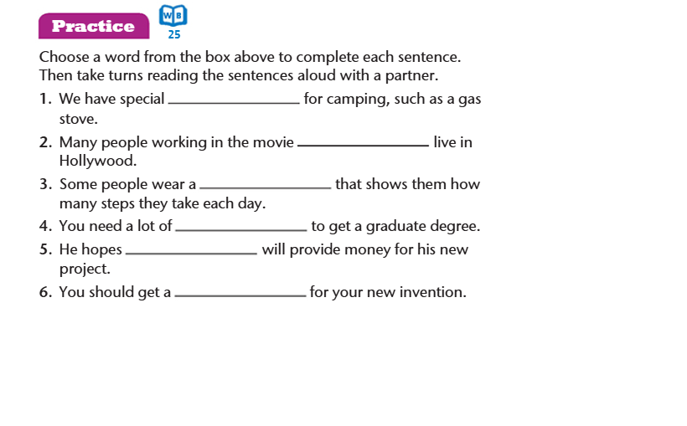

equipment
industry
device
tenacity
investors
patent

Slide 34

SUBJECT: Grammar
GRADE: 9
UNIT: 4
Lesson: 1
OUTCOMES
Real Life Application
04:00 minutes
WARM UP
Real Life Application
CRITICAL THINKING
FORMATIVE ASSESSMENT
We will work in pairs.
.
Student A reads the scenario aloud.
Student B guess the word and then take turns.
FEEDBACK
DIFFERENTIATION
REAL LIFE APPLICATION
PRESENTATION
EXIT TICKET

Slide 35

ISLAMIC EDUCATIONAL COLLEGE DATE: / 5/ 2025
SUBJECT: Grammar
GRADE: 9
UNIT:4
Lesson: 1
OUTCOMES
Which word am I thinking of….
device
05:00 minutes
WARM UP
1. Industry
2. Inventors
3. Patent
4. Tenacity
5. device
REAL LIFE APPLICATION
Situation 1 : Sarah recently bought a new item that helps her monitor her daily steps. The small, wearable gadget tracks her activity and even syncs with her phone to provide health insights.
CRITICAL THINKING
PREASSESSMENT
PRESENTATION
DIFFERENTIATION
FORMATIVE ASSESSMENT
FEEDBACK
EXIT TICKET

Slide 36
ISLAMIC EDUCATIONAL COLLEGE DATE: / 5/ 2025
SUBJECT: Grammar
GRADE: 9
UNIT:4
Lesson: 1
OUTCOMES
Which word am I thinking of….
Industry
03:00 minutes
WARM UP
Situation 5:In a large part of the city, you can hear machines running all day. Hundreds of people work there building cars, assembling electronics, and packing goods. That area is known for producing a lot of manufactured items that are sent all over the country.
1. Industry
2. Inventors
3. Patent
4. Tenacity
REAL LIFE APPLICATION
CRITICAL THINKING
PREASSESSMENT
PRESENTATION
DIFFERENTIATION
FORMATIVE ASSESSMENT
FEEDBACK
EXIT TICKET

Slide 37
ISLAMIC EDUCATIONAL COLLEGE DATE: / 5/ 2025
SUBJECT: Grammar
GRADE: 9
UNIT:4
Lesson: 1
OUTCOMES
Which word am I thinking of….
Patent
05:00 minutes
WARM UP
Situation 6: Leo invented a new type of water bottle that can keep drinks cold for two days. Before he started selling it, he filled out official documents to make sure no one else could steal his idea or design.
1. Industry
2. Inventors
3. Patent
4. Tenacity
REAL LIFE APPLICATION
CRITICAL THINKING
PREASSESSMENT
PRESENTATION
DIFFERENTIATION
FORMATIVE ASSESSMENT
FEEDBACK
EXIT TICKET

Slide 38
ISLAMIC EDUCATIONAL COLLEGE DATE: / 5/ 2025
SUBJECT: Grammar
GRADE: 9
UNIT:4
Lesson: 1
OUTCOMES
Which word am I thinking of….
investors
05:00 minutes
WARM UP
Situation 7: Mia had a great idea for a new app, but she didn’t have the money to build it. She gave a presentation to a group of people who were willing to give her money to start her business, hoping it would become successful so they could earn some of the profits later.
1. Industry
2. Inventors
3. Patent
4. Tenacity
5.Investors
REAL LIFE APPLICATION
CRITICAL THINKING
PREASSESSMENT
PRESENTATION
DIFFERENTIATION
FORMATIVE ASSESSMENT
FEEDBACK
EXIT TICKET

Slide 39
ISLAMIC EDUCATIONAL COLLEGE DATE: / 5/ 2025
SUBJECT: Grammar
GRADE: 9
UNIT:4
Lesson: 1
OUTCOMES
Which word am I thinking of….
Tenacity
05:00 minutes
WARM UP
Situation 8: Despite failing her driving test three times, Aisha refused to give up. She kept practicing every weekend and finally passed on her fourth try. Her friends admired how determined she was.
1. Industry
2. Inventors
3. Patent
4. Tenacity
REAL LIFE APPLICATION
CRITICAL THINKING
PREASSESSMENT
PRESENTATION
DIFFERENTIATION
FORMATIVE ASSESSMENT
FEEDBACK
EXIT TICKET

Slide 40
ISLAMIC EDUCATIONAL COLLEGE DATE: / 5/ 2025
SUBJECT: Grammar
GRADE: 9
UNIT: 4
Lesson: 1
OUTCOMES
04:00 minutes
Differentiation
WARM UP
PREASSESSMENT
Students 1+2
Students 3+4
PRESENTATION
FORMATIVE ASSESSMENT
FEEDBACK
Put the following words in sentences and write them on your notebook.
Tenacity
Industry
Device
Write a short paragraph using the words
patent
Tenacity
Device
DIFFERENTIATION
REAL LIFE APPLICATION
CRITICAL THINKING
EXIT TICKET

Slide 41
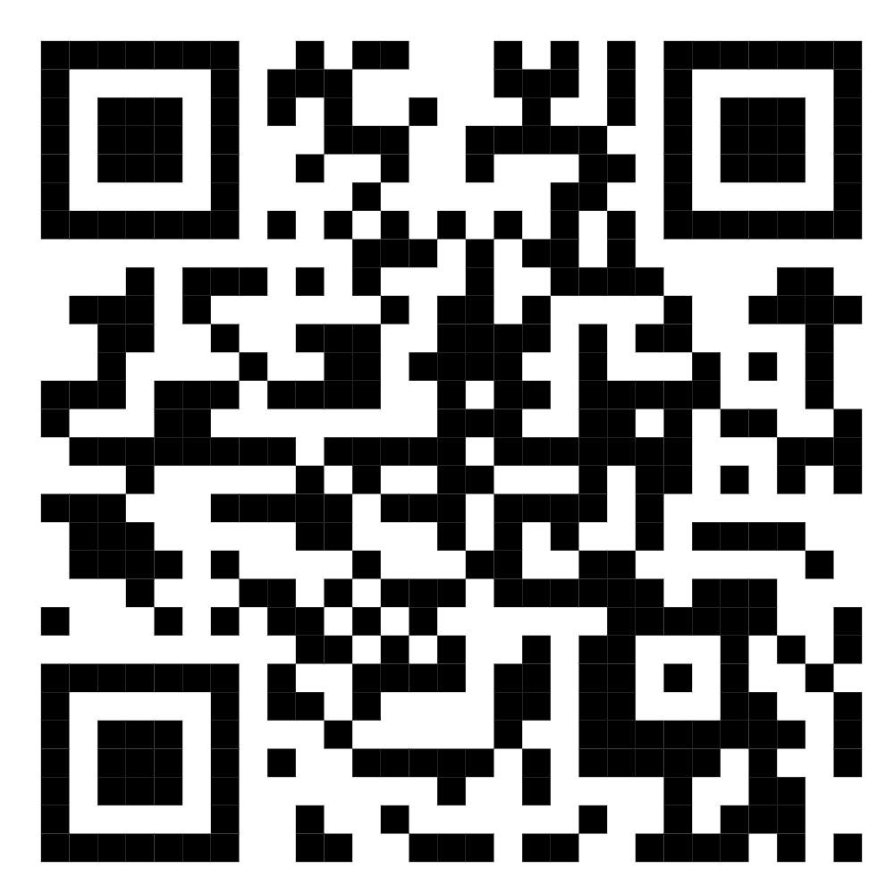
ISLAMIC EDUCATIONAL COLLEGE DATE: / / 2025
SUBJECT: Grammar
GRADE: 9
UNIT: 4
Lesson: 1
OUTCOMES
04:00 minutes
WARM UP
PREASSESSMENT
PRESENTATION
FORMATIVE ASSESSMENT
FEEDBACK
DIFFERENTIATION
REAL LIFE APPLICATION
CRITICAL THINKING
https://wayground.com/admin/quiz/68ad82c2458a9e3404810b34?source=live_dash_game_complete&gameType=live&players=0
EXIT TICKET

Slide 42
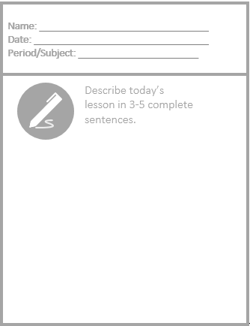
Exit Ticket

Slide 43
ISLAMIC EDUCATIONAL COLLEGE DATE: / 5/ 2025
SUBJECT: Grammar
GRADE: 9
UNIT:4
Lesson: 1
OUTCOMES
03:00 minutes
What do we call someone who gives or adds something to help project , group or cause ?
a) competitor
b) contributor
WARM UP
REAL LIFE APPLICATION
CRITICAL THINKING
PREASSESSMENT
PRESENTATION
DIFFERENTIATION
FORMATIVE ASSESSMENT
FEEDBACK
EXIT TICKET

Slide 44
ISLAMIC EDUCATIONAL COLLEGE DATE: / 5/ 2025
SUBJECT: Grammar
GRADE: 9
UNIT:4
Lesson: 1
OUTCOMES
03:00 minutes
WARM UP
If something is important or has big effect , we say it’s?
a) ordinary.
b) significant.
c) boring.
REAL LIFE APPLICATION
CRITICAL THINKING
PREASSESSMENT
PRESENTATION
DIFFERENTIATION
FORMATIVE ASSESSMENT
FEEDBACK
B
EXIT TICKET

Slide 45
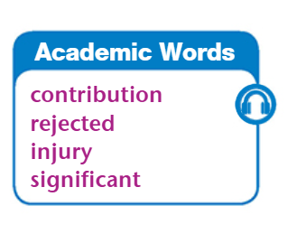

Slide 46
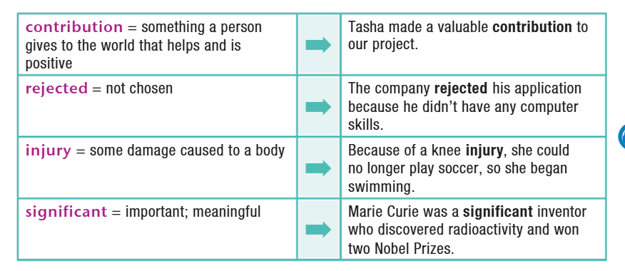

Slide 47
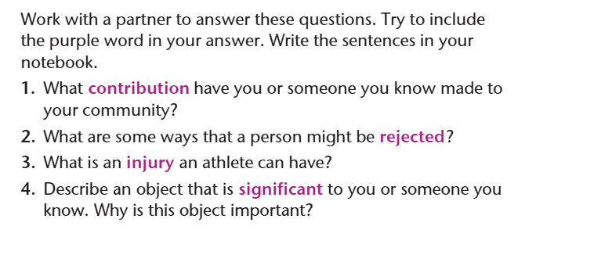

Slide 48
ISLAMIC EDUCATIONAL COLLEGE DATE: /2/ 2025
SUBJECT: Grammar
GRADE: 9
Unit: 4
Lesson: 1
OUTCOMES
CRITICAL THINKING
WARM UP
REAL LIFE APPLICATION
Imagine that you just invented a device that helps students stay focused while studying. In 60 seconds, decide:
What does the device do?
What problem does it solve?
Who would invest in it?
CRITICAL THINKING
PREASSESSMENT
FEEDBACK
FORMATIVE ASSESSMENT
PRESENTATION
DIFFERENTIATION
BUZZ IN
EXIT TICKET

Slide 49
SUBJECT: Grammar
GRADE: 9
UNIT: 4
Lesson: 1
OUTCOMES
Real Life Application
04:00 minutes
WARM UP
Real Life Application
CRITICAL THINKING
FORMATIVE ASSESSMENT
We will work in pairs.
Each pair will recieve a card of a scenario.
Student A reads the scenario aloud.
Student B guess the word and then take turns.
FEEDBACK
DIFFERENTIATION
REAL LIFE APPLICATION
PRESENTATION
EXIT TICKET

Slide 50
ISLAMIC EDUCATIONAL COLLEGE DATE: / 5/ 2025
SUBJECT: Grammar
GRADE: 9
UNIT:4
Lesson: 1
OUTCOMES
Which word am I thinking of….
device
05:00 minutes
WARM UP
1. Industry
2. Inventors
3. Patent
4. Tenacity
5.Contribution
6. Reject
7. Injury
8. Significant
REAL LIFE APPLICATION
Situation 1 : Sarah recently bought a new item that helps her monitor her daily steps. The small, wearable gadget tracks her activity and even syncs with her phone to provide health insights.
CRITICAL THINKING
PREASSESSMENT
PRESENTATION
DIFFERENTIATION
FORMATIVE ASSESSMENT
FEEDBACK
EXIT TICKET

Slide 51
ISLAMIC EDUCATIONAL COLLEGE DATE: / 5/ 2025
SUBJECT: Grammar
GRADE: 9
UNIT:4
Lesson: 1
OUTCOMES
Which word am I thinking of….
Contribution
05:00 minutes
WARM UP
Situation 2:During the class project, everyone worked together. John brought the supplies, Maria wrote the report, and Ahmed created the presentation. Each person helped in their own way to complete the project.
1. Industry
2. Inventors
3. Patent
4. Tenacity
5.Contribution
6. Reject
7. Injury
8. Significant
REAL LIFE APPLICATION
CRITICAL THINKING
PREASSESSMENT
PRESENTATION
DIFFERENTIATION
FORMATIVE ASSESSMENT
FEEDBACK
EXIT TICKET

Slide 52
ISLAMIC EDUCATIONAL COLLEGE DATE: / 5/ 2025
SUBJECT: Grammar
GRADE: 9
UNIT:4
Lesson: 1
OUTCOMES
Which word am I thinking of….
Injury
05:00 minutes
WARM UP
Situation 3:During the soccer game, James fell and twisted his ankle. He had to sit on the bench for the rest of the game, and the coach said he would need to visit the doctor. The doctor told him he might need a week to recover before he can play again.
1. Industry
2. Inventors
3. Patent
4. Tenacity
5.Contribution
6. Reject
7. Injury
8. Significant
REAL LIFE APPLICATION
CRITICAL THINKING
PREASSESSMENT
PRESENTATION
DIFFERENTIATION
FORMATIVE ASSESSMENT
FEEDBACK
EXIT TICKET

Slide 53
ISLAMIC EDUCATIONAL COLLEGE DATE: / 5/ 2025
SUBJECT: Grammar
GRADE: 9
UNIT:4
Lesson: 1
OUTCOMES
Which word am I thinking of….
significant
05:00 minutes
WARM UP
Situation 4:The teacher told the students that the upcoming exam would be very important. It would count for 50% of their final grade, which means doing well on it would have a big impact on their overall result.
1. Industry
2. Inventors
3. Patent
4. Tenacity
5.Contribution
6. Reject
7. Injury
8. Significant
REAL LIFE APPLICATION
CRITICAL THINKING
PREASSESSMENT
PRESENTATION
DIFFERENTIATION
FORMATIVE ASSESSMENT
FEEDBACK
EXIT TICKET

Slide 54
ISLAMIC EDUCATIONAL COLLEGE DATE: / 5/ 2025
SUBJECT: Grammar
GRADE: 9
UNIT: 4
Lesson: 1
OUTCOMES
04:00 minutes
Differentiation
WARM UP
PREASSESSMENT
Students 1+2
Students 3+4
PRESENTATION
FORMATIVE ASSESSMENT
FEEDBACK
Put the following words in sentences and write them on your notebook.
injury
Significant
Write a short paragraph using the words
injury
Significant
Reject
DIFFERENTIATION
REAL LIFE APPLICATION
CRITICAL THINKING
EXIT TICKET

Slide 55
ISLAMIC EDUCATIONAL COLLEGE DATE: / / 2025
SUBJECT: Grammar
GRADE: 9
UNIT: 4
Lesson: 1
OUTCOMES
04:00 minutes
WARM UP
PREASSESSMENT
PRESENTATION
FORMATIVE ASSESSMENT
FEEDBACK
DIFFERENTIATION
REAL LIFE APPLICATION
CRITICAL THINKING
https://wayground.com/admin/quiz/68ad82c2458a9e3404810b34?source=live_dash_game_complete&gameType=live&players=0
EXIT TICKET

