Slide 1

Unit: 1
Lesson: Grammar Lesson #1
Subject: Simple present
Grade: 10

Slide 2


ISLAMIC EDUCATIONAL COLLEGE DATE: 6/ 5/ 2024 :
SUBJECT: Reported Speech
GRADE: 8
UNIT: 5
Lesson: 1
LESSON
OBJECTIVES
OBJECTIVES:
1. Identify the structure and usage of the simple present tense
2. Apply the rule in meaningful sentences
3. Use the tense to describe daily routines and facts
01:00 minute
WARM UP
PREASSESSMENT
PRESENTATION
FORMATIVE ASSESSMENT
FEEDBACK
DIFFERENTIATION
REAL LIFE APPLICATION
CRITICAL THINKING
EXIT TICKET

Slide 3
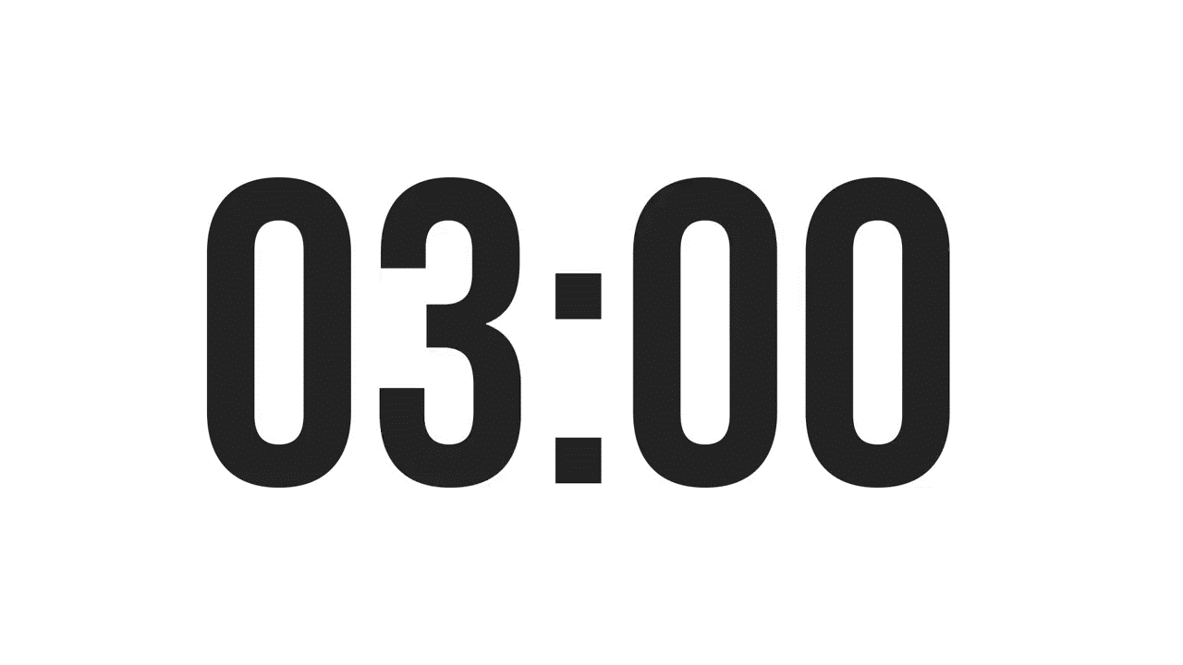


ISLAMIC EDUCATIONAL COLLEGE DATE: 6/ 5/ 2024
SUBJECT: Reported Speech
GRADE: 8
UNIT: 5
LESSON:1
OUTCOMES
03:00 minutes
WARM UP
Warming Up (Kagan Strategy: Think-Pair-Share)
PREASSESSMENT
PRESENTATION
Think of three things you do every morning.
Share with your partner and find one thing you both do.
FORMATIVE ASSESSMENT
FEEDBACK
DIFFERENTIATION
REAL LIFE APPLICATION
CRITICAL THINKING
EXIT TICKET

Slide 4
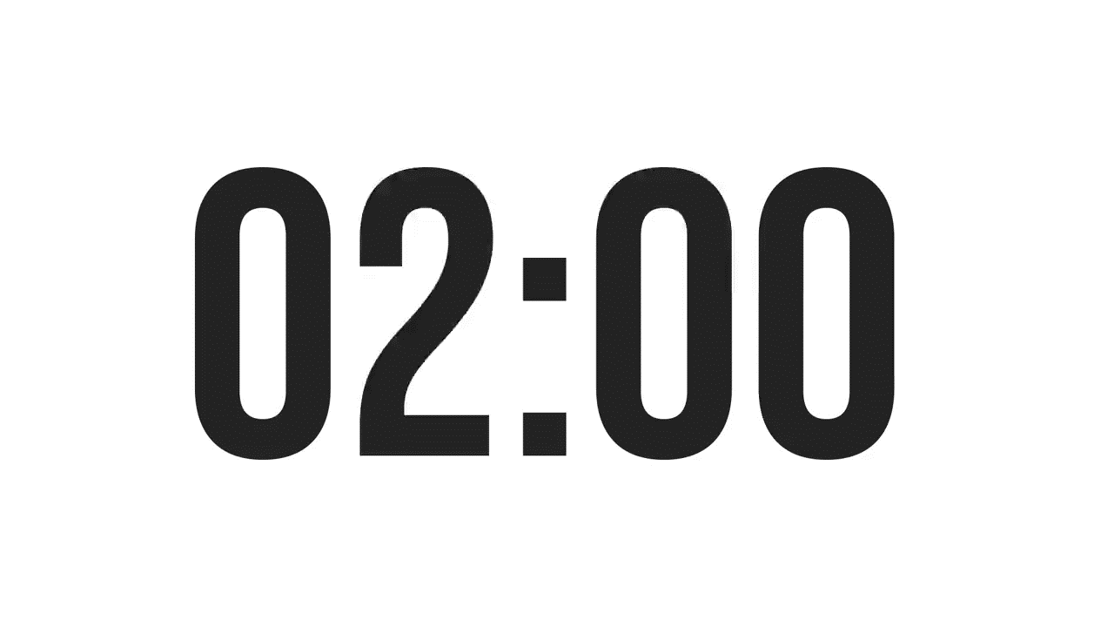
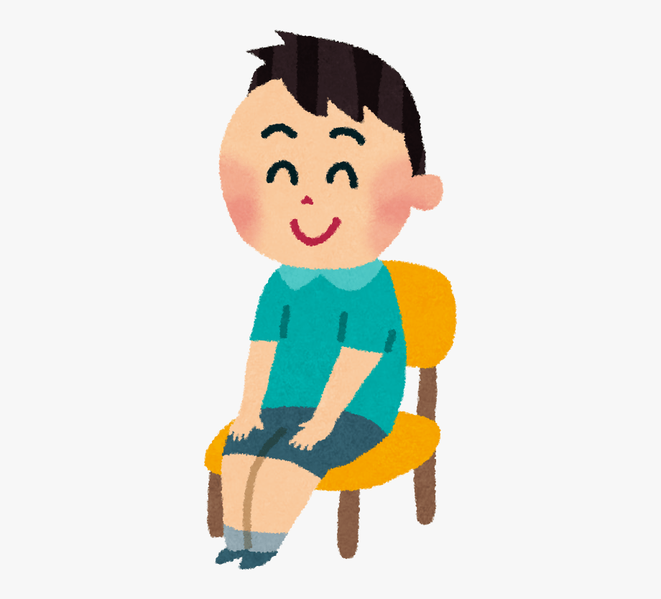
ISLAMIC EDUCATIONAL COLLEGE DATE: 6/ 5/ 2024
SUBJECT: Reported Speech
GRADE: 8
UNIT: 5
LESSON: 1
OUTCOMES
Preassessment (Kagan Strategy: Take Off – Touch Down)
02:00 minutes
WARM UP
PREASSESSMENT
Students who can talk about their daily routine stand up.
Students who are unsure remain seated.
standing students give examples aloud.
PRESENTATION
FORMATIVE ASSESSMENT
FEEDBACK
DIFFERENTIATION
REAL LIFE APPLICATION
CRITICAL THINKING
EXIT TICKET
BUZZ IN

Slide 5
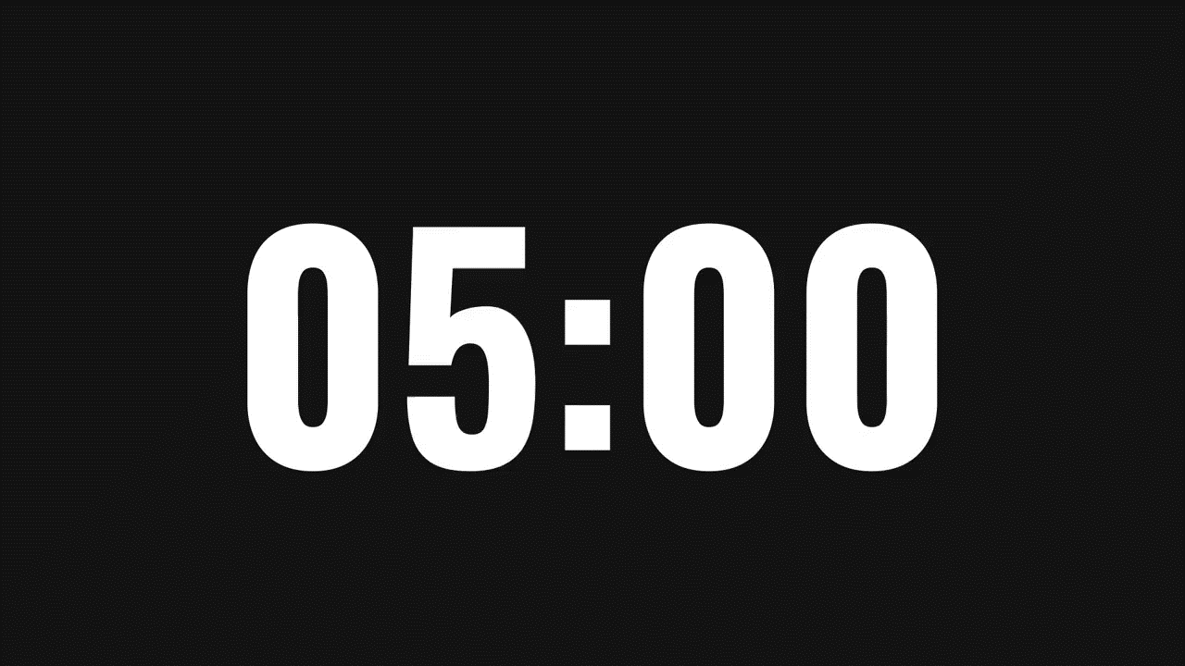
ISLAMIC EDUCATIONAL COLLEGE DATE: 6/ 5/ 2024 :
SUBJECT: Reported Speech
GRADE: 8
UNIT: 5
LESSON: 1
PRESENTATION:
Function: The simple present tense is used to describe habits, routines, and general truths.
Structure:
- Affirmative: Subject + base verb (add -s/-es for he/she/it)
- Negative: Subject + do/does not + base verb
- Question: Do/Does + subject + base verb?
Examples:
- I eat breakfast at 7 a.m.
- She reads every night.
- They don’t play football on weekdays.
- Does he work here?
OUTCOMES
05:00 minutes
WARM UP
PREASSESSMENT
PRESENTATION
FORMATIVE ASSESSMENT
FEEDBACK
DIFFERENTIATION
REAL LIFE APPLICATION
CRITICAL THINKING
EXIT TICKET

Slide 6
The Earth orbits the Sun once every year.
She works as a graphic designer in a marketing company.
The movie starts at 7:30 tonight.
He enjoys listening to classical music.
Water freezes at 0°C.
They live in a small town near the coast.
The striker shoots—and he scores!
Our teacher gives us a quiz every Monday. c
Birds migrate south in winter.
My brother hates doing the dishes.
The train leaves the station at 9:15.
The company owns several international brands.
A. Facts and permanent states B. General truths and laws of nature C. Habits and routines D. Timetables and programmes E. Sporting commentaries, reviews, and narrations F. Likes and dislikes

Slide 7
The Earth orbits the Sun once every year. B
She works as a graphic designer in a marketing company. A
The movie starts at 7:30 tonight. D
He enjoys listening to classical music. F
Water freezes at 0°C. B
They live in a small town near the coast. A
The striker shoots—and he scores! E
Our teacher gives us a quiz every Monday. C
Birds migrate south in winter. B
My brother hates doing the dishes. F
The train leaves the station at 9:15. D
The company owns several international brands. A
A. Facts and permanent states B. General truths and laws of nature C. Habits and routines D. Timetables and programmes E. Sporting commentaries, reviews, and narrations F. Likes and dislikes

Slide 8
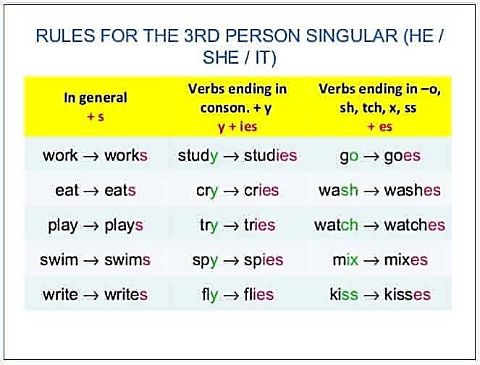

Slide 9
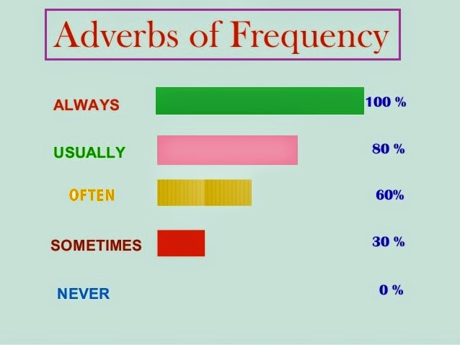
ISLAMIC EDUCATIONAL COLLEGE DATE: 6/ 5/ 2024 :
SUBJECT: Reported Speech
GRADE: 8
UNIT: 5
LESSON: 1
OUTCOMES
Keywords:
05:00 minutes
WARM UP
always, usually, often, sometimes, never, rarely, seldom, every day/ month ..., daily/ weekly/ yearly …, once/twice a week/ day …, on Fridays/ Wednesdays ...
PREASSESSMENT
PRESENTATION
FORMATIVE ASSESSMENT
FEEDBACK
DIFFERENTIATION
REAL LIFE APPLICATION
CRITICAL THINKING
EXIT TICKET

Slide 10
ISLAMIC EDUCATIONAL COLLEGE DATE: 6/ 5/ 2024
SUBJECT: Count & Non-count Nouns
GRADE: 8
UNIT: 5
LESSON : 3
LESSON: 1
OUTCOMES
03:00 minutes
FORMATIVE ASSESSMENT: + connect to life
Answer the following
Fill in the blanks with either simple present or present continuous:
'My name __________ (to be) Peter; l ____________ (to live) in the suburbs of Boston with my family. Most people _____________ (to believe) we ______________ (to be) rich because we ________________ (to live) in a big house. But our family ____________(to seem) to be like any other one. Have a look: Maggy, my wife,_______________ (to like) cooking. She_______________(to enjoy) being in the kitchen with her friends. What really________________ (to worry) her is our daughter who_____________(to prefer) to chat in front of her computer instead of cooking with her. Like many teenagers, Jenny____________ (to think) it_____________(to be) easier to get advice from someone you are not going to see later.
WARM UP
PREASSESSMENT
PRESENTATION
FORMATIVE ASSESSMENT
FEEDBACK
DIFFERENTIATION
REAL LIFE APPLICATION
CRITICAL THINKING
EXIT TICKET
IRS

Slide 11
is
live
believe
live
seems
likes
enjoys
worries
prefers
thinks
is

Slide 12

ISLAMIC EDUCATIONAL COLLEGE DATE: / 5/ 2025
SUBJECT: Reading
GRADE: 10
UNIT: 4
Lesson: 1
OUTCOMES
Differentiation
WARM UP
Students 1+2
Students 3+4
PREASSESSMENT
Do The task fill in the spaces
Do The task fill in the spaces
PRESENTATION
FORMATIVE ASSESSMENT
FEEDBACK
DIFFERENTIATION
REAL LIFE APPLICATION
CRITICAL THINKING
EXIT TICKET

Slide 13
Task: Complete the sentences with the correct form of the verb in brackets. Use affirmative, negative, or question forms.
Most teenagers aren’t (not/be) interested in reading newspapers anymore.
do your parents have ___ (have) a plan for the summer holiday?
The science teacher is (be) always ready to explain difficult concepts clearly.
Students who study regularly have (have) better results in exams.
Why does she do (do) the experiments without wearing gloves?
We aren’t (not/be) allowed to use mobile phones during class.
He usually has (have) breakfast at 7:00, but today he is late.
does the football team do (do) practice twice a week after school?
Task: Complete the sentences with the correct form of the verb in brackets.
My cousin is (be) very good at solving math problems.
Our school library doesn’t have (not/have) enough computers for all students.
She usually does (do) her homework before dinner.
Are you (be) familiar with the school rules?

Slide 14
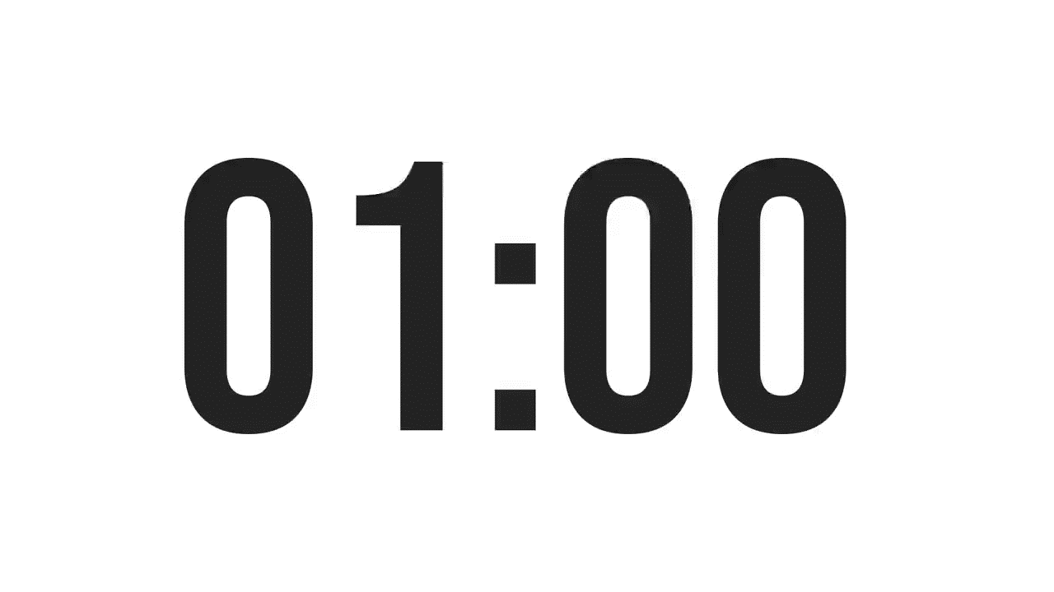

ISLAMIC EDUCATIONAL COLLEGE DATE: 6/ 5/ 2024 :
SUBJECT: Reported Speech
GRADE: 8
UNIT: 5
LESSON: 1
OUTCOMES
CRITICAL THINKING:
Can you think of a situation where using the wrong tense could cause confusion?
01:00 minute
WARM UP
PREASSESSMENT
PRESENTATION
FORMATIVE ASSESSMENT
FEEDBACK
DIFFERENTIATION
REAL LIFE APPLICATION
CRITICAL THINKING
EXIT TICKET
BUZZ IN

Slide 15
ISLAMIC EDUCATIONAL COLLEGE DATE: 6/ 5/ 2024 :
SUBJECT: Reported Speech
GRADE: 8
UNIT: 5
LESSON: 1
OUTCOMES
Connection to real life
Describe your daily routine using the simple present tense.
How does this help you communicate clearly with others?
01:00 minute
WARM UP
PREASSESSMENT
PRESENTATION
FORMATIVE ASSESSMENT
FEEDBACK
DIFFERENTIATION
REAL LIFE APPLICATION
CRITICAL THINKING
EXIT TICKET
BUZZ IN

Slide 16
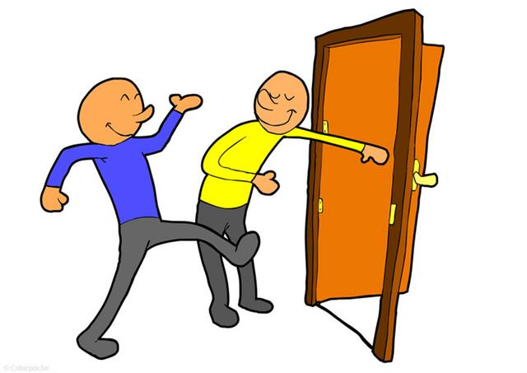
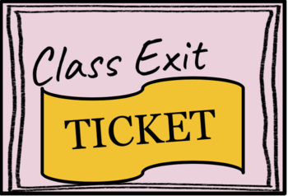
ISLAMIC EDUCATIONAL COLLEGE DATE: 6/ 5/ 2024 :
SUBJECT: Reported Speech
GRADE: 8
UNIT: 5
LESSON: 1
OUTCOMES
EXIT TICKET:
Write one paragraph about your daily routine in the weekdays.
02:00 minutes
WARM UP
PREASSESSMENT
PRESENTATION
FORMATIVE ASSESSMENT
FEEDBACK
DIFFERENTIATION
REAL LIFE APPLICATION
CRITICAL THINKING
EXIT TICKET
BUZZ IN

