Slide 1

Unit: 1
Lesson: Reading .
Subject: The ties that bind.
Grade: 10

Slide 2
LESSON 1

Slide 3



SUBJECT: Reading
GRADE: 10
UNIT: 1
Lesson: 1
LESSON
OBJECTIVES
00:30 minute
WARM UP
Objectives
PREASSESSMENT
To read for specific details in the article
To identify the meanings of the new words in the text
PRESENTATION
FORMATIVE ASSESSMENT
FEEDBACK
DIFFERENTIATION
REAL LIFE APPLICATION
CRITICAL THINKING
EXIT TICKET

Slide 4

SUBJECT: Reading
GRADE: 10
UNIT: 1
Lesson: 1
OUTCOMES
WARM UP
02:00 minutes
WARM UP
When is the International Day of Friendship?
What makes a good friend?
Real Life Application
PRESENTATION
FORMATIVE ASSESSMENT
FEEDBACK
DIFFERENTIATION
REAL LIFE APPLICATION
CRITICAL THINKING
EXIT TICKET

Slide 5


ISLAMIC EDUCATIONAL COLLEGE DATE: / / 2025
SUBJECT: Reading
GRADE: 10
UNIT:1
Lesson: 1
OUTCOMES
1:30 minute
Pre assessment
WARM UP
REAL LIFE APPLICATION
CRITICAL THINKING
What does the phrase “ties that bind” most likely mean?
Shoes and clothes
Relationships and connections
Knots in a rope
Rules and laws
Which of these is an example of a strong friendship?
Ignoring someone when they need help
Sharing secrets and supporting each other
Only talking to someone when you need something
Competing to see who is better
PREASSESSMENT
PRESENTATION
DIFFERENTIATION
FORMATIVE ASSESSMENT
FEEDBACK
EXIT TICKET

Slide 6
ISLAMIC EDUCATIONAL COLLEGE DATE: / / 2025
SUBJECT: Reading
GRADE: 10
UNIT:1
Lesson: 1
OUTCOMES
1:30 minute
Pre assessment
WARM UP
REAL LIFE APPLICATION
CRITICAL THINKING
A person who always expects the best to happen is...
pessimistic
b) realistic
c) optimistic
PREASSESSMENT
PRESENTATION
DIFFERENTIATION
FORMATIVE ASSESSMENT
FEEDBACK
EXIT TICKET

Slide 7
ISLAMIC EDUCATIONAL COLLEGE DATE: / / 2025
SUBJECT: Reading
GRADE: 10
UNIT:1
Lesson: 1
OUTCOMES
1:30 minute
Pre assessment
WARM UP
REAL LIFE APPLICATION
CRITICAL THINKING
Someone described as hot-headed is likely to...
a) stay calm during arguments
b) lose their temper easily
c) think carefully before reacting
PREASSESSMENT
PRESENTATION
DIFFERENTIATION
FORMATIVE ASSESSMENT
FEEDBACK
EXIT TICKET

Slide 8
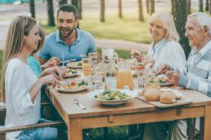
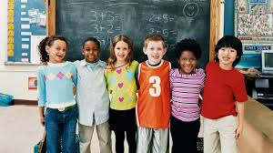


SUBJECT: Reading
GRADE: 10
UNIT: 1
Lesson: 1
OUTCOMES
02:00
minute
Real Life Application
WARM UP
Real Life Application
How do these pictures relate to our lesson title?
CRITICAL THINKING
FORMATIVE ASSESSMENT
FEEDBACK
DIFFERENTIATION
REAL LIFE APPLICATION
PRESENTATION
EXIT TICKET

Slide 9
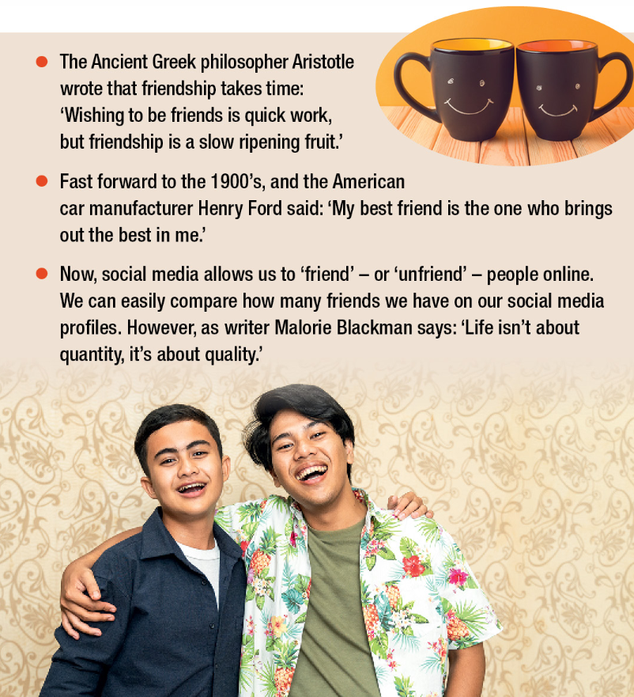
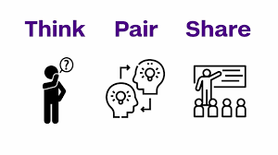
ISLAMIC EDUCATIONAL COLLEGE DATE: / / 2025
SUBJECT: Reading
GRADE: 10
UNIT: 1
Lesson: 1
OUTCOMES
4:00 minutes
Read the friendship quotes carefully.
Which quote you like best and why?
Use a drawing to show what the quote means. Be creative and think about how the idea can be shown in a picture.”
WARM UP
REAL LIFE APPLICATION
CRITICAL THINKING
PREASSESSMENT
PRESENTATION
DIFFERENTIATION
FEEDBACK
FORMATIVE ASSESSMENT
EXIT TICKET

Slide 10

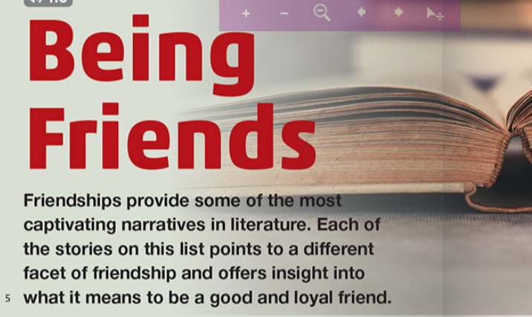
Captivating : charming/attractive
Facet: side, aspect

Slide 11
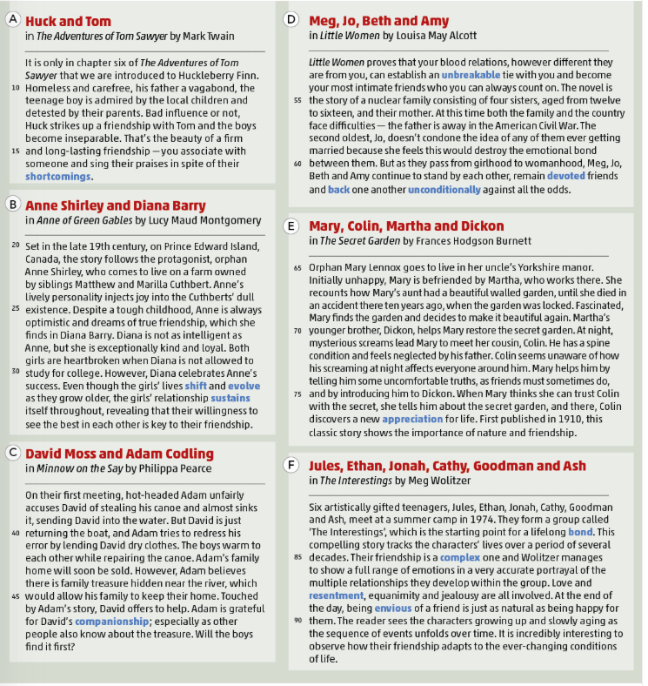
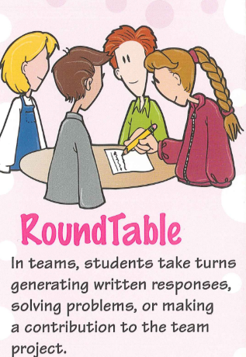
ISLAMIC EDUCATIONAL COLLEGE DATE: / / 2025
SUBJECT: Reading
GRADE: 10
UNIT: 1
Lesson: 1
OUTCOMES
Read then fill in the table with information from your selection, take a picture, post on Padlet:
3:00 minutes
WARM UP
REAL LIFE APPLICATION
CRITICAL THINKING
PREASSESSMENT
PRESENTATION
DIFFERENTIATION
FEEDBACK
FORMATIVE ASSESSMENT
EXIT TICKET

Slide 12
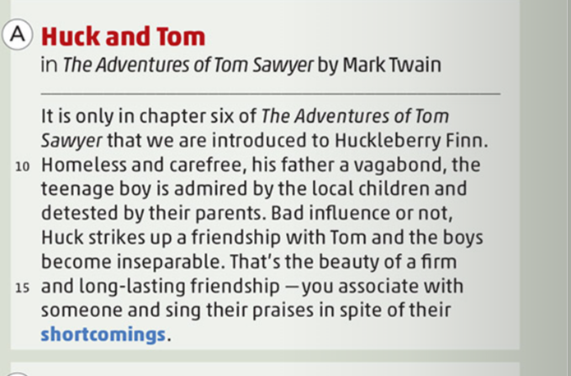
Who are the main characters in this selection?
What is each character’s background or situation?
How do the characters meet or become friends?
What actions show that they value their friendship?
What does the text say about the qualities of friendship?
Carefree: without any worry
Vagabond: a person who has no home, no job and travel from place to place
Detested: hated
Shortcomings: flaws, faults, weaknesses
Sing their praises: speak highly of someone

Slide 13
ISLAMIC EDUCATIONAL COLLEGE DATE: / 5/ 2025
SUBJECT: Reading
GRADE: 10
UNIT: 4
Lesson: 1
OUTCOMES
Differentiation
WARM UP
Students 1+3
Students 2+4
PREASSESSMENT
Do questions 3,4,5
Do questions 1,2
PRESENTATION
FORMATIVE ASSESSMENT
Read, Answer, fill in the table with information from you selection, take a picture, post on Padlet:
Who are the main characters in this selection?
What is each character’s background or situation?
How do the characters meet or become friends?
What actions show that they value their friendship?
What does the text say about the qualities of friendship?
FEEDBACK
DIFFERENTIATION
REAL LIFE APPLICATION
CRITICAL THINKING
EXIT TICKET

Slide 14
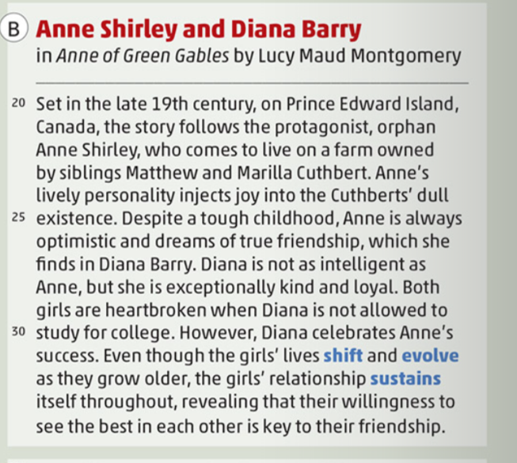
Who are the main characters in this selection?
What is each character’s background or situation?
How do the characters meet or become friends?
What actions show that they value their friendship?
What does the text say about the qualities of friendship?
Protagonist: main character
Shift: change
Evolve : grow/develop gradually

Slide 15
Selection / Story | Main Characters | Background / Situation | How They Become Friends | Actions Showing Friendship | Qualities of Friendship
Huck and Tom (The Adventures of Tom Sawyer)
Anne Shirley and Diana Barry (Anne of Green Gables)
David Moss and Adam Codling (Minnow on the Say)

Slide 16
Selection / Story | Main Characters | Background / Situation | How They Become Friends | Actions Showing Friendship | Qualities of Friendship
Meg, Jo, Beth, and Amy (Little Women)
Mary, Colin, Martha, and Dickon (The Secret Garden)
Jules, Ethan, Jonah, Cathy, Goodman, Ash (The Interestings)

Slide 17
Selection / Story | Main Characters | Background / Situation | How They Become Friends | Actions Showing Friendship | Qualities of Friendship
Huck and Tom (The Adventures of Tom Sawyer) | Huck Finn, Tom Sawyer | Huck: homeless, carefree, disliked by adults; Tom: local boy | Huck strikes up friendship with Tom; they become inseparable | Spend time together, go on adventures, stick with each other despite flaws | Loyalty, acceptance of shortcomings
Anne Shirley and Diana Barry (Anne of Green Gables) | Anne Shirley, Diana Barry | Anne: orphan, lively, optimistic; Diana: kind, loyal | Meet as young girls; bond through kindness and support | Celebrate each other’s successes, support emotionally, long-lasting friendship | Loyalty, kindness, support, seeing the best in each other
David Moss and Adam Codling (Minnow on the Say) | David Moss, Adam Codling | David: honest, helpful; Adam: hot-headed, family home at risk | Meet after Adam accuses David of stealing canoe; bond while repairing it | Adam lends clothes; David helps find treasure; trust and companionship | Trust, forgiveness, support, shared adventures
Meg, Jo, Beth, and Amy (Little Women) | Meg, Jo, Beth, Amy March | Sisters aged 12–16; father away in Civil War; face family and societal challenges | Friendship grows naturally as sisters | Stand by each other, remain devoted, support unconditionally | Loyalty, devotion, unconditional support
Mary, Colin, Martha, and Dickon (The Secret Garden) | Mary Lennox, Colin Craven, Martha, Dickon | Mary: orphan; Colin: sick, neglected; Martha: maid; Dickon: helpful brother | Mary and Colin(she hers his screams at night) became friends after meeting through Martha and Dickon while working on the secret garden | Help each other, restore garden, build trust, encourage growth | Trust, support, honesty, encouragement
Jules, Ethan, Jonah, Cathy, Goodman, Ash (The Interestings) | Jules, Ethan, Jonah, Cathy, Goodman, Ash | Artistically gifted teenagers; meet at summer camp 1974 | Form group “The Interestings,” lifelong bond | Maintain connection, support each other, navigate complex emotions | Loyalty, patience, adaptability, understanding

Slide 18
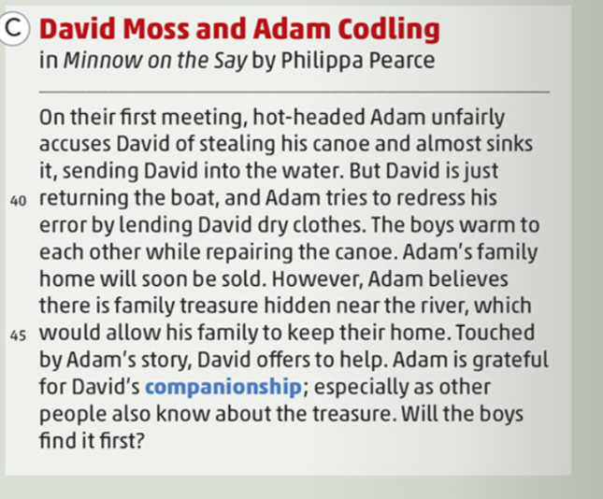

Who are the main characters in this selection?
What is each character’s background or situation?
How do the characters meet or become friends?
What actions show that they value their friendship?
What does the text say about the qualities of friendship?
Hot-headed :doing things or reacting to things quickly and without thinking carefully first
Redress: to correct a wrong:
Companionship: the enjoyment of spending time with other people:

Slide 19
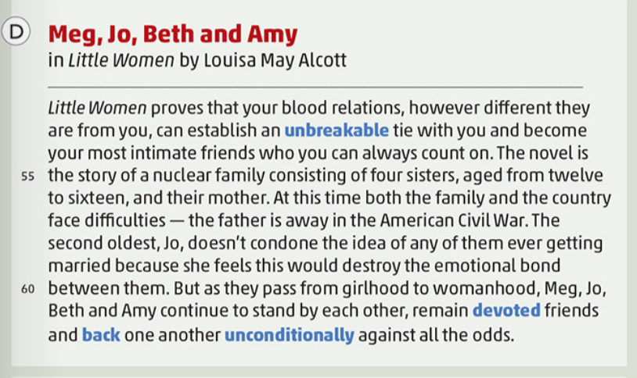
Who are the main characters in this selection?
What is each character’s background or situation?
How do the characters meet or become friends?
What actions show that they value their friendship?
What does the text say about the qualities of friendship?
Nuclear family: a couple and their children, regarded as a basic social unit
condone: to accept or allow behaviour that is wrong
devoted: extremely loyal
Unconditionally: in a way that is complete and not limited in any way:

Slide 20
ISLAMIC EDUCATIONAL COLLEGE DATE: / / 2025
SUBJECT: Reading
GRADE: 10
UNIT:1
Lesson: 1
OUTCOMES
1:30 minute
Pre assessment
WARM UP
REAL LIFE APPLICATION
CRITICAL THINKING
After moving to a new city, she missed the __________ of her old friends.
Companion b) companionship
The dog was more than a pet; it was his faithful __________.
a) Companion b) companionship
PREASSESSMENT
PRESENTATION
DIFFERENTIATION
FORMATIVE ASSESSMENT
FEEDBACK
EXIT TICKET

Slide 21
ISLAMIC EDUCATIONAL COLLEGE DATE: / / 2025
SUBJECT: Reading
GRADE: 10
UNIT:1
Lesson: 1
OUTCOMES
1:30 minute
Pre assessment
WARM UP
REAL LIFE APPLICATION
CRITICAL THINKING
After moving to a new city, she missed the __________ of her old friends.
Companion b) companionship
The dog was more than a pet; it was his faithful __________.
a) Companion b) companionship
PREASSESSMENT
PRESENTATION
DIFFERENTIATION
FORMATIVE ASSESSMENT
FEEDBACK
EXIT TICKET

Slide 22
ISLAMIC EDUCATIONAL COLLEGE DATE: / / 2025
SUBJECT: Reading
GRADE: 10
UNIT:1
Lesson: 1
OUTCOMES
1:30 minute
Pre assessment
WARM UP
REAL LIFE APPLICATION
I really __________ your honesty and effort during the project.
appreciation b)appreciated
The teacher expressed her __________ for the students’ hard work.
appreciation
b) appreciate
appreciating
CRITICAL THINKING
PREASSESSMENT
PRESENTATION
DIFFERENTIATION
FORMATIVE ASSESSMENT
FEEDBACK
EXIT TICKET

Slide 23
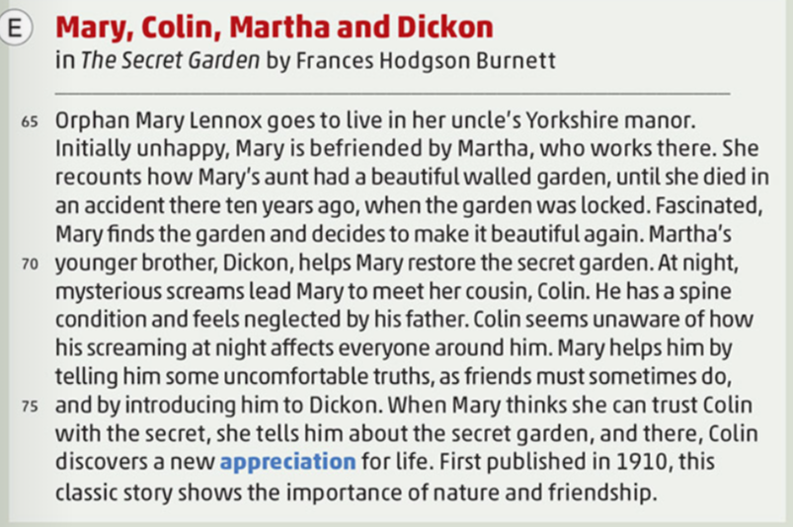
Who are the main characters in this selection?
What is each character’s background or situation?
How do the characters meet or become friends?
What actions show that they value their friendship?
What does the text say about the qualities of friendship?
manor: a large old house in the country with land belonging to it, especially in Europe
recount: to tell a story
appreciation: the act of recognizing or understanding that something is valuable, important,..

Slide 24
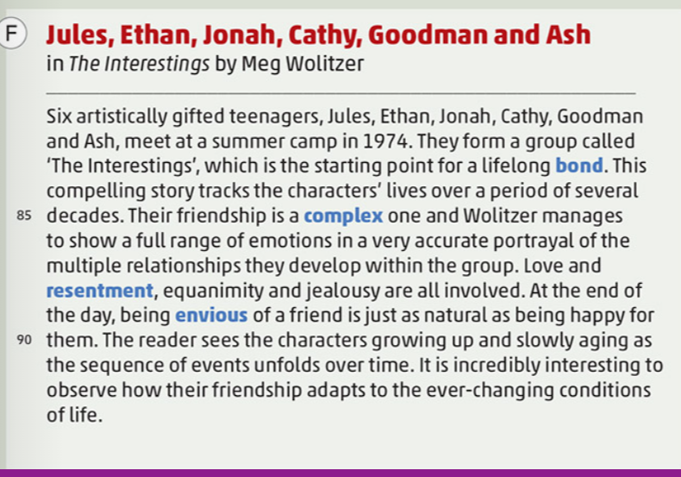
Who are the main characters in this selection?
What is each character’s background or situation?
How do the characters meet or become friends?
What actions show that they value their friendship?
What does the text say about the qualities of friendship?
bond: a close connection joining two or more people
compelling: very exciting and interesting and making you want to watch or listen:
portrayal: he way that someone or something is described or represented in a painting, film, book, or other artistic work
resentment: a feeling of anger because you have been forced to accept something that you do not like:
equanimity: a calm mental state, especially after a shock or disappointment or in a difficult situation:

Slide 25
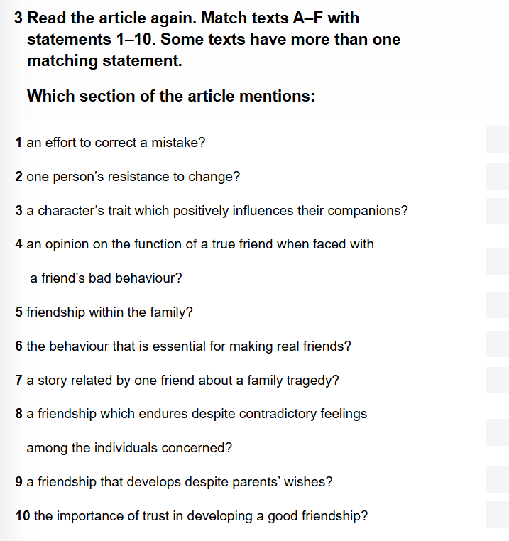

ISLAMIC EDUCATIONAL COLLEGE DATE: / / 2025
SUBJECT: Reading
GRADE: 10
UNIT: 1
Lesson: 1
OUTCOMES
3:00 minutes
WARM UP
REAL LIFE APPLICATION
CRITICAL THINKING
PREASSESSMENT
PRESENTATION
DIFFERENTIATION
FEEDBACK
FORMATIVE ASSESSMENT
EXIT TICKET

Slide 26
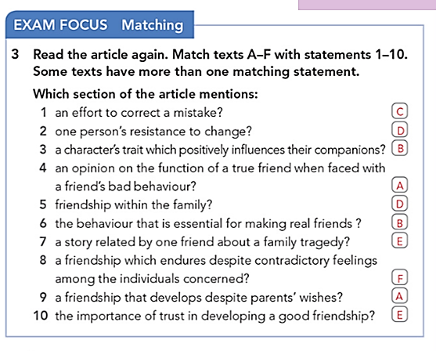
ISLAMIC EDUCATIONAL COLLEGE DATE: / / 2025
SUBJECT: Reading
GRADE: 10
UNIT: 1
Lesson: 1
OUTCOMES
1:00 minutes
WARM UP
REAL LIFE APPLICATION
CRITICAL THINKING
PREASSESSMENT
PRESENTATION
DIFFERENTIATION
FEEDBACK
FORMATIVE ASSESSMENT
EXIT TICKET

Slide 27
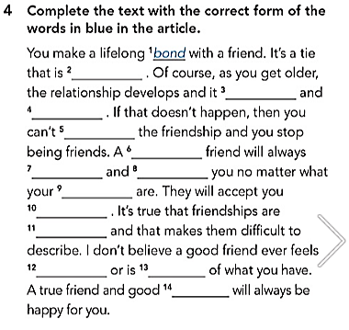
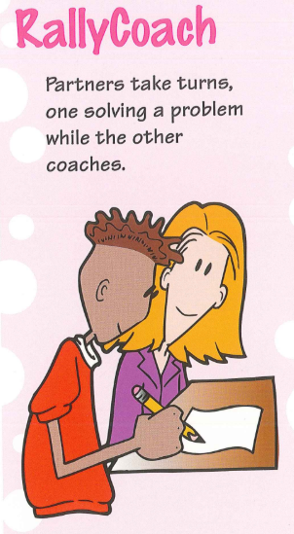
ISLAMIC EDUCATIONAL COLLEGE DATE: / / 2025
SUBJECT: Reading
GRADE: 10
UNIT: 1
Lesson: 1
OUTCOMES
5:00 minutes
WARM UP
REAL LIFE APPLICATION
CRITICAL THINKING
PREASSESSMENT
PRESENTATION
DIFFERENTIATION
FEEDBACK
FORMATIVE ASSESSMENT
EXIT TICKET

Slide 28
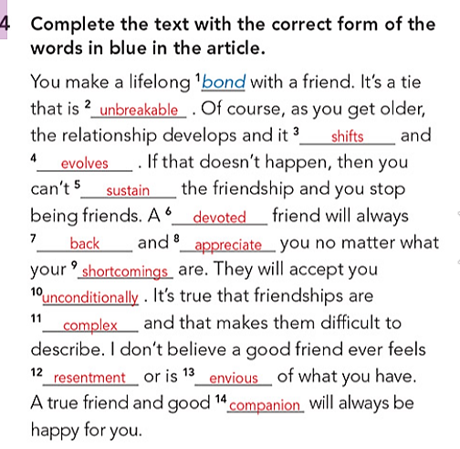
ISLAMIC EDUCATIONAL COLLEGE DATE: / / 2025
SUBJECT: Reading
GRADE: 10
UNIT: 1
Lesson: 1
OUTCOMES
1:00 minutes
WARM UP
REAL LIFE APPLICATION
CRITICAL THINKING
PREASSESSMENT
PRESENTATION
DIFFERENTIATION
FEEDBACK
FORMATIVE ASSESSMENT
EXIT TICKET

Slide 29
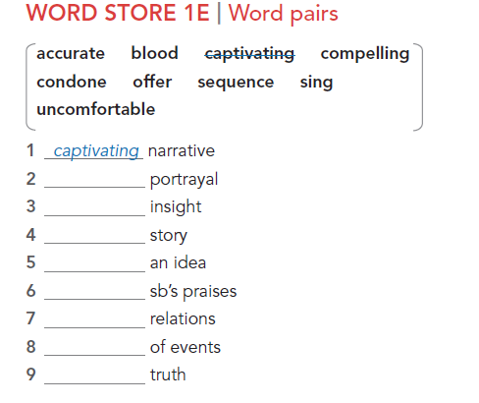

Slide 30
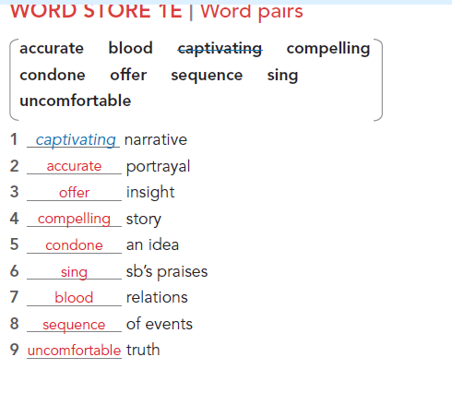
family members who are connected by birth
a fact that is true but hard to accept
to accept or allow an idea, even if it may be wrong or bad
a story that is so exciting or emotional that you want to keep reading or listening
to give a deeper understanding or a useful idea about something
a story that is very interesting and holds your attention
to say very good things about someone
a description or picture that shows something truthfully and correctly
the order in which things happen
1, F
2,H
3,E
4,D
5,C
6,G
7,A
8,I
9,B

Slide 31
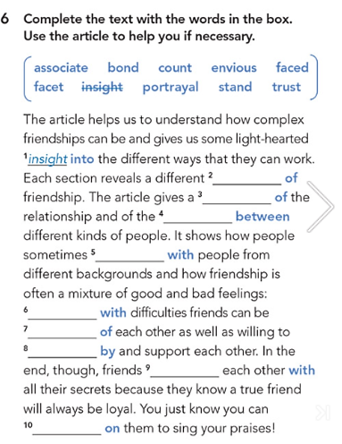
ISLAMIC EDUCATIONAL COLLEGE DATE: / / 2025
SUBJECT: Reading
GRADE: 10
UNIT: 1
Lesson: 1
OUTCOMES
Formative assessment
5:00 minute
WARM UP
Performance : Pair Work .
Time : 5 Minutes.
PREASSESSMENT
PRESENTATION
FORMATIVE ASSESSMENT
FEEDBACK
DIFFERENTIATION
REAL LIFE APPLICATION
CRITICAL THINKING
EXIT TICKET

Slide 32
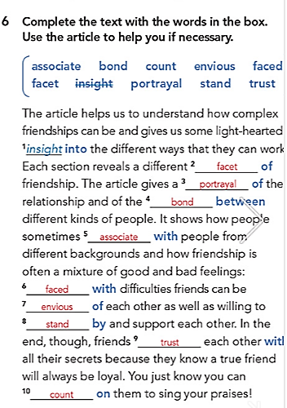
ISLAMIC EDUCATIONAL COLLEGE DATE: 19 / 2/ 2025
SUBJECT: Reading
GRADE: 10
UNIT: 1
Lesson: 1
OUTCOMES
1:00 minutes
WARM UP
REAL LIFE APPLICATION
CRITICAL THINKING
PREASSESSMENT
PRESENTATION
DIFFERENTIATION
FEEDBACK
FORMATIVE ASSESSMENT
EXIT TICKET

Slide 33
ISLAMIC EDUCATIONAL COLLEGE DATE: / / 2025
SUBJECT: Reading
GRADE: 10
Unit: 1
Lesson: 1
OUTCOMES
CRITICAL THINKING
2:00 minutes
WARM UP
REAL LIFE APPLICATION
How do challenges (like family problems, illness, or jealousy) test the strength of a friendship?
CRITICAL THINKING
PREASSESSMENT
FEEDBACK
FORMATIVE ASSESSMENT
PRESENTATION
DIFFERENTIATION
EXIT TICKET

Slide 34
ISLAMIC EDUCATIONAL COLLEGE DATE: / / 2025
SUBJECT: Reading
GRADE: 10
Unit: 1
Lesson: 1
OUTCOMES
CRITICAL THINKING
2:00 minutes
WARM UP
REAL LIFE APPLICATION
Which story’s friendship do you think would be hardest to keep in real life? Why?
CRITICAL THINKING
PREASSESSMENT
FEEDBACK
FORMATIVE ASSESSMENT
PRESENTATION
DIFFERENTIATION
EXIT TICKET

