Slide 1

Unit: 1
Lesson: Vocabulary Lesson #1
Subject: Being friends
Grade: 10

Slide 2


ISLAMIC EDUCATIONAL COLLEGE DATE: / 9/ 2024
SUBJECT: Vocabulary
GRADE: 10
UNIT: 1
Lesson: 1
LESSON
OBJECTIVES
OBJECTIVES:
1. To identify the meanings of the new words
2. To use the words in meaningful context
01:00 minute
WARM UP
PREASSESSMENT
PRESENTATION
FORMATIVE ASSESSMENT
FEEDBACK
DIFFERENTIATION
REAL LIFE APPLICATION
CRITICAL THINKING
EXIT TICKET

Slide 3
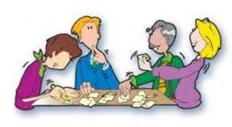
ISLAMIC EDUCATIONAL COLLEGE DATE: / 9/ 2024
SUBJECT: Vocabulary
GRADE: 10
UNIT: 1
Lesson: 1
OUTCOMES
WARM UP: jot your thoughts
Personality adjectives
02:00 minutes
WARM UP
PREASSESSMENT
PRESENTATION
FORMATIVE ASSESSMENT
FEEDBACK
DIFFERENTIATION
REAL LIFE APPLICATION
CRITICAL THINKING
EXIT TICKET

Slide 4
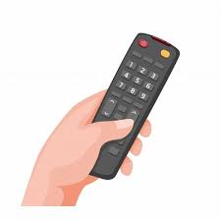

ISLAMIC EDUCATIONAL COLLEGE DATE: / 5/ 2025
SUBJECT: Grammar
GRADE: 9
UNIT:4
Lesson: 1
OUTCOMES
03:00 minutes
WARM UP
Which word doesn’t have the same meaning of “down-to-earth” : a) Practical b) realistic c) Arrogant
REAL LIFE APPLICATION
CRITICAL THINKING
PREASSESSMENT
PRESENTATION
DIFFERENTIATION
FORMATIVE ASSESSMENT
FEEDBACK
EXIT TICKET

Slide 5
ISLAMIC EDUCATIONAL COLLEGE DATE: / 5/ 2025
SUBJECT: Grammar
GRADE: 9
UNIT:4
Lesson: 1
OUTCOMES
03:00 minutes
WARM UP
Which sentence uses “considerate” correctly? a) She is always considerate of other people’s feelings. b) He was considerate when he shouted at his friend. c) It was considerate to hold the door open for others.
d) a, c
REAL LIFE APPLICATION
CRITICAL THINKING
PREASSESSMENT
PRESENTATION
DIFFERENTIATION
FORMATIVE ASSESSMENT
FEEDBACK
EXIT TICKET

Slide 6
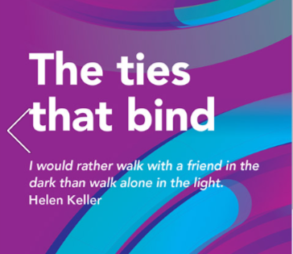

CRITICAL THINKING
In the quote, “I would rather walk with a friend in the dark than walk alone in the light,” are “dark” and “light” used literally or figuratively? What do you think the speaker means by them?

Slide 7
CRITICAL THINKING
Do you agree with the idea that it’s better to face difficulties with a friend than to be comfortable alone? Explain your answer with an example or reason.

Slide 8
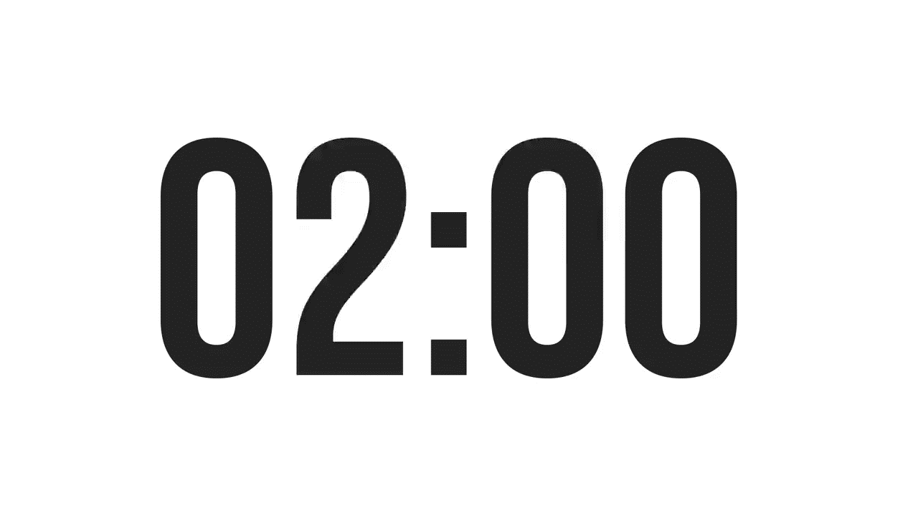

ISLAMIC EDUCATIONAL COLLEGE DATE: / 9/ 2024
SUBJECT: Vocabulary
GRADE: 10
UNIT: 1
Lesson: 1
OUTCOMES
PREASSESSMENT:
02:00 minutes
WARM UP
Take off – Touch down
PREASSESSMENT
PRESENTATION
Students who know at least 5 words from the table are asked to stand up.
Students who know less than 5 words from the table remain seated.
FORMATIVE ASSESSMENT
FEEDBACK
DIFFERENTIATION
Unprejudiced
Obstinate
Sharp
Irreverent
Considerate
Down-to-earth
Faithful
REAL LIFE APPLICATION
CRITICAL THINKING
EXIT TICKET

Slide 9
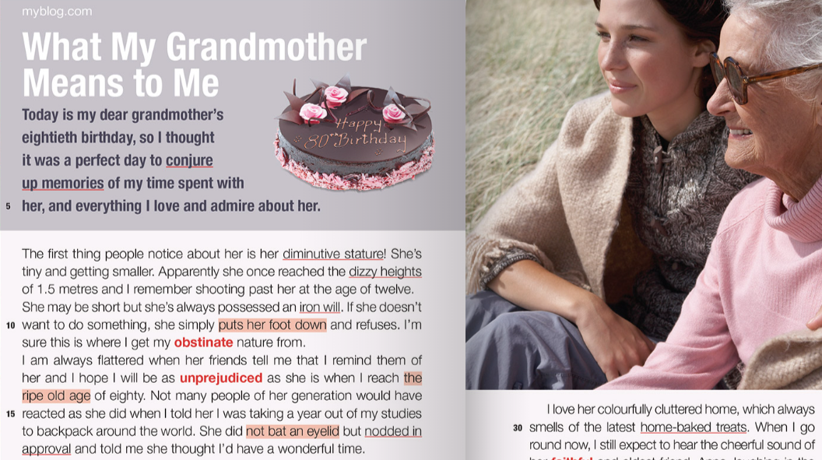

Slide 10
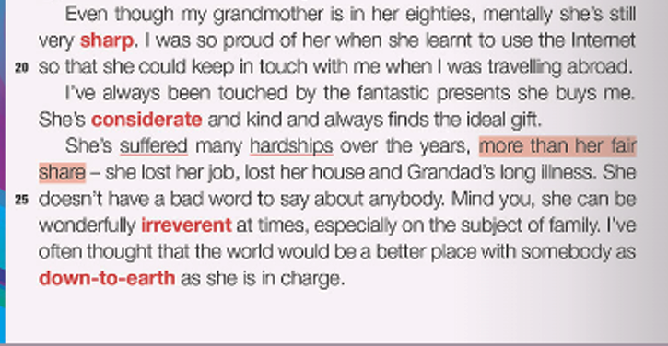

Slide 11
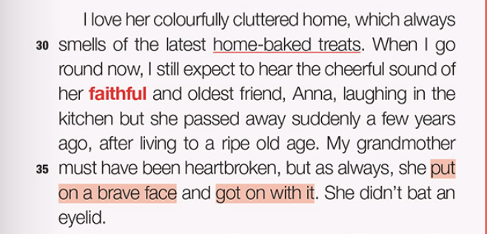

Slide 12

ISLAMIC EDUCATIONAL COLLEGE DATE: / 9/ 2024
SUBJECT: Vocabulary
GRADE: 10
UNIT: 1
Lesson: 1
PRESENTATION: Listen to the audio, answer the exercise solo, then discuss your answers with your shoulder partner
OUTCOMES
03:00 minutes
WARM UP
PREASSESSMENT
PRESENTATION
Unprejudiced:
Obstinate:
Sharp:
Irreverent:
Considerate:
Down to earth:
Faithful:
FORMATIVE ASSESSMENT
FEEDBACK
DIFFERENTIATION
REAL LIFE APPLICATION
CRITICAL THINKING
EXIT TICKET

Slide 13
ISLAMIC EDUCATIONAL COLLEGE DATE: / 9/ 2024
SUBJECT: Vocabulary
GRADE: 10
UNIT: 1
Lesson: 1
Feedback: Check your answers
OUTCOMES
03:00 minutes
WARM UP
PREASSESSMENT
Unprejudiced: tolerant
Obstinate: stubborn
Sharp: quick-witted
Irreverent: disrespectful
Considerate: thoughtful
Down to earth: practical
Faithful: loyal
PRESENTATION
FORMATIVE ASSESSMENT
FEEDBACK
DIFFERENTIATION
REAL LIFE APPLICATION
CRITICAL THINKING
EXIT TICKET

Slide 14

Look up synonyms for unprejudiced

Slide 15
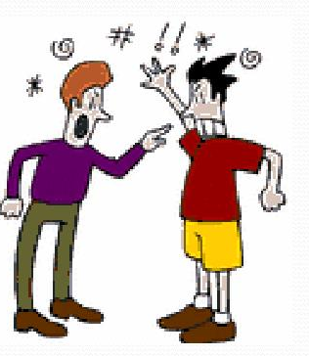

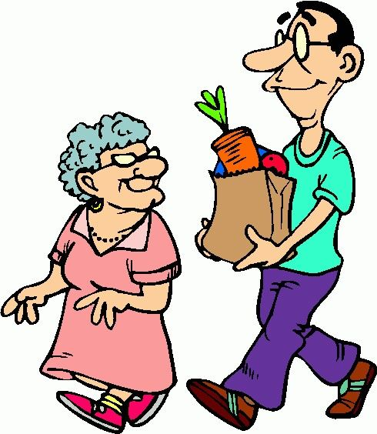

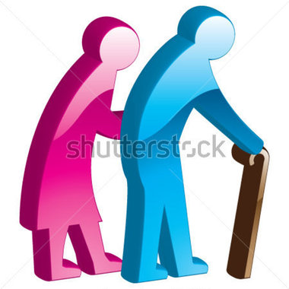

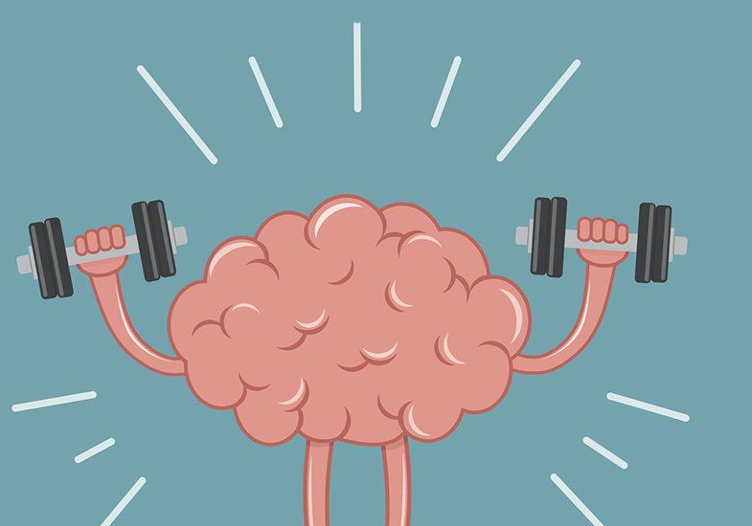
ISLAMIC EDUCATIONAL COLLEGE DATE: / 9/ 2024
SUBJECT: Vocabulary
GRADE: 10
UNIT: 1
Lesson: 1
PRESENTATION: Match the word with the best image (Think- Pair- share
OUTCOMES
03:00 minutes
WARM UP
unprejudiced
obstinate
sharp
irreverent
considerate
down to earth
faithful
PREASSESSMENT
PRESENTATION
FORMATIVE ASSESSMENT
FEEDBACK
DIFFERENTIATION
REAL LIFE APPLICATION
CRITICAL THINKING
EXIT TICKET

Slide 16
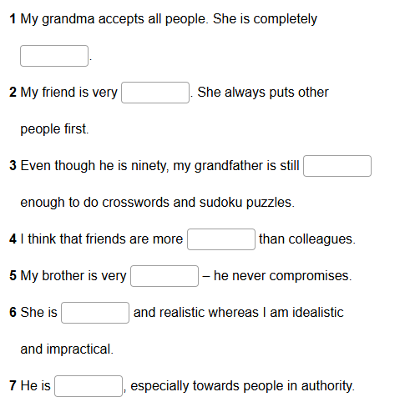
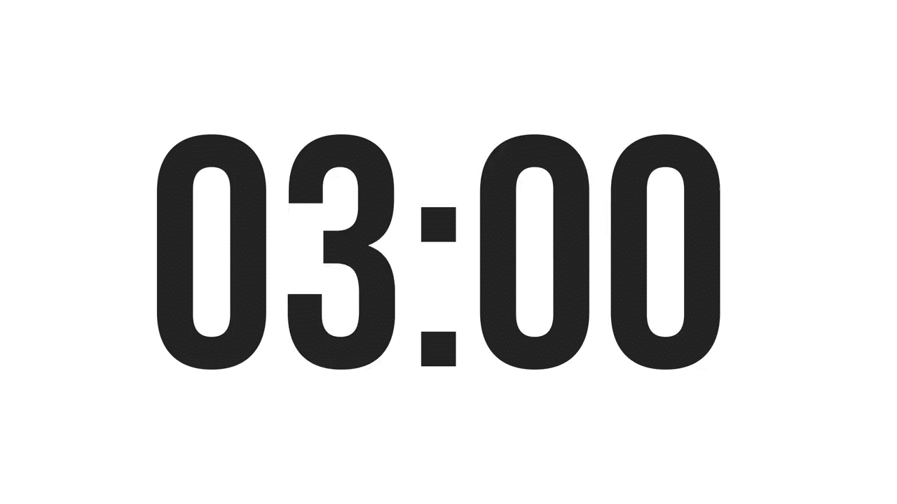

ISLAMIC EDUCATIONAL COLLEGE DATE: / 9/ 2024
SUBJECT: Vocabulary
GRADE: 10
UNIT: 1
Lesson: 1
OUTCOMES
03:00 minutes
WARM UP
PREASSESSMENT
PRESENTATION
FORMATIVE ASSESSMENT
FEEDBACK
DIFFERENTIATION
REAL LIFE APPLICATION
CRITICAL THINKING
EXIT TICKET
IRS

Slide 17
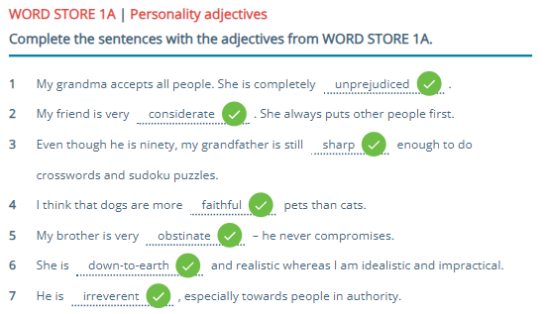

ISLAMIC EDUCATIONAL COLLEGE DATE: / 9/ 2024
SUBJECT: Vocabulary
GRADE: 10
UNIT: 1
Lesson: 1
OUTCOMES
02:00 minutes
WARM UP
PREASSESSMENT
PRESENTATION
FORMATIVE ASSESSMENT
FEEDBACK
DIFFERENTIATION
REAL LIFE APPLICATION
CRITICAL THINKING
EXIT TICKET

Slide 18
ISLAMIC EDUCATIONAL COLLEGE DATE: / 9/ 2024
SUBJECT: Vocabulary
GRADE: 10
UNIT: 1
Lesson: 1
OUTCOMES
02:00 minutes
REAL LIFE APPLICATION
WARM UP
PREASSESSMENT
PRESENTATION
FORMATIVE ASSESSMENT
Who in your family is down-to-earth? Who is sharp? Why?”
FEEDBACK
DIFFERENTIATION
REAL LIFE APPLICATION
CRITICAL THINKING
EXIT TICKET

Slide 19


ISLAMIC EDUCATIONAL COLLEGE DATE: / 9/ 2024
SUBJECT: Vocabulary
GRADE: 10
UNIT: 1
Lesson: 1
OUTCOMES
CRITICAL THINKING:
Why might leaders need to be both “sharp” and “down-to-earth”?
01:00 minute
WARM UP
PREASSESSMENT
PRESENTATION
FORMATIVE ASSESSMENT
FEEDBACK
DIFFERENTIATION
REAL LIFE APPLICATION
CRITICAL THINKING
EXIT TICKET
BUZZ IN

Slide 20
ISLAMIC EDUCATIONAL COLLEGE DATE: / 5/ 2025
SUBJECT: Grammar
GRADE: 9
UNIT: 4
Lesson: 1
OUTCOMES
04:00 minutes
Differentiation
EXIT TICKET
WARM UP
PREASSESSMENT
Students 1+2
Students 3+4
PRESENTATION
FORMATIVE ASSESSMENT
FEEDBACK
Put the following words in sentences and write them in your notebook.
sharp
Considerate
obstinate
Write a short paragraph using the words
Unprejudiced
Down-to-earth
Obstinate
sharp
DIFFERENTIATION
REAL LIFE APPLICATION
CRITICAL THINKING
EXIT TICKET

Slide 21
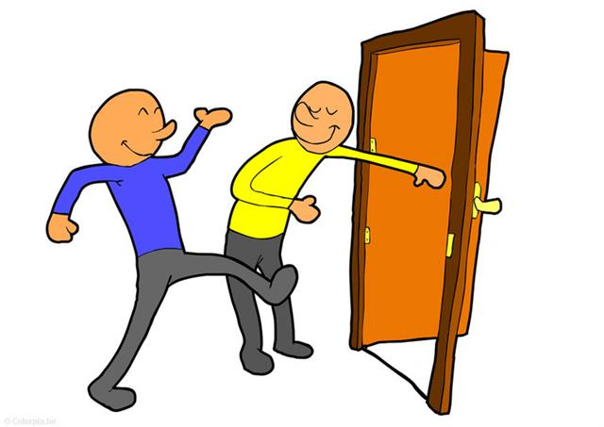
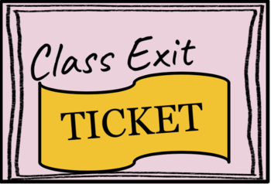
ISLAMIC EDUCATIONAL COLLEGE DATE: / 9/ 2024
SUBJECT: Vocabulary
GRADE: 10
UNIT: 1
Lesson: 1
OUTCOMES
EXIT TICKET:
Individually, write three sentences using any three of the listed words describing your best friend.
02:00 minutes
WARM UP
PREASSESSMENT
PRESENTATION
FORMATIVE ASSESSMENT
FEEDBACK
DIFFERENTIATION
REAL LIFE APPLICATION
CRITICAL THINKING
EXIT TICKET
BUZZ IN

