Slide 1

Unit: 1
Lesson: Vocabulary Lesson #2
Subject: Being friends
Grade: 10

Slide 2


ISLAMIC EDUCATIONAL COLLEGE DATE: / 9/ 2024
SUBJECT: Vocabulary
GRADE: 10
UNIT: 1
Lesson: 1
LESSON
OBJECTIVES
OBJECTIVES:
1. To identify the meanings of the new collocations
2. To use the words in meaningful context
01:00 minute
WARM UP
PREASSESSMENT
PRESENTATION
FORMATIVE ASSESSMENT
FEEDBACK
DIFFERENTIATION
REAL LIFE APPLICATION
CRITICAL THINKING
EXIT TICKET

Slide 3
ISLAMIC EDUCATIONAL COLLEGE DATE: / 9/ 2024
SUBJECT: Vocabulary
GRADE: 10
UNIT: 1
Lesson: 1
OUTCOMES
WARM UP:
02:00 minutes
WARM UP
PREASSESSMENT
PRESENTATION
https://create.kahoot.it/details/1c7ecc42-3d20-432a-a386-bf7f7c464343
FORMATIVE ASSESSMENT
FEEDBACK
DIFFERENTIATION
REAL LIFE APPLICATION
CRITICAL THINKING
EXIT TICKET

Slide 4

ISLAMIC EDUCATIONAL COLLEGE DATE: / 5/ 2025
SUBJECT: Grammar
GRADE: 9
UNIT:4
Lesson: 1
OUTCOMES
03:00 minutes
He offered help in an unassuming manner, quietly assisting without seeking praise.: What does it mean? A) He helped loudly to get attention. B) He helped modestly, without showing off. C) He refused to help anyone. D) He asked for a reward for helping.
WARM UP
REAL LIFE APPLICATION
CRITICAL THINKING
PREASSESSMENT
PRESENTATION
DIFFERENTIATION
FORMATIVE ASSESSMENT
FEEDBACK
EXIT TICKET

Slide 5


ISLAMIC EDUCATIONAL COLLEGE DATE: / 9/ 2024
SUBJECT: Vocabulary
GRADE: 10
UNIT: 1
Lesson: 1
OUTCOMES
PREASSESSMENT:
02:00 minutes
Take off – Touch down
WARM UP
PREASSESSMENT
Students who know at least 5 phrases from the table are asked to stand up.
Students who know less than 5 phrases from the table remain seated.
PRESENTATION
FORMATIVE ASSESSMENT
FEEDBACK
conjure up memories dizzy heights
Iron will nodded in approval
home-baked treats diminutive stature
Suffer hardships unassuming manner
DIFFERENTIATION
REAL LIFE APPLICATION
CRITICAL THINKING
EXIT TICKET

Slide 6
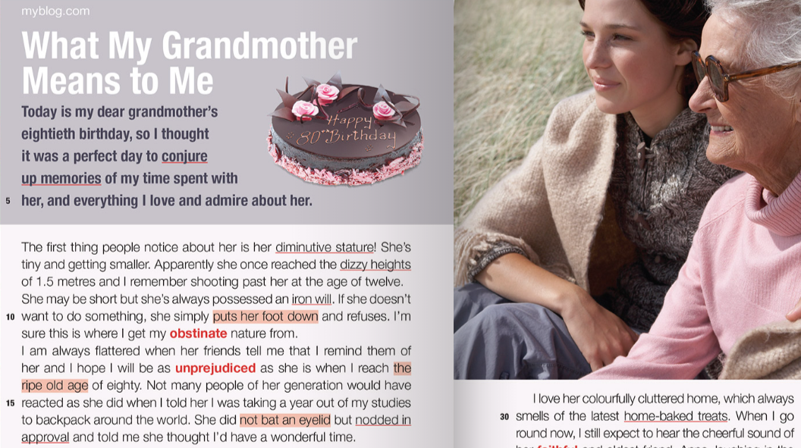

Slide 7
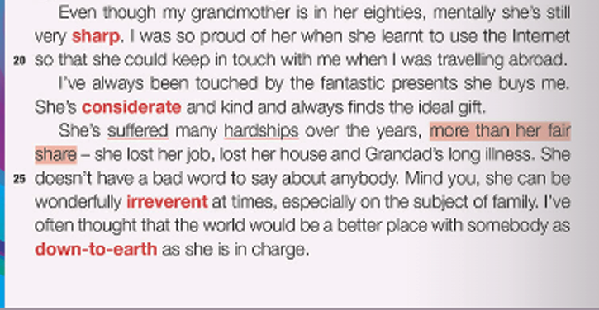

Slide 8
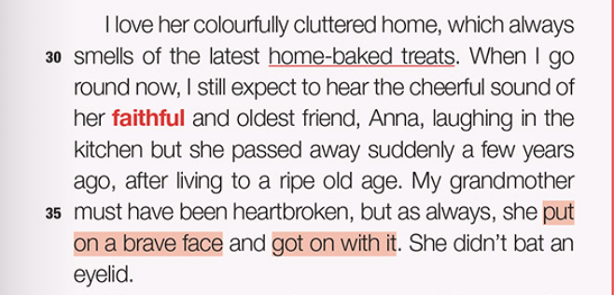

Slide 9
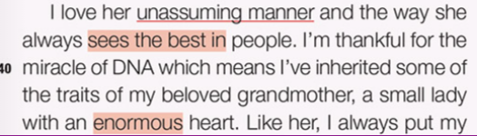

Slide 10
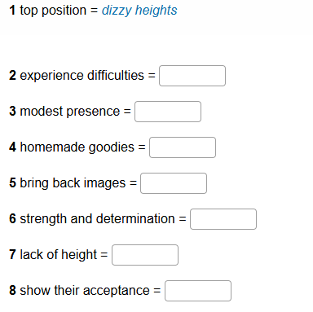

ISLAMIC EDUCATIONAL COLLEGE DATE: / 9/ 2024
SUBJECT: Vocabulary
GRADE: 10
UNIT: 1
Lesson: 1
PRESENTATION: Listen to the audio, answer the exercise solo, then discuss your answers with your shoulder partner
OUTCOMES
03:00 minutes
WARM UP
PREASSESSMENT
PRESENTATION
FORMATIVE ASSESSMENT
FEEDBACK
DIFFERENTIATION
REAL LIFE APPLICATION
CRITICAL THINKING
EXIT TICKET

Slide 11
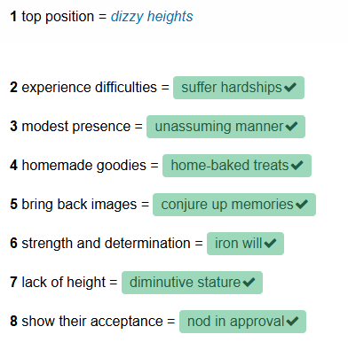
ISLAMIC EDUCATIONAL COLLEGE DATE: / 9/ 2024
SUBJECT: Vocabulary
GRADE: 10
UNIT: 1
Lesson: 1
Feedback: Check your answers
OUTCOMES
03:00 minutes
WARM UP
PREASSESSMENT
PRESENTATION
FORMATIVE ASSESSMENT
FEEDBACK
DIFFERENTIATION
REAL LIFE APPLICATION
CRITICAL THINKING
EXIT TICKET

Slide 12


ISLAMIC EDUCATIONAL COLLEGE DATE: / 9/ 2024
SUBJECT: Vocabulary
GRADE: 10
UNIT: 1
Lesson: 1
OUTCOMES
CRITICAL THINKING:
Do you think suffering hardships can make people stronger? Why or why not?
01:00 minute
WARM UP
PREASSESSMENT
PRESENTATION
FORMATIVE ASSESSMENT
FEEDBACK
DIFFERENTIATION
REAL LIFE APPLICATION
CRITICAL THINKING
EXIT TICKET
BUZZ IN

Slide 13
ISLAMIC EDUCATIONAL COLLEGE DATE: / 9/ 2024
SUBJECT: Vocabulary
GRADE: 10
UNIT: 1
Lesson: 1
OUTCOMES
01:00 minute
REAL LIFE APPLICATION:
Tell about one thing (a smell, food, or song) that conjures up memories for you.
Think of someone you know with an iron will. What do they do that shows it?
WARM UP
PREASSESSMENT
PRESENTATION
FORMATIVE ASSESSMENT
FEEDBACK
DIFFERENTIATION
REAL LIFE APPLICATION
CRITICAL THINKING
EXIT TICKET
BUZZ IN

Slide 14
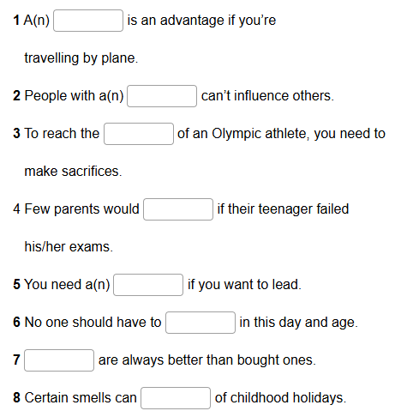

ISLAMIC EDUCATIONAL COLLEGE DATE: / 9/ 2024
SUBJECT: Vocabulary
GRADE: 10
UNIT: 1
Lesson: 1
OUTCOMES
03:00 minutes
WARM UP
PREASSESSMENT
PRESENTATION
FORMATIVE ASSESSMENT
FEEDBACK
DIFFERENTIATION
REAL LIFE APPLICATION
CRITICAL THINKING
EXIT TICKET
IRS

Slide 15
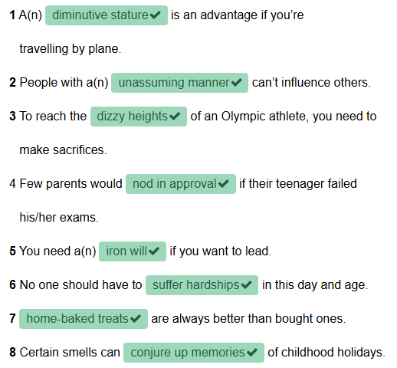

ISLAMIC EDUCATIONAL COLLEGE DATE: / 9/ 2024
SUBJECT: Vocabulary
GRADE: 10
UNIT: 1
Lesson: 1
OUTCOMES
02:00 minutes
WARM UP
PREASSESSMENT
PRESENTATION
FORMATIVE ASSESSMENT
FEEDBACK
DIFFERENTIATION
REAL LIFE APPLICATION
CRITICAL THINKING
EXIT TICKET

Slide 16
ISLAMIC EDUCATIONAL COLLEGE DATE: / 9/ 2024
SUBJECT: Vocabulary
GRADE: 10
UNIT: 1
Lesson: 1
DIFFERENTIATION: (Students 3 and 4)
Which phrase means “bring back the past”?
dizzy heights b) conjure up memories c) iron will
Which phrase means “very high or a big success”?
diminutive stature b) dizzy heights c) home-baked treats
Which phrase means “strong determination”?
iron will b) nodded in approval c) suffer hardships
What does “nodded in approval” mean?
said no loudly b) shook head angrily c) moved head to agree
Which phrase means food cooked at home?
home-baked treats b) iron will c) dizzy heights
OUTCOMES
01:00 minute
WARM UP
PREASSESSMENT
PRESENTATION
FORMATIVE ASSESSMENT
FEEDBACK
DIFFERENTIATION
REAL LIFE APPLICATION
CRITICAL THINKING
EXIT TICKET

Slide 17
ISLAMIC EDUCATIONAL COLLEGE DATE: / 9/ 2024
SUBJECT: Vocabulary
GRADE: 10
UNIT: 1
Lesson: 1
DIFFERENTIATION: (Students 2 and 4)
Which phrase means “bring back the past”?
dizzy heights b) conjure up memories c) iron will
Which phrase means “very high or a big success”?
diminutive stature b) dizzy heights c) home-baked treats
Which phrase means “strong determination”?
iron will b) nodded in approval c) suffer hardships
What does “nodded in approval” mean?
said no loudly b) shook head angrily c) moved head to agree
Which phrase means food cooked at home?
home-baked treats b) iron will c) dizzy heights
OUTCOMES
01:00 minute
WARM UP
PREASSESSMENT
PRESENTATION
FORMATIVE ASSESSMENT
FEEDBACK
DIFFERENTIATION
REAL LIFE APPLICATION
CRITICAL THINKING
EXIT TICKET

Slide 18
ISLAMIC EDUCATIONAL COLLEGE DATE: / 9/ 2024
SUBJECT: Vocabulary
GRADE: 10
UNIT: 1
Lesson: 1
OUTCOMES
DIFFERENTIATION: (Students 1 and 3)
Fill in the blanks with the correct phrase.
Looking at old photos always ________.
She reached the ________ of her career.
He showed an ________ when he kept practicing every day.
The teacher ________ when she liked my answer.
My grandmother makes delicious ________.
The ________ child was smaller than the others.
During the war, many families had to ________.
Although he was rich, he had an ________.
01:00 minute
WARM UP
PREASSESSMENT
PRESENTATION
FORMATIVE ASSESSMENT
FEEDBACK
DIFFERENTIATION
REAL LIFE APPLICATION
CRITICAL THINKING
EXIT TICKET

Slide 19
ISLAMIC EDUCATIONAL COLLEGE DATE: / 9/ 2024
SUBJECT: Vocabulary
GRADE: 10
UNIT: 1
Lesson: 1
OUTCOMES
DIFFERENTIATION: (Students 1 and 3)
Fill in the blanks with the correct phrase.
Looking at old photos always conjure up memories
She reached the dizzy heights of her career.
He showed an iron will when he kept practicing every day.
The teacher nodded in agreement when she liked my answer.
My grandmother makes delicious home-baked treats
The diminutive stature child was smaller than the others.
During the war, many families had to suffer hardships
Although he was rich, he had an unassuming manner
01:00 minute
WARM UP
PREASSESSMENT
PRESENTATION
FORMATIVE ASSESSMENT
FEEDBACK
DIFFERENTIATION
REAL LIFE APPLICATION
CRITICAL THINKING
EXIT TICKET

Slide 20
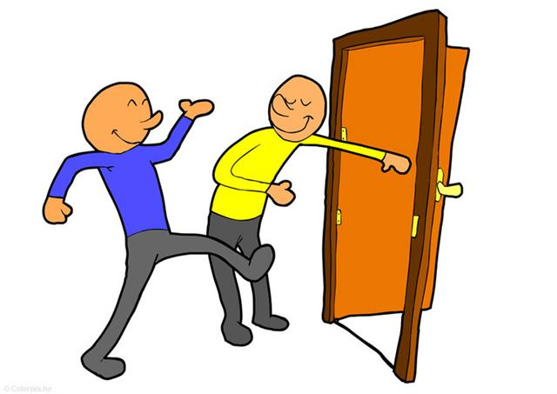
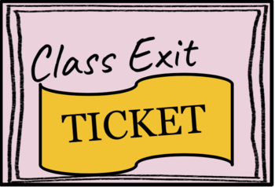
ISLAMIC EDUCATIONAL COLLEGE DATE: / 9/ 2024
SUBJECT: Vocabulary
GRADE: 10
UNIT: 1
Lesson: 1
OUTCOMES
EXIT TICKET:
Individually, write three sentences using any three of the listed collocations
02:00 minutes
WARM UP
PREASSESSMENT
PRESENTATION
FORMATIVE ASSESSMENT
FEEDBACK
DIFFERENTIATION
REAL LIFE APPLICATION
CRITICAL THINKING
EXIT TICKET
BUZZ IN

