Slide 1

OBJECTIVES
WARM UP
Unit: Two
Lesson: Used to / be used to
Subject: English
Grade: Nine
PREASSESSMENT
PRESENTATION
FORMATIVE ASSESSMENT
FEEDBACK
DIFFERENTIATION
REAL LIFE APPLICATION
CRITICAL THINKING
EXIT TICKET

Slide 2

ISLAMIC EDUCATIONAL COLLEGE DATE:
SUBJECT: English
GRADE:9
UNIT:2
LESSON:2
Objectives
01:00 minutes
Lesson Objectives:
Students should be able to:
2. To make question / negative sentences using used to
3. use used to in meaningful sentences

Slide 3

ISLAMIC EDUCATIONAL COLLEGE DATE:
SUBJECT: English
GRADE:9
UNIT:2
LESSON :2
WARM UP
03:00 minutes

Slide 4

ISLAMIC EDUCATIONAL COLLEGE DATE:
SUBJECT: English
GRADE:9
UNIT:2
LESSON:2
PREASSESSMENT
2:00 minutes
* Choose the correct sentence:
a) I used to go to the gym every day.
b) I use to go to the gym every day.
c) I used to going to the gym every day.
* Choose the correct sentence:
a) I didn’t used to work late hours.
b) I used to working late hours.
c) I didn’t use to work late hours.

Slide 5
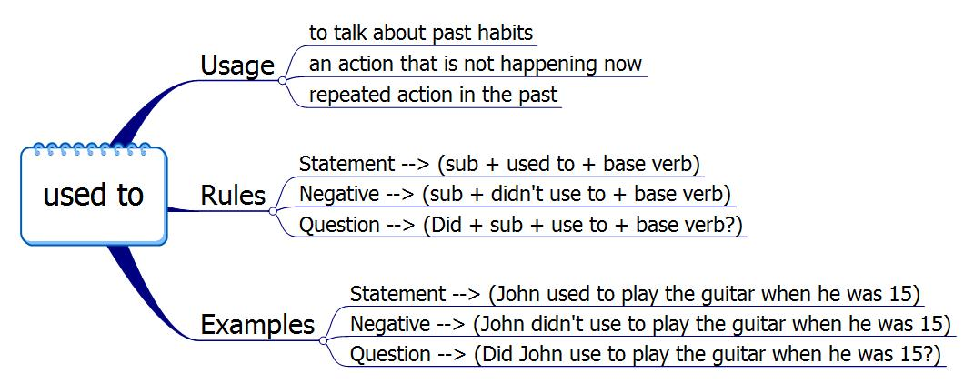
ISLAMIC EDUCATIONAL COLLEGE DATE:
SUBJECT: English
GRADE: 9
UNIT:2
LESSON:2
PRESENTATION
06:00 minutes
Used to is a verb we use to talk about something that happened in the past that doesn't happen anymore.

Slide 6
ISLAMIC EDUCATIONAL COLLEGE DATE:
SUBJECT: English
GRADE: 9
UNIT:2
LESSON:2
FORMATIVE ASSESSMENT:
04:00 minutes
Fill in the Blanks.
1- I ______________ (play) the piano, but I stopped a few years ago.
2- When I was younger, I __________ (not/eat) a lot of sweets.
3- When I was 8, I---------------------------(come) to school late, but now I DON’T. (COME)
4- ………………………YOU………………….(HELP) YOU PEERS IN CLASSES?

Slide 7
ISLAMIC EDUCATIONAL COLLEGE DATE:
SUBJECT: English
GRADE:9
UNIT:2
LESSON:2
ANSWERS
01:00 minutes
1- used to play.
2- didn’t use to eat.
3- used to COME.
4. Did/use to help

Slide 8
ISLAMIC EDUCATIONAL COLLEGE DATE:
SUBJECT: English
GRADE: 9
UNIT: 2
LESSON:2
FORMATIVE ASSESSMENT:
04:00 minutes
Rewrite the sentences using the correct form of "used to"
It was my habit to come to school with the bus, but now I have a car.
2. It was a routine to take speaking classes , but now we don’t.

Slide 9
ISLAMIC EDUCATIONAL COLLEGE DATE:
SUBJECT: English
GRADE:9
UNIT:2
LESSON:2
ANSWERS
01:00 minutes
1-We used to come to school with the bus.
2- We used to take English classes.

Slide 10
Feature | Action Verbs | State verbs
Definition | Describe an action being performed by the subject | Describe a state of being, condition, or quality.
Examples | * Run, jump, think, work | Believe, want, love, hate, own
Continuous Tense | Can be used in continuous tenses to show ongoing actions | Typically cannot be used in continuous tenses.
Examples | She is running. They are working | He believes the story." (Not: "*He is believing the story.") I own three cars." (Not: "*I am owning three cars."

Slide 11

Critical thinking
Is the verb smell stative or an action verb?
Give examples

Slide 12
Read each of the following and choose the correct answer.
1- Which sentence shows a past action?
used to visit my grandparents every summer.
She used to be very tall.
He used to own a pet snake.
They used to like pizza.
2- Which sentence shows a past state?
We used to play video games after school.
She used to feel nervous before exams.
He used to ride his bike to school.
I used to study French at school.

Slide 13
ISLAMIC EDUCATIONAL COLLEGE DATE:
SUBJECT: English
GRADE:9
UNIT:2
LESSON:3
DIFFERENTIATION
04:00 minutes
Write a short paragraph (4–5 sentences) comparing life in Edison’s time to today using “used to.”
Write 2 sentences talking about the things that you used to do in the past.

Slide 14
ISLAMIC EDUCATIONAL COLLEGE DATE:
SUBJECT: English
GRADE: 9
UNIT: 2
LESSON:2
FORMATIVE ASSESSMENT:
04:00 minutes
https://wayground.com/admin/quiz/5f6c5c26c131ba001c87ebfd/grade-7-used-to-didnt-use-to

Slide 15
ISLAMIC EDUCATIONAL COLLEGE DATE:
SUBJECT: English
GRADE:9
UNIT:2
LESSON:2
REAL LIFE APPLICATION
03:00 minutes
.
Think about what you used to do in elementary school or when you were younger." (Examples: hobbies, food, bedtime, technology use)
Partner A says a sentence using "used to" (e.g., “I used to go to bed at 8 PM.”), and Partner B listens and gives a quick correction or encouragement (“Nice!” or “Maybe say didn’t use to if it’s something you didn’t do.”).
Rally Coach

Slide 16
ISLAMIC EDUCATIONAL COLLEGE DATE:
SUBJECT: English
GRADE:9
UNIT:2
LESSON:2
CRITICAL THINKING
02:00 minutes
People used to write letters to stay in touch, but now we use instant messaging. Do you think instant communication has made relationships stronger or weaker? Why?
Rally Robin

Slide 17
ISLAMIC EDUCATIONAL COLLEGE DATE:
SUBJECT: English
GRADE :9
UNIT:2
LESSON:2
EXIT TICKET
03:00 minutes
*
Write three things you’ve learned today

