Slide 1

OBJECTIVES
WARM UP
Unit: Two
Lesson: 4
Subject: Reading: Providing Light in The darkness
Grade: Nine
PREASSESSMENT
PRESENTATION
FORMATIVE ASSESSMENT
FEEDBACK
DIFFERENTIATION
REAL LIFE APPLICATION
CRITICAL THINKING
EXIT TICKET

Slide 2

ISLAMIC EDUCATIONAL COLLEGE DATE:
SUBJECT: English
GRADE:9
UNIT:1
LESSON:2
Objectives
01:00 minutes
Lesson Objectives:
Students should be able to:
1. Read and Analyze an informational text
2. Identify key facts about Thomas Edison and his major inventions, particularly the incandescent light bulb.

Slide 3
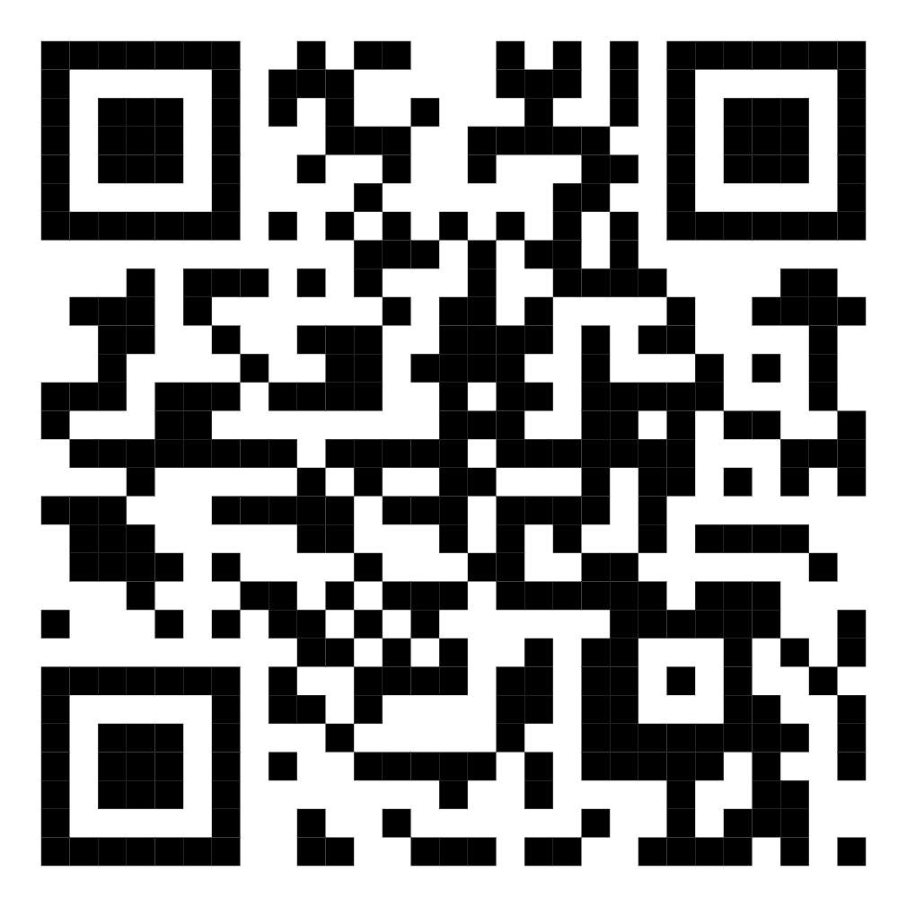
ISLAMIC EDUCATIONAL COLLEGE DATE: / / 2025
SUBJECT: Grammar
GRADE: 9
UNIT: 4
Lesson: 1
OUTCOMES
04:00 minutes
WARM UP
PREASSESSMENT
PRESENTATION
FORMATIVE ASSESSMENT
FEEDBACK
DIFFERENTIATION
REAL LIFE APPLICATION
CRITICAL THINKING
https://wayground.com/admin/quiz/68ad82c2458a9e3404810b34?source=live_dash_game_complete&gameType=live&players=0
EXIT TICKET

Slide 4

01:00 minutes
Warm-Up
Think of an invention you use every day (e.g., a smartphone, a computer, or a light bulb). How would your life be different if it didn’t exist?

Slide 5

ISLAMIC EDUCATIONAL COLLEGE DATE:
SUBJECT: English
GRADE:9
UNIT:1
LESSON:2
PREASSESSMENT
3:00 minutes
What was the main purpose of the telegraph when it was first invented?
A) To send written messages quickly over long distances B) To transmit electricity to homes C) To play music remotely

Slide 6
Which type of language is most commonly used in informational texts?
A) Figurative and imaginative language B) Literal and precise language C) Poetic and rhyming language

Slide 7
Read ,answer
1. An expression that is used when suddenly you have an idea is ?
2. What does the light bulb symbolize ?
3. How did people light their homes in the past?
4. Scientists and inventors always wanted to create a light bulb that was powered by heat not fire. Explain

Slide 8
Read ,answer
1. An expression that is used when suddenly you have an idea is ? a light bulb turned on
2. What does the light bulb symbolize ?It symbolizes ingenuity
3. How did people light their homes in the past? At that time, people lit their homes at night with only candles, torches, and gas lamps.
4. Scientists and inventors always wanted to create a light bulb that was powered by heat not fire. Explain
Using fire to create light could be quite dangerous.

Slide 9

You may have said it yourself when you have a great idea—“a light bulb turned on.” But have you ever wondered where the expression came from? To trace the origin of the light bulb as a symbol of ingenuity, you’d have to travel back in time to the late 1880s. At that time, people lit their homes at night with only candles, torches, and gas lamps. Using fire to create light could be quite dangerous. For 50 years, scientists and inventors had been trying to create a light bulb that was powered by heat, and not fire.
Ingenuity: The quality of being clever, original, and inventive . It refers to the ability to solve difficult problems in creative or unusual ways

Slide 10
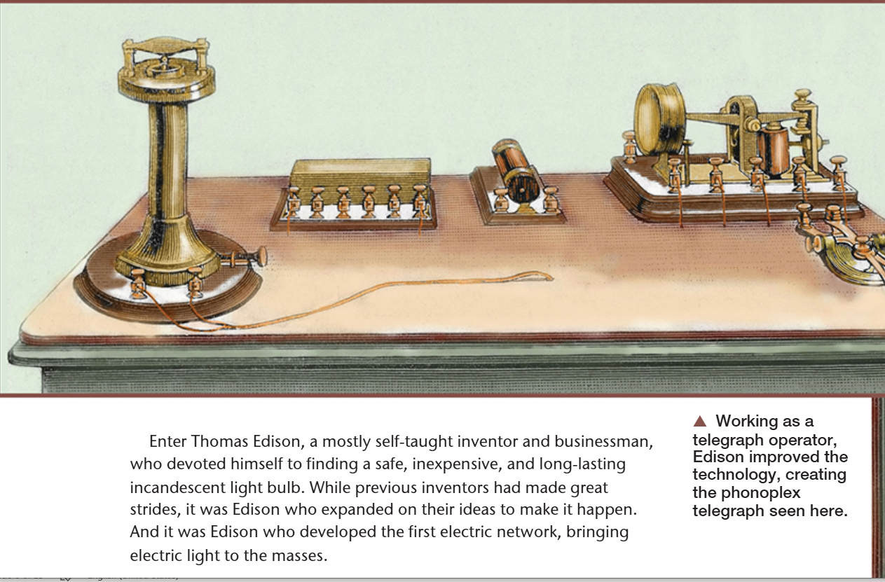

Slide 11
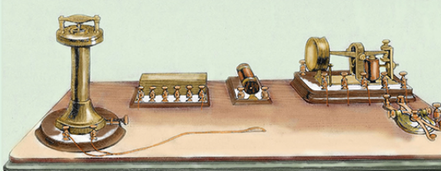

ISLAMIC EDUCATIONAL COLLEGE DATE:
SUBJECT: English
GRADE: 9
UNIT:1
LESSON:2
PRESENTATION
Telegraph
03:00 minutes
What is a telegraph ?
When was it invented ?
1:30

Slide 12

ISLAMIC EDUCATIONAL COLLEGE DATE:
SUBJECT: English
GRADE: 9
UNIT:1
LESSON:2
10 m
PRESENTATION
DIFFERENTIATION
1- When and where was Edison born ? Student 1
2- Describe Thomas Edison . Student 4
3- What was his first profession ? At what age ? Where ?
Student 2 4. What do Edison’s early actions—like publishing a newspaper on a moving train—reveal about his personality and future potential as an inventor? Explain your reasoning. Student 3

Slide 13
ISLAMIC EDUCATIONAL COLLEGE DATE:
SUBJECT: English
GRADE: 9
UNIT:1
LESSON:2
FORMATIVE ASSESSMENT:
04:00 minutes
1. Where did Edison set up his small laboratory? 2. What caused Edison to be banned from selling newspapers on the train? 3. What was Edison’s first patented invention?
4. Why did Congress choose not to use Edison’s vote recorder?
5.How did Edison’s curiosity and willingness to take risks both help and hurt him in this part of his life?
6.Why do you think people sometimes resist using new inventions, even when they can improve processes?

Slide 14
ISLAMIC EDUCATIONAL COLLEGE DATE:
SUBJECT: English
GRADE:9
UNIT:1
LESSON:2
ANSWERS
01:00 minutes
1. In a baggage car on the train.
2. He accidentally started a fire while experimenting with chemicals.
3. An electrical vote recorder for members of Congress.
4. They did not want to change the way they had always voted.

Slide 15
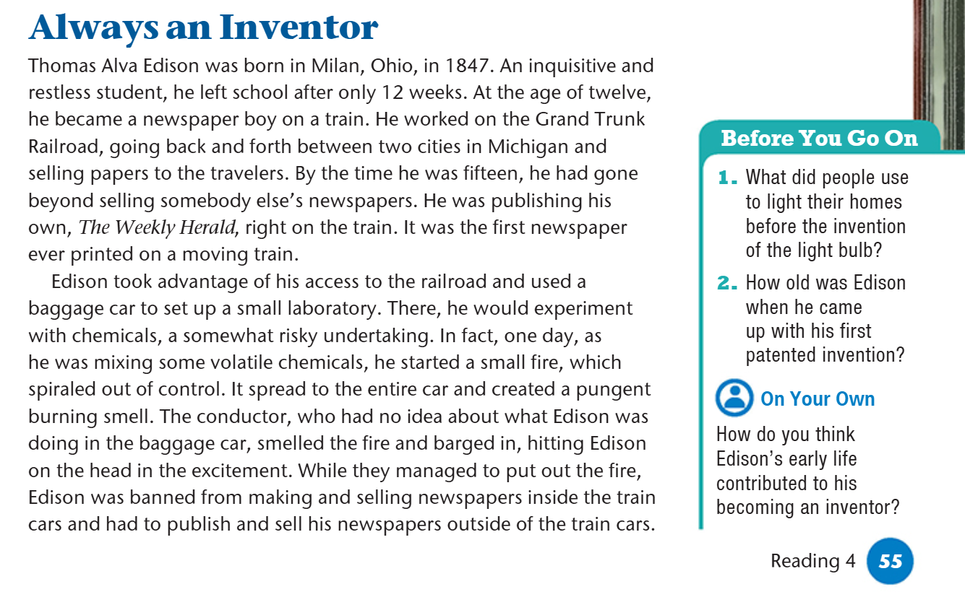
ISLAMIC EDUCATIONAL COLLEGE DATE:
SUBJECT: English
GRADE: 9
UNIT:1
LESSON:2
PRESENTATION
08:00 minutes
Inquisitive: curious
Restless: hard-working
took advantage ( make use of)
pungent( strong )
conductor( manager) ,
banned( stopped)

Slide 16
ISLAMIC EDUCATIONAL COLLEGE DATE:
SUBJECT: English
GRADE:9
UNIT:1
LESSON:2
ANSWERS
01:00 minutes
was born in Milan, Ohio, in 1847
Curious , hardworking
At the age of twelve, he became a newspaper boy on a train. He worked on the Grand Trunk Railroad

Slide 17

REAL LIFE APPLICATION
Edison worked hard from a young age. What is something you have worked hard on ?

Slide 18
Student 1:
At what age did Edison become a telegraph operator?
Student 4 2. What was Edison’s first patented invention, and what was its purpose?
Student 2 3. Why do you think Edison’s electrical vote recorder was not used by Congress, even though it could have sped up the voting process?
Student 3– Critical Thinking (higher-order thinking): 4. How do Edison’s early experiences as a telegraph operator help explain his later success as an inventor?
DIFFERENTIATION

Slide 19
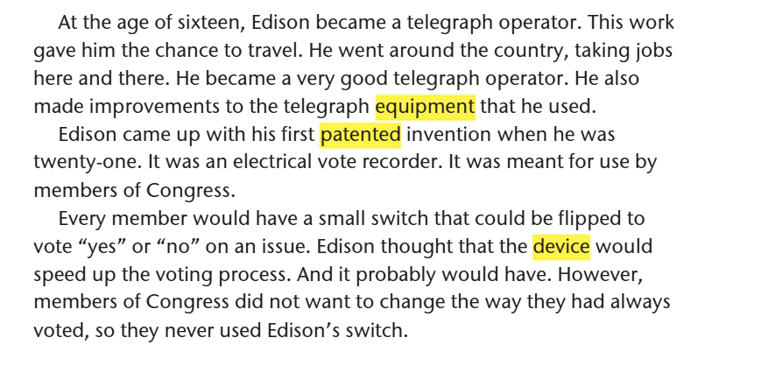
ISLAMIC EDUCATIONAL COLLEGE DATE:
SUBJECT: English
GRADE: 9
UNIT:1
LESSON:2
10m
PRESENTATION

Slide 20
Edison became a telegraph operator at the age of sixteen.
2. Edison’s first patented invention was an electrical vote recorder, meant for members of Congress to vote “yes” or “no” more quickly.
3. Edison’s device was not used because members of Congress did not want to change the way they had always voted, even though it could have made the process faster.
Critical Thinking: 4. Edison’s early experiences as a telegraph operator helped him travel, gain practical skills, understand technology, and improve equipment, which contributed to his later success as an inventor.

Slide 21
CRITICAL THINKING
Do you think Edison's inventions would have been possible without his early experiences as a telegraph operator? Why or why not?

Slide 22
What was Edison's second invention? Was it successful?
Who did his invention help and how?
What did he make improvement to?
Mention another invention ?
After sound ,what did he focus on inventing ? What was his goal and how did he plan to achieve it?
Were investors willing to back him up why?

Slide 23
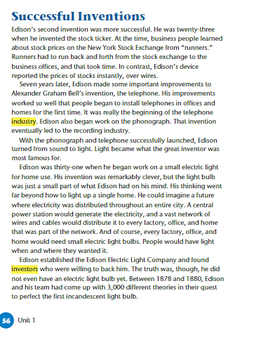
ISLAMIC EDUCATIONAL COLLEGE DATE:
SUBJECT: English
GRADE: 9
UNIT:1
LESSON:2
10m
PRESENTATION

Slide 24
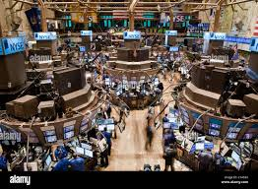


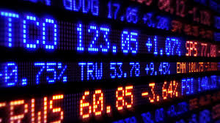
ISLAMIC EDUCATIONAL COLLEGE DATE:
SUBJECT: English
GRADE: 9
UNIT:1
LESSON:2
10m
PRESENTATION
Stock Exchange
Investors

Slide 25
ISLAMIC EDUCATIONAL COLLEGE DATE:
SUBJECT: English
GRADE: 9
UNIT:1
LESSON:2
FORMATIVE ASSESSMENT:
04:00 minutes
Problem : obtaining real-time stock prices from the New York Stock Exchange was a slow and inefficient process. "Runners" were tasked with physically carrying the latest prices from the exchange floor to brokers and investors. This often led to delays and inaccuracies.
Work with your partner and try to think of a solution to deliver the information from the stock exchange to the investors directly to save time.

Slide 26
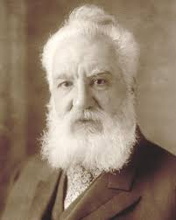
ISLAMIC EDUCATIONAL COLLEGE DATE:
SUBJECT: English
GRADE: 9
UNIT:1
LESSON:2
FORMATIVE ASSESSMENT:
04:00 minutes
Alexander Graham Bell
What is Edison’s contribution to Alexander Graham Bell’s invention?

Slide 27
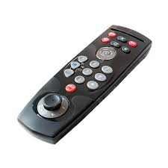
ISLAMIC EDUCATIONAL COLLEGE DATE:
SUBJECT: English
GRADE:9
UNIT:1
LESSON:2
PREASSESSMENT
3:00 minutes
Which invention was more successful?
A) Stock ticker B) Electrical vote recorder

Slide 28
ISLAMIC EDUCATIONAL COLLEGE DATE:
SUBJECT: English
GRADE:9
UNIT:1
LESSON:2
PREASSESSMENT
3:00 minutes
The kinetophone combines?
A) Light and sound B) Film and sound

Slide 29
REAL LIFE APPLICATION
Edison worked hard from a young age. What is something you have worked hard on ?

Slide 30
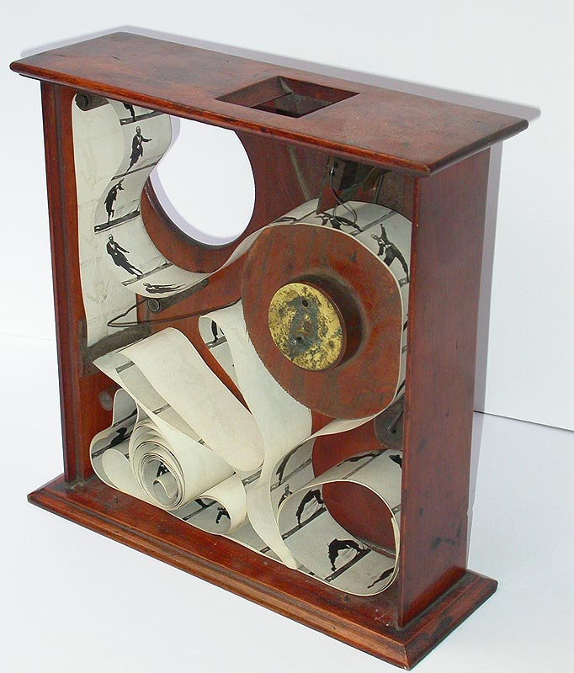
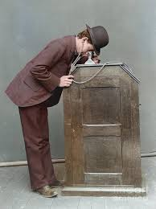

Slide 31
ISLAMIC EDUCATIONAL COLLEGE DATE:
SUBJECT: English
GRADE:9
UNIT:2
LESSON:3
DIFFERENTIATION
05:00 minutes
Differentiation
Students 1 and 3
Students 1 and 3
Write a timeline showing the major inventions Edison worked on, in the correct order.
Include at least 4 key inventions from the passage.
For each invention, write 1–2 sentences explaining:
What the invention did
How it changed life for people at the time
Match each invention to its use:
Stock Ticker → 📈
Telephone → 📞
Phonograph → 🎵
Light Bulb → 💡
Draw a picture of your favorite invention from the list.
Group work should be done quietly.

Slide 32
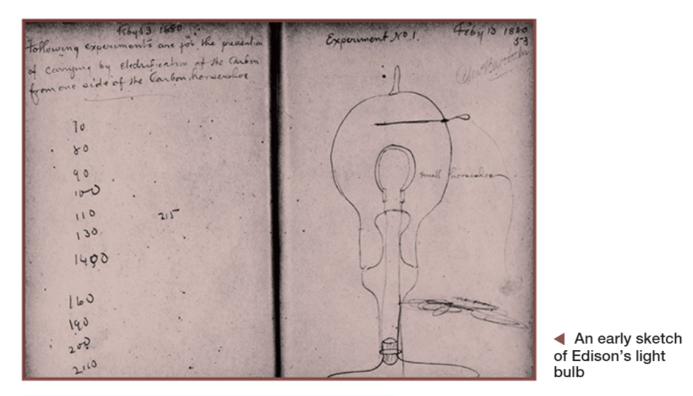

Slide 33
ISLAMIC EDUCATIONAL COLLEGE DATE:
SUBJECT: English
GRADE: 9
UNIT:1
LESSON:2
Differentiation
04:00 minutes
1. Student 2
What did Edison do before he had actually finished inventing the electric light? Student 4
2. What was the most difficult part of inventing the electric light bulb?
Student 1
3. What material did Edison and his team finally use for the element inside the bulb?
Student 3 critical thinking
4. Why do you think Edison made the announcement about his invention before it was finished? Was it a smart move? Why or why not?

Slide 34
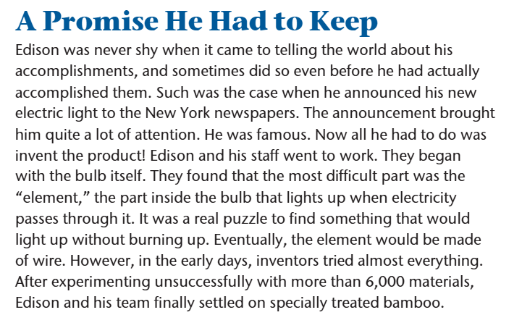

Slide 35
ISLAMIC EDUCATIONAL COLLEGE DATE:
SUBJECT: English
GRADE:9
UNIT:1
LESSON:2
ANSWERS
01:00 minutes
He announced it to the New York newspapers and told the public it was ready before it actually was
Finding the right element (the part that lights up) that would glow without burning out.
Made of Wire

Slide 36
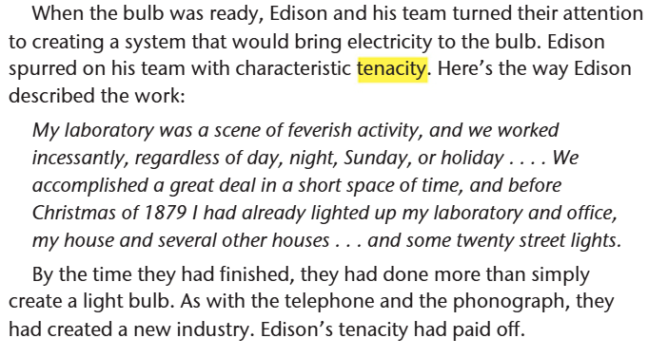
Spurred on → pushed or encouraged someone to take action.
Characteristic → something typical of him.
Tenacity → determination; not giving up easily.
Feverish : doing something with intense energy, activity, or emotion.
“incessantly” means continuously, without stopping, or constantly.

Slide 37
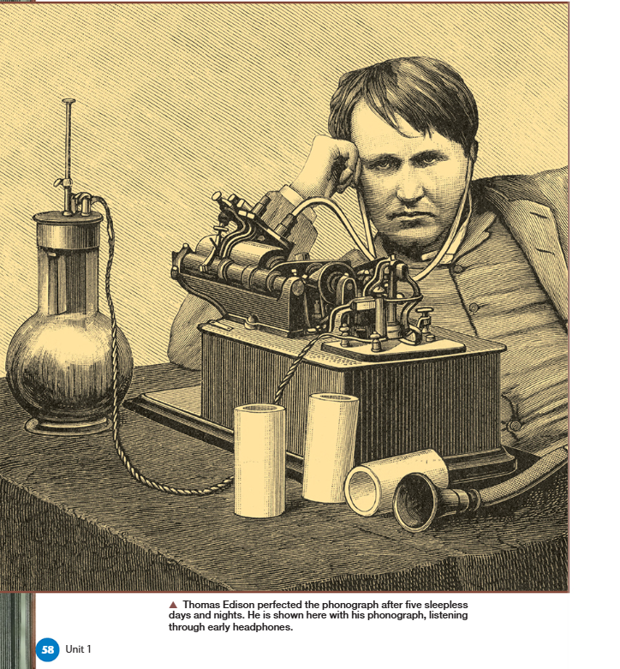

Slide 38
Kinetoscope
an object containing a very small hole through which a person watched a film in the early days of film

Slide 39
Student 1
How many patents did Edison secure by the end of his life?
Student 4
What is a kinetophone?
Student 2
Why was the kinetophone abandoned in 1915?
Student 3
What does Edison’s quote about finding 10,000 ways that didn’t work tell us about his approach to invention?

Slide 40
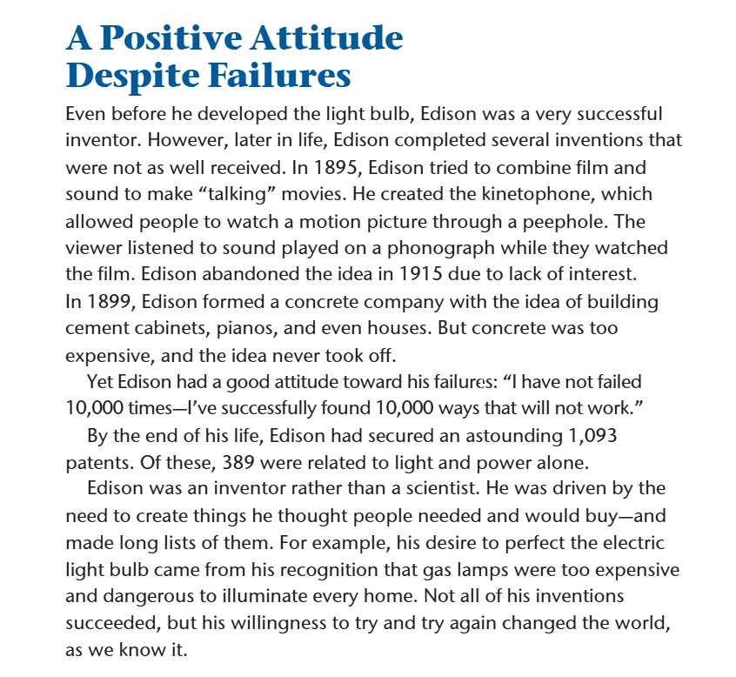

Slide 41
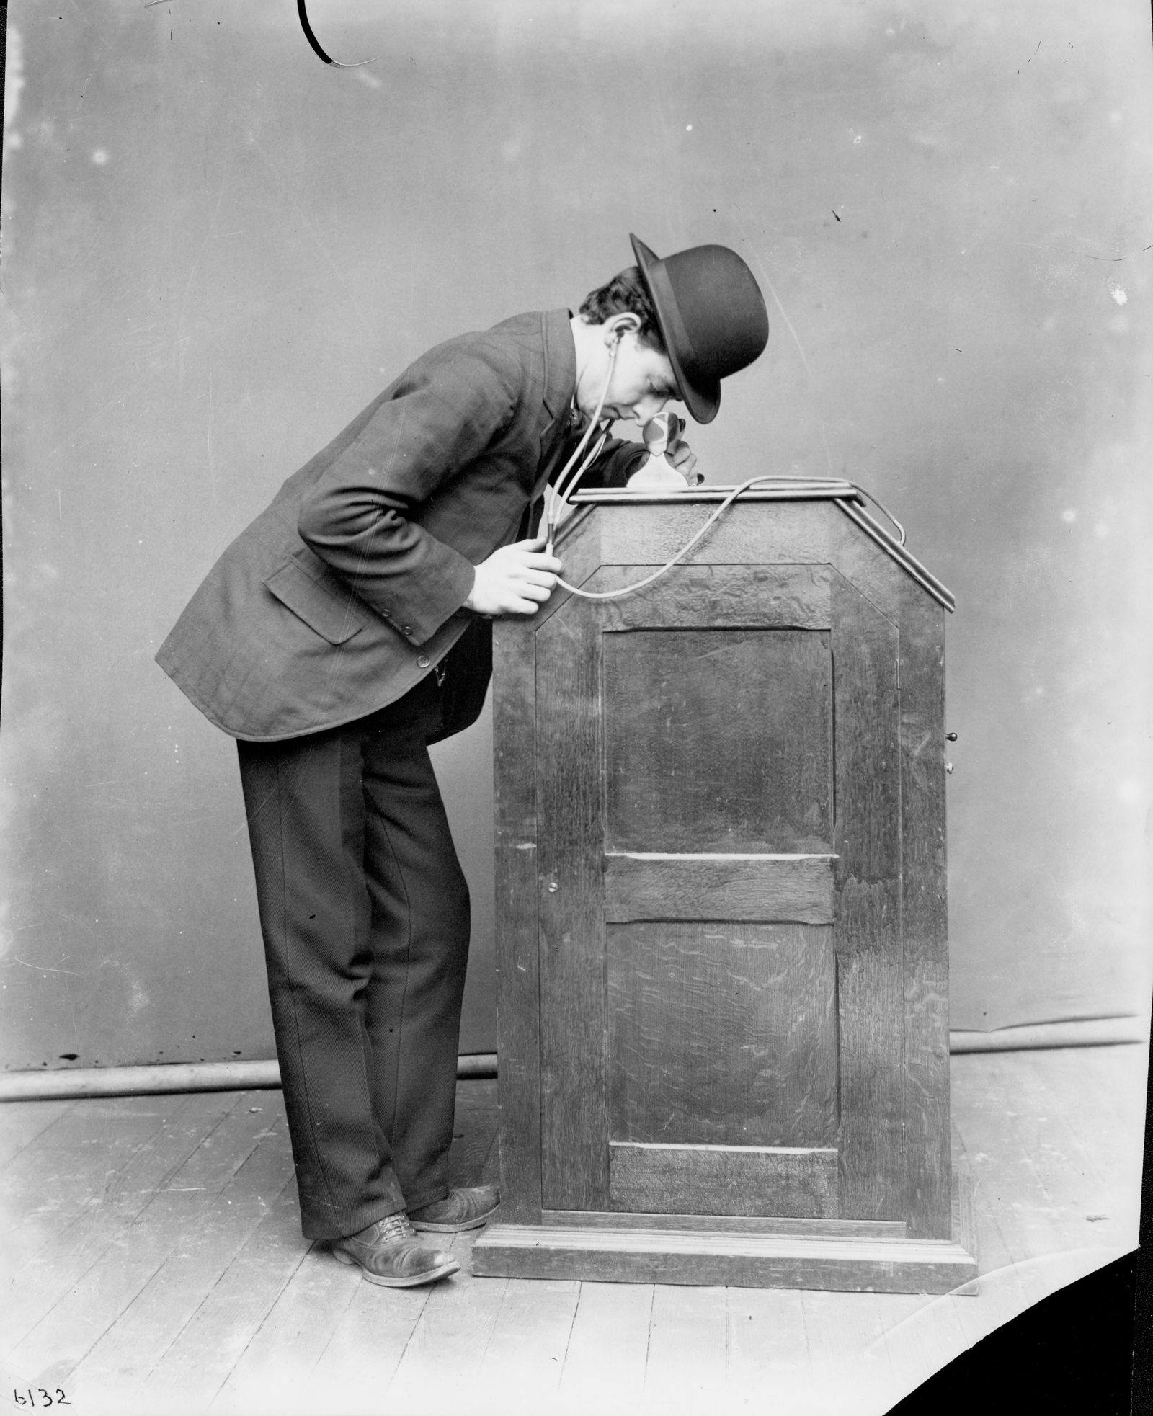
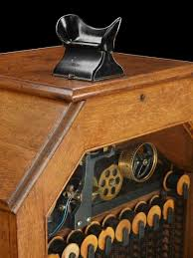

Slide 42
ISLAMIC EDUCATIONAL COLLEGE DATE:
SUBJECT: English
GRADE:9
UNIT:1
LESSON:2
REAL LIFE APPLICATION
02:00 minutes
.
What lessons can modern inventors learn from Edison’s approach to invention, particularly his willingness to experiment and face setbacks?

Slide 43
ISLAMIC EDUCATIONAL COLLEGE DATE:
SUBJECT: English
GRADE :9
UNIT:1
LESSON:2
EXIT TICKET
03:00 minutes
Write 3 things you’ve learned today.

Slide 44
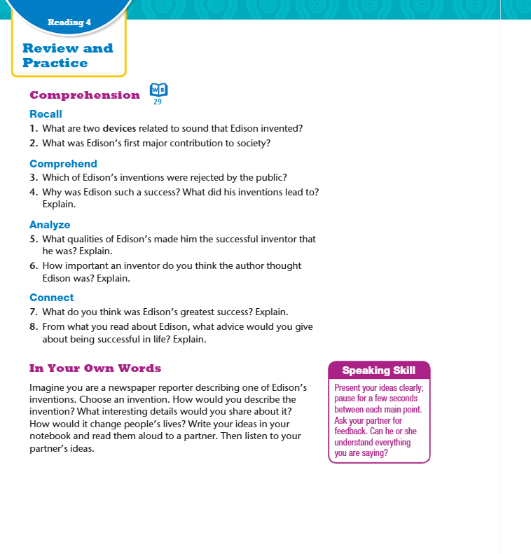

ANSWERS
Two devices that Edison invented are the phonograph and the kinetoscope.
2. Edison's first major contribution was the stock ticker.
3. The electrical vote recorder and the kinetophone were rejected by the public.
4. Edison was such a success because he thought about what people needed and never gave up. His invention of the light bulb led to people having lights in their homes.

Slide 45
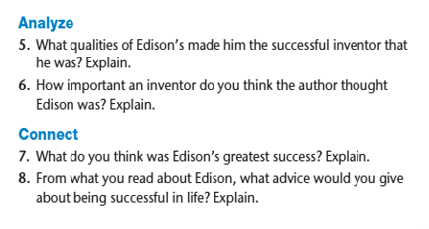
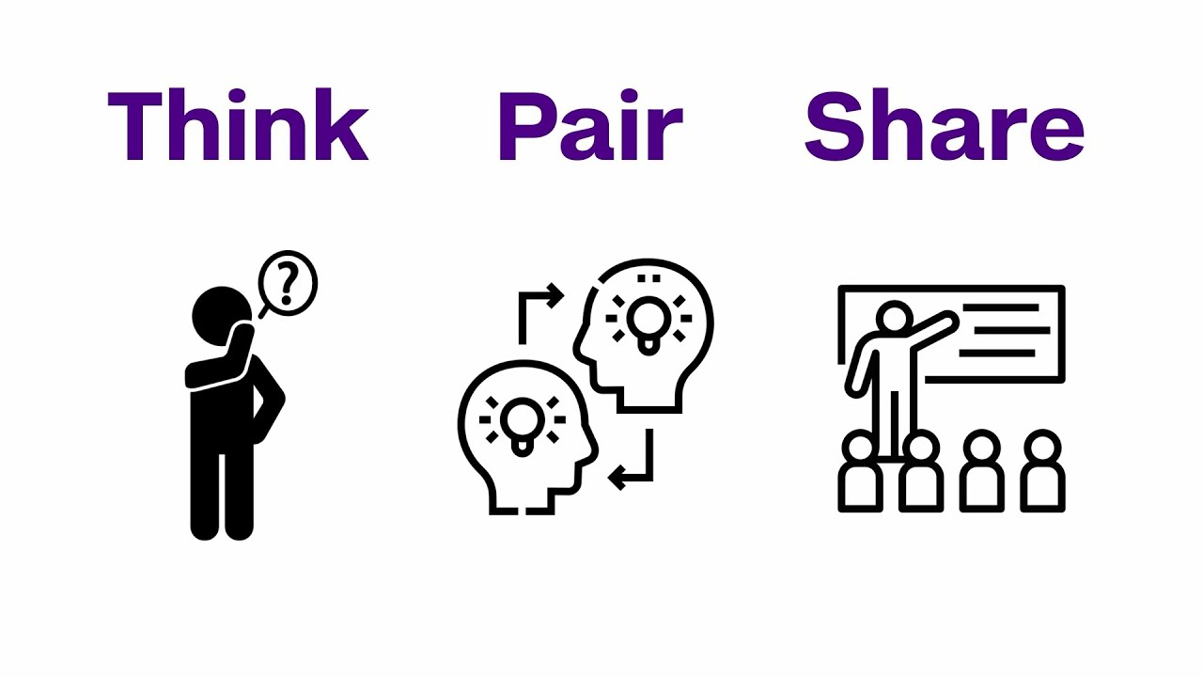
5. Edison was persistent—he never gave up. He was also brave and passionate, pursuing his inventions despite rejection.
6. The author thinks that Edison was a very important inventor because he brought electric light to our everyday lives, which changed the world.
7. Answers will vary.
8. Answers will vary.

Slide 46
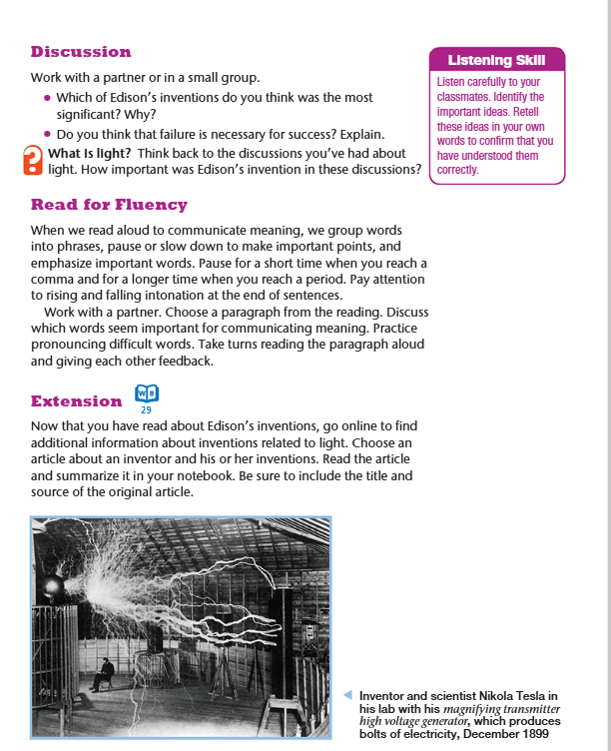


Slide 47
ISLAMIC EDUCATIONAL COLLEGE DATE:
SUBJECT: English
GRADE:9
UNIT:1
LESSON:2
REAL LIFE APPLICATION
02:00 minutes
.
What lessons can modern inventors and entrepreneurs learn from Edison’s approach to invention, particularly his willingness to experiment and face setbacks?

Slide 48
ISLAMIC EDUCATIONAL COLLEGE DATE:
SUBJECT: English
GRADE:9
UNIT:1
LESSON:2
CRITICAL THINKING
02:00 minutes
Edison invented or improved many things—like the stock ticker, telephone, phonograph, and light bulb.
Which invention do you think made the biggest difference in people’s lives at the time? Why?
Kagan-Style Structure: Think-Pair-Share
Think (1 minute):
Students silently choose one invention and write 1 reason why they think it was the most important.
Pair (1 minute):
Turn to a partner. Partner A shares their idea first (30 seconds), then Partner B shares (30 seconds).
Share (1 minute):
Invite 2–3 students to share their or their partner’s answer with the class.

