Slide 1
Doctors Without Borders pp.90-95
5th grade

Slide 2

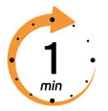
Warm up
She sells seashells by the seashore.
Pair work
Buzz in
2 min.

Slide 3
Warm up
I scream, you scream, we all scream
for ice cream.
Pair work
Buzz in
2 min.

Slide 4
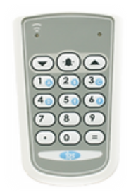
IRS
Pre-assessment
It is nonfiction writing, written with the intention of informing
the reader about a specific topic
1. folktale
2. Informational text
3. fable

Slide 5
IRS
Pre-assessment
It is nonfiction writing, written with the intention of informing
the reader about a specific topic
1. folktale
2. Informational text
3. fable

Slide 6
One of the following is a feature of the informational text.
Pre-assessment
It tells a story
It has characters and setting
It gives us facts.
It has a moral

Slide 7
Pre-assessment
One of the following is a feature of the informational text.
It tells a story
It has characters and setting
It gives us facts.
It has a moral

Slide 8
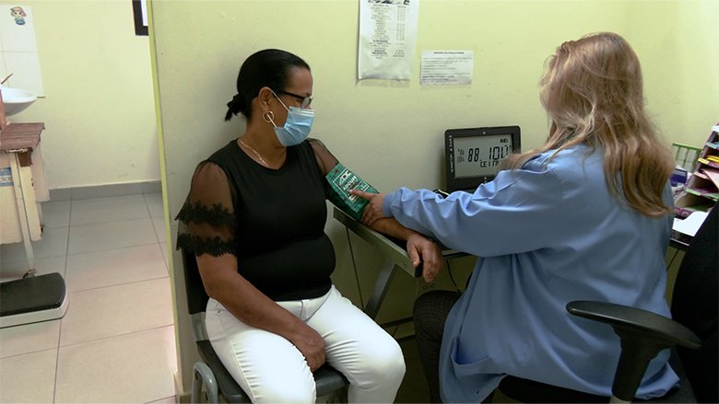
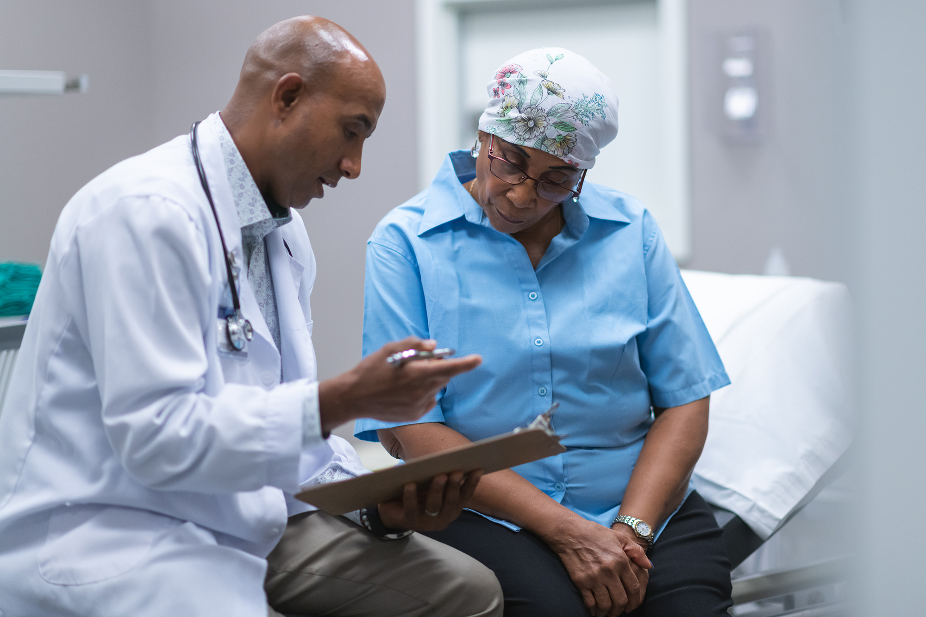
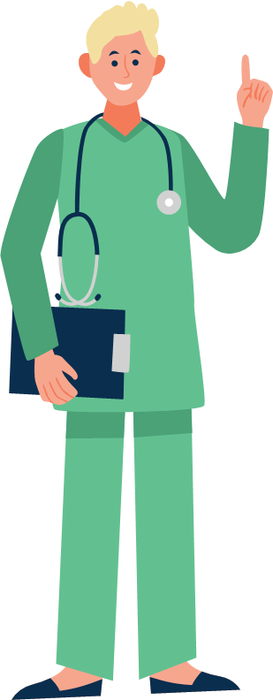
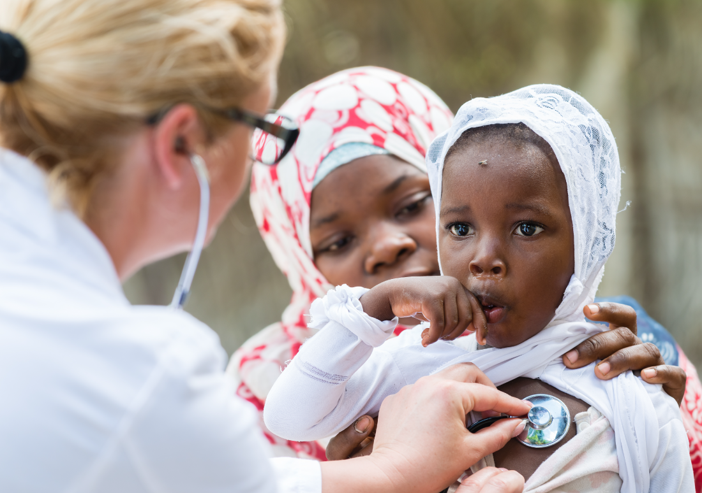
Where do we go when
we are sick or hurt?

Slide 9
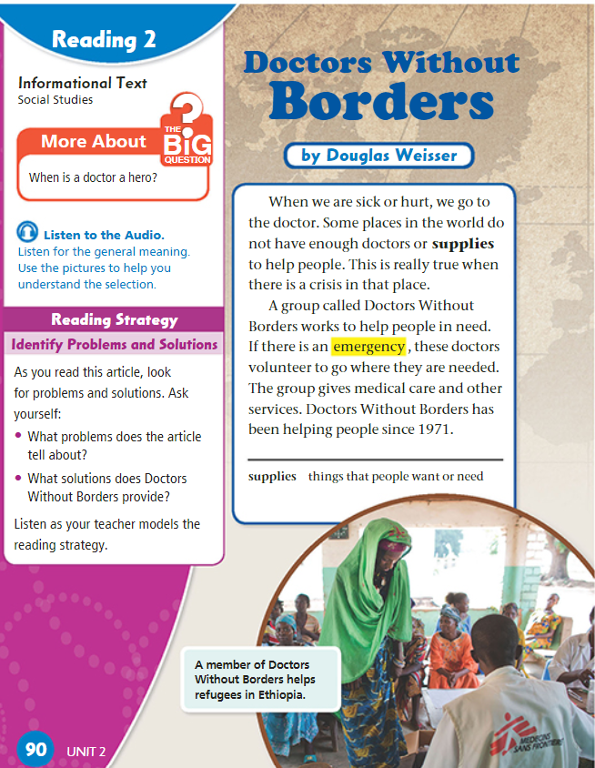

Quiz-Quiz-Trade (Kagan) to ask:
“Is this a folktale, fable, or informational text?”
Students quiz partners and discuss answers.

Slide 10
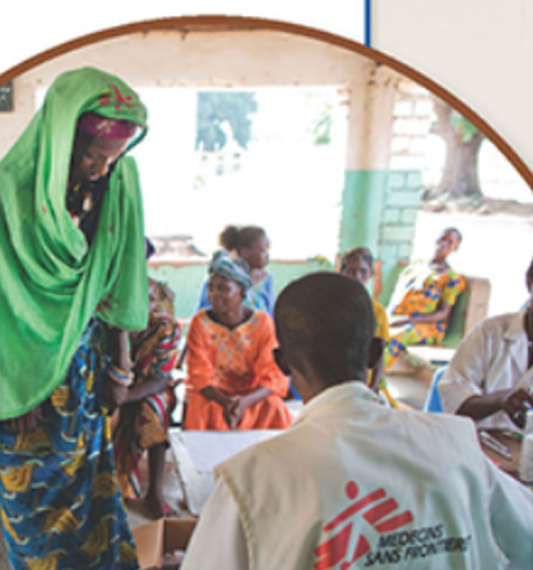

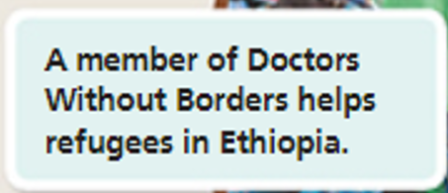
p.90
“Who are refugees?

Slide 11


Discussion Questions on p.90
Where do we usually go when we are sick or hurt?
What problem do some places in the world face?
When is the need for doctors and supplies important?
What is the name of the group that helps people in need?
What do the doctors from Doctors Without Borders do in an emergency?
When did Doctors Without Borders start helping people?
What does the word ‘supplies’ mean?
Use it in a sentence of your own.

Slide 12
Feedback
Where do we usually go when we are sick or hurt?
What problem do some places in the world face?
When is the need for doctors and supplies important?
What is the name of the group that helps people in need?
What do the doctors from Doctors Without Borders do in an emergency?
When did Doctors Without Borders start helping people?
What does the word ‘supplies’ mean?
Use it in a sentence of your own.
Doctors need medical supplies such as bandages and gloves.

Slide 13
p.90
Think-Pair-Share.
Critical Thinking : “Why do you think doctors volunteer to help people in other countries?”

Slide 14
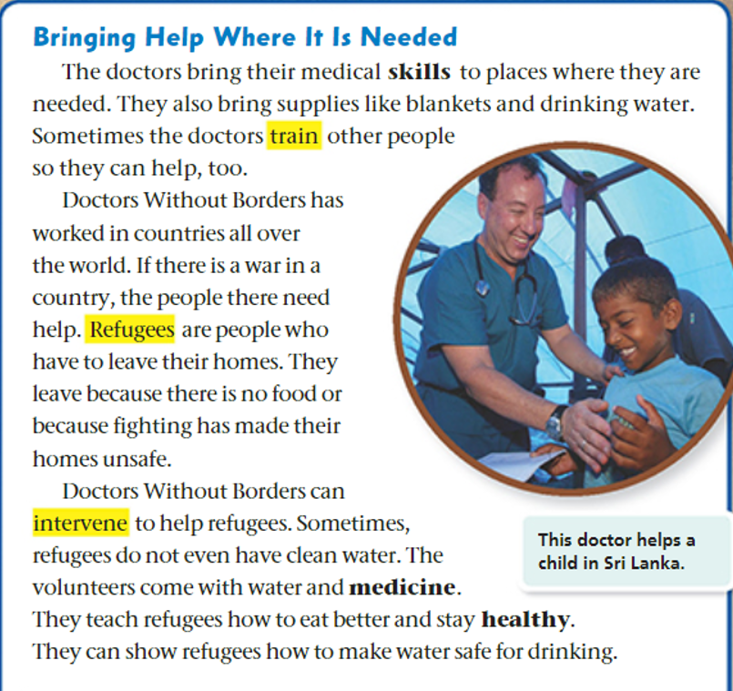
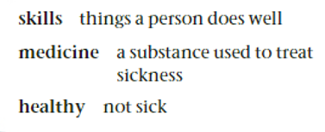

p.91

Slide 15
Discussion Questions on p.91
Circle the heading of the text. How does the heading
help you understand what the text is about?
2. What do the doctors bring to places where help is needed?
3. Who do the doctors sometimes train to help with their work?
4. Who are refugees?
5. Why do refugees have to leave their homes?
6. How does Doctors Without Borders help refugees?
7. What do the doctors teach refugees?
8. Highlight the caption. How does it help you understand what’s happening in the picture?

Slide 16
Feedback
heading
Circle the heading of the text. How does the heading
help you understand what the text is about?
2. What do the doctors bring to places where help is needed?
3. Who do the doctors sometimes train to help with their work?
4. Who are refugees?
5. Why do refugees have to leave their homes?
6. How does Doctors Without Borders help refugees?
7. What do the doctors teach refugees?
8. Highlight the caption. How does it help you understand what’s happening in the picture?
caption

Slide 17
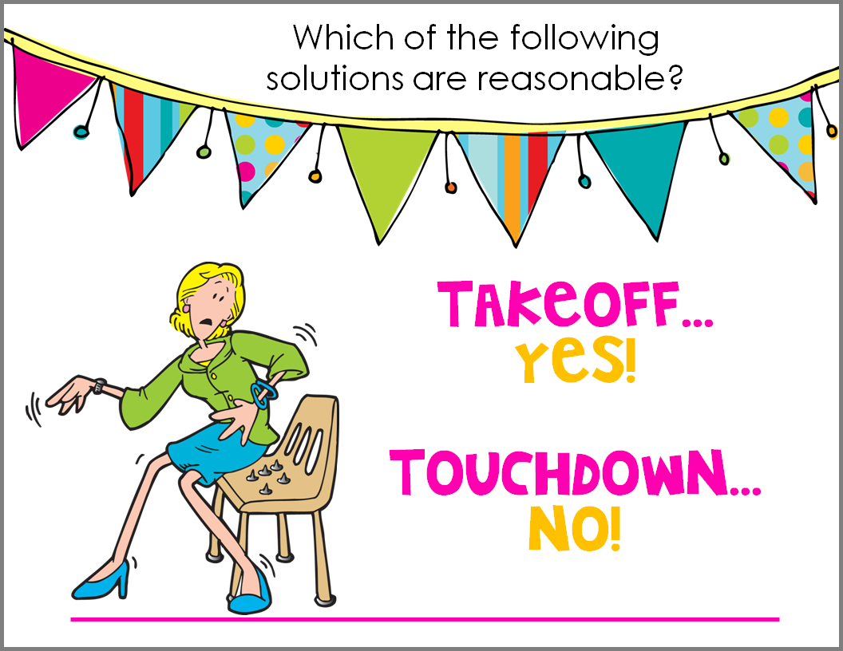
Blankets and drinking water are examples for supplies.
2. Doctors train only other doctors but not other people.
3. Doctors Without Boarders teach refugees how to eat healthy.

Slide 18
p.91
What do the circled pronouns refer to?

Slide 19
Differentiation
Students
3-Summerize problems.
2- Explain Who are doctors without boarders.
Students
4. Write two facts were mentioned in this page.
1- What is the genre? Mention one element.
Random pick
1 min.

Slide 20
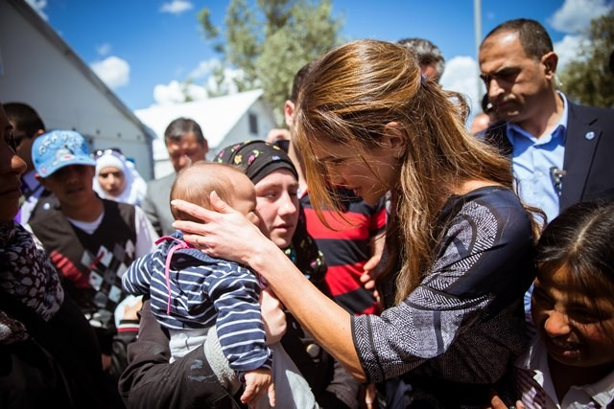
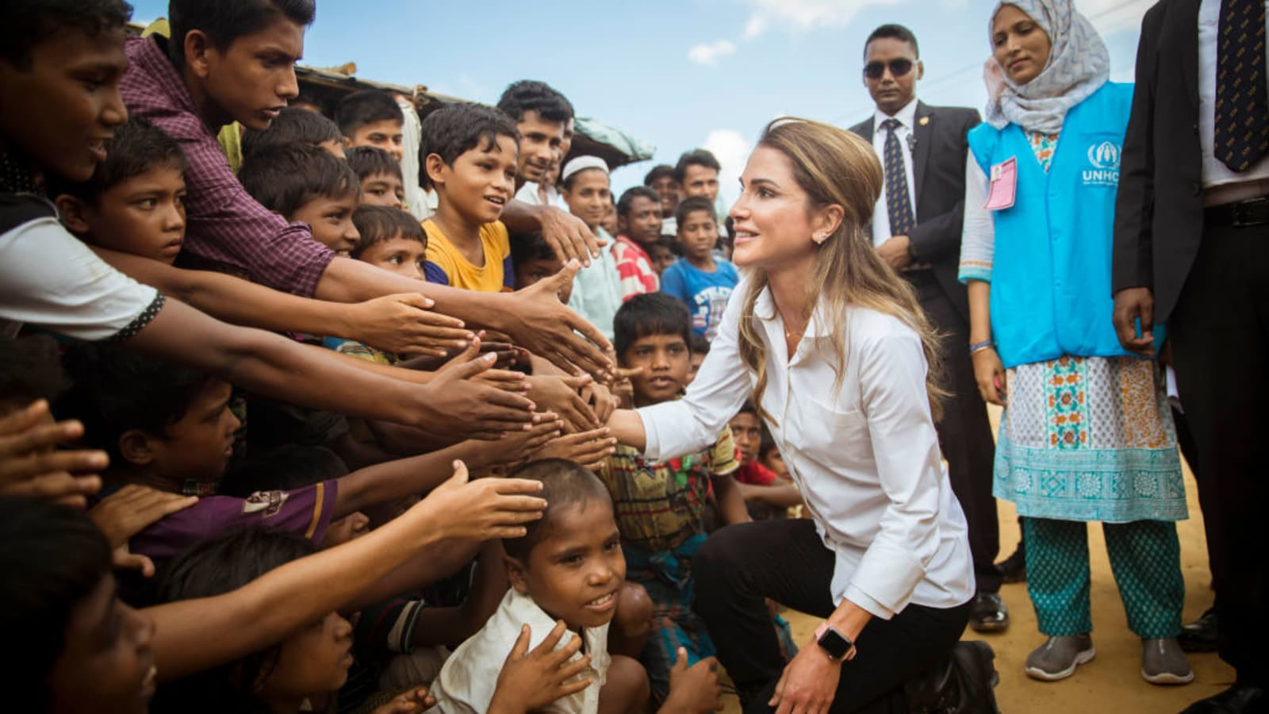



Linking to Life
Critical Thinking:
Talk about the pictures using the new vocabularies?

Slide 21
p.91
What do the circled pronouns refer to?

Slide 22
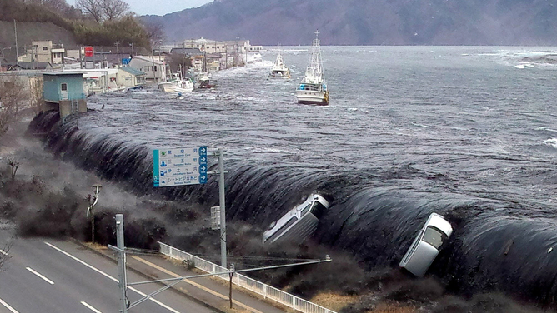
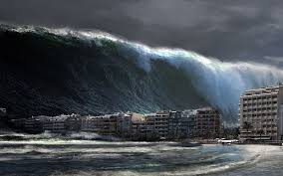

What is a Tsunami?

Slide 23
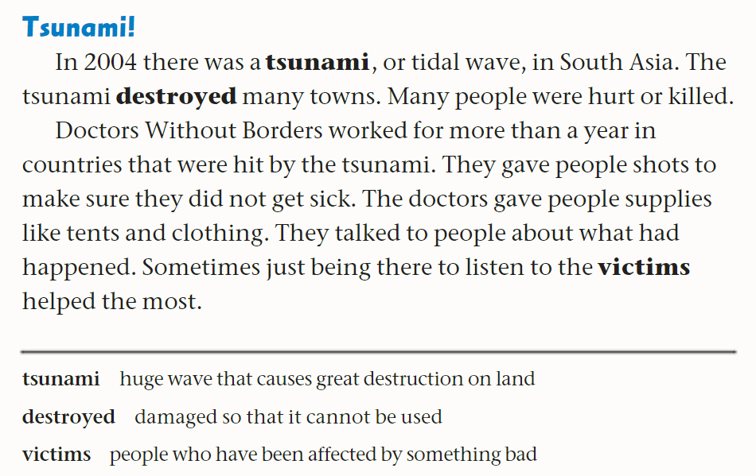


p.92

Slide 24
p.92
when
where
1
2
What did the tsunami do?
1
How did Doctors Without Borders help?
2
3

Slide 25
Differentiation
Students
3-Summerize problems.
2- Explain Who are doctors without boarders.
Students
4. Write two facts were mentioned in this page.
1- What is the genre? Mention one element.
Random pick
1 min.

Slide 26
Linking to Life
Critical Thinking:
Talk about the pictures using the new vocabularies?

Slide 27
Read how Doctors Without Borders helped people in South Asia after the tsunami in 2004. The, complete the chart.
Problem | Solution
People could get sick easily.
 | The doctors gave people tents and other supplies.
People were upset.

Slide 28
Read how Doctors Without Borders helped people in South Asia after the tsunami in 2004. The, complete the chart.
Problem | Solution
People could get sick easily. | The doctors gave people shots.
People lost their homes and didn’t have sufficient supplies. | The doctors gave people tents and other supplies.
People were upset. | The doctors talked to the victims and listened to them.

Slide 29
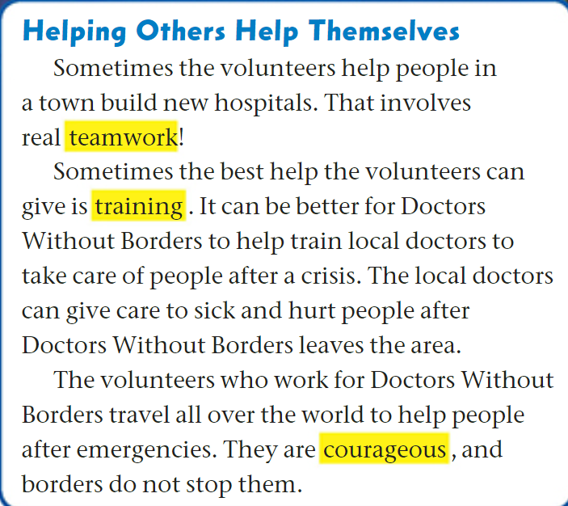


p.93

Slide 30
Discussion Questions on p.93
What do volunteers help build in towns?
How do volunteers help local people?
Why is training helpful for local doctors?
Find a word that means “major problem”.
What do local doctors do after volunteers leave?
Where do volunteers go to help people?
What quality do the volunteers have?
Do borders stop Doctors Without Borders volunteers from helping others?

Slide 31
Feedback
What do volunteers help build in towns?
How do volunteers help local people?
Why is training helpful for local doctors?
Find a word that means “major problem”.
What do local doctors do after volunteers leave?
Where do volunteers go to help people?
What quality do the volunteers have?
Do borders stop Doctors Without Borders volunteers from helping others?
crisis

Slide 32
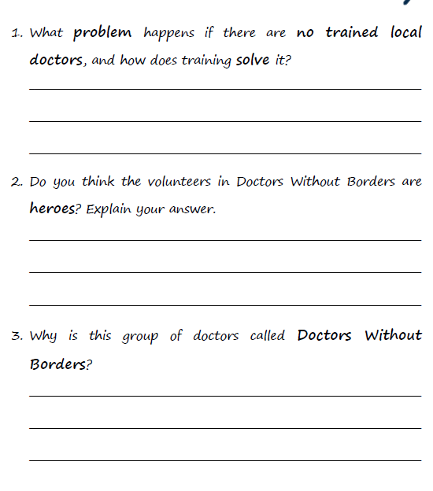
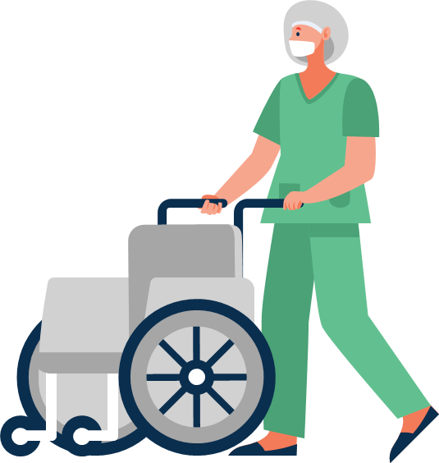
Comprehension Questions p.93

Slide 33
Feedback
Without trained doctors, sick and hurt people will not get help after volunteers leave. Training solves this by teaching local doctors to take care of them.
Yes, I think the volunteers are heroes because they are courageous, they help people in need, and they save lives.
The doctors travel anywhere in the world to help people, and borders do not stop them.

Slide 34
Summative Assessment
How can Doctors Without Borders help refugees?
1. By giving them rides
By teaching them music
By providing medical care, food, and support
1 min.

Slide 35
Summative Assessment
How can Doctors Without Borders help refugees?
1. By giving them rides
By teaching them music
By providing medical care, food, and support
1 min.

Slide 36
Summative Assessment
What do doctors bring to places in need?
1. Toys and games
2. Medical supplies and care
3. Food for animals
Mini Board
1 min.

Slide 37
Summative Assessment
What do doctors bring to places in need?
1. Toys and games
2. Medical supplies and care
3. Food for animals
Mini Board
1 min.

Slide 38
Summative Assessment
The pronoun “they” in line 18 refers to:
Doctors Without Borders
2. Refugees
3. Schools
Mini Board
1 min.

Slide 39
Summative Assessment
The pronoun “they” in line 18 refers to:
Doctors Without Borders
2. Refugees
3. Schools
Mini Board
1 min.

Slide 40


Closure

