Slide 2

Students understand how to use the simple present for facts, routines, habits, and general truths.
Students recognize subject-verb agreement in simple present sentences.

Slide 3
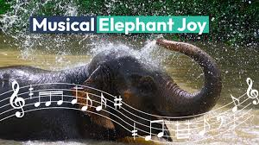
Warm up
The elephants are having a dance party in the river. What is your reaction?

Slide 4

Can you match the correct form of the irregular verb ‘to be’ to each pronoun?
am
are
I _____
You _____
He / She / It _____
We _____
You _____
They _____
are
am
is
are
are
are
are
are
are
is
What do you notice about the verb forms?

Slide 5


Simple Present Tense
We use the simple present tense when we are writing about something that is repeated, is always true or is happening in a future time.
Eva wakes up at half past seven every morning.
Repeated
I ride my bike every weekend.
I walk to school.
Always or generally true
The sun sets in the west.
They live in a city.
I speak Urdu.
Happening in a future time
The bus leaves at 9 o’clock.
The film starts at half past three.

Slide 6

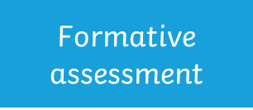
Can you match the correct form of the irregular verb ‘to run’ to each pronoun?
run
run
I _____
You _____
He / She / It _____
We _____
You _____
They _____
run
run
runs
runs
run
run
run
run
run
run
What do you notice about the verb forms?

Slide 7
Can you match the correct form of the irregular verb ‘to sing’ to each pronoun?
I _____
You _____
He / She / It _____
We _____
You _____
They _____
sing
sing
sing
sing
sings
sing
sing
sing
sing
sing
sing
sings
What do you notice about the verb forms?

Slide 8
The Rules
The form of the verb depends on the subject.
run
sing
I you we they
laugh
jump
runs
sings
he she it
(third person singular)
laughs
jumps
Can you make a simple present tense sentence with these words?

Slide 9

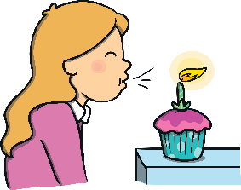


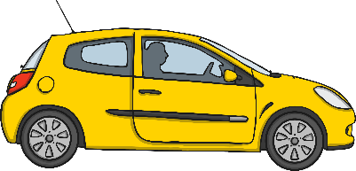


The Rules
The spelling of the verb depends on the ending of the verb.
Verbs ending in:
-o, -ch, -sh, -ss, -s, -x or -z
Add -es
Examples:
fix
- wishes
– fixes
go
– goes
wish
buzz
- buzzes

Slide 10

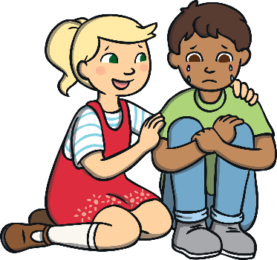
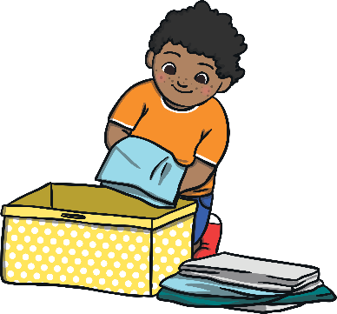
The Rules
The spelling of the verb depends on the ending of the verb.
Verbs ending in:
Consonant and -y
Remove –y and add -ies
Examples:
carry
– carries
cry
- tidies
– cries
tidy

Slide 11

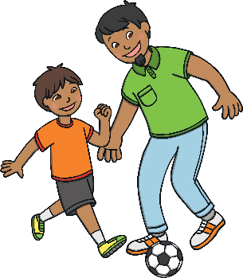
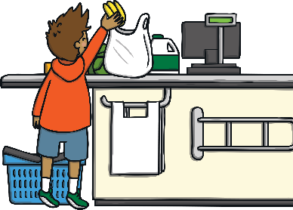
The Rules
The spelling of the verb depends on the ending of the verb.
Verbs ending in:
Vowel and -y
Just add -s
Examples:
say
– says
play
- buys
– plays
buy

Slide 12
Are these simple present sentences correct or incorrect?

I rides my bike around the field.
Is this correct?

She knows the answer.
Is this correct?

They jumps on the bouncy castle.
Is this correct?
Can you write the correct sentences?

Slide 13

This sentence has been mixed up. Can you put it in the right order?
speaks He French home. at
Show answer
He speaks French at home.
Challenge
Can you write your own mixed-up sentence for your partner?

Slide 14
This sentence has been mixed up. Can you put it in the right order?
joke. funny laugh a They at
Show answer
They laugh at a funny joke.
Challenge
Can you write your own mixed-up sentence for your partner?

Slide 15

1. Fill in the blanks with the correct simple present form of the verb:
I ___ (like) apples.
He ___ (go) to school every day.
2. Choose the correct verb form: . My sister ___ (watch / watches) cartoons in the morning. . The birds ___ (sing / sings) in the trees.
3. Say 2 sentences about your daily routine using simple present.
4.Describe your best friend using 3 sentences in simple present.

Slide 16

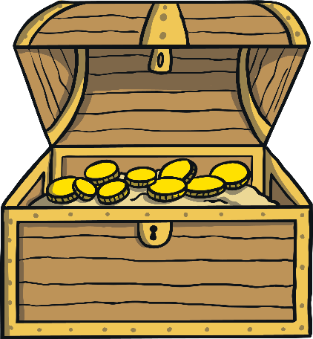
Summative assessment
Can you sort the sentences? Put the correct simple present tense sentences into the treasure chest and the incorrect ones in the rubbish bin.
Can you think of a sentence of your own that you could put into the treasure chest?
Simple Present Tense
Rubbish
I likes tennis.
She watchs the TV.
Emily sings loudly.
She fixes the broken tap.
We jump together.
Aisha speakes Farsi.

Slide 17
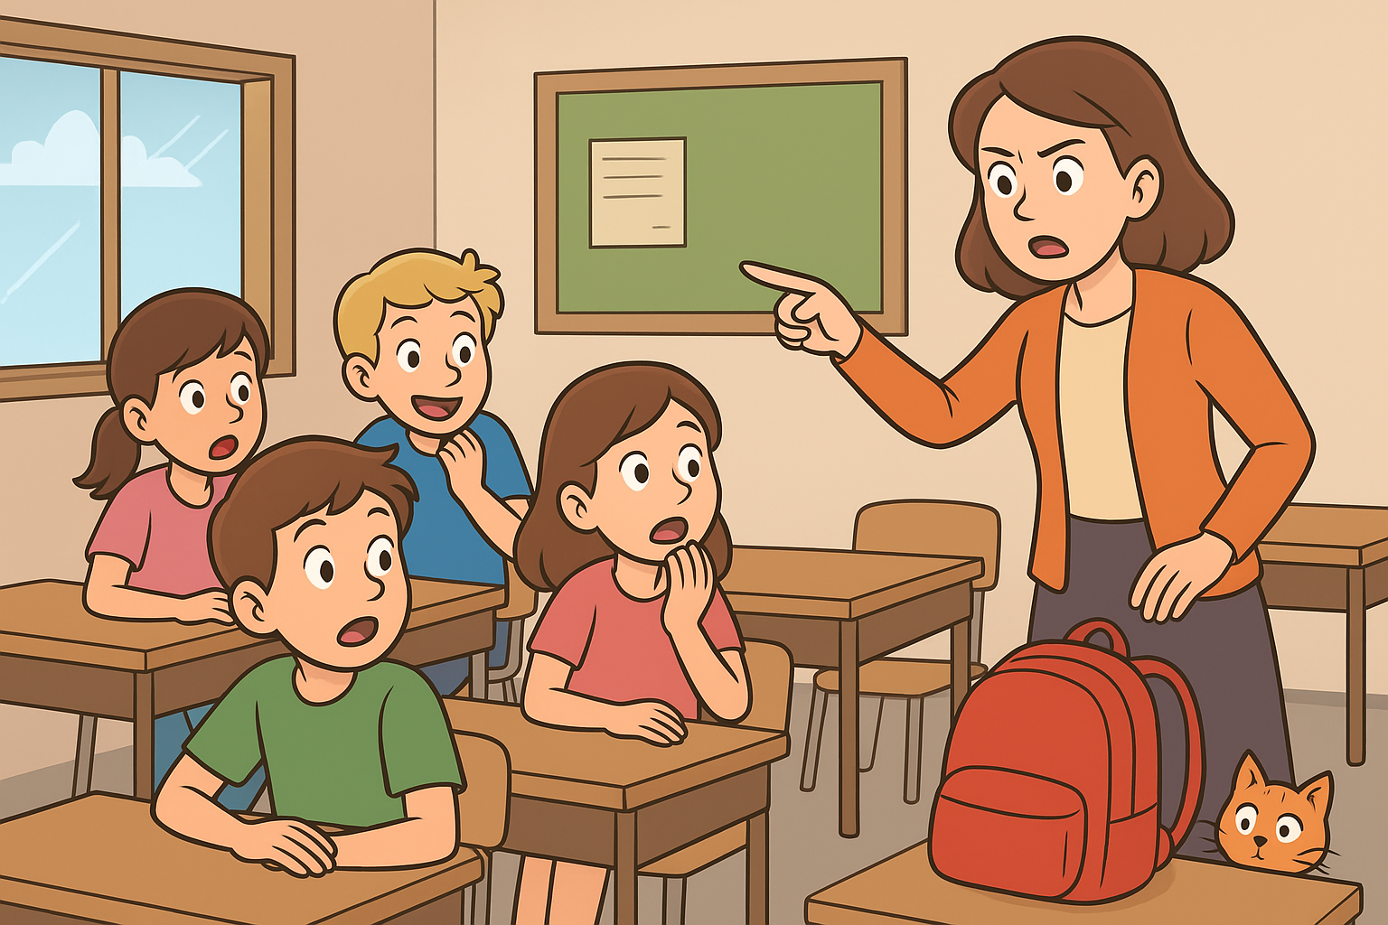
Critical thinking
Describe what you think is happening. Use “is” or “are” and other verbs in simple present.

Slide 18


