Slide 1
The Star Llama

Slide 2
LET’S BEGIN WITH THE END IN MIND
By the end of today's class, students will: ​
identify the new genre
answer questions about the story and predict what will happen next.

Slide 3
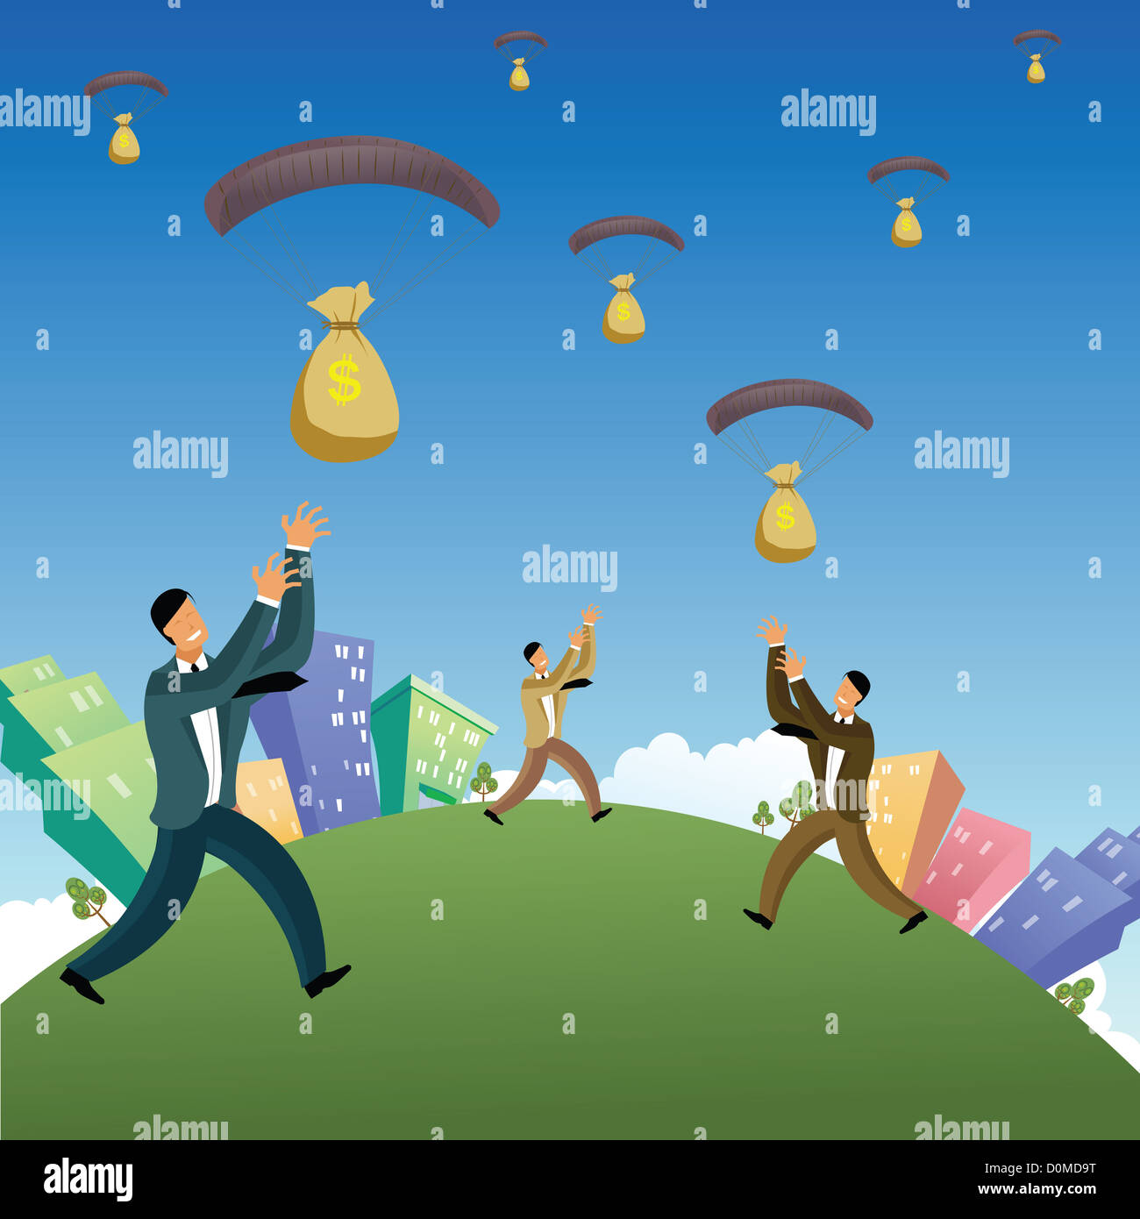
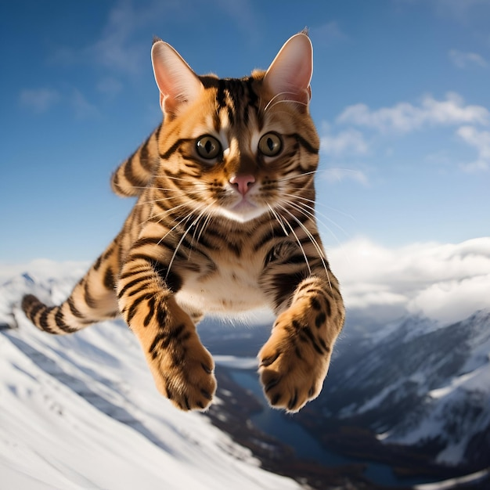
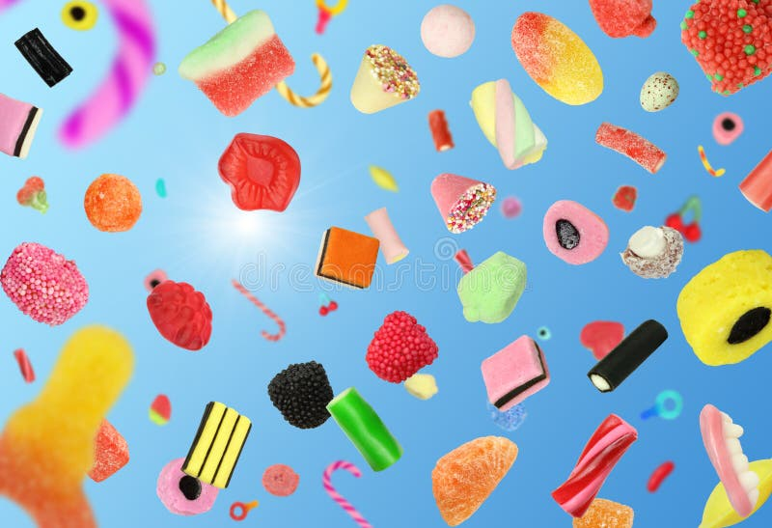
Lead in ( Round Robin)
1- If you wish that something would fall from the sky ,what would it be? Why?

Slide 4
Pre assessment
Which shape did the star that fell from the sky took?
Mini boards

Slide 5
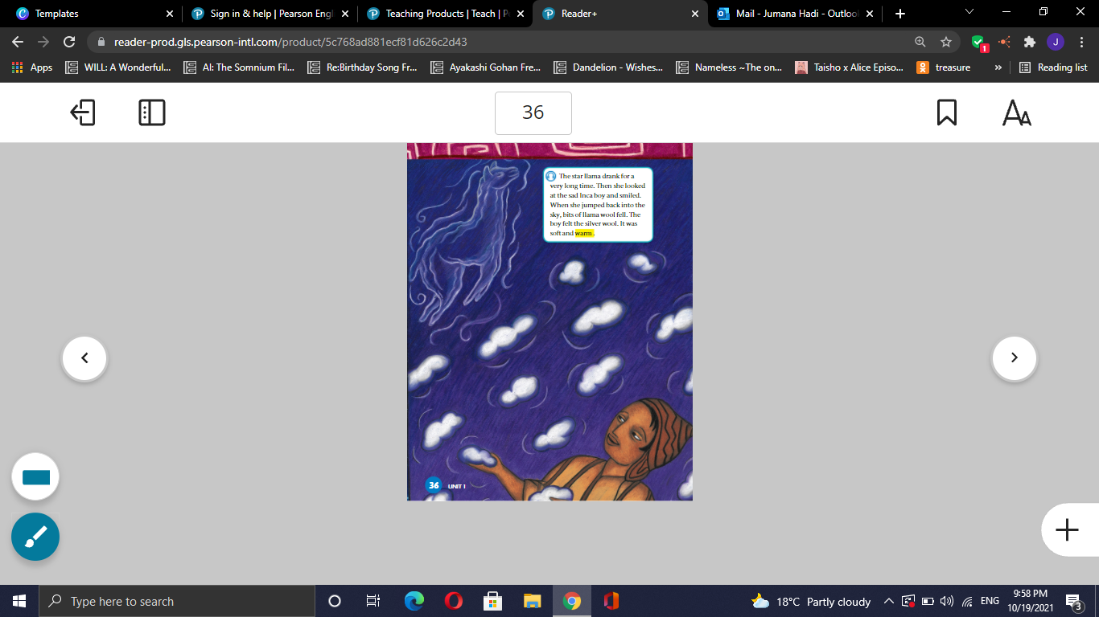
Look and say
P36

Slide 6
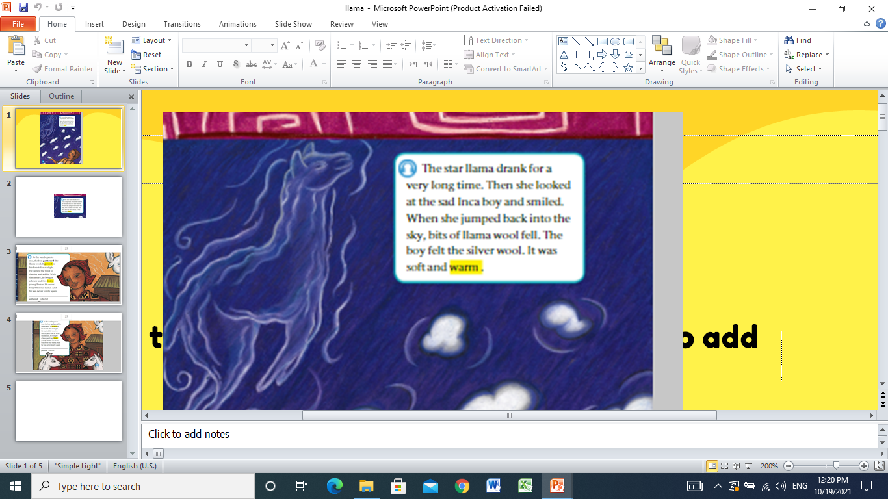

Page 36 minute
Listen:

Slide 7
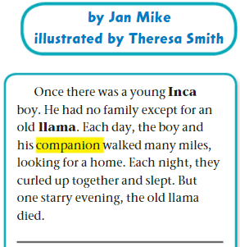
Formative assessment l Rally Robin mins​
1-How did the llama react when she looked at the
boy?
2-What happened when the llama jump to sky?
3-Describe the wool.

Slide 8
DIFFERENTIATION I 2 MIN
Students 3:
How would you feel if you were in his shoes?
Students 4:
Who looked at the sad Inca boy
Students 2:
How does the wool feel?
Students 1:
True or false
The star llama looked at the sad Inca boy.( )

Slide 9
Critical Thinking
Could that happen in real life?
Buzz in

Slide 10
SUMMATIVE ASSESSMENT I IRS I
1 MIN
The star llama drank for a short time. 1. True 2. False
The star llama didn’t jump back to the sky .
1. True 2. False
The wool was soft and warm
1. True 2. False

Slide 11
CLOSURE I 1 MIN
Choose a word you learnt today and write a sentence.
Mini-Boards

