Slide 1
The Star Llama p.37

Slide 2
LET’S BEGIN WITH THE END IN MIND
By the end of today's class, students will: ​
To listen and comprehend
To answer comprehension questions.

Slide 3
Lead in + Real life application
Round Robin
1- If you have the chance to run your own business and sell something, what would you sell? Why?

Slide 4
Pre assessment
Write one sentence about the previous part of the story.
Mini boards

Slide 5
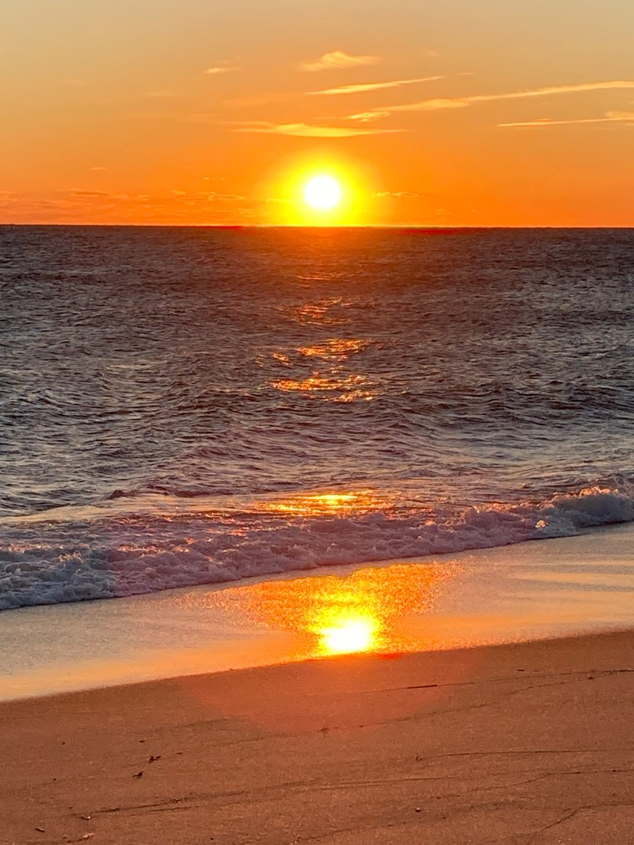
Learn the new vocab:
P37
The sun rises:
A friend or a playmate.

Slide 6
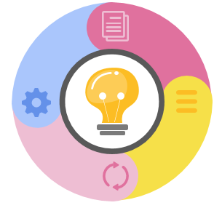

Learn the new vocab:
P37
glowed :
gave off a soft light.

Slide 7
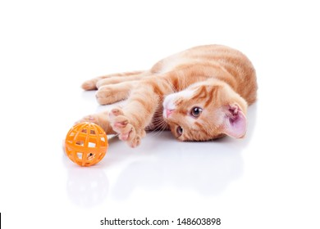
Learn the new vocab:
P37
frisky:
Lively and playful.

Slide 8
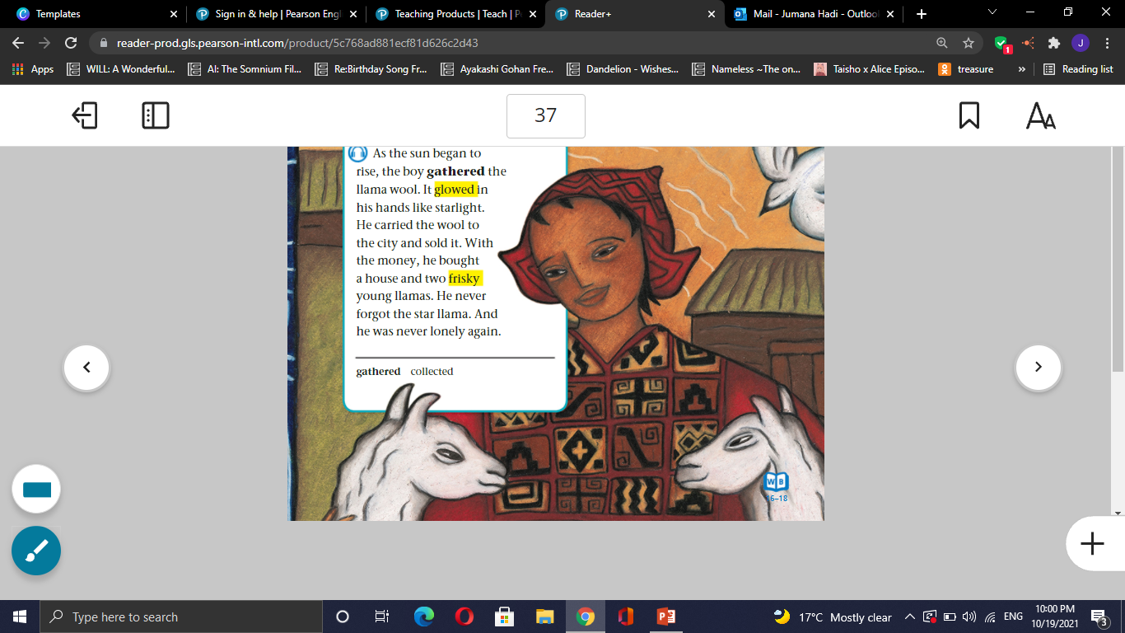
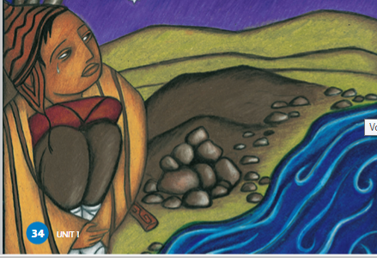
Look and say.
p 37

Slide 9

Page 34 1 minute

Slide 10
Formative assessment l Rally Robin 3 mins​
1- What did the boy do when the sun rose?
2- What did the boy do with the wool?
3-What did he do with the money?

Slide 11
Formative assessment (Feedback)​
1- What did the boy do when the sun rose? He gathered the llama wool
2- What did the boy do with the wool?
He sold it.
3-What did he do with the money?
He bought a house and two frisky llamas.

Slide 12
DIFFERENTIATION I 2 MIN
Students 3:
If you were the author, how would you end the story?
Students 1 :
Why did the inca boy go to the city?
Students 2:
The inca boy is not lonely again. Explain?
Students 4:
True or false
The boy bought a house only.
The Inca boy forgot the llama.

Slide 13
Critical Thinking
If you were in the boy’s shoes , what would you buy?
Buzz in

Slide 14
SUMMATIVE ASSESSMENT I IRS I
1 MIN
The boy sold the wool next to the icy stream.
1. True
2. False
He bought a house and one frisky llama.
  1. True
  2. False
The boy was sad at the end of the story.
  1. True
  2. False

Slide 15
CLOSURE I 1 MIN
What did you learn from the story?
Mini-Boards

