Slide 1

OBJECTIVES
WARM UP
Unit: One
Lesson: Present perfect
Subject: English
Grade: 11
PREASSESSMENT
PRESENTATION
FORMATIVE ASSESSMENT
FEEDBACK
DIFFERENTIATION
REAL LIFE APPLICATION
CRITICAL THINKING
EXIT TICKET

Slide 2
Open your booklets to page 9

Slide 3
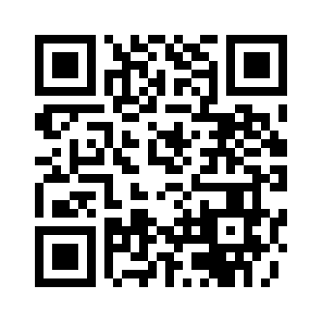
https://wordwall.net/resource/81361575

Slide 4


ISLAMIC EDUCATIONAL COLLEGE DATE:
SUBJECT
GRADE
UNIT
LESSON
Objectives
01:00 minutes
By the end of this lesson, students should be able to:
1- Identify the use of the present perfect.
2- Identify the form and the keywords of using present perfect.

Slide 5

Warm up
What is something new you have tried recently?
What is something you have achieved so far?
Have you visited any new places this year?

Slide 6
ISLAMIC EDUCATIONAL COLLEGE DATE:
SUBJECT
GRADE
UNIT
LESSON
PRESENTATION
01:00 minutes
We use the Present Perfect for:
a actions and states which began in the past and continue until now
b finished actions in the past when we don’t say exactly when they happened
Time Expressions
ever since, for, in_recent years, recently, since, already ,almost , so far , up to now, until now, just , never , finally , recently, lately , yet, since then

Slide 7
They’ve just arrived at school.
We’ve gone over this lesson several times.
He’s studied English since he was ten.
I’ve already done my homework.
They’ve won a science competition.
We’ve had many meetings this month.
She’s worked at this school for a year.
He’s seen that show so many times
They’ve traveled twice this year.
1. Repetition
2. Recent past events
3. Unfinished time periods
4. Duration of something
5. Achievements/Life experience (unspecified time)

Slide 8
They’ve just arrived at school. 2
We’ve gone over this lesson several times.1
He’s studied English since he was ten.4
I’ve already done my homework.2
They’ve won a science competition. 5
She’s worked at this school for a year. 4
We’ve had many meetings this month. 3
He’s seen that show so many times. 1
They’ve traveled twice this year. 1
1. Repetition
2. Recent past events
3. Unfinished time periods
4. Duration of something
5. Achievements/Life experience (unspecified time)

Slide 9
Use | Keywords | Example
Achievements/Life experience (unspecified time) We use it to describe life experience (events or things that we have done in our lives) but we don’t say when they happened. | never ever yet | I have never eaten sushi. I have eaten sushi. Have you ever eaten sushi? I have won many awards. Have you written your essay yet?
Duration of something We use it to say how long an action has lasted (the duration of something) until the present. | since for | We have rented this house since June. (beginning point in the past) We have rented this house for four months. (length of time)
Unfinished time periods We use it to talk about period of times that have not finished. | this week this month this year today | We have spent a lot of money this month. She has had five cups of coffee today.
Repetition We use it to describe actions that have been repeated many times up until now and are likely to continue to happen. | several times ten times many times dozen times | She has seen the movie several times. We have eaten at that restaurant many times.
Recent past events We use it to describe actions that happened recently. | recently just already | The film has just started. (a short time ago) Have you seen any good films recently? (not long ago) I have already read the newspaper. (before you expected)

Slide 10
ISLAMIC EDUCATIONAL COLLEGE DATE:
SUBJECT
GRADE
UNIT
LESSON
PRESENTATION
01:00 minutes
Positive: Subject + have / has + past participle
I’ve eaten breakfast. / He has eaten lunch.
Negative: Subject + have / has + not + past participle
We haven’t eaten yet. / She hasn’t eaten the chocolate.
Question: (Question word +) have / has + subject + past participle?
What have you eaten today? / Has she eaten lunch?

Slide 11
Here are some common contractions with the present perfect tense:
I have → I’ve
I’ve finished my homework.
You have → You’ve
You’ve done a great job.
He has → He’s
He’s just left.
She has → She’s
She’s already eaten.
It has → It’s
It’s stopped raining.
We have → We’ve
We’ve visited that place before.
They have → They’ve
They’ve studied hard for the exam.
Here are present perfect contractions with “not”:
I have not → I haven’t
I haven’t seen that movie.
You have not → You haven’t
You haven’t finished your work yet.
He has not → He hasn’t
He hasn’t called me today.
She has not → She hasn’t
She hasn’t arrived yet.
It has not → It hasn’t
It hasn’t rained this week.
We have not → We haven’t
We haven’t decided what to do.
They have not → They haven’t
They haven’t done their homework.

Slide 12

ISLAMIC EDUCATIONAL COLLEGE DATE: / 5/ 2025
SUBJECT: Reading
GRADE: 10
UNIT: 4
Lesson: 1
OUTCOMES
Differentiation
WARM UP
Students 1+2
Students 3+4
PREASSESSMENT
Do The task fill in the spaces , use the present perfect
Do The task fill in the spaces, match the sentences with the uses
PRESENTATION
FORMATIVE ASSESSMENT
FEEDBACK
DIFFERENTIATION
REAL LIFE APPLICATION
CRITICAL THINKING
EXIT TICKET

Slide 13
Use the verbs in parentheses in the Present Perfect. Then match with correct use.
I _____haven’t seen_____ (not see) him since last Monday. 4
She has written (write) three research papers this semester. 3
We have lived (live) in this neighborhood since 2008. 4
They have completed (complete) several environmental projects already. 2 ______
He hasn’t got (not get) a response from the company yet. 6
The students have studied (study) the same topic for two months. 4
I have read (read) many books by this author. 1
Have you worked there? (work) 5
1. Repetition 2. Recent past events 3. Unfinished time periods 4. Duration of something 5. Achievements/Life experience (unspecified time) 6. unfinished actions or things expected to happen

Slide 14
ISLAMIC EDUCATIONAL COLLEGE DATE:
SUBJECT
GRADE
UNIT
LESSON
FORMATIVE ASSESSMENT
05:00 minutes
Write the correct form of the verbs in brackets:
1.The committee members ……………….. out since seven o’clock. ( be)
2.I ……………….. (not see) my friend since the last meeting.
3.Hani ……………….. three letters so far. (write)
4.We ……………….. our uncle for a long time. (not / see)
5 .Scientists ……………….. treatment for Covid-19 yet . (not/discover)
6.They ……………….. the law – they should be punished. (break)
7.I ……………….. already…………….. a book about the history of law–making. (summarise)
8.They ……………….. (not / phone) each other since they were at school.
have been
haven’t seen
has written
haven’t seen
haven't discovered
have broken
have/summarized
haven’t phoned

Slide 15
Critical thinking
What is the difference between “since” and “for” in the Present Perfect tense? Give an example of each.

Slide 16
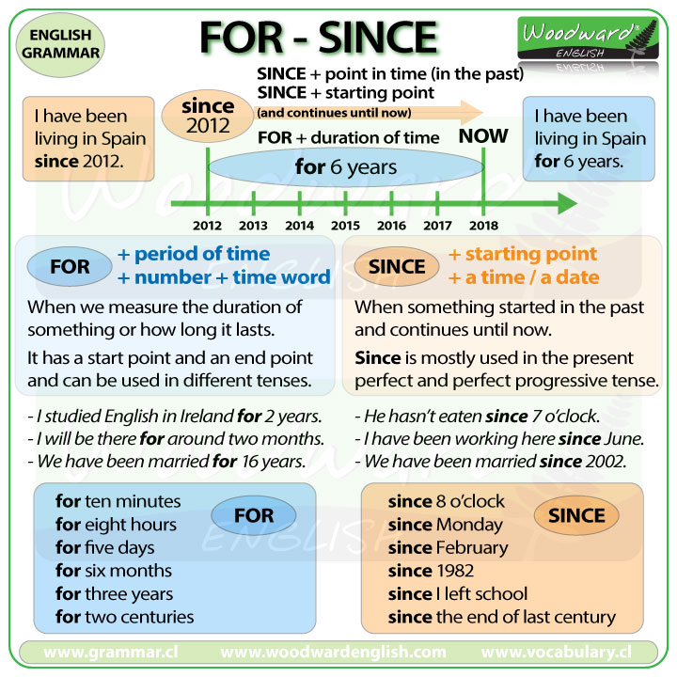

Slide 17
ISLAMIC EDUCATIONAL COLLEGE DATE:
SUBJECT
GRADE
UNIT
LESSON
differentiation
05:00 minutes
Instructions:
Students are grouped into four levels based on their understanding of the Present Perfect Tense. Each group receives a tailored question.
🟢 Group 1 – Beginners:
Choose the correct verb form:
1. She ___ (has/have) gone to the store.
2. We ___ (has/have) finished our work.
🔵 Group 2 – Developing:
Correct the mistakes:
1. He have ate lunch.
2. They has went to the park.
🟠 Group 3 – Proficient:
Write two affirmative and two negative sentences using the present perfect tense.
Use different subjects (I, she, we, etc.).
🔴 Group 4 – Advanced:
Explain the difference in usage between:
- “I have seen that movie.”
- “I saw that movie.”
Why is the first sentence in the present perfect tense?

Slide 18
ISLAMIC EDUCATIONAL COLLEGE DATE:
SUBJECT
GRADE
UNIT
LESSON
Real life connection
05:00 minutes
Imagine you’re applying for a job and the interviewer asks about your experiences. Why would you use the present perfect tense to describe what you’ve done? How does it help you highlight your qualifications?

Slide 19
ISLAMIC EDUCATIONAL COLLEGE DATE:
SUBJECT
GRADE
UNIT
LESSON
Exit Ticket
05:00 minutes
Write three sentences using the following keywords:
Just
Already
Since
For
Yet

Slide 20
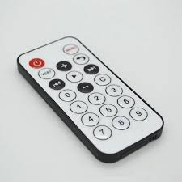
ISLAMIC EDUCATIONAL COLLEGE DATE:
SUBJECT
GRADE
UNIT
LESSON
Pre-assessment
01:00 minutes
We _________ tomorrow to Syria
have travelled 2. travel 3. are travelling
How many times ______ you ______ your grandparents this week?
Do /visit 2. have/visited 3. are/visiting
The sun ________ around the earth.
1.goes 2. doesn’t go 3. doesn’t goes
3. ______ the bus ________(arrive) at 4?

