Slide 1

Unit: 2
Lesson: writing .
Subject: writing a proposal.
Grade: 10

Slide 2
LESSON 1

Slide 3



SUBJECT: Grammar
GRADE: 9
UNIT: 4
Lesson: 1
LESSON
OBJECTIVES
00:30 minute
WARM UP
Objectives
PREASSESSMENT
to recognize, understand and write a proposal.
PRESENTATION
FORMATIVE ASSESSMENT
FEEDBACK
DIFFERENTIATION
REAL LIFE APPLICATION
CRITICAL THINKING
EXIT TICKET

Slide 4



ISLAMIC EDUCATIONAL COLLEGE DATE: / 5/ 2025
SUBJECT: Reading
GRADE: 9
UNIT:4
Lesson: 1
OUTCOMES
She hasn’t big house. she don’t have enogh money to buy one.
How many mistakes?
1. three 2. five 3. four
I am believeing that she know the answer yet she wont say it. ( buzz in)
WARM UP
REAL LIFE APPLICATION
CRITICAL THINKING
PREASSESSMENT
PRESENTATION
DIFFERENTIATION
FORMATIVE ASSESSMENT
FEEDBACK
EXIT TICKET

Slide 5
ISLAMIC EDUCATIONAL COLLEGE DATE: / / 2025
SUBJECT: Grammar
GRADE: 9
UNIT:4
Lesson: 1
OUTCOMES
2:30 minute
What is the primary purpose of a proposal?
To narrate a personal story or experience.
To persuade a reader to approve a project, funding, or an action you recommend.
To review and summarize existing literature on a topic.
To criticize a policy or idea without offering a solution.
WARM UP
REAL LIFE APPLICATION
CRITICAL THINKING
PREASSESSMENT
PRESENTATION
DIFFERENTIATION
FORMATIVE ASSESSMENT
FEEDBACK
EXIT TICKET

Slide 6

SUBJECT: Grammar
GRADE: 9
UNIT: 4
Lesson: 1
OUTCOMES
WARM UP
Real Life Application
02:30 minutes
WARM UP
Think of a small problem in our classroom. State the problem and quickly suggest ONE practical solution.
Real Life Application
PRESENTATION
FORMATIVE ASSESSMENT
FEEDBACK
DIFFERENTIATION
REAL LIFE APPLICATION
CRITICAL THINKING
EXIT TICKET

Slide 7

ISLAMIC EDUCATIONAL COLLEGE DATE: / / 2025
SUBJECT: Grammar
GRADE: 9
UNIT: 4
Lesson: 1
OUTCOMES
7:00 minute
WARM UP
Proposal: A proposal is a formal suggestion or plan put forward for consideration, discussion, or approval, often in written form and supported with reasons or evidence.
REAL LIFE APPLICATION
CRITICAL THINKING
PREASSESSMENT
PRESENTATION
DIFFERENTIATION
FEEDBACK
FORMATIVE ASSESSMENT
EXIT TICKET

Slide 8
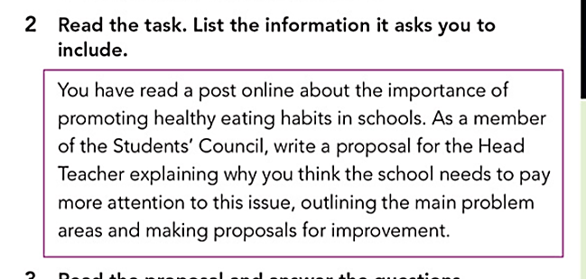
Page 36
Title
Main points to include
Why it is important
Main problem( current situation)
Recommendations

Slide 9
Title
Proposal to ……. and then you write the topic of what you’re reporting.
Title: Proposal to promote healthy eating habits at school

Slide 10
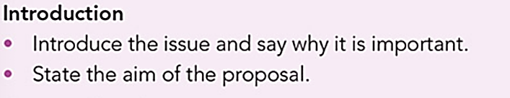
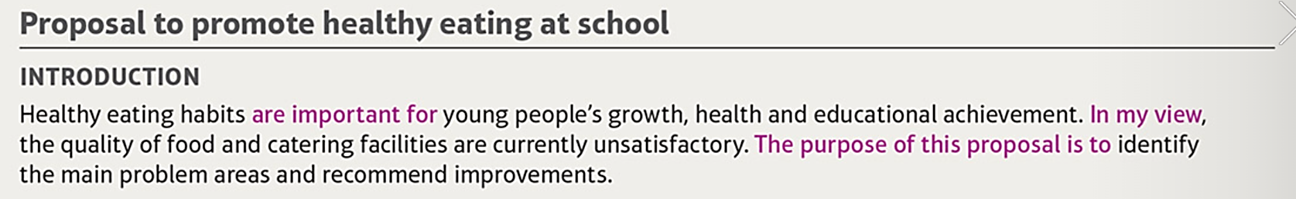

Slide 11
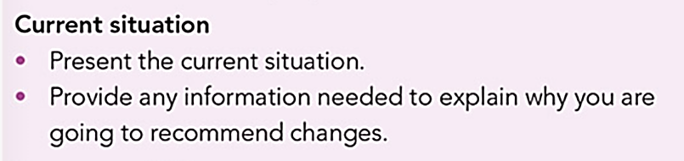
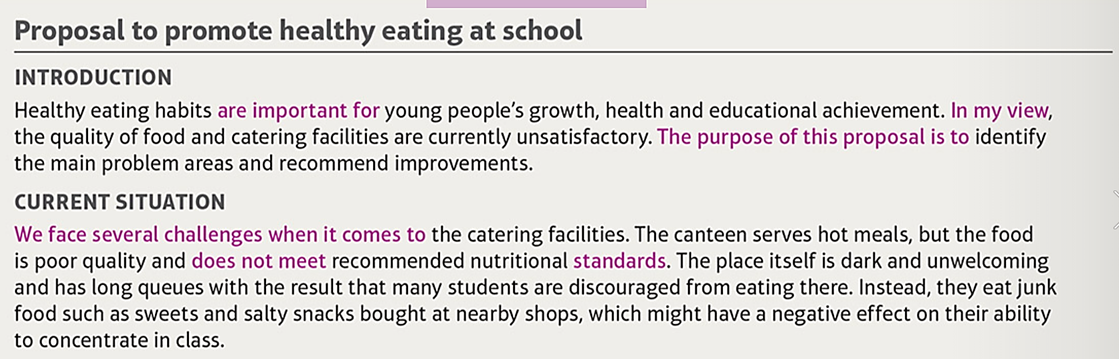

Slide 12
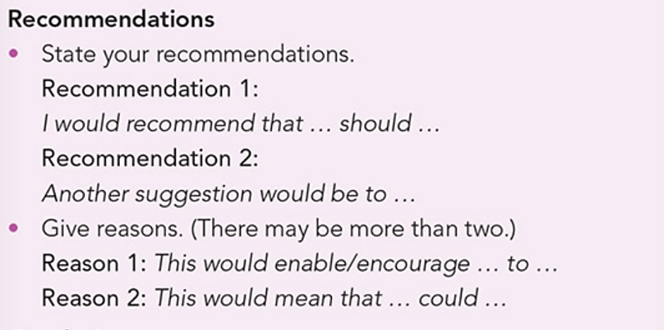
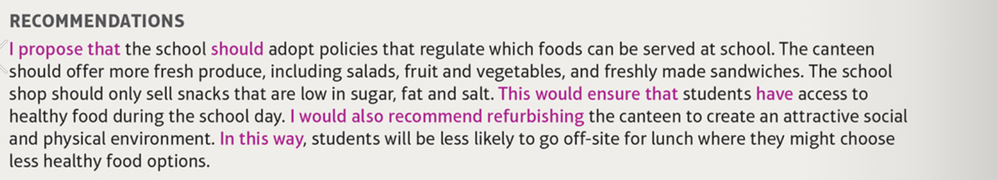

Slide 13
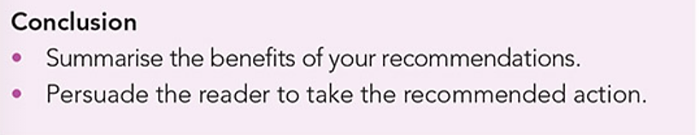

Slide 14
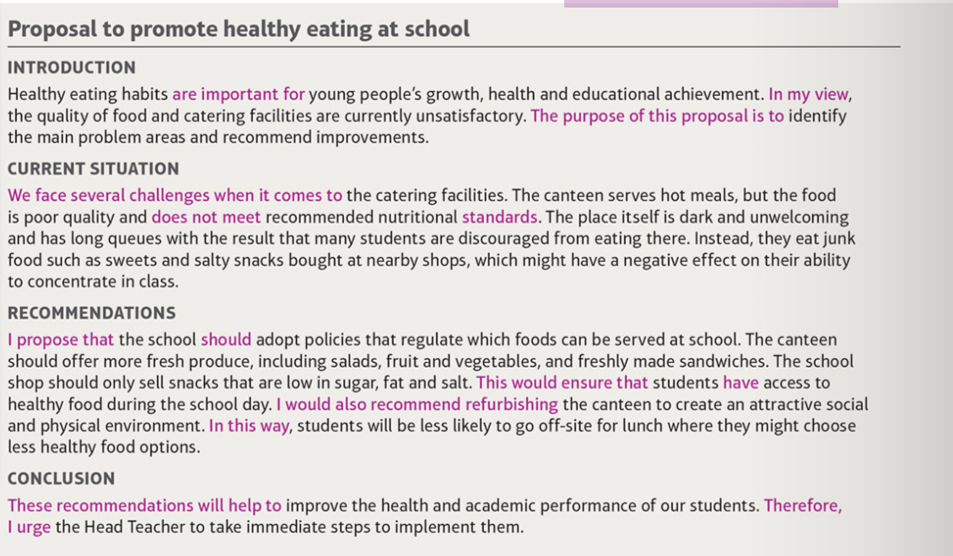
Tips
Start by reading the question carefully. Brainstorm all your thoughts about the proposal first. Then choose your best ideas and plan your paragraphs.
2. Use subheadings to make the structure clear.
3. Start by stating the aim of the proposal (Introduction) and giving information about the context (Background).
3. Next, move on to the Current problems/situation and your Proposed solution/recommendations.
4. The final section(conclusion) should include an overall recommendation based on your previous points.
You should use a formal tone for your proposal.

Slide 15
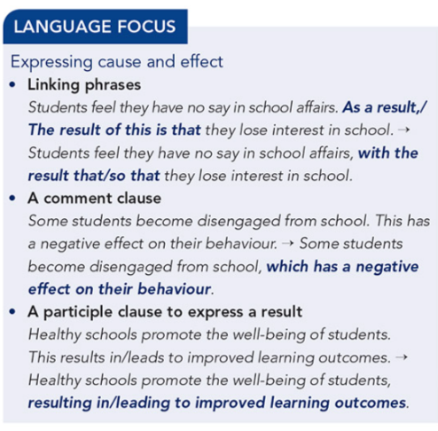

Slide 16
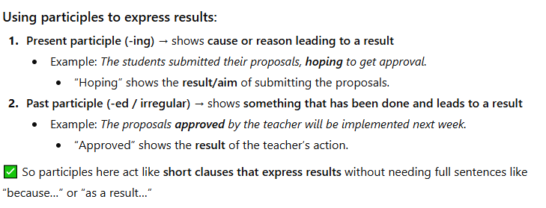

Slide 17
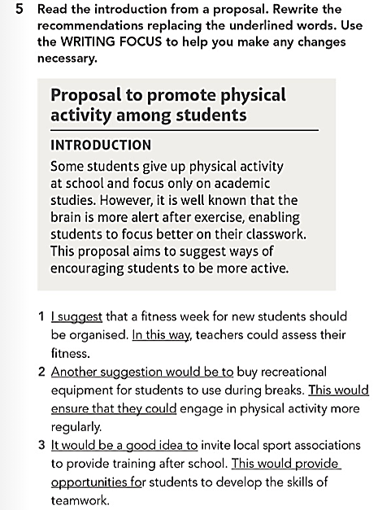
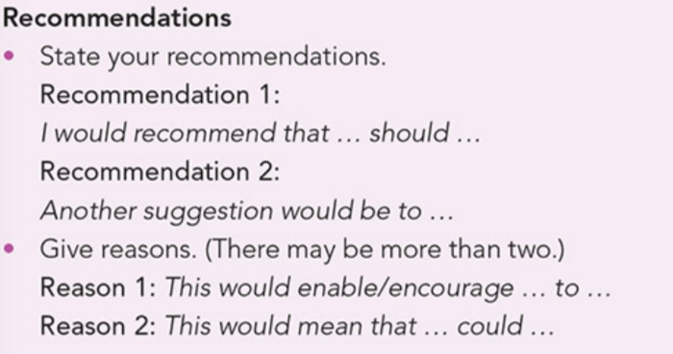

Slide 18
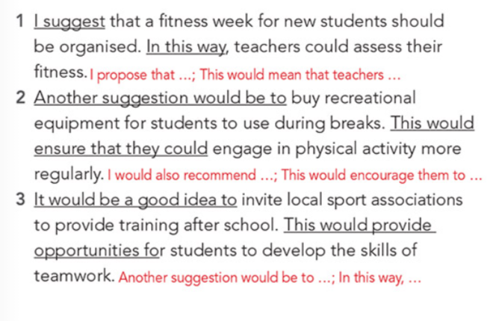

Slide 19
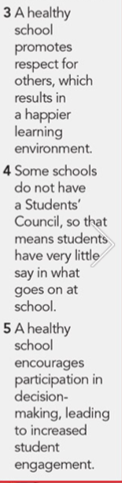
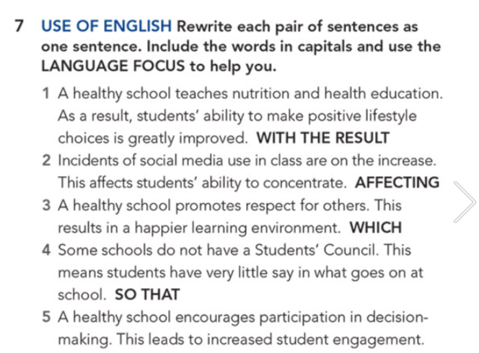
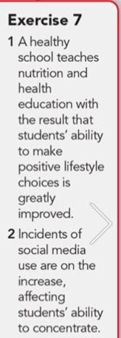

Slide 20
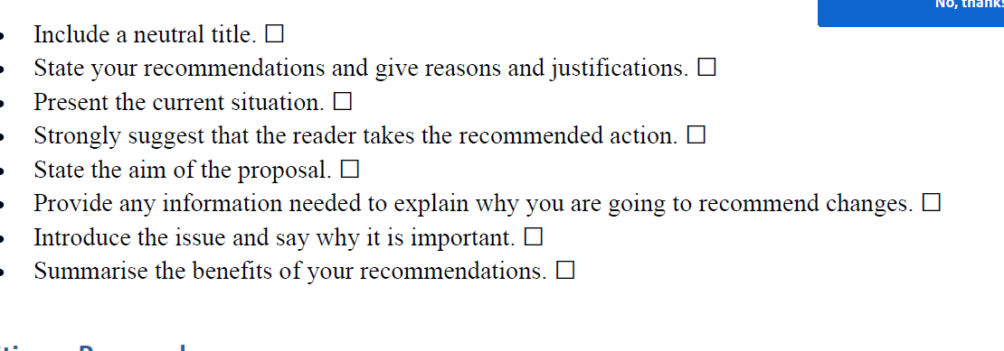
1
6
4
8
3
5
2
7

Slide 21
Your local youth centre is planning to replace the current youth centre café with a new one and is asking for recommendations from people who use the centre. Write a proposal outlining the main problems with the current café and proposing improvements
Your local youth centre is planning to replace the current youth centre café with a new one and is asking for recommendations from people who use the centre. Write a proposal outlining the main problems with the current café and proposing improvements

Slide 22
Recommendations
Problems with the current cafe

Slide 23
Problems with the current café:
Limited seating → not enough space during busy times
Uncomfortable chairs/tables
Limited menu → few healthy or affordable options
Slow service / long waiting time
Poor hygiene or cleanliness
No area for socializing or studying
Old décor → looks outdated and uninviting
Proposed improvements:
Add more tables and chairs → comfortable and spacious
Improve menu → include healthy snacks, drinks, and affordable options
Faster service → more staff or better organization
Clean and well-maintained café area
Modern, colorful décor → welcoming atmosphere
Create a small study/social area → games, Wi-Fi, music
Include environmentally friendly options → recycling bins, reusable cups

Slide 24
Proposal to ------------------------------------------------------------------------------------------
Introduction
------------------------------------ are important for -------------------------------------------.In my view-------------------------------------------------------------------------------. The purpose of this proposal is to ------------------------------------------------------------------------------------------------------------------------------------------.
Current situation
We face several challenges when it comes to --------------------------------------------------------------------------------------------------------------------------------------------------------------------------------------------------------------------------------------------------------------------------------------------------------------------------------------------------------------------------------------------------------------------------------------------------------------------------------------------------------------------------------------------------------------------------
Recommendations
I propose that ----------should-------------------------------------------------------------------------------------------------------------------. This would ensure that ----------------------------------------------------------------------------------------------------------------------------------------------. I would also recommend ----------------------------------------------------------------------------------------. In this way ------------------------------------------------------------------------------------------------------------------------------------------------------------------
Conclusion
These recommendations will help to ----------------------------------------------------------------------------------------------------------------------------- . Therefore I urge -------------------------------------------------------------------------------------------

Slide 25
Proposal to improve the youth center café
Introduction
Our local youth centre café is an important place for students and young people to relax, meet friends, and enjoy refreshments. In my view, the current café has some problems that make it less comfortable and convenient for visitors. This proposal highlights the main issues and suggests improvements to create a more welcoming and enjoyable space for everyone who uses the centre.

