Slide 1

OBJECTIVES
WARM UP
Unit: 3
Lesson: Writing
Subject: Opinion essay
Grade: 10
PREASSESSMENT
PRESENTATION
FORMATIVE ASSESSMENT
FEEDBACK
DIFFERENTIATION
REAL LIFE APPLICATION
CRITICAL THINKING
EXIT TICKET

Slide 2

ISLAMIC EDUCATIONAL COLLEGE DATE:
Subject: English
Grade: 10
Unit: 3
Lesson: 4
01:00 minutes
Lesson Objectives:
Understand the structure of an opinion essay (introduction, body, conclusion).
2. Recognize the difference between fact and opinion.

Slide 3

01:00 minutes
Warm-Up
Is it better to work in a group or alone

Slide 4
Capitalize the first word of every sentence.➜ Example: Today is a great day.
Capitalize the pronoun “I.”➜ Example: My friend and I went shopping.
Capitalize proper nouns — specific names of people, places, and things.➜ Example: Amneh, Paris, Google, The Nile River
Capitalize days, months, and holidays (but not seasons).➜ Example: Monday, December, Eid, but summer
Capitalize the first, last, and important words in titles of books, movies, and songs.➜ Example: The Lion King, To Kill a Mockingbird
Capitalize nationalities, languages, and religions.➜ Example: Jordanian, English, Islam, Christianity
Capitalize historical periods, special events, and documents.➜ Example: World War II, The Renaissance, The Constitution

Slide 5
ISLAMIC EDUCATIONAL COLLEGE DATE:
SUBJECT: English
GRADE:
UNIT:
LESSON:2
PRESENTATION
05:00 minutes
The Introduction
The Body Paragraphs
The Conclusion

Slide 6
ISLAMIC EDUCATIONAL COLLEGE DATE:
SUBJECT: English
GRADE: 9
UNIT:1
LESSON:2
PRESENTATION
08:00 minutes
The Introduction
Attention grabber (hook) : you can start with a question, fact or quotation to grab the readers attention.
1.Over 90% of schools in Japan require uniforms, and they report fewer discipline issues as a result. 2.Would students focus more on learning if they didn’t have to worry about what to wear every day? 3."Clothes make the man. Naked people have little or no influence on society."

Slide 7
ISLAMIC EDUCATIONAL COLLEGE DATE:
SUBJECT: English
GRADE: 9
UNIT:1
LESSON:2
PRESENTATION
08:00 minutes
The Introduction
2. Background Statement
Definition: This sentence gives general information about the topic. It helps the reader understand what the essay will be about and prepares them for the writer’s opinion.
Example:
"School uniforms have been a tradition in many countries, and some believe they help promote discipline and equality in schools."

Slide 8
ISLAMIC EDUCATIONAL COLLEGE DATE:
SUBJECT: English
GRADE: 9
UNIT:1
LESSON:2
PRESENTATION
08:00 minutes
The Introduction
Thesis Statement
Definition: The thesis statement is the most important sentence in the introduction. It clearly states the writer’s opinion and outlines the main reasons that will be discussed in the body paragraphs.
Example:
"However, I believe that students should not be required to wear school uniforms because they limit self-expression, add unnecessary costs, and do not improve academic performance."

Slide 9
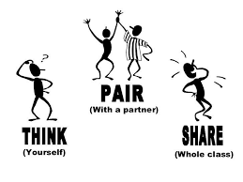
Strength
Invention
ISLAMIC EDUCATIONAL COLLEGE DATE:
SUBJECT: writing
GRADE: 10
UNIT: 1
Lesson: 1
OUTCOMES
Students 3+4
Compose an introduction to an opinion essay. The first words of each sentence are given.
Students 1+2:
Put the given sentences in the right order to form an introduction to opinion essay
01:30 minutes
WARM UP
PREASSESSMENT
PRESENTATION
FORMATIVE ASSESSMENT
FEEDBACK
DIFFERENTIATION
REAL LIFE APPLICATION
CRITICAL THINKING
EXIT TICKET

Slide 10
Parts (mixed up):
I think Wearing uniforms is important because they create equality and help students focus in class.
Many schools around the world require students to wear uniforms even though some students don’t like wearing them.
C. Imagine walking into a school where everyone wears the same outfit!

Slide 11
FEEDBACK
Hook
Imagine walking into a school where everyone wears the same outfit! Many schools around the world require students to wear uniforms even though some students don’t like wearing them. I think Wearing uniforms is important because they create equality and help students focus in class.
Background statement
Thesis

Slide 12

REAL LIFE APPLICATION
Have you ever noticed a difference in your morning routine between uniform days and non-uniform days? How long did it take, and how did it make you feel?

Slide 13
Topic sentence
Body Paragraph 1: One reason uniforms are important is that they create equality. When everyone wears the same outfit, students are judged less by their clothes. This helps everyone feel included and more confident at school.
Body Paragraph 2: Another reason uniforms are useful is that they help students focus. Without worrying about fashion or comparing clothes, students can pay more attention in class and concentrate on learning.
Body Paragraph 3: Moreover, uniforms teach discipline and responsibility. Wearing them every day encourages punctuality and gives a sense of belonging to the school community.
Topic sentence
Topic sentence

Slide 14

Look up a phrase you can use to introduce a new point in your essay body

Slide 15
ISLAMIC EDUCATIONAL COLLEGE DATE:
SUBJECT: English
GRADE: 9
UNIT:1
LESSON:2
PRESENTATION
08:00 minutes
What Does a Conclusion Include?
A strong conclusion usually has:
Restated Thesis – Reword your main argument or point.
Summary of Key Points – Briefly mention the main ideas (but don’t repeat everything).
Final Thought/Reflection – A closing sentence that might give insight, a call to action, or a broader implication.

Slide 16
1 or 2
To sum up, school uniforms create a good and fair learning environment, and I believe this is a vital policy for all schools. By boosting equality among students, improving focus in the classroom, and teaching valuable discipline, uniforms help every student succeed.
To sum up, school uniforms create a good and fair learning environment. By promoting equality, improving focus, and teaching discipline, they help all students succeed. Furthermore, wearing uniforms also makes getting ready in the morning much faster and easier for families, saving valuable time every day.
IRS

Slide 17
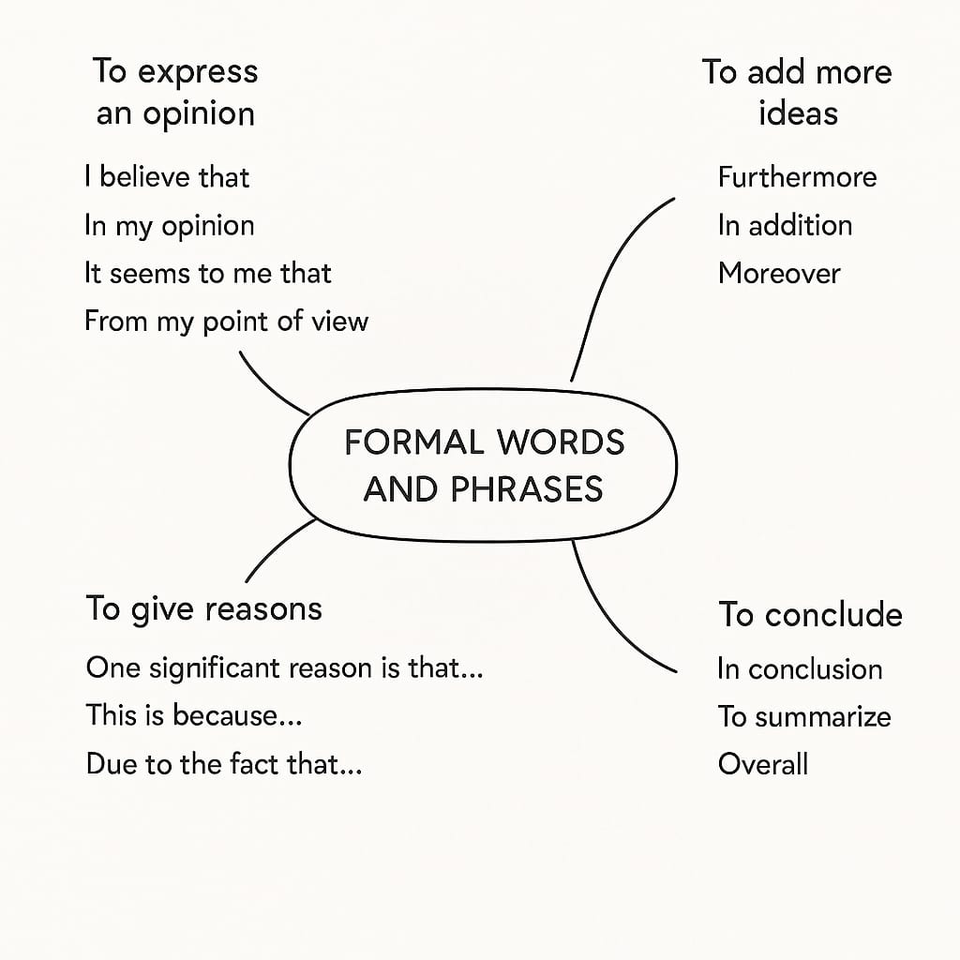
ISLAMIC EDUCATIONAL COLLEGE DATE:
SUBJECT: English
GRADE: 9
UNIT:1
LESSON:2
PRESENTATION
08:00 minutes

Slide 18
Academic tone means writing in a formal, clear, and professional way rather than casual or conversational.
Key features:
No slang or informal words: use do not instead of don’t, children instead of kids.
Full sentences: avoid sentence fragments.
Objective and precise language: avoid personal chatty phrases like I guess or kind of.
Polite and neutral expressions: instead of I hate homework, say Homework can be challenging for some students.

Slide 19

ISLAMIC EDUCATIONAL COLLEGE DATE:
SUBJECT: English
GRADE:9
UNIT:1
LESSON:2
CRITICAL THINKING
02:00 minutes
“Why do you think professional writers brainstorm before they write?” Write a 1-sentence response on a sticky note and stick it on the board.

Slide 20
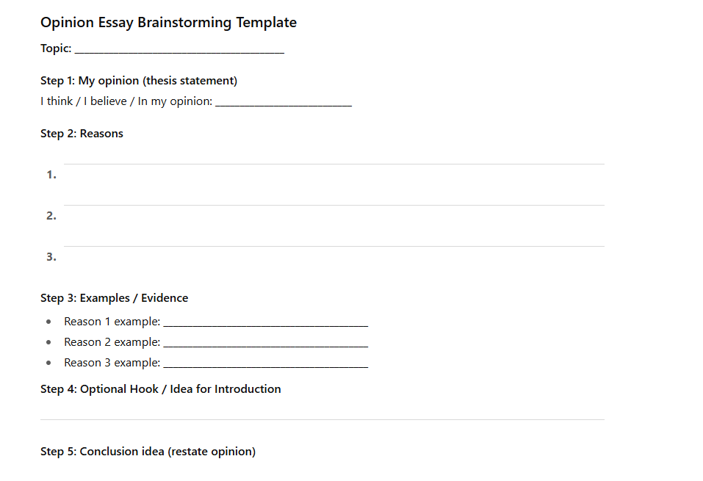

Slide 21
ISLAMIC EDUCATIONAL COLLEGE DATE:
SUBJECT: English
GRADE :9
UNIT:1
LESSON:2
EXIT TICKET
03:00 minutes
*
Write an opinion essay on the subject “Videogames are harmful, thus, should be banned immediately.” Your essay should be 150 words long.
Brainstorm
Decide what you are going to include in your essay

Slide 22

ISLAMIC EDUCATIONAL COLLEGE DATE:
SUBJECT: English
GRADE: 9
UNIT:1
LESSON:2
FORMATIVE ASSESSMENT:
04:00 minutes

Slide 23
ISLAMIC EDUCATIONAL COLLEGE DATE:
SUBJECT: English
GRADE:9
UNIT:2
LESSON:3
DIFFERENTIATION
05:00 minutes
Students 1+3 Students 2+4
Match the sentence with the correct component
Should kids have homework every day?
Introduction
One reason
A conclusion

Slide 24
ISLAMIC EDUCATIONAL COLLEGE DATE:
SUBJECT: English
GRADE:9
UNIT:1
LESSON:2
REAL LIFE APPLICATION
02:00 minutes
.
“Should we use robots at school?”
Students stand up, hand up, find a partner.
Share their answers, switch partners if time allows.
(Stand Up, Hand Up, Pair Up)

Slide 25

ISLAMIC EDUCATIONAL COLLEGE DATE:
SUBJECT: English
GRADE: 9
UNIT:1
LESSON:2
FORMATIVE ASSESSMENT:
04:00 minutes

