Slide 1


Unit: 3
Lesson: Grammar
Subject: Past perfect
Grade: 9

Slide 2


ISLAMIC EDUCATIONAL COLLEGE DATE: :
SUBJECT: Past Tenses
GRADE: 10
UNIT: 2
Lesson: 4
LESSON
OBJECTIVES
OBJECTIVES:
By the end of the lesson, students will be able to:
Identify the uses and forms of the past perfect tense.
01:00 minute
WARM UP
PREASSESSMENT
PRESENTATION
FORMATIVE ASSESSMENT
FEEDBACK
DIFFERENTIATION
REAL LIFE APPLICATION
CRITICAL THINKING
EXIT TICKET

Slide 3

ISLAMIC EDUCATIONAL COLLEGE DATE:
SUBJECT: Past Tenses
GRADE:
UNIT:
LESSON: 1
OUTCOMES
02:00 minutes
Student A: say an affirmative sentence in the past simple tense
Student B: make it negative
Student A: change it into the interrogative form
Student B : gives an affirmative sentence
Student A: make it negative
Student B: change it into the interrogative form
WARM UP
PREASSESSMENT
PRESENTATION
FORMATIVE ASSESSMENT
FEEDBACK
DIFFERENTIATION
REAL LIFE APPLICATION
CRITICAL THINKING
EXIT TICKET

Slide 4
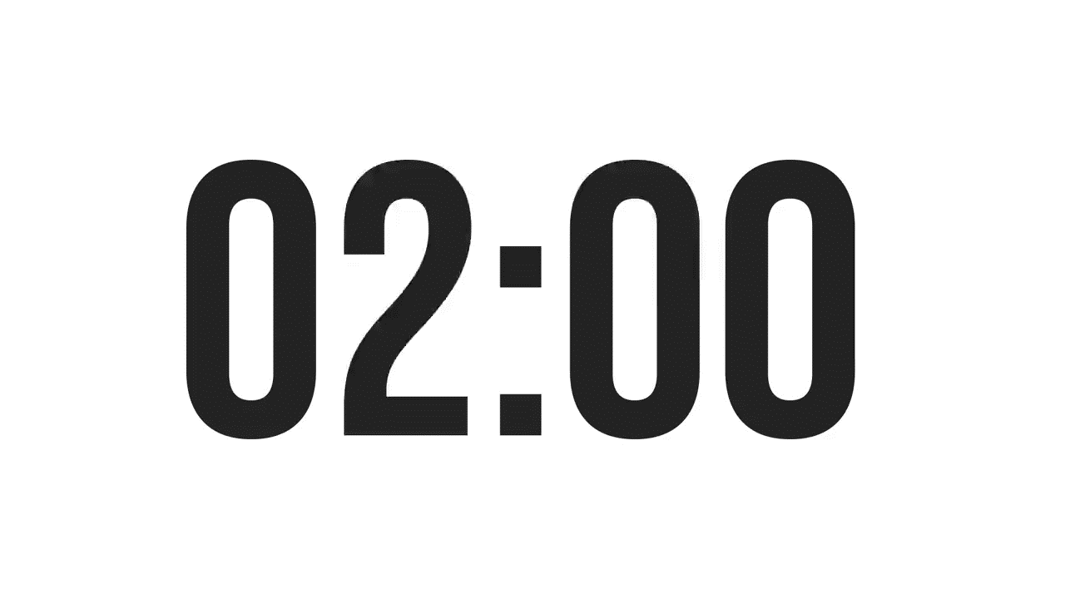
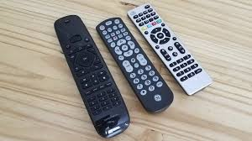
ISLAMIC EDUCATIONAL COLLEGE DATE:
SUBJECT: Past Tenses
GRADE:
UNIT:
LESSON: 1
OUTCOMES
02:00 minutes
PREASSESSMENT:
I ________ before I _______
1. had breakfast/ watched tv
2. Had had breakfast / watched tv
3. Had breakfast/ had watched tv d) weren’t make
WARM UP
PREASSESSMENT
PRESENTATION
FORMATIVE ASSESSMENT
FEEDBACK
DIFFERENTIATION
REAL LIFE APPLICATION
CRITICAL THINKING
EXIT TICKET

Slide 5
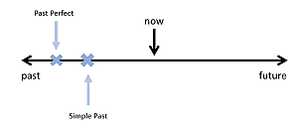
She had left before we arrived

Slide 6
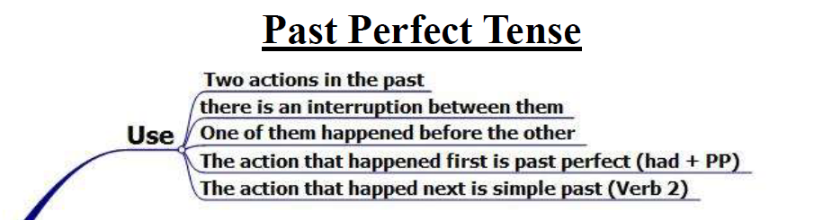
ISLAMIC EDUCATIONAL COLLEGE DATE:
SUBJECT: Past Tenses
GRADE: 10
UNIT: 2
LESSON:1
OUTCOMES
0:30 minutes
WARM UP
PREASSESSMENT
PRESENTATION
FORMATIVE ASSESSMENT
FEEDBACK
DIFFERENTIATION
REAL LIFE APPLICATION
CRITICAL THINKING
EXIT TICKET

Slide 7
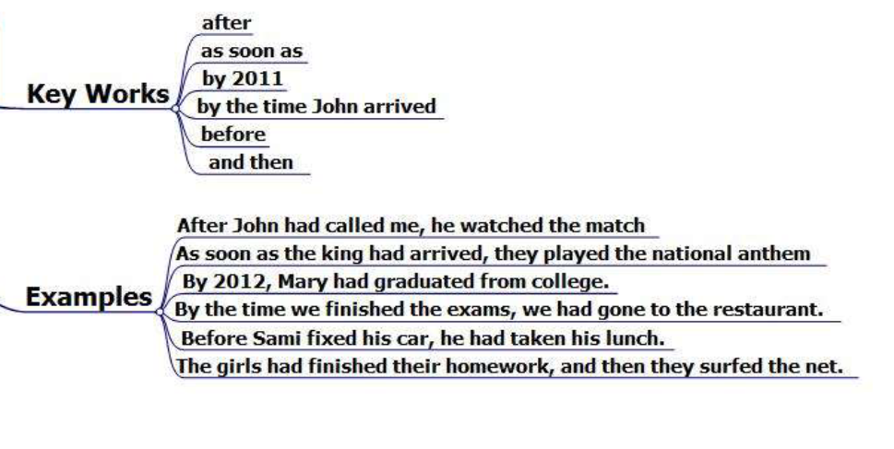
ISLAMIC EDUCATIONAL COLLEGE DATE:
SUBJECT: Past Tenses
GRADE: 10
UNIT: 2
LESSON:1
OUTCOMES
0:30 minutes
WARM UP
PREASSESSMENT
PRESENTATION
FORMATIVE ASSESSMENT
FEEDBACK
DIFFERENTIATION
REAL LIFE APPLICATION
CRITICAL THINKING
EXIT TICKET

Slide 8
As soon as+ subject + past perfect, subject + past simple
subject + past simple as soon as+ subject + past perfect.
After + subject + past perfect , subject + past simple.
Subject + past simple after + subject + past perfect .
Before + subject + past simple , subject + past perfect.
Subject + past perfect before + subject + past simple.
By the time+ subject + past simple , subject + past perfect.
Subject + past perfect by the time + subject + past simple.
By 2020 + subject + past perfect
Subject + past perfect and then subject + past perfect.

Slide 9
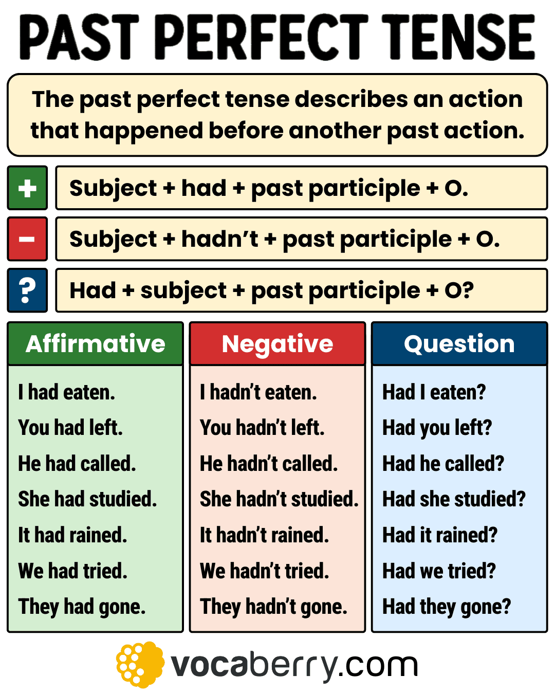

ISLAMIC EDUCATIONAL COLLEGE DATE: :
SUBJECT: Past Tenses
GRADE:
UNIT:
LESSON: 1
OUTCOMES
05:00 minutes
WARM UP
PREASSESSMENT
PRESENTATION
FORMATIVE ASSESSMENT
FEEDBACK
DIFFERENTIATION
REAL LIFE APPLICATION
CRITICAL THINKING
EXIT TICKET

Slide 10
ISLAMIC EDUCATIONAL COLLEGE DATE: :
SUBJECT: Past Tenses
GRADE:
UNIT:
LESSON: 1
OUTCOMES
Form sentences Brushed teeth ( first) 2. slept ( second)
By the time she slept, she had brushed her teeth
After she had brushed her teeth, she had slept.
She had brushed her teeth before she slept.
She had brushed her teeth and then she slept
As soon as she had brushed her teeth, she slept.
05:00 minutes
WARM UP
PREASSESSMENT
PRESENTATION
FORMATIVE ASSESSMENT
FEEDBACK
DIFFERENTIATION
REAL LIFE APPLICATION
CRITICAL THINKING
EXIT TICKET

Slide 11
https://create.kahoot.it/share/past-perfect/18c329f1-b006-4f7f-895a-b55467422c74

Slide 12


ISLAMIC EDUCATIONAL COLLEGE DATE: :
SUBJECT: Past Tenses
GRADE: 10
UNIT: 2
LESSON: 1
OUTCOMES
EXIT TICKET:
Write sentences using the past perfect tense correctly.
02:00 minutes
WARM UP
PREASSESSMENT
PRESENTATION
FORMATIVE ASSESSMENT
FEEDBACK
DIFFERENTIATION
REAL LIFE APPLICATION
CRITICAL THINKING
EXIT TICKET
BUZZ IN

