Slide 1


Unit: 3
Lesson: Grammar
Subject: Past simple
Grade: 9

Slide 2


ISLAMIC EDUCATIONAL COLLEGE DATE: :
SUBJECT: Past Tenses
GRADE: 10
UNIT: 2
Lesson: 4
LESSON
OBJECTIVES
OBJECTIVES:
By the end of the lesson, students will be able to:
Identify the uses and forms of the past simple tense.
Identify the key words and time expressions used with the past simple.
01:00 minute
WARM UP
PREASSESSMENT
PRESENTATION
FORMATIVE ASSESSMENT
FEEDBACK
DIFFERENTIATION
REAL LIFE APPLICATION
CRITICAL THINKING
EXIT TICKET

Slide 3

ISLAMIC EDUCATIONAL COLLEGE DATE:
SUBJECT: Past Tenses
GRADE:
UNIT:
LESSON: 1
OUTCOMES
02:00 minutes
What did you do yesterday?
WARM UP
PREASSESSMENT
PRESENTATION
FORMATIVE ASSESSMENT
FEEDBACK
DIFFERENTIATION
REAL LIFE APPLICATION
CRITICAL THINKING
EXIT TICKET

Slide 4
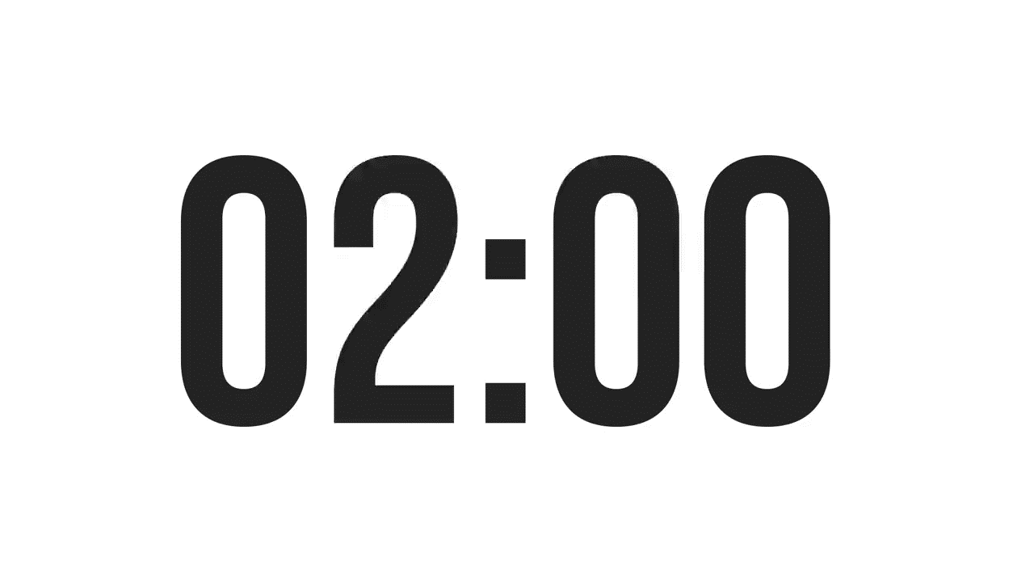
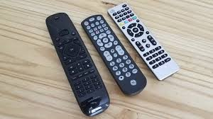
ISLAMIC EDUCATIONAL COLLEGE DATE:
SUBJECT: Past Tenses
GRADE:
UNIT:
LESSON: 1
OUTCOMES
02:00 minutes
PREASSESSMENT:
I ________ them yesterday in the café.
1. didn’t met
2. have met
3. met
WARM UP
PREASSESSMENT
PRESENTATION
FORMATIVE ASSESSMENT
FEEDBACK
DIFFERENTIATION
REAL LIFE APPLICATION
CRITICAL THINKING
EXIT TICKET

Slide 5
ISLAMIC EDUCATIONAL COLLEGE DATE:
SUBJECT: Past Tenses
GRADE:
UNIT:
LESSON: 1
OUTCOMES
02:00 minutes
PREASSESSMENT:
I ________ them yesterday in the café.
1. didn’t met
2. have met
3. met
WARM UP
PREASSESSMENT
PRESENTATION
FORMATIVE ASSESSMENT
FEEDBACK
DIFFERENTIATION
REAL LIFE APPLICATION
CRITICAL THINKING
EXIT TICKET

Slide 6
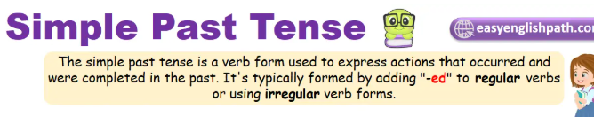
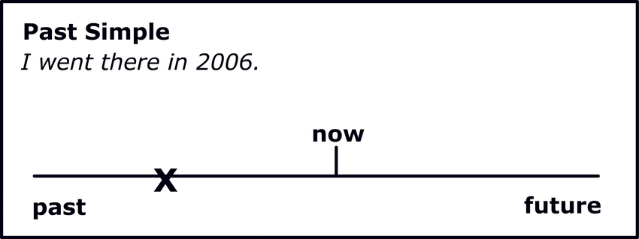

Slide 7
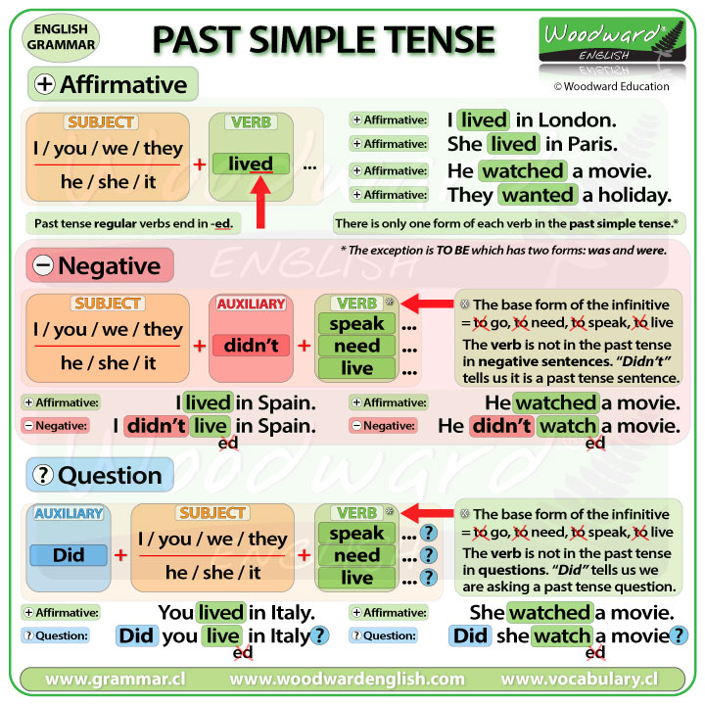
ISLAMIC EDUCATIONAL COLLEGE DATE:
SUBJECT: Past Tenses
GRADE: 10
UNIT: 2
LESSON:1
OUTCOMES
0:30 minutes
WARM UP
PREASSESSMENT
PRESENTATION
FORMATIVE ASSESSMENT
FEEDBACK
DIFFERENTIATION
REAL LIFE APPLICATION
CRITICAL THINKING
EXIT TICKET

Slide 8
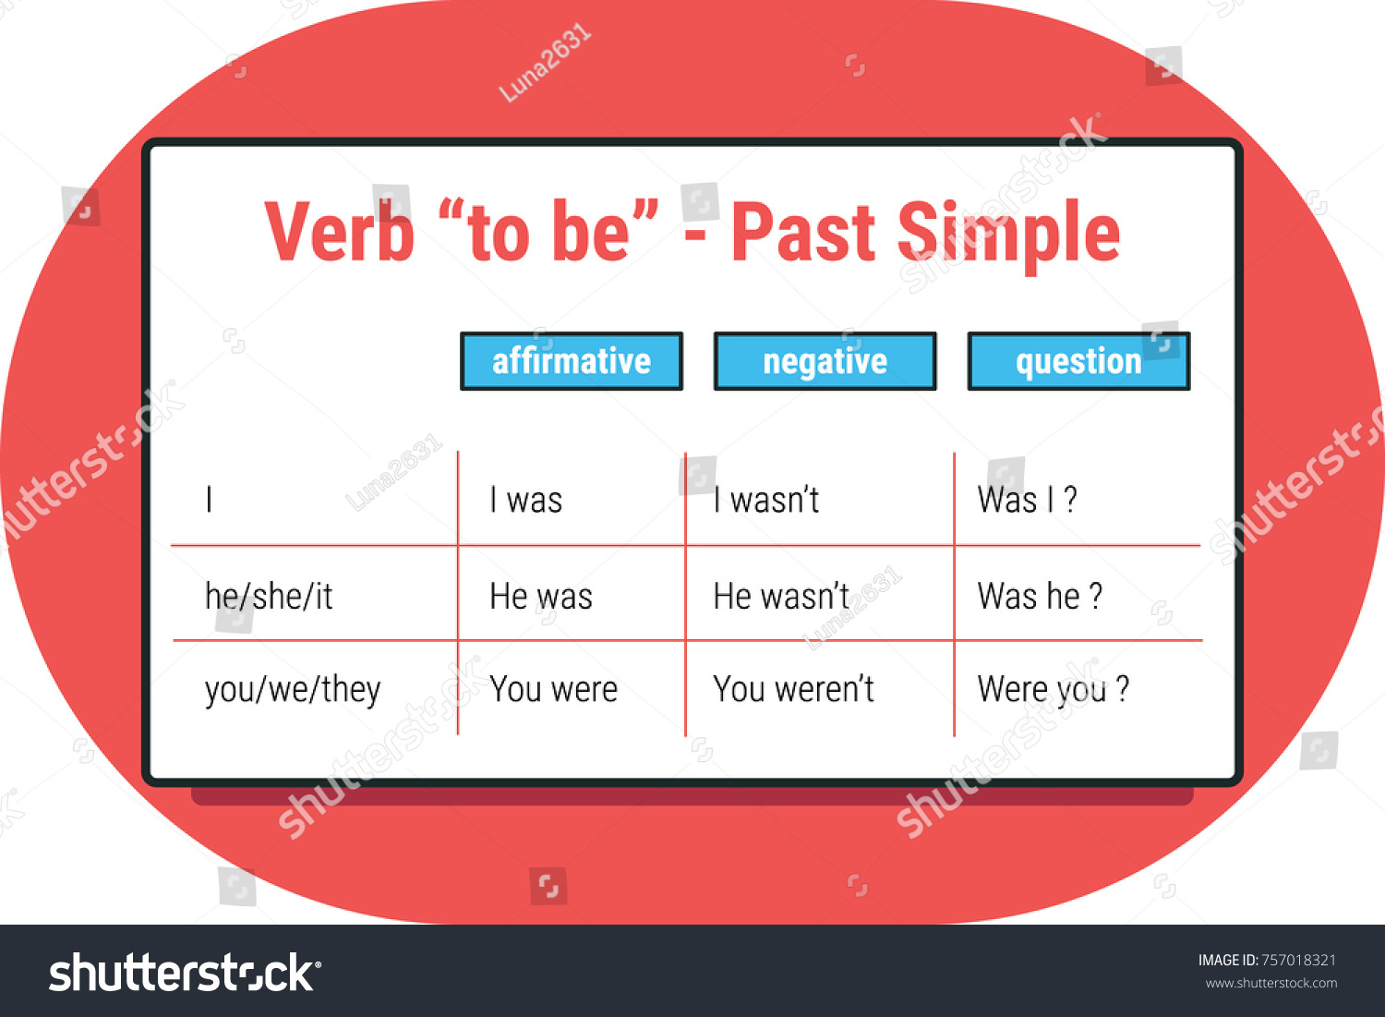

Slide 9
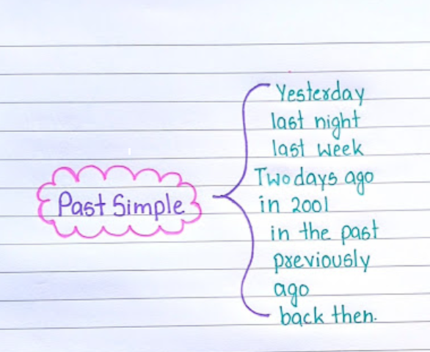

Slide 10
Remember, some verbs in English are regular while others are irregular.
· Regular verbs are formed by adding (d,ed) to the end of the verb following the rules below:
Basic rules
· Most verbs: Add "-ed" to the end. o Example: jump -> jumped
· Verbs ending in "e": Add "-d" to the end. o Example: like -> liked
Rules for specific endings
· Verb ends in "y": o If the "y" is preceded by a consonant, change "y" to "i" and add "-ed". o Example: carry -> carried
o If the "y" is preceded by a vowel, just add "-ed". o Example: play -> played · Verb ends in a single vowel followed by a single consonant: Double the final consonant before adding "-ed," provided the last syllable is stressed.
o Example: stop -> stopped, hug -hugged
For irregular verbs, see and study the list of most commonly used ones at the end of this booklet.

Slide 11
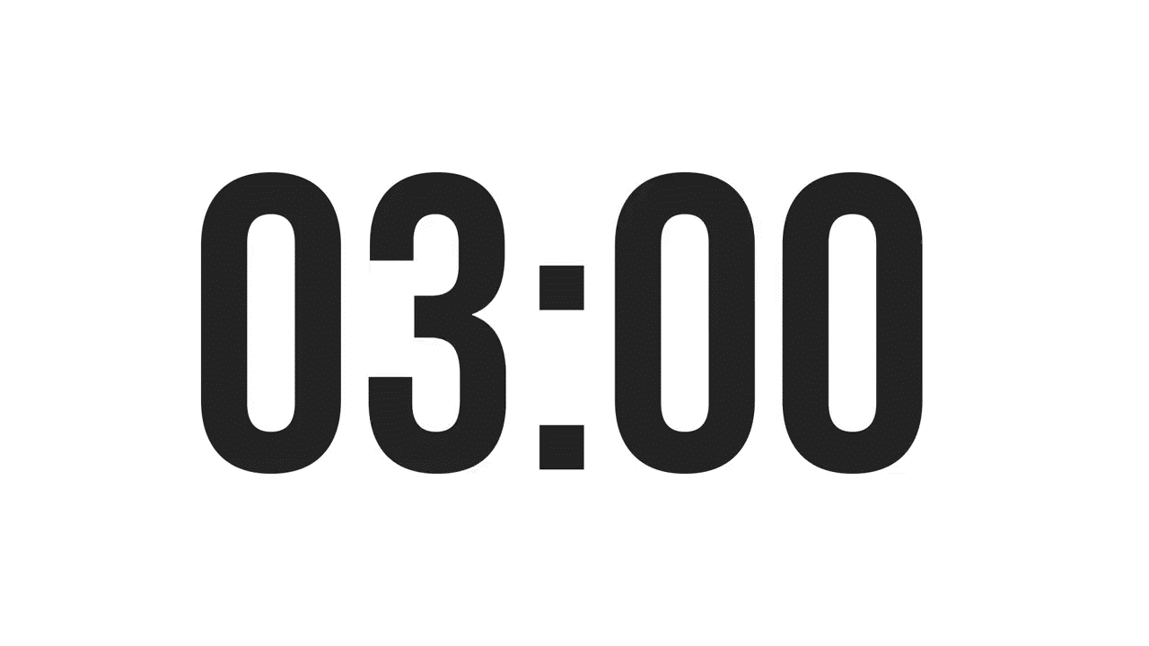
ISLAMIC EDUCATIONAL COLLEGE DATE:
SUBJECT: Past Tenses
GRADE:
UNIT:
LESSON : 3
LESSON: 1
OUTCOMES
students 1+2 : write 5 sentences , different forms using the past simple
students 3+4 : write a short paragraph, start with last week, I forgot my homework at home…..
03:00 minutes
WARM UP
PREASSESSMENT
PRESENTATION
FORMATIVE ASSESSMENT
FEEDBACK
DIFFERENTIATION
REAL LIFE APPLICATION
CRITICAL THINKING
EXIT TICKET

Slide 12

ISLAMIC EDUCATIONAL COLLEGE DATE:
SUBJECT: Past Tenses
GRADE:
UNIT:
LESSON : 3
LESSON: 1
OUTCOMES
What is the difference between
‘I have visited my friend’
‘I visited my friend yesterday’?
03:00 minutes
WARM UP
PREASSESSMENT
PRESENTATION
FORMATIVE ASSESSMENT
FEEDBACK
DIFFERENTIATION
REAL LIFE APPLICATION
CRITICAL THINKING
EXIT TICKET

Slide 13
1️⃣ I have visited my friend.
This is Present Perfect.
Use it to talk about an experience at an unspecified time in the past.
The exact time is not mentioned.
It often focuses on the experience or result, not when it happened.
2️⃣ I visited my friend yesterday.
This is Past Simple.
Use it to talk about a completed action at a specific time in the past.
The time is clearly mentioned (“yesterday”).
It’s about when the action happened, not about the experience in general.
FEEDBACK

Slide 14


ISLAMIC EDUCATIONAL COLLEGE DATE: :
SUBJECT: Past Tenses
GRADE:
UNIT:
LESSON: 1
OUTCOMES
Complete the sentences with the correct Past Simple form:
Yesterday, I _______ (be) very tired after school.
I _______ (not/finish) my homework because I was late.
_______ you _______ (go) to the park after class?
My friend _______ (see) a funny movie last night.
We _______ (play) football together before dinner.
The teacher _______ (not/be) in the classroom yesterday
02:00 minutes
WARM UP
PREASSESSMENT
PRESENTATION
FORMATIVE ASSESSMENT
FEEDBACK
DIFFERENTIATION
REAL LIFE APPLICATION
CRITICAL THINKING
EXIT TICKET

Slide 15
Answer Key:
was
didn’t finish
Did / go
saw
played
wasn’t

Slide 16
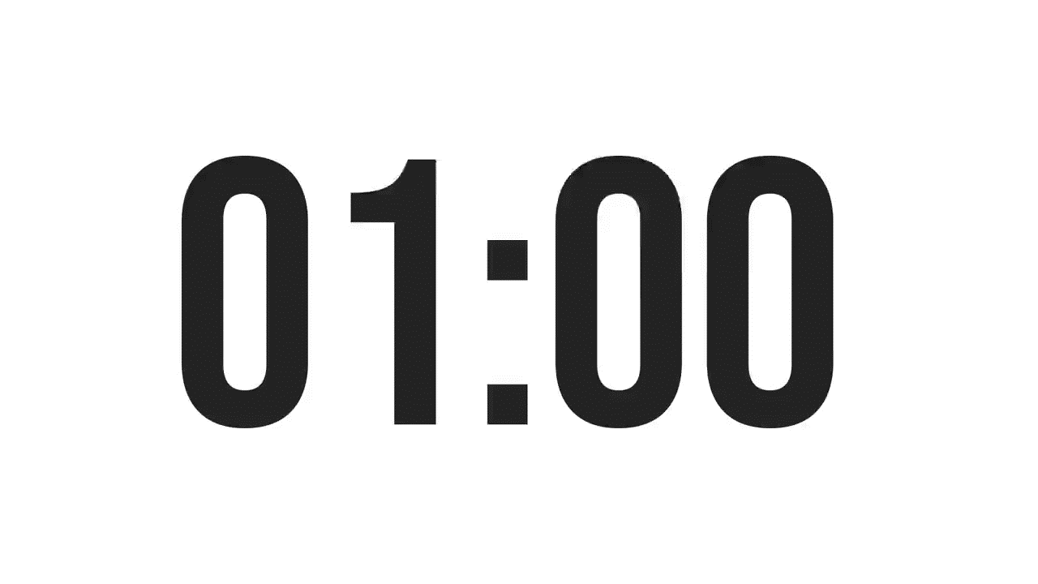
ISLAMIC EDUCATIONAL COLLEGE DATE: :
SUBJECT: Past Tenses
GRADE:
UNIT:
LESSON: 1
OUTCOMES
01:00 minute
WARM UP
Real Life Application : Share a short story with your classmates about an activity you did last weekend. Use past tense verbs in your sentences.
PREASSESSMENT
PRESENTATION
FORMATIVE ASSESSMENT
FEEDBACK
DIFFERENTIATION
REAL LIFE APPLICATION
CRITICAL THINKING
EXIT TICKET
BUZZ IN

Slide 17

ISLAMIC EDUCATIONAL COLLEGE DATE: :
SUBJECT: Past Tenses
GRADE:
UNIT:
LESSON: 1
OUTCOMES
01:00 minute
WARM UP
Critical Thinking:
Sometimes people spend a lot of time thinking about the past and old memories. What advice would you give to someone who feels stuck in the past?
PREASSESSMENT
PRESENTATION
FORMATIVE ASSESSMENT
FEEDBACK
DIFFERENTIATION
REAL LIFE APPLICATION
CRITICAL THINKING
EXIT TICKET
BUZZ IN

Slide 18
https://create.kahoot.it/share/duplicate-of-past-simple/af97fed9-486d-49e6-833a-d506e4b9bb24

Slide 19
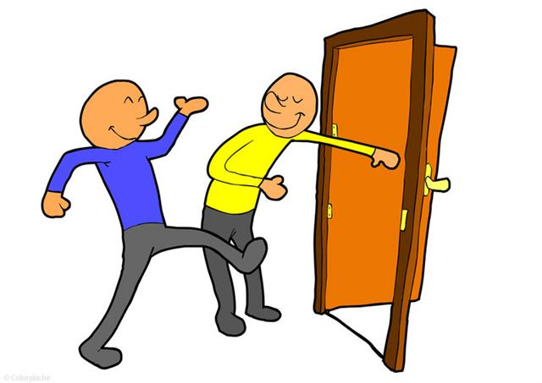
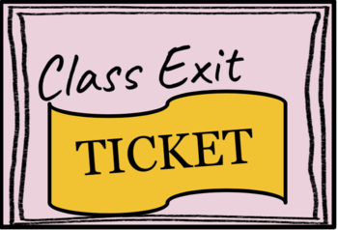
ISLAMIC EDUCATIONAL COLLEGE DATE: :
SUBJECT: Past Tenses
GRADE: 10
UNIT: 2
LESSON: 1
OUTCOMES
EXIT TICKET:
Give one sentence using the past tense correctly.
02:00 minutes
WARM UP
PREASSESSMENT
PRESENTATION
FORMATIVE ASSESSMENT
FEEDBACK
DIFFERENTIATION
REAL LIFE APPLICATION
CRITICAL THINKING
EXIT TICKET
BUZZ IN

