Slide 1


Unit: 3
Lesson: Grammar
Subject: first conditional
Grade: 9

Slide 2


ISLAMIC EDUCATIONAL COLLEGE DATE: :
SUBJECT: Past Tenses
GRADE: 10
UNIT: 2
Lesson: 4
LESSON
OBJECTIVES
OBJECTIVES:
By the end of the lesson, students will be able to:
Identify the use of first conditional.
Form first conditional sentences
01:00 minute
WARM UP
PREASSESSMENT
PRESENTATION
FORMATIVE ASSESSMENT
FEEDBACK
DIFFERENTIATION
REAL LIFE APPLICATION
CRITICAL THINKING
EXIT TICKET

Slide 3
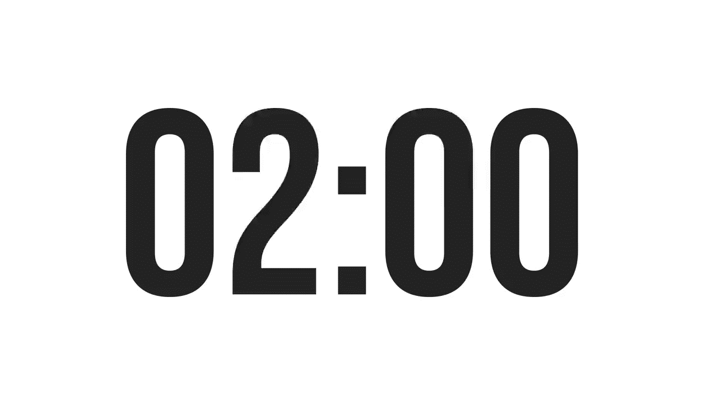
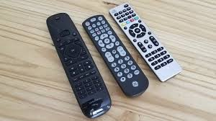
ISLAMIC EDUCATIONAL COLLEGE DATE:
SUBJECT: Past Tenses
GRADE:
UNIT:
LESSON: 1
OUTCOMES
02:00 minutes
PREASSESSMENT:
what is meant by a clause?
a) a group of words that has a subject b) a group of words that has a subject and a verb c) a group of words that has two subjects and a verb
WARM UP
PREASSESSMENT
PRESENTATION
FORMATIVE ASSESSMENT
FEEDBACK
DIFFERENTIATION
REAL LIFE APPLICATION
CRITICAL THINKING
EXIT TICKET

Slide 4
ISLAMIC EDUCATIONAL COLLEGE DATE:
SUBJECT: Past Tenses
GRADE:
UNIT:
LESSON: 1
OUTCOMES
02:00 minutes
PREASSESSMENT:
what is meant by a clause?
a) a group of words that has a subject b) a group of words that has a subject and a verb c) a group of words that has two subjects and a verb
WARM UP
PREASSESSMENT
PRESENTATION
FORMATIVE ASSESSMENT
FEEDBACK
DIFFERENTIATION
REAL LIFE APPLICATION
CRITICAL THINKING
EXIT TICKET

Slide 5

ISLAMIC EDUCATIONAL COLLEGE DATE:
SUBJECT: Past Tenses
GRADE:
UNIT:
LESSON: 1
OUTCOMES
02:00 minutes
What will your parents do if you fail your Math exam?
WARM UP
PREASSESSMENT
PRESENTATION
FORMATIVE ASSESSMENT
FEEDBACK
DIFFERENTIATION
REAL LIFE APPLICATION
CRITICAL THINKING
EXIT TICKET

Slide 6
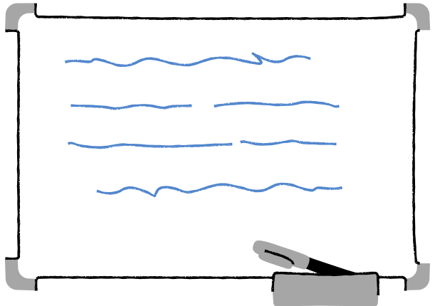

In This Lesson:
What is the first conditional?
How to form first conditional sentences.
First conditional example sentences
Review Quiz
www.Games4esl.com

Slide 7
1. What Is The First Conditional?
First conditional sentences are used to talk about future things which might happen that we believe are real and possible.
Example:
"If it doesn't rain tomorrow, I'll go to the park."
www.Games4esl.com

Slide 8
2. How To Form First Conditional Sentences
First conditional sentences are made up of an 'if clause' and a 'main clause'. The 'if clause' has the present simple tense. The 'main clause' has the future simple tense with will.
Example:
"If it doesn't rain tomorrow, I'll go to the park."
www.Games4esl.com

Slide 9
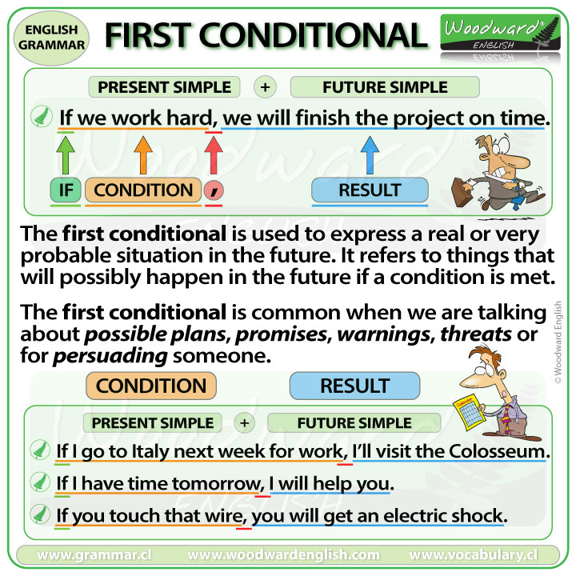

Slide 10
My sister / not win she / be sad
If __________________________, _____________________________
______________________________ if _______________________________

Slide 11
My sister / not win she / be sad
If my sister doesn’t win, she will be sad.
My sister will be sad if she doesn’t win.

Slide 12
Your room / be tidy you / leave
If __________________________, _____________________________
______________________________ if _______________________________

Slide 13
Your room / be tidy you / leave
If your room is tidy, you will leave.
You will leave if your room is tidy.

Slide 14
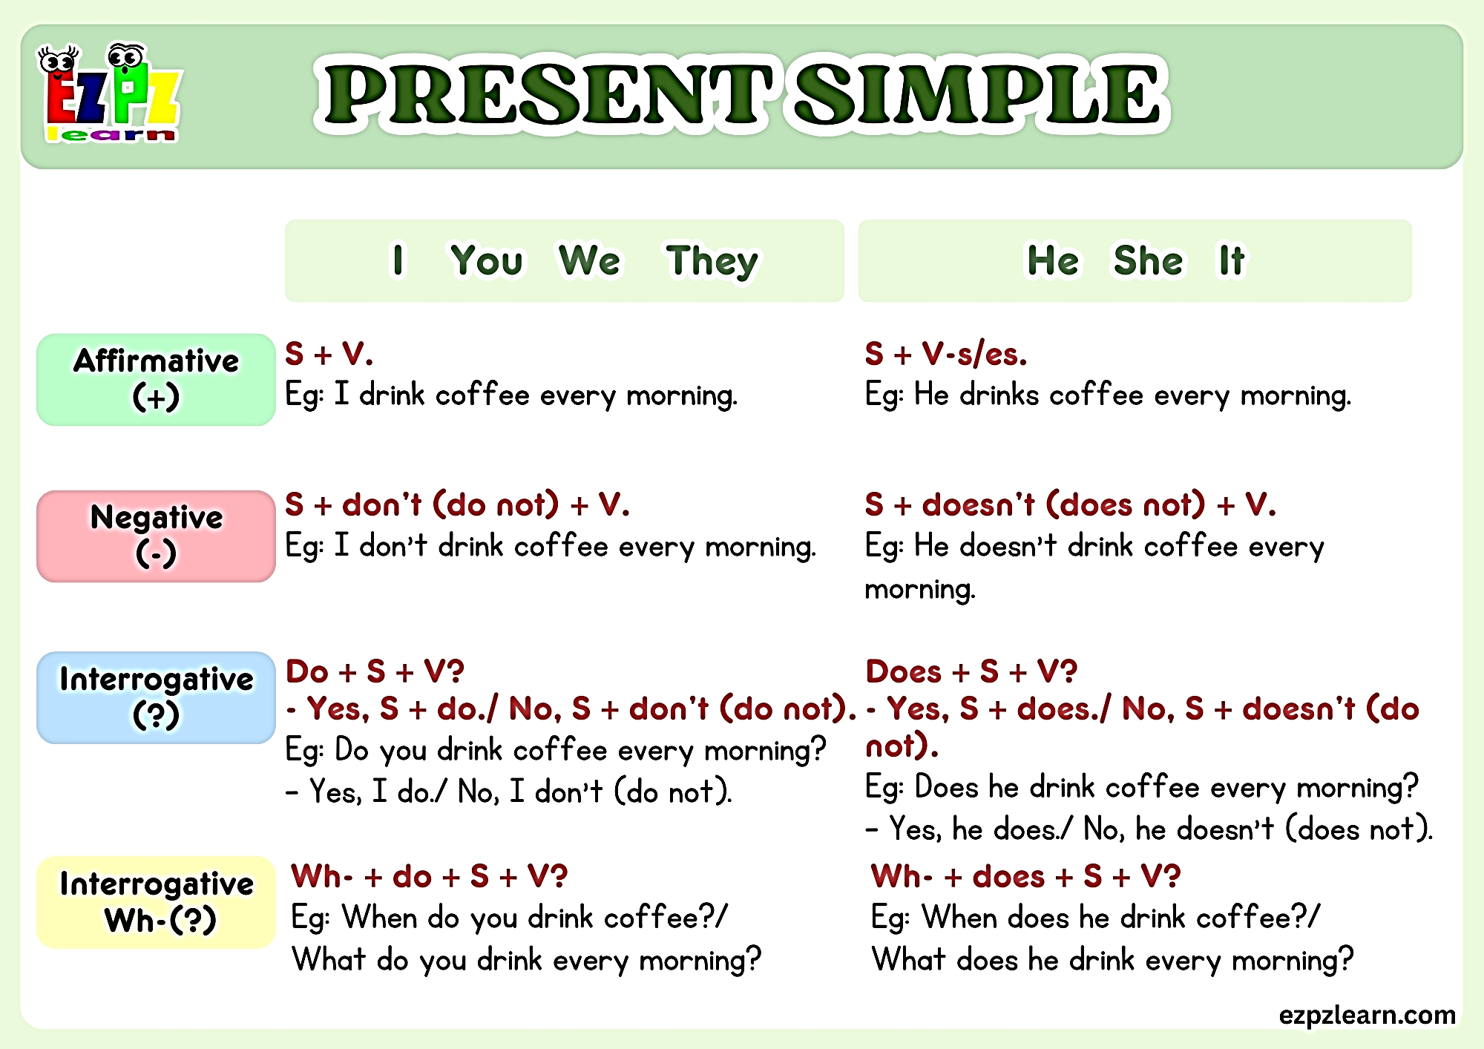

Slide 15
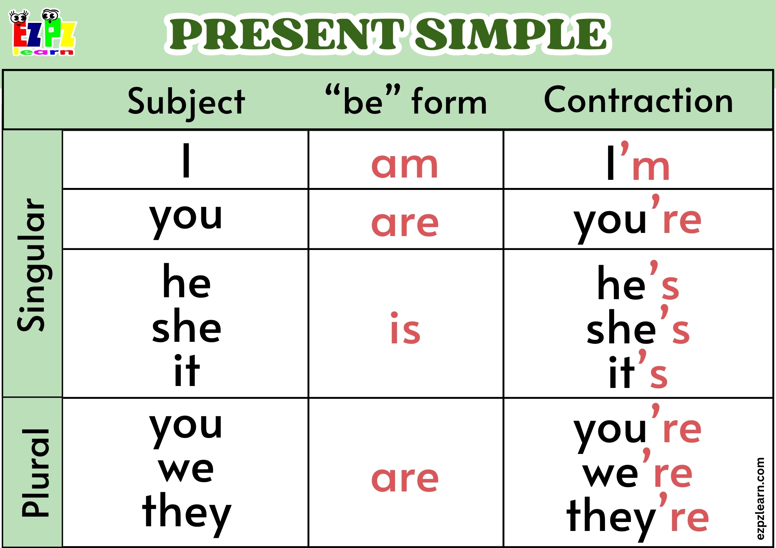

Slide 16
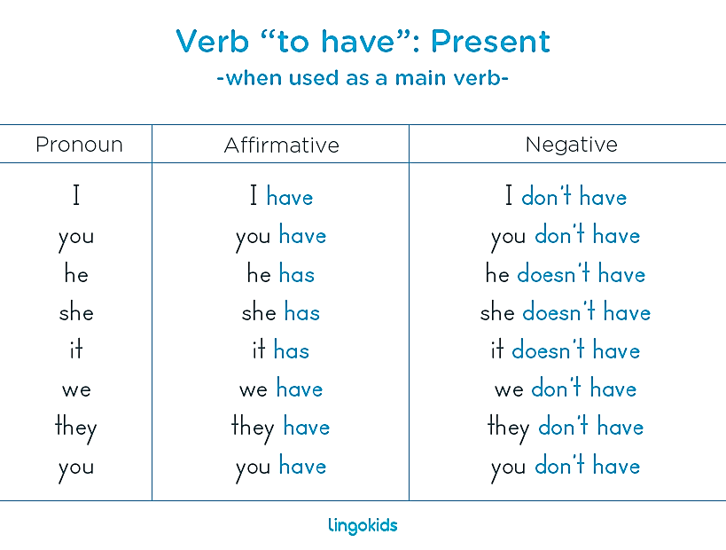

Slide 17
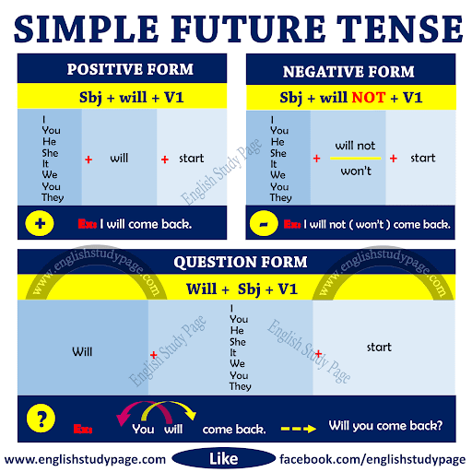

Slide 18
If + S + present simple , S + simple future
Conditional clause
If clause
Main clause
Result clause
If my colleagues agree, our project will be about climate change.
Our project will be about climate change if my colleagues agree
If she doesn’t return my calls, I won’t talk to her again
I won’t talk to her again If she doesn’t return my calls

Slide 19
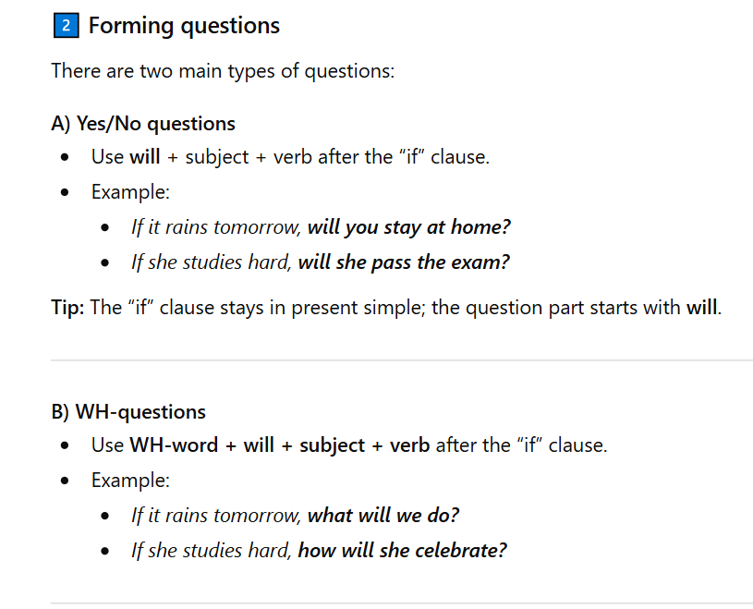

Slide 20

Forming questions : we form the question in the main clause using will
If she __________ (study) hard, __________ she __________ (pass) the exam?
If they __________ (be) tired, __________ they __________ (rest) at home?
If he __________ (eat) too much cake, what __________ he __________ (feel)?
If it __________ (be) sunny tomorrow, __________ we __________ (go) to the beach
If I __________ (be) late, who __________ (wait) for me?
doesn’t study/will she pass
aren’t /will they rest
doesn’t eat/will he feel
is /will we go
am/ will wait

Slide 21
DIFFERENTIATION
3+4
Instructions: Write three sentences using the first conditional. Then, rewrite each sentence in the negative form and as a question.
1+2
Instructions: Use the two events to make first conditional sentences
It rains tomorrow / you stay at home
She is tired / she goes to bed early
I am late / my friend waits for me

Slide 22
It rains tomorrow / you stay at home
Statement: If it rains tomorrow, you will stay at home.
Question: If it rains tomorrow, will you stay at home?
She is tired / she goes to bed early
Statement: If she is tired, she will go to bed early.
Question: If she is tired, will she go to bed early?
I am late / my friend waits for me
Statement: If I am late, my friend will wait for me.
Question: If I am late, will my friend wait for me?
He studies hard / he passes the test
Statement: If he studies hard, he will pass the test.
Question: If he studies hard, will he pass the test?
They don’t eat lunch / they feel hungry
Statement: If they don’t eat lunch, they will feel hungry.
Question: If they don’t eat lunch, will they feel hungry?
We go to the park / we play football
Statement: If we go to the park, we will play football.
Question: If we go to the park, will we play football?

Slide 23

3. Example Sentences
If we eat all this cake, we will feel sick.
www.Games4esl.com

Slide 24

3. Example Sentences
If I am late for class, the teacher will be angry.
www.Games4esl.com

Slide 25

3. Example Sentences
If we don't leave now, we will miss the train.
www.Games4esl.com

Slide 26

3. Example Sentences
If it rains, I'll take a taxi.
www.Games4esl.com

Slide 27

3. Example Sentences
If I don't study, I'll fail the test.

Slide 28
https://create.kahoot.it/share/first-conditional/82a17f8d-380a-44b1-9b83-05f7fcb4784b

Slide 29

Review Quiz
Choose the correct answer to make a first conditional sentence
www.Games4esl.com

Slide 30
1
If it rains,
A
I will stay at home.
B
I stays at home.
C
staying at home.
www.Games4esl.com

Slide 31
1
If it rains,
A
I will stay at home.
B
I stays at home.
C
staying at home.
www.Games4esl.com

Slide 32
2
If I wake up late,
A
I was late for work.
B
I lates for work.
C
I will be late for work.
www.Games4esl.com

Slide 33
2
If I wake up late,
A
I was late for work.
B
I lates for work.
C
I will be late for work.
www.Games4esl.com

Slide 34
3
If you come home late,
A
I am angry.
B
I will be angry.
C
I be angry.
www.Games4esl.com

Slide 35
3
If you come home late,
A
I am angry.
B
I will be angry.
C
I be angry.
www.Games4esl.com

Slide 36
4
If she comes to the party,
A
I'll be surprised.
B
I wasn't surprised.
C
I am surprised.
www.Games4esl.com

Slide 37
4
If she comes to the party,
A
I'll be surprised.
B
I wasn't surprised.
C
I am surprised.
www.Games4esl.com

Slide 38
5
If I don't go to sleep early,
A
I am so tired.
B
I will be tired.
C
I was tired.
www.Games4esl.com

Slide 39
5
If I don't go to sleep early,
A
I am so tired.
B
I will be tired.
C
I was tired.
www.Games4esl.com

