Slide 1
Unreal Conditional
2nd

Slide 2


ISLAMIC EDUCATIONAL COLLEGE DATE: :
SUBJECT: Past Tenses
GRADE: 10
UNIT: 2
Lesson: 4
LESSON
OBJECTIVES
OBJECTIVES:
By the end of the lesson, students will be able to:
Identify the structure and use of the second
Form correct second conditional sentences to express unreal situations
01:00 minute
WARM UP
PREASSESSMENT
PRESENTATION
FORMATIVE ASSESSMENT
FEEDBACK
DIFFERENTIATION
REAL LIFE APPLICATION
CRITICAL THINKING
EXIT TICKET

Slide 3
PRESENTATION
Give examples of past simple verbs
Give examples of modal verbs

Slide 4
A conditional sentence is a sentence that expresses a condition and its result. It usually has two parts.
PRESENTATION
If clause (condition)
Conditional sentence
Main clause
(result)
If + subject + verb
subject + verb
,

Slide 5

If you won the lottery, what would you do?
If your life were a movie, what would the title be?

Slide 6
Are they real or imaginary?
How likely are they to happen?
If I won the lottery, I would save some money for the future.
If my life were a movie, I would call it the unexpected journey.
If she had more free time, she would read a book.
I would be afraid if someone pointed a gun at me.
Imaginary future situation and unlikely to happen ) . “Won the lottery” is something the speaker imagines might happen someday.
Your life is not a movie. Imaginary present situation)
she doesn’t have free time now/imaginary present)
Hypothetical /imaginary future situation and unlikely to happen ) . “Won the lottery” is something the speaker imagines might happen someday.

Slide 7
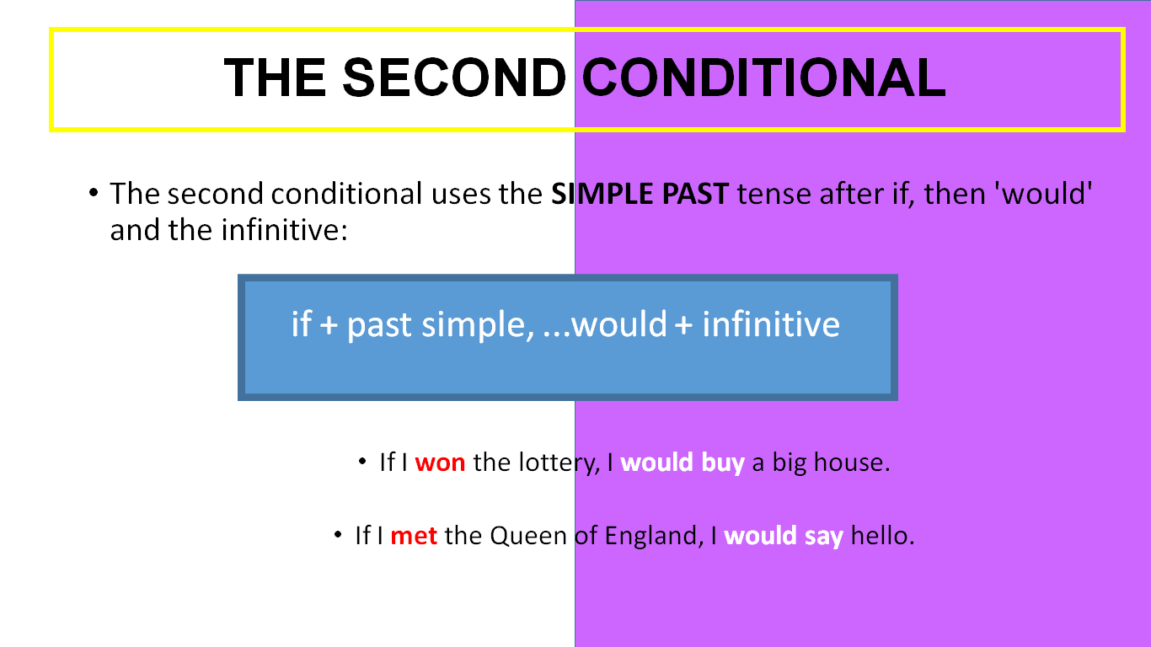

Slide 8


Verb to be in second conditional sentences
✅ In second conditional sentences, we usually use "were" for all subjects when using the verb to be — even with "I", "he", "she", etc.
✔️ Correct:
If I were rich, I would travel the world.
If she were taller, she could play basketball.
If he were the president, he would change the rules.
If it were summer now, we would go swimming.
❗Why "were" and not "was"?
We use "were" (called the subjunctive form) to show that the situation is unreal or imaginary
BUT: In informal English , people sometimes say "If I was...", especially in speaking:
If I was rich, I’d travel the world. ✅ (Common in speech, but less formal)

Slide 9
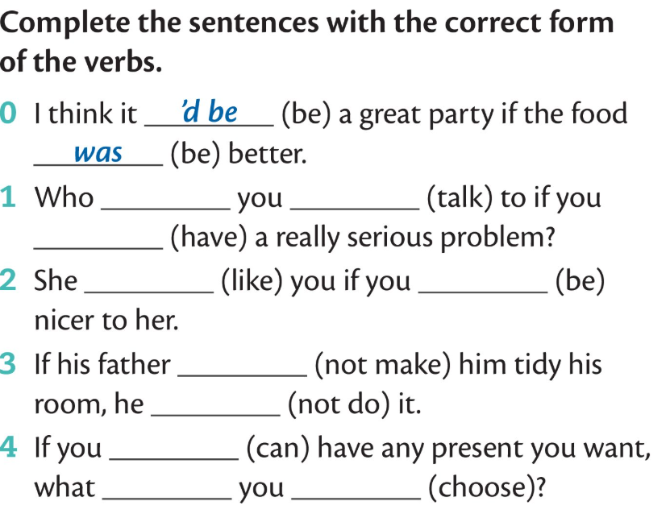
FORMATIVE ASSESSMENT

Slide 10
FEEDBACK
would/talk/had
Would like /were
Didn’t make /wouldn’t
Could /would/choose

Slide 11
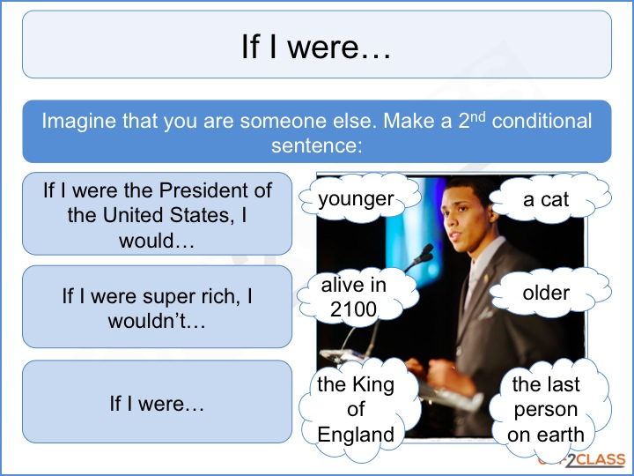
If I were to give advice

Slide 12
EXIT TICKET
https://create.kahoot.it/share/second-conditional/4d2d671c-1e58-4e0b-9563-eea88d3a5f0d

