Slide 1


Unit: 3
Lesson: Grammar
Subject: Past continuous
Grade: 10

Slide 2


ISLAMIC EDUCATIONAL COLLEGE DATE: :
SUBJECT: Past Tenses
GRADE: 10
UNIT: 2
Lesson: 4
LESSON
OBJECTIVES
OBJECTIVES:
By the end of the lesson, students will be able to:
Identify the uses and forms of the past continuous tense.
Identify the key words and time expressions used with the past continuous.
01:00 minute
WARM UP
PREASSESSMENT
PRESENTATION
FORMATIVE ASSESSMENT
FEEDBACK
DIFFERENTIATION
REAL LIFE APPLICATION
CRITICAL THINKING
EXIT TICKET

Slide 3

ISLAMIC EDUCATIONAL COLLEGE DATE:
SUBJECT: Past Tenses
GRADE:
UNIT:
LESSON: 1
OUTCOMES
0:30 minutes
What were you doing at 7 oclock yesterday?
WARM UP
PREASSESSMENT
PRESENTATION
FORMATIVE ASSESSMENT
FEEDBACK
DIFFERENTIATION
REAL LIFE APPLICATION
CRITICAL THINKING
EXIT TICKET

Slide 4
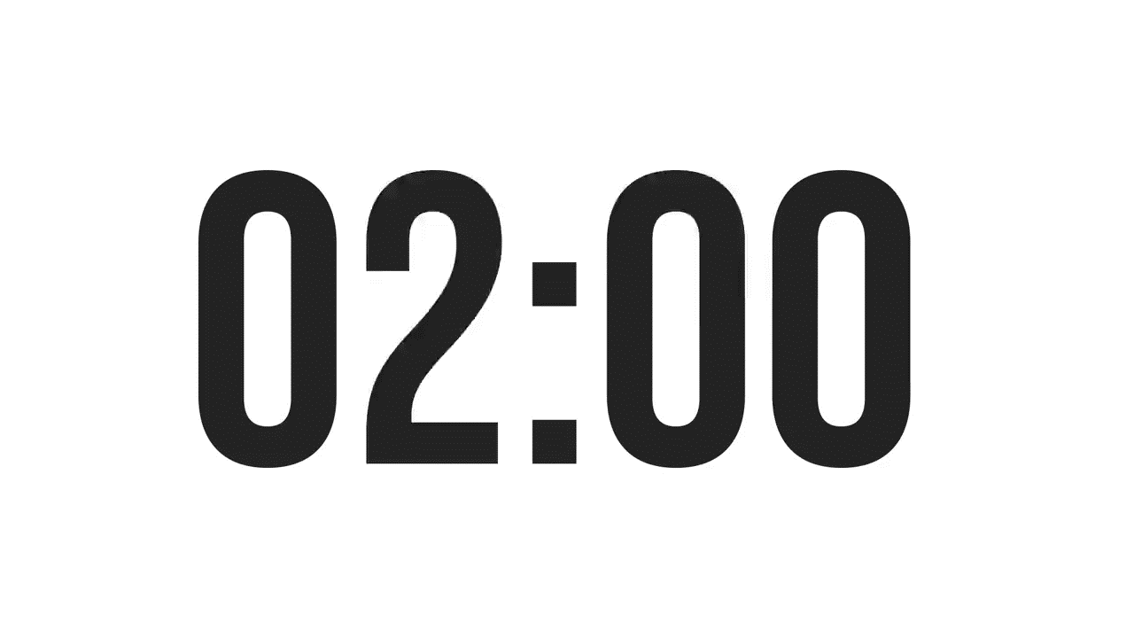
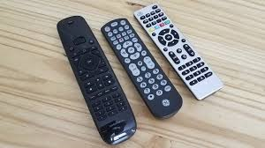
ISLAMIC EDUCATIONAL COLLEGE DATE:
SUBJECT: Past Tenses
GRADE:
UNIT:
LESSON: 1
OUTCOMES
02:00 minutes
PREASSESSMENT:
I ________ lunch when you called.
1. had
2. was having
3. have had
WARM UP
PREASSESSMENT
PRESENTATION
FORMATIVE ASSESSMENT
FEEDBACK
DIFFERENTIATION
REAL LIFE APPLICATION
CRITICAL THINKING
EXIT TICKET

Slide 5
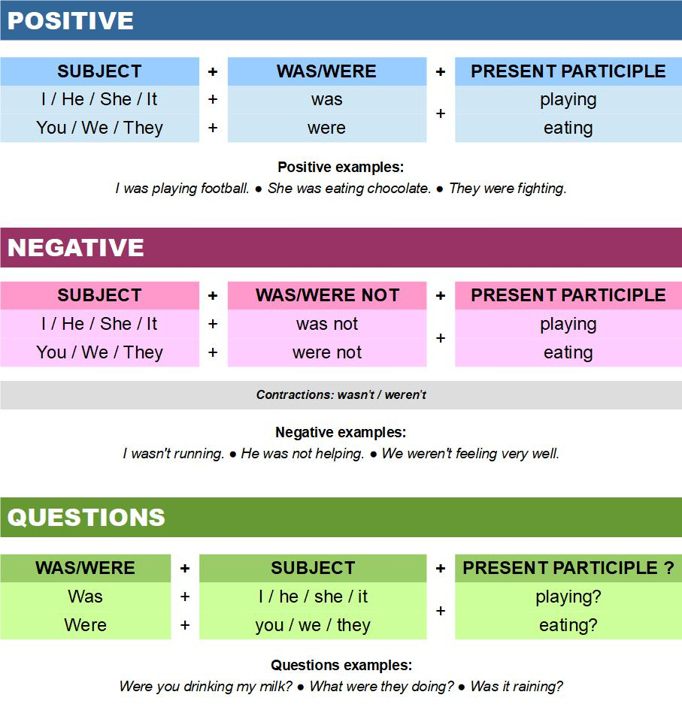

Slide 6
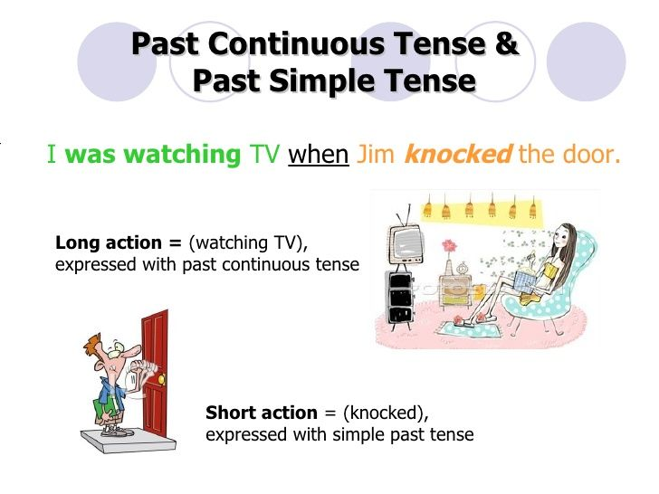
ISLAMIC EDUCATIONAL COLLEGE DATE:
SUBJECT: Past Tenses
GRADE: 10
UNIT: 2
LESSON:1
OUTCOMES
0:30 minutes
Use 1
WARM UP
PREASSESSMENT
PRESENTATION
FORMATIVE ASSESSMENT
FEEDBACK
DIFFERENTIATION
REAL LIFE APPLICATION
CRITICAL THINKING
EXIT TICKET

Slide 7
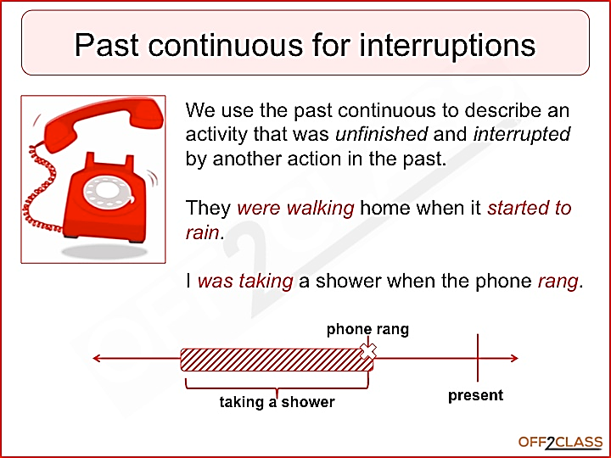
ISLAMIC EDUCATIONAL COLLEGE DATE:
SUBJECT: Past Tenses
GRADE: 10
UNIT: 2
LESSON:1
OUTCOMES
Past continuous + when + past simple.
when +Past simple + Past continuous
0:30 minutes
WARM UP
PREASSESSMENT
PRESENTATION
FORMATIVE ASSESSMENT
FEEDBACK
DIFFERENTIATION
REAL LIFE APPLICATION
CRITICAL THINKING
EXIT TICKET

Slide 8
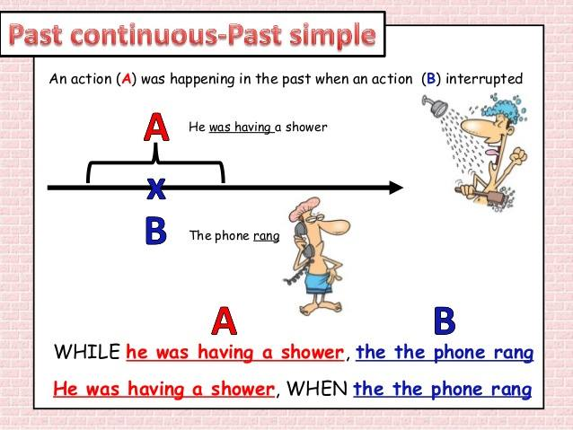
Past simple while Past continuous .
while Past continuous ,Past simple.
As Past continuous ,Past simple. As she was cooking, the phone rang.

Slide 9
✅ Simple rule
While → almost always introduces the long action (past continuous).
When → usually introduces the short action (past simple), but it can also introduce the long action.
🔍 Examples
1. While = long action
While I was sleeping, someone knocked on the door. (Sleeping = long, knocking = interruption)
2. When = short interruption
I was sleeping when someone knocked.
Both can show interruption, but: While → long action When → short action (most of the time)

Slide 10

I __________ (watch) TV when the electricity __________ (go) out.
The girl ___________(arrive)while her brother __________ (play) outside.
They __________ (have) lunch when the phone __________ (ring).
As we __________ (walk) home, it __________ (start) to rain.
Was watching /went
Arrived/was playing
Were having/ rang
Were walking /started

Slide 11
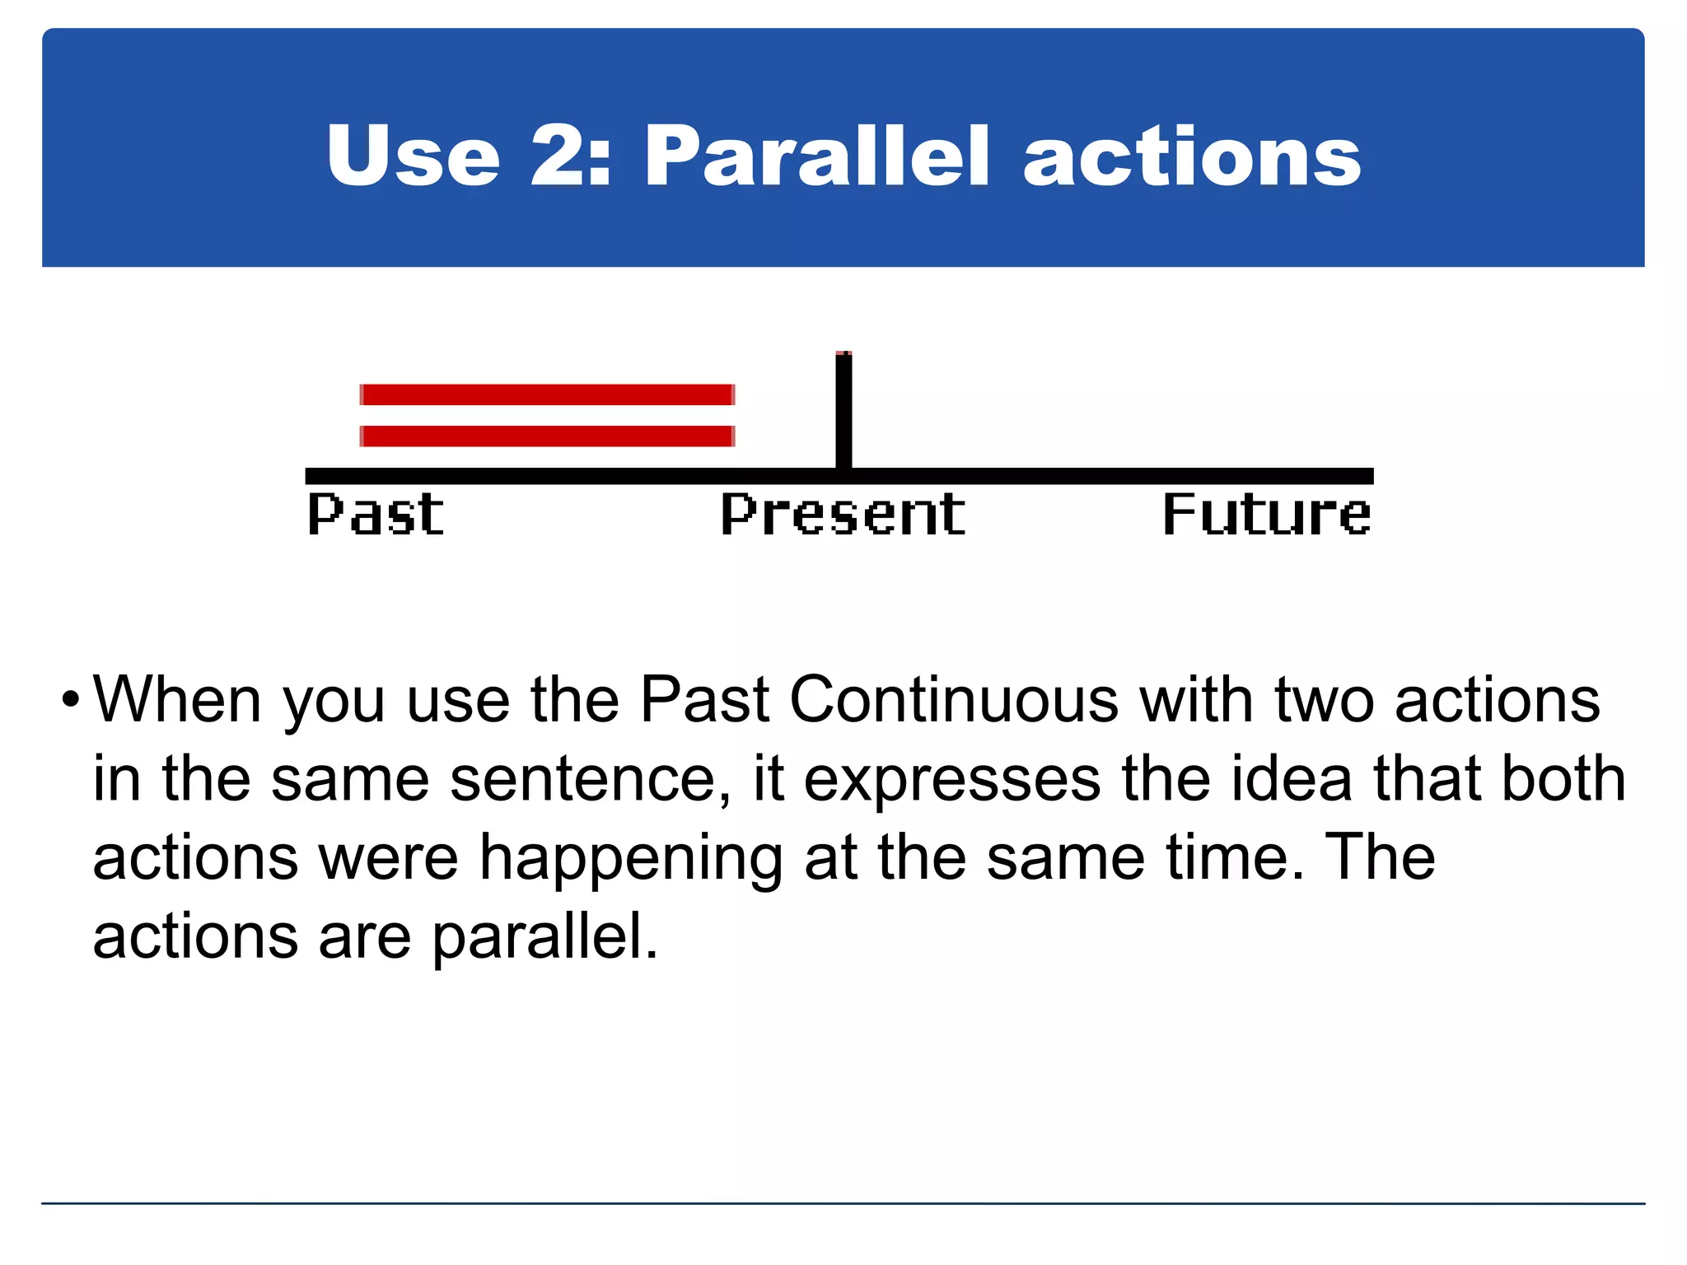
simultaneous
Two long actions
I was cleaning my room while my sister was talking on the phone.
She was walking as they were having lunch.

Slide 12
Maria ___________ (listening) to music as her parents ______________ (watch) tv.
While the kids ___________(play), I ______________(study) for my exams.
Were listening/ were watching
Were playing/ was studying

Slide 13
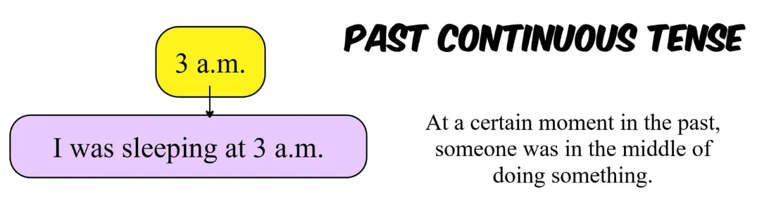
She was writing an essay at midnight yesterday
What were you doing at 5 o'clock three days ago?

Slide 14
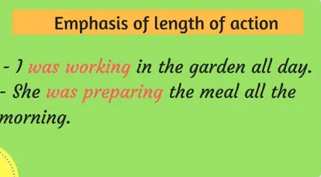

Slide 15
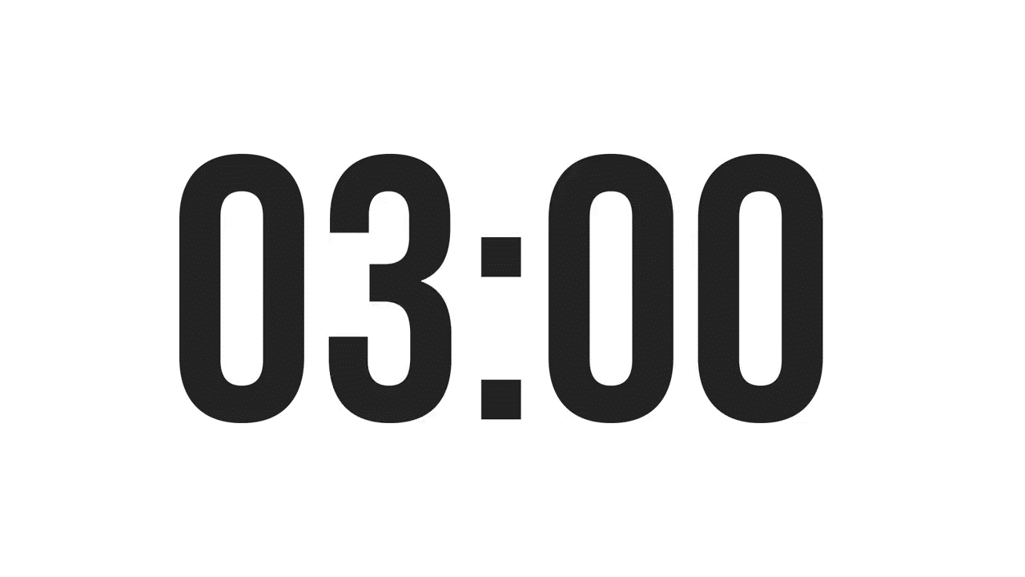

ISLAMIC EDUCATIONAL COLLEGE DATE:
SUBJECT: Past Tenses
GRADE:
UNIT:
LESSON : 3
LESSON: 1
OUTCOMES
Which sentence is correct and why?
‘I was knowing the answer
I knew the answer
03:00 minutes
WARM UP
PREASSESSMENT
PRESENTATION
FORMATIVE ASSESSMENT
FEEDBACK
DIFFERENTIATION
REAL LIFE APPLICATION
CRITICAL THINKING
EXIT TICKET

Slide 16
I was knowing the answer( incorrect)
I knew the answer

Slide 17
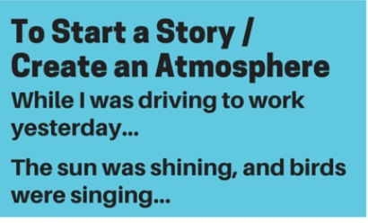
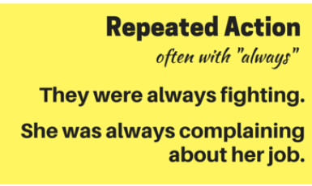
Example: My old roommate was constantly leaving the lights on, which drove up the electricity bill.

Slide 18
Past Continuous Quiz: Fill in the blanks
I __________ (walk) home when it __________ (start) to rain.
She __________ (read) a book as her brother __________ (play) outside.
We __________ (wait) for our old teacher all afternoon .
He __________ (always/complain) about his homework.
______you __________ (see) your friend while you __________ (leave) the park?
I __________ (not/sell) at the market at 5 o’clock last Monday.
She __________ (check) her bag when we __________(meet)
They ___________(not/drive) while I _____________ (watch).

Slide 19
ISLAMIC EDUCATIONAL COLLEGE DATE:
SUBJECT: Past Tenses
GRADE:
UNIT:
LESSON : 3
LESSON: 1
OUTCOMES
students 1+2 : write 5 sentences , different forms using the past continuous
students 3+4 : write a short paragraph, start with last week, I was cleaning when …..
03:00 minutes
WARM UP
PREASSESSMENT
PRESENTATION
FORMATIVE ASSESSMENT
FEEDBACK
DIFFERENTIATION
REAL LIFE APPLICATION
CRITICAL THINKING
EXIT TICKET

