Slide 1

Chapter: 6
Lesson title: Types of Triangles
Subject: math
Class: 10th grade

Slide 2


ISLAMIC EDUCATIONAL COLLEGE DATE: 5-Dec-25 :
SUBJECT: Math
GRADE: 10
UNIT: 2
Lesson: 2
LESSON
Classifying Triangles by their sides

Slide 3
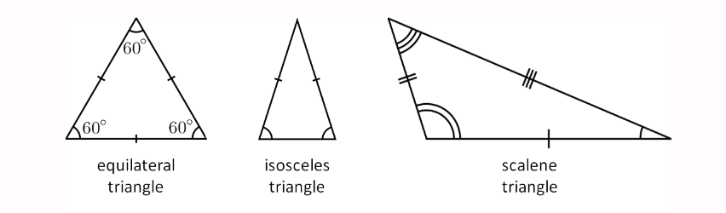
ISLAMIC EDUCATIONAL COLLEGE DATE: 5-Dec-25 :
SUBJECT: Math
GRADE: 10
UNIT: 2
Lesson: 2
LESSON
Classifying by sides:
Equilateral Triangle.
Isosceles Triangle.
Scalene Triangle.

Slide 4
ISLAMIC EDUCATIONAL COLLEGE DATE: 5-Dec-25 :
SUBJECT: Math
GRADE: 10
UNIT: 2
Lesson: 2
LESSON
Classifying Triangles by their angles

Slide 5
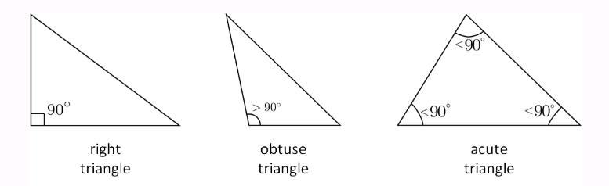
ISLAMIC EDUCATIONAL COLLEGE DATE: 5-Dec-25 :
SUBJECT: Math
GRADE: 10
UNIT: 2
Lesson: 2
LESSON
Classifying by angles:
Acute-angled triangle.
Right-angled triangle.
Obtuse-angled triangle.

Slide 6
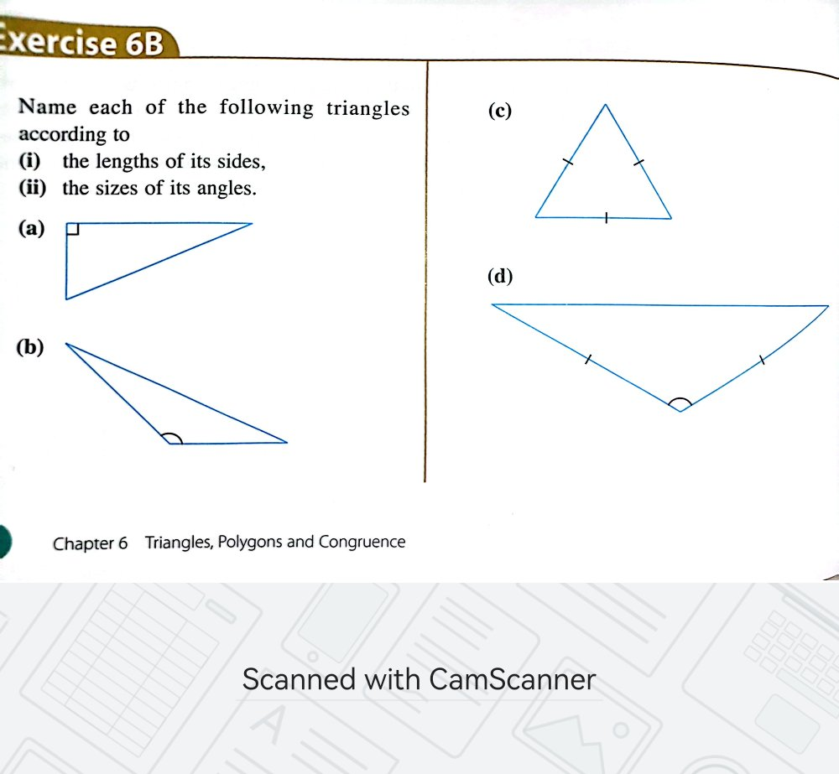
ISLAMIC EDUCATIONAL COLLEGE DATE: 5-Dec-25 :
SUBJECT: Math
GRADE: 10
UNIT: 2
Lesson: 2
LESSON
Exercise 6B page 180

Slide 7
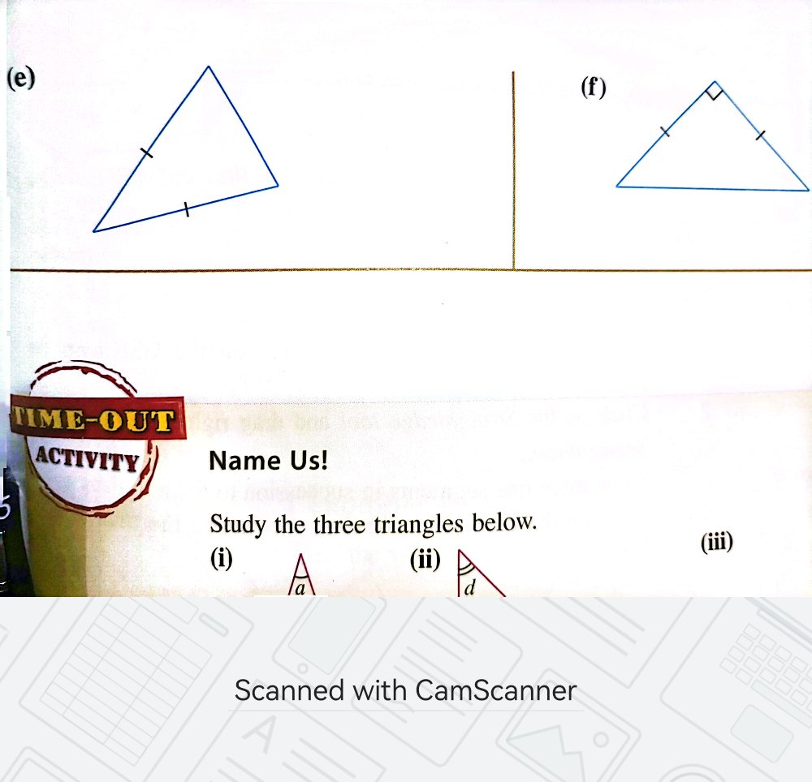
ISLAMIC EDUCATIONAL COLLEGE DATE: 5-Dec-25 :
SUBJECT: Math
GRADE: 10
UNIT: 2
Lesson: 2
LESSON

Slide 8
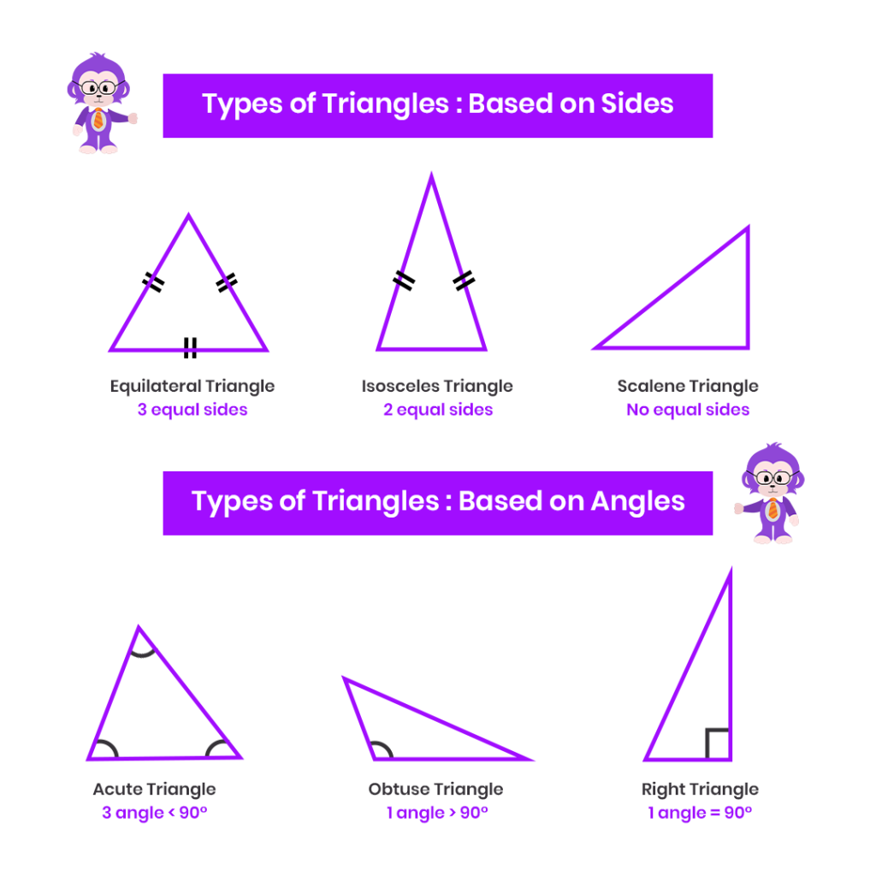
ISLAMIC EDUCATIONAL COLLEGE DATE: 5-Dec-25 :
SUBJECT: Math
GRADE: 10
UNIT: 2
Lesson: 2
LESSON

Slide 9



ISLAMIC EDUCATIONAL COLLEGE DATE: 5-Dec-25 :
SUBJECT: Math
GRADE: 6
UNIT: 3
Lesson: 1
LESSON
What is an angle?

Slide 10
ISLAMIC EDUCATIONAL COLLEGE DATE: 5-Dec-25 :
SUBJECT: Math
GRADE: 6
UNIT: 3
Lesson: 1
LESSON
What is an angle?
An angle is a figure formed by two rays that have the same endpoint.

Slide 11
ISLAMIC EDUCATIONAL COLLEGE DATE: 5-Dec-25 :
SUBJECT: Math
GRADE: 6
UNIT: 3
Lesson: 1
LESSON
Obtuse
Right
Reflex
Acute
Straight

Slide 12
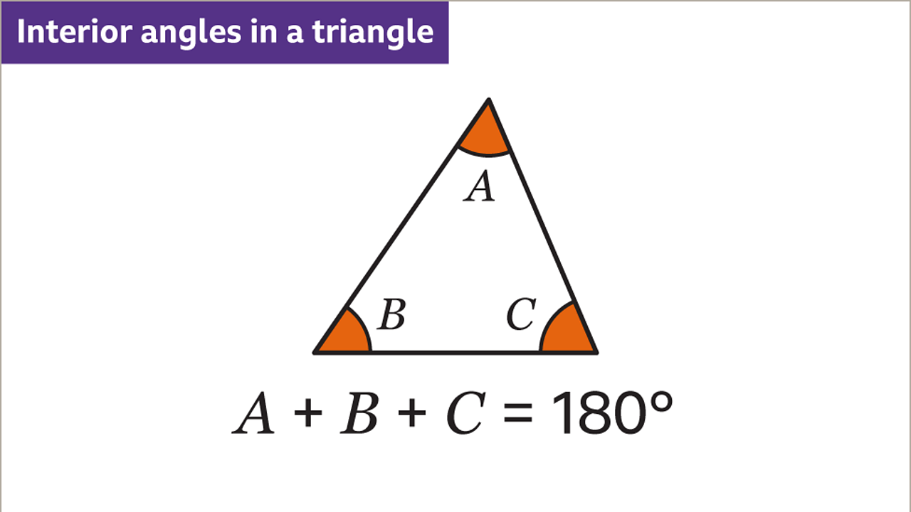
ISLAMIC EDUCATIONAL COLLEGE DATE: 5-Dec-25 :
SUBJECT: Math
GRADE: 10
UNIT: 2
Lesson: 2
LESSON

Slide 13
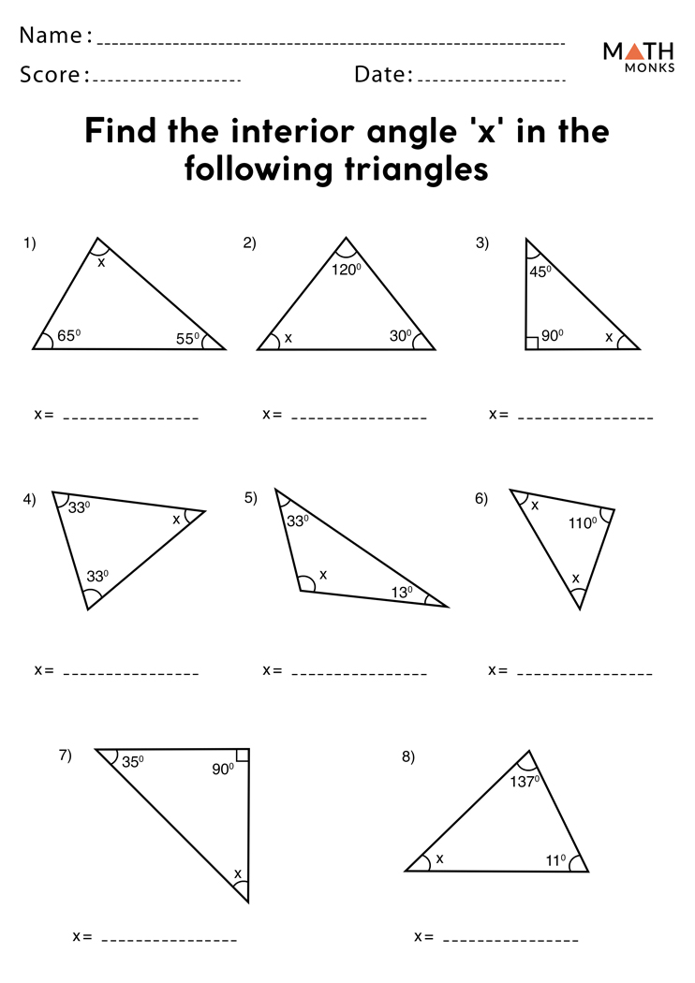
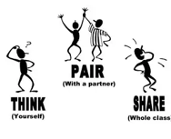
ISLAMIC EDUCATIONAL COLLEGE DATE: 5-Dec-25 :
SUBJECT: Math
GRADE: 10
UNIT: 2
Lesson: 2
LESSON

Slide 14
ISLAMIC EDUCATIONAL COLLEGE DATE: 5-Dec-25 :
SUBJECT: Math
GRADE: 10
UNIT: 2
Lesson: 2
LESSON

Slide 15


ISLAMIC EDUCATIONAL COLLEGE DATE: 5-Dec-25 :
SUBJECT: Math
GRADE: 10
UNIT: 2
Lesson: 2
LESSON
A triangle has angles in the ratio 2:3:4. Find the measure of each angle.

Slide 16
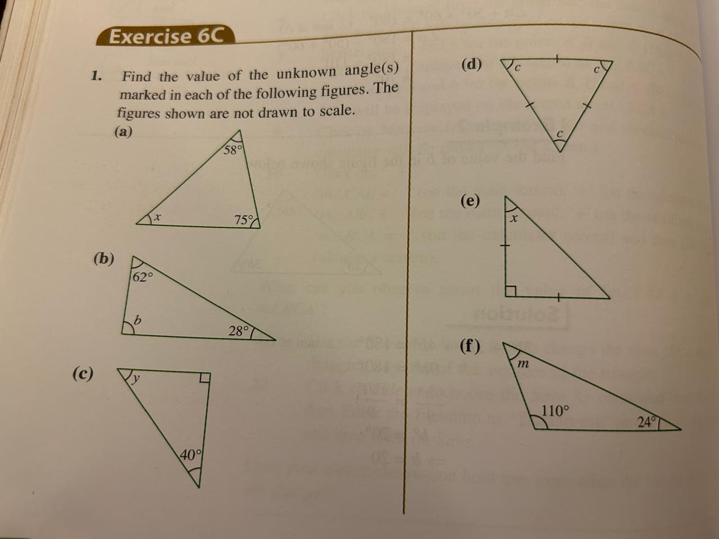
ISLAMIC EDUCATIONAL COLLEGE DATE: 31-Oct-25 :
SUBJECT: Math
GRADE: 10
UNIT: 2
Lesson: 2
LESSON

Slide 17
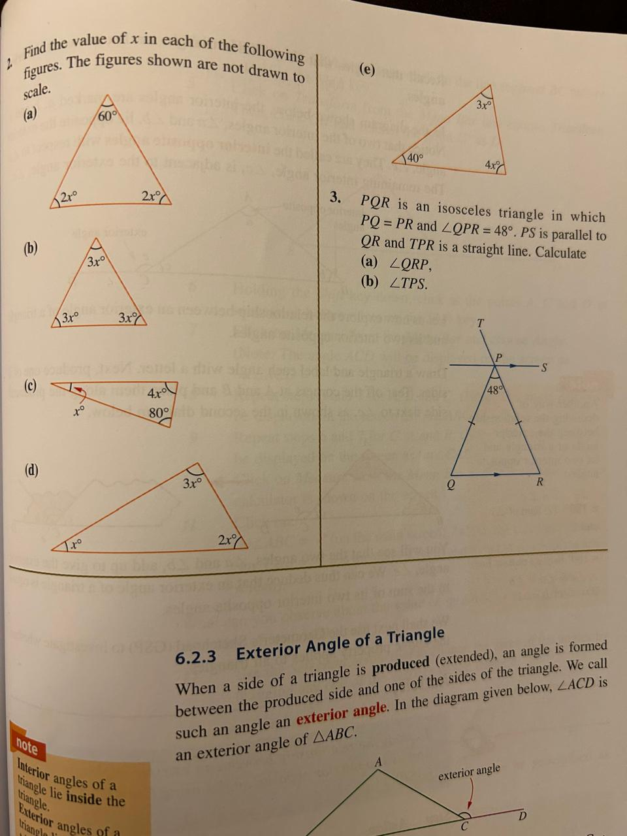
ISLAMIC EDUCATIONAL COLLEGE DATE: 5-Dec-25 :
SUBJECT: Math
GRADE: 10
UNIT: 2
Lesson: 2
LESSON

Slide 18
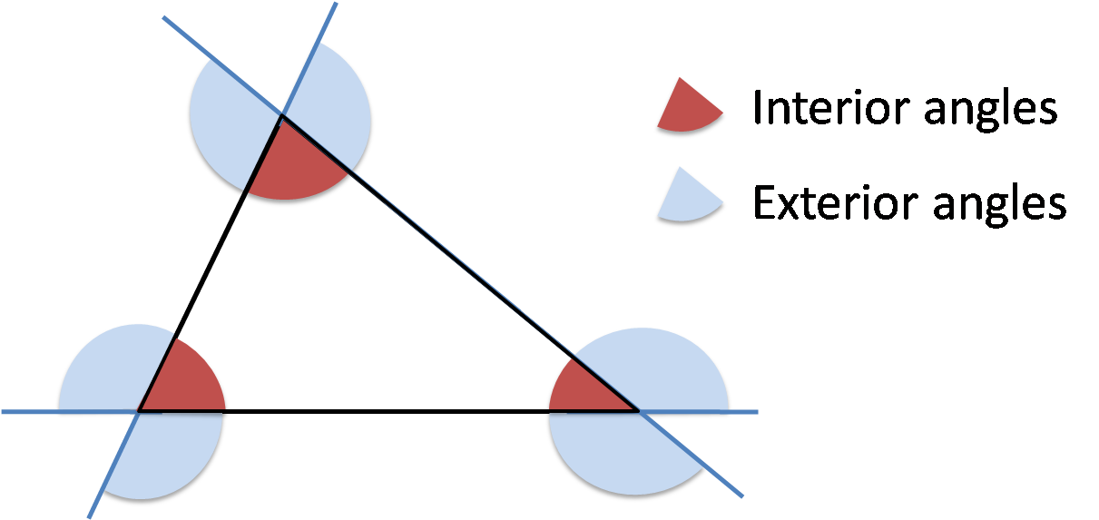
ISLAMIC EDUCATIONAL COLLEGE DATE: 5-Dec-25 :
SUBJECT: Math
GRADE: 10
UNIT: 2
Lesson: 3
LESSON

Slide 19
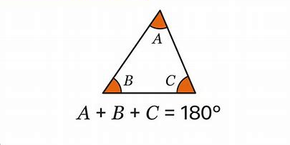
ISLAMIC EDUCATIONAL COLLEGE DATE: 5-Dec-25 :
SUBJECT: Math
GRADE: 10
UNIT: 2
Lesson: 3
LESSON
Interior Angle of triangle lie
inside the triangle

Slide 20
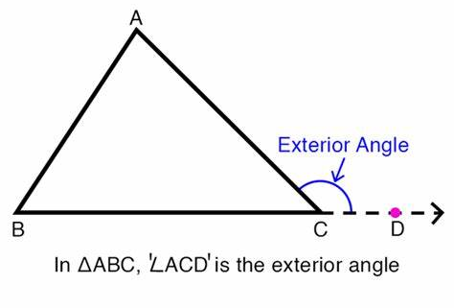
ISLAMIC EDUCATIONAL COLLEGE DATE: 5-Dec-25 :
SUBJECT: Math
GRADE: 10
UNIT: 2
Lesson: 3
LESSON
Exterior Angle of triangle lie
outside the triangle

Slide 21
ISLAMIC EDUCATIONAL COLLEGE DATE: 5-Dec-25 :
SUBJECT: Math
GRADE: 10
UNIT: 2
Lesson: 3
LESSON
Label the exterior angles and their opposite angles!

Slide 22
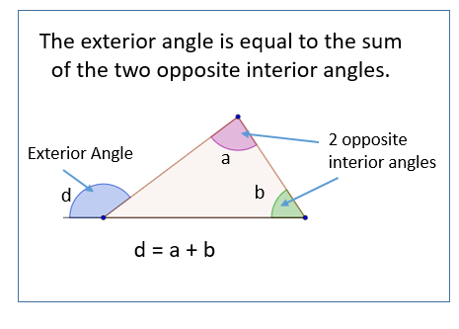
ISLAMIC EDUCATIONAL COLLEGE DATE: 5-Dec-25 :
SUBJECT: Math
GRADE: 10
UNIT: 2
Lesson: 3
LESSON

Slide 23
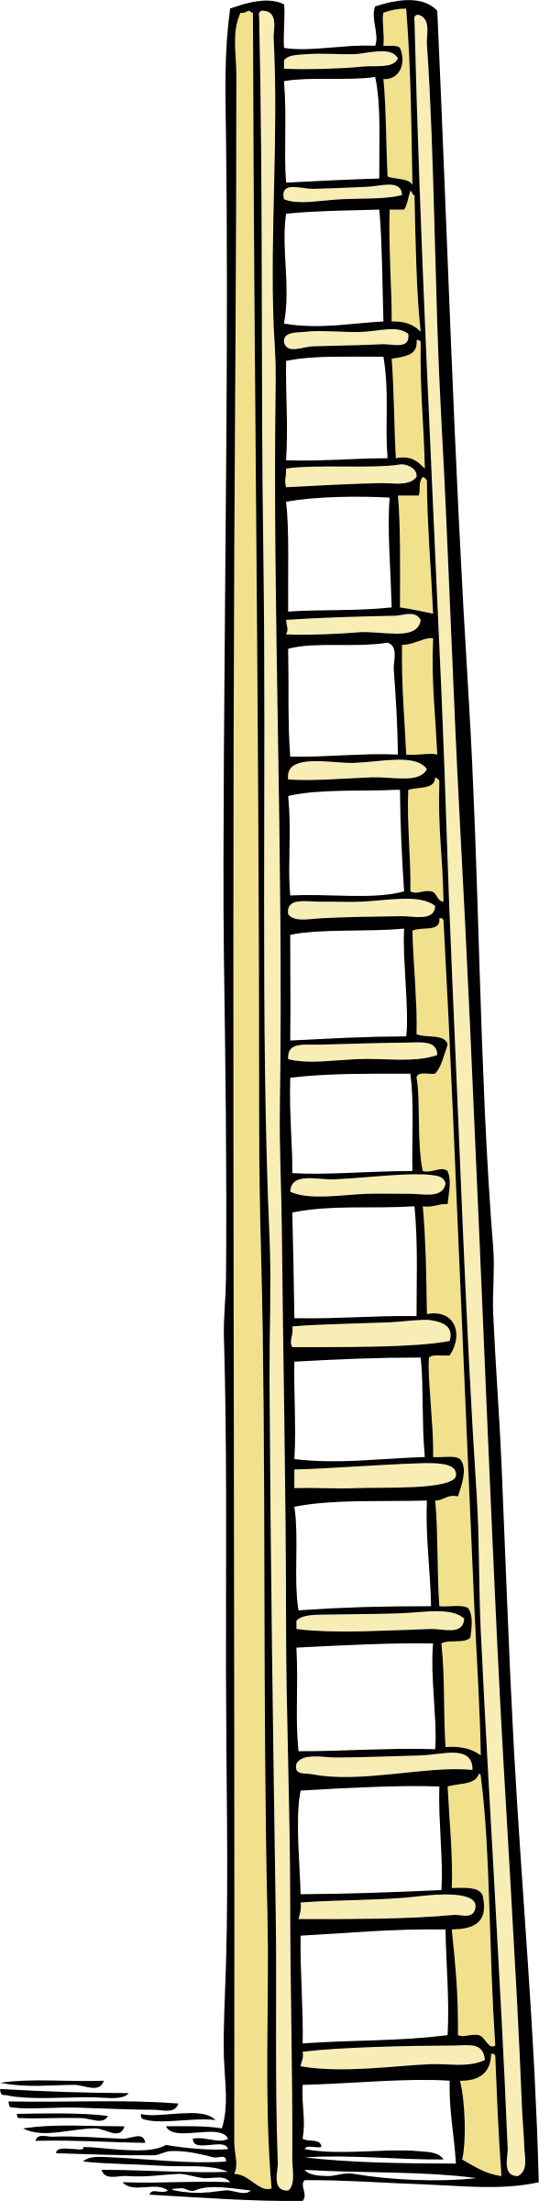
ISLAMIC EDUCATIONAL COLLEGE DATE: 5-Dec-25 :
SUBJECT: Math
GRADE: 10
UNIT: 2
Lesson: 3
LESSON
A ladder is leaning against a wall, forming a triangle with the ground and the wall. The ladder makes an angle of 65° with the ground, and the angle between the wall and the ground is 90°. The side of the triangle representing the ground is extended beyond the base of the ladder.
Exterior angle=
25+90= 115˚

Slide 24
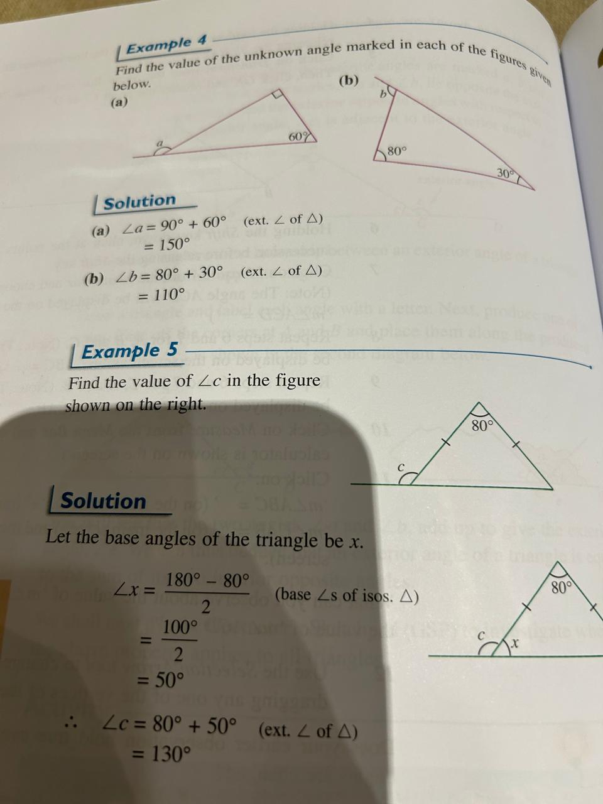
ISLAMIC EDUCATIONAL COLLEGE DATE: 5-Dec-25 :
SUBJECT: Math
GRADE: 10
UNIT: 2
Lesson: 3
LESSON

Slide 25
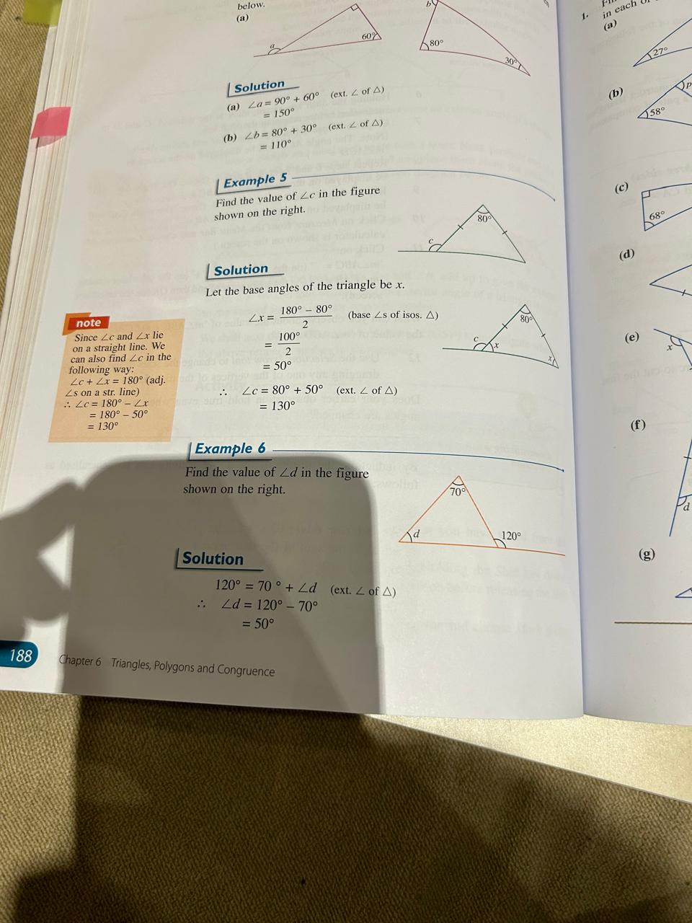
ISLAMIC EDUCATIONAL COLLEGE DATE: 5-Dec-25 :
SUBJECT: Math
GRADE: 10
UNIT: 2
Lesson: 3
LESSON

Slide 26
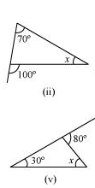
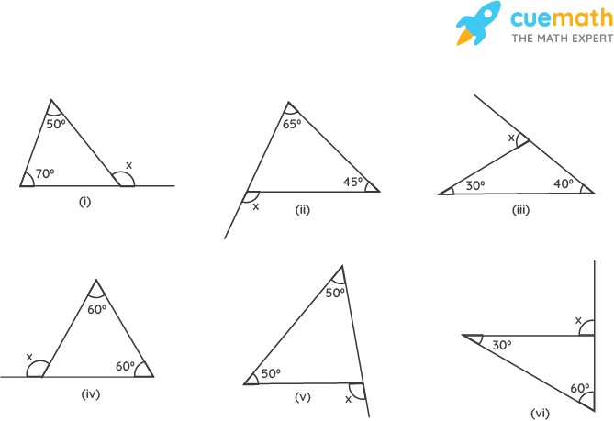
ISLAMIC EDUCATIONAL COLLEGE DATE: 5-Dec-25 :
SUBJECT: Math
GRADE: 10
UNIT: 2
Lesson: 3
LESSON
1
2
4
3

Slide 27
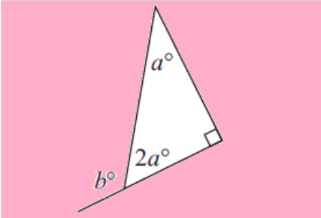
ISLAMIC EDUCATIONAL COLLEGE DATE: 5-Dec-25 :
SUBJECT: Math
GRADE: 10
UNIT: 2
Lesson: 3
LESSON

Slide 28
ISLAMIC EDUCATIONAL COLLEGE DATE: 5-Dec-25 :
SUBJECT: Math
GRADE: 10
UNIT: 2
Lesson: 3
LESSON
Required Questions:
P. 180 Q1
P. 184 Q1,2
P. 189 Q1,2

