Slide 1
Unit: Triangles, Polygons and Congruence
Lesson: Sum of the angles of a quadrilateral
Grade: Ten

Slide 2

ISLAMIC EDUCATIONAL COLLEGE DATE: 5-Dec-25 :
SUBJECT: Math
GRADE: 10
UNIT: 2
Lesson: 2
LESSON
Square
Parallelogram
Trapezium
Rhombus
Rectangle

Slide 3
ISLAMIC EDUCATIONAL COLLEGE DATE: 5-Dec-25 :
SUBJECT: Math
GRADE: 10
UNIT: 2
Lesson: 2
LESSON
Quadrilateral

Slide 4
ISLAMIC EDUCATIONAL COLLEGE DATE: 5-Dec-25 :
SUBJECT: Math
GRADE: 10
UNIT: 2
Lesson: 2
LESSON
Square

Slide 5
ISLAMIC EDUCATIONAL COLLEGE DATE: 5-Dec-25 :
SUBJECT: Math
GRADE: 10
UNIT: 2
Lesson: 2
LESSON
Rectangle

Slide 6
ISLAMIC EDUCATIONAL COLLEGE DATE: 5-Dec-25 :
SUBJECT: Math
GRADE: 10
UNIT: 2
Lesson: 2
LESSON
Parallelogram

Slide 7
ISLAMIC EDUCATIONAL COLLEGE DATE: 5-Dec-25 :
SUBJECT: Math
GRADE: 10
UNIT: 2
Lesson: 2
LESSON
Trapezium

Slide 8
ISLAMIC EDUCATIONAL COLLEGE DATE: 5-Dec-25 :
SUBJECT: Math
GRADE: 10
UNIT: 2
Lesson: 2
LESSON
Rhombus

Slide 9
ISLAMIC EDUCATIONAL COLLEGE DATE: 5-Dec-25 :
SUBJECT: Math
GRADE: 10
UNIT: 2
Lesson: 2
LESSON
The sum of the angles of a
Quadrilateral is 360˚

Slide 10


ISLAMIC EDUCATIONAL COLLEGE DATE: 5-Dec-25 :
SUBJECT: Math
GRADE: 10
UNIT: 2
Lesson: 2
LESSON
100˚
70˚
$$x$$
100˚
Find the value of $x$?

Slide 11
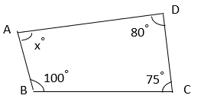

ISLAMIC EDUCATIONAL COLLEGE DATE: 5-Dec-25 :
SUBJECT: Math
GRADE: 10
UNIT: 2
Lesson: 2
LESSON
What is the value of $x?$
75
105
80
115

Slide 12
ISLAMIC EDUCATIONAL COLLEGE DATE: 5-Dec-25 :
SUBJECT: Math
GRADE: 10
UNIT: 2
Lesson: 2
LESSON
What is the value of $x?$
75
105
80
115

Slide 13
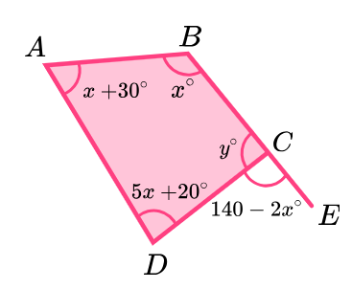
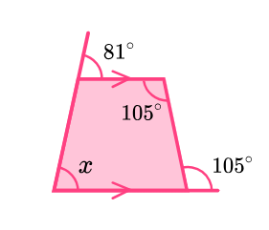
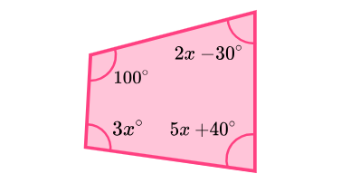
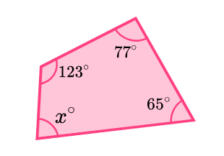
ISLAMIC EDUCATIONAL COLLEGE DATE: 5-Dec-25 :
SUBJECT: Math
GRADE: 10
UNIT: 2
Lesson: 2
LESSON
1
2
4
3

Slide 14
ISLAMIC EDUCATIONAL COLLEGE DATE: 5-Dec-25 :
SUBJECT: Math
GRADE: 10
UNIT: 2
Lesson: 2
LESSON
The angles of a quadrilateral are in the ratio of 1: 2: 3: 4. Find the measure of each angle.

Slide 15

ISLAMIC EDUCATIONAL COLLEGE DATE: 5-Dec-25 :
SUBJECT: Math
GRADE: 10
UNIT: 2
Lesson: 2
LESSON
P 196 Q1,2

