Slide 1
Unit: Geometry
Lesson: Types of Triangle
Grade: Ten

Slide 2

ISLAMIC EDUCATIONAL COLLEGE DATE: 31-Oct-25 :
SUBJECT: Math
GRADE: 10
UNIT: 2
Lesson: 2
LESSON
Objectives:
- Calculate the sum of angles of a triangle.

Slide 3
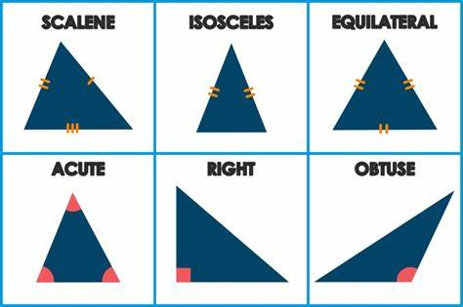
ISLAMIC EDUCATIONAL COLLEGE DATE: 31-Oct-25 :
SUBJECT: Math
GRADE: 10
UNIT: 2
Lesson: 2
LESSON

Slide 4



ISLAMIC EDUCATIONAL COLLEGE DATE: 1-Nov-25 :
SUBJECT: Math
GRADE: 6
UNIT: 3
Lesson: 1
LESSON
What is an angle?

Slide 5
ISLAMIC EDUCATIONAL COLLEGE DATE: 1-Nov-25 :
SUBJECT: Math
GRADE: 6
UNIT: 3
Lesson: 1
LESSON
What is an angle?
An angle is a figure formed by two rays that have the same endpoint.

Slide 6
ISLAMIC EDUCATIONAL COLLEGE DATE: 1-Nov-25 :
SUBJECT: Math
GRADE: 6
UNIT: 3
Lesson: 1
LESSON
Obtuse
Right
Reflex
Acute
Straight

Slide 7
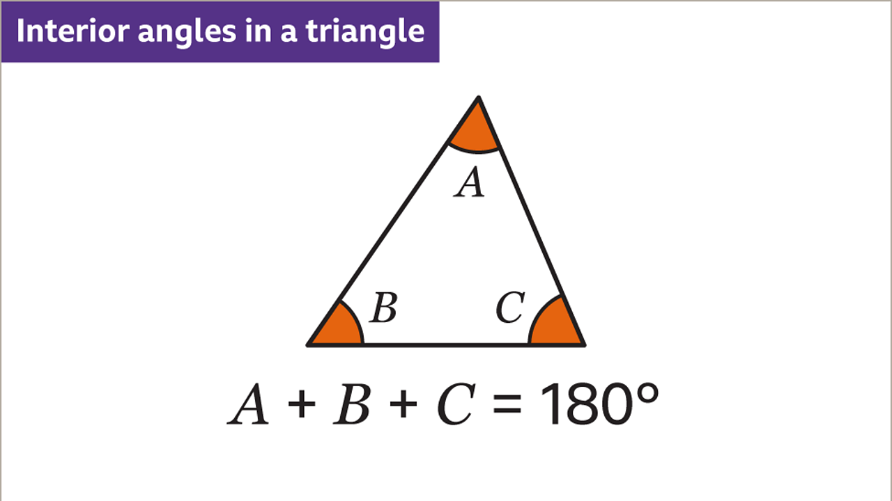
ISLAMIC EDUCATIONAL COLLEGE DATE: 31-Oct-25 :
SUBJECT: Math
GRADE: 10
UNIT: 2
Lesson: 2
LESSON

Slide 8
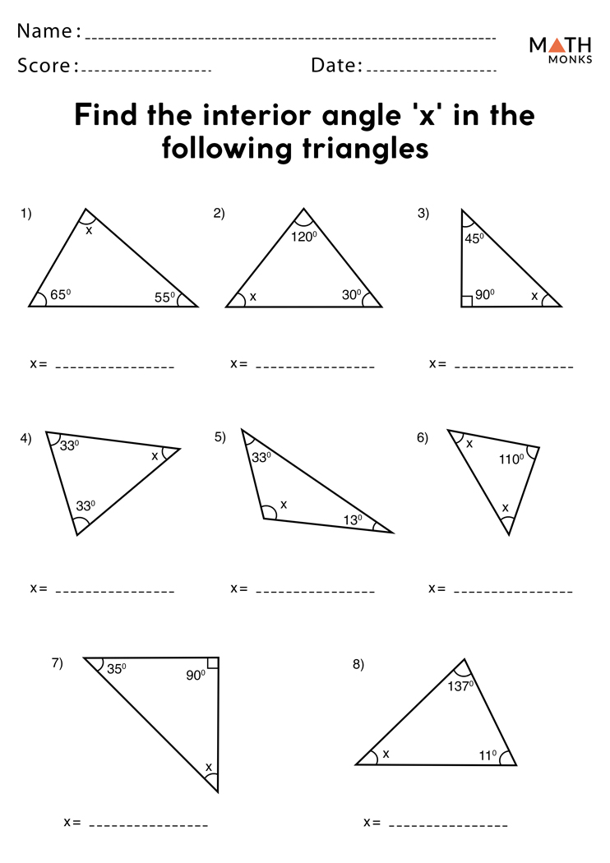
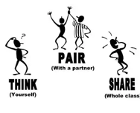
ISLAMIC EDUCATIONAL COLLEGE DATE: 1-Nov-25 :
SUBJECT: Math
GRADE: 10
UNIT: 2
Lesson: 2
LESSON

Slide 9
ISLAMIC EDUCATIONAL COLLEGE DATE: 1-Nov-25 :
SUBJECT: Math
GRADE: 10
UNIT: 2
Lesson: 2
LESSON

Slide 10


ISLAMIC EDUCATIONAL COLLEGE DATE: 31-Oct-25 :
SUBJECT: Math
GRADE: 10
UNIT: 2
Lesson: 2
LESSON
A triangle has angles in the ratio 2:3:4. Find the measure of each angle.

Slide 11
ISLAMIC EDUCATIONAL COLLEGE DATE: 1-Nov-25 :
SUBJECT: Math
GRADE: 10
UNIT: 2
Lesson: 2
LESSON
1
In a triangle, two angles measure 55° and 75°.
2
The three angles of a triangle are x, x + 20°, and 40°. Find the value of x.
3
In a triangle, one angle is three times another angle, and the third angle is 20° more than the smallest angle. Find the angles.
4
A triangle has angles 3x + 10°,
x – 5°, and 2x. Find all the angles.

Slide 12
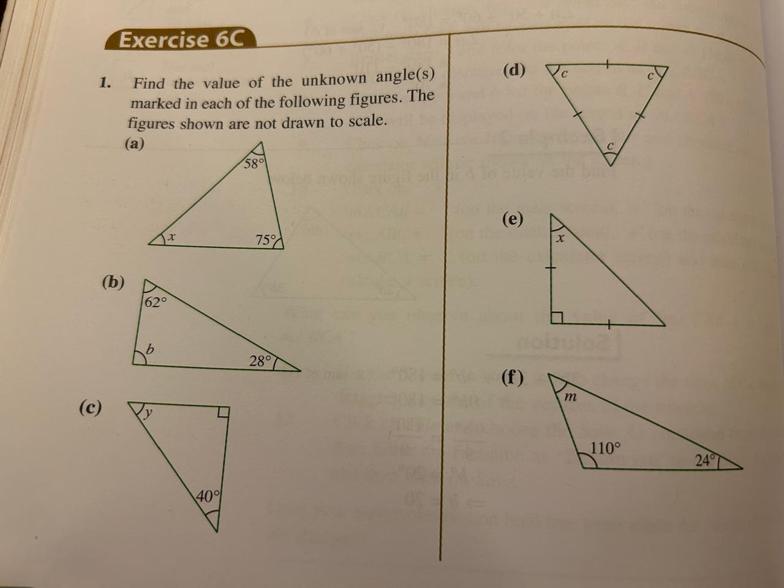
ISLAMIC EDUCATIONAL COLLEGE DATE: 31-Oct-25 :
SUBJECT: Math
GRADE: 10
UNIT: 2
Lesson: 2
LESSON

Slide 13
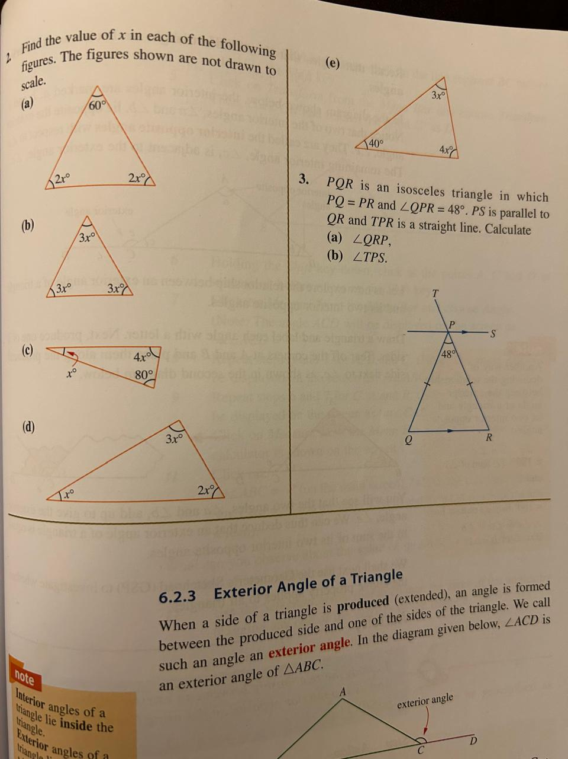
ISLAMIC EDUCATIONAL COLLEGE DATE: 31-Oct-25 :
SUBJECT: Math
GRADE: 10
UNIT: 2
Lesson: 2
LESSON

