Slide 1
Hurricane

Slide 2
Objectives
Identify the genre
1.
Answer text based questions
2.

Slide 3
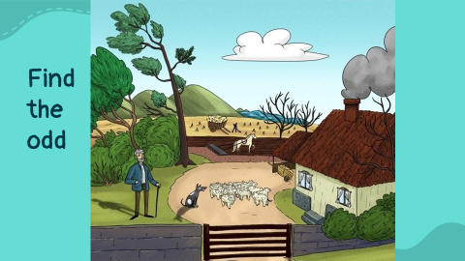
Warm Up:

Slide 4
Real Life Application:
Do you think it is important to know the weather before going on a picnic, Why?
Random pick

Slide 5

Pre assessment: After watching the video, what does the word (hurricanes) mean?

Slide 6
What is the genre? Open p.(108)
1-It is made up piece of writing that didn’t really happen
2-It focuses on a single theme or a subject
3-It has limited numbers of characters
Short Story

Slide 7
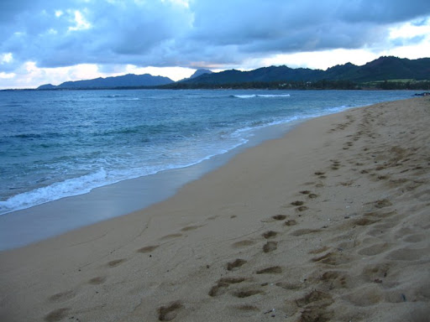
Shore

Slide 8
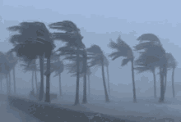
Storm

Slide 9
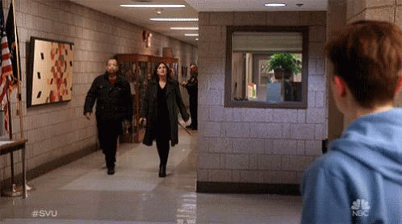
Approaching: moving nearer

Slide 10
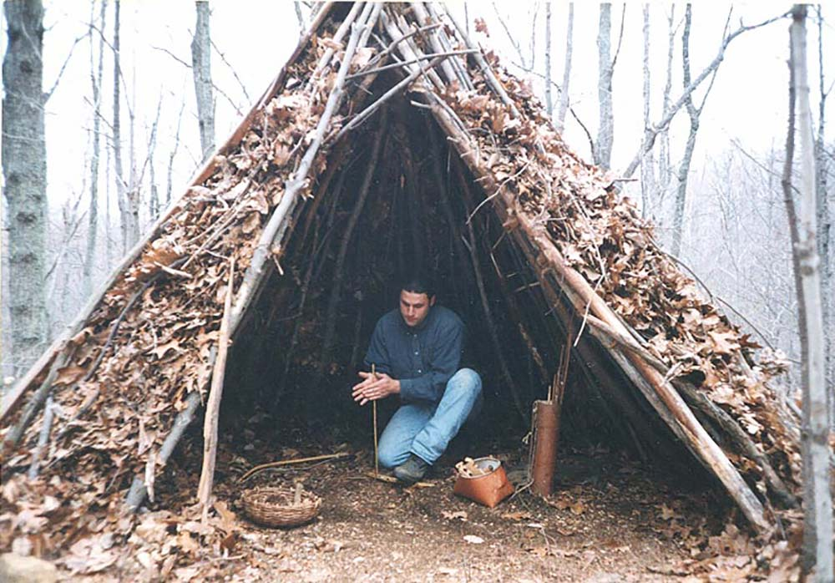
Shelter: a place where people are protected

Slide 11
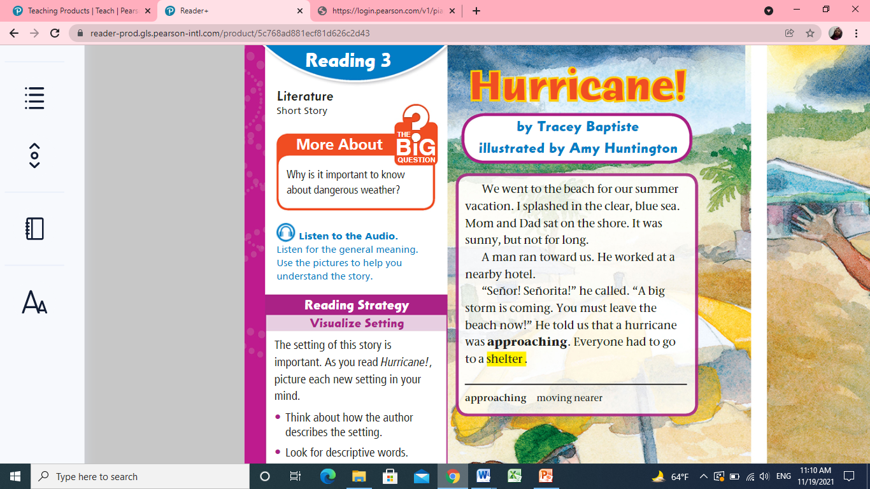

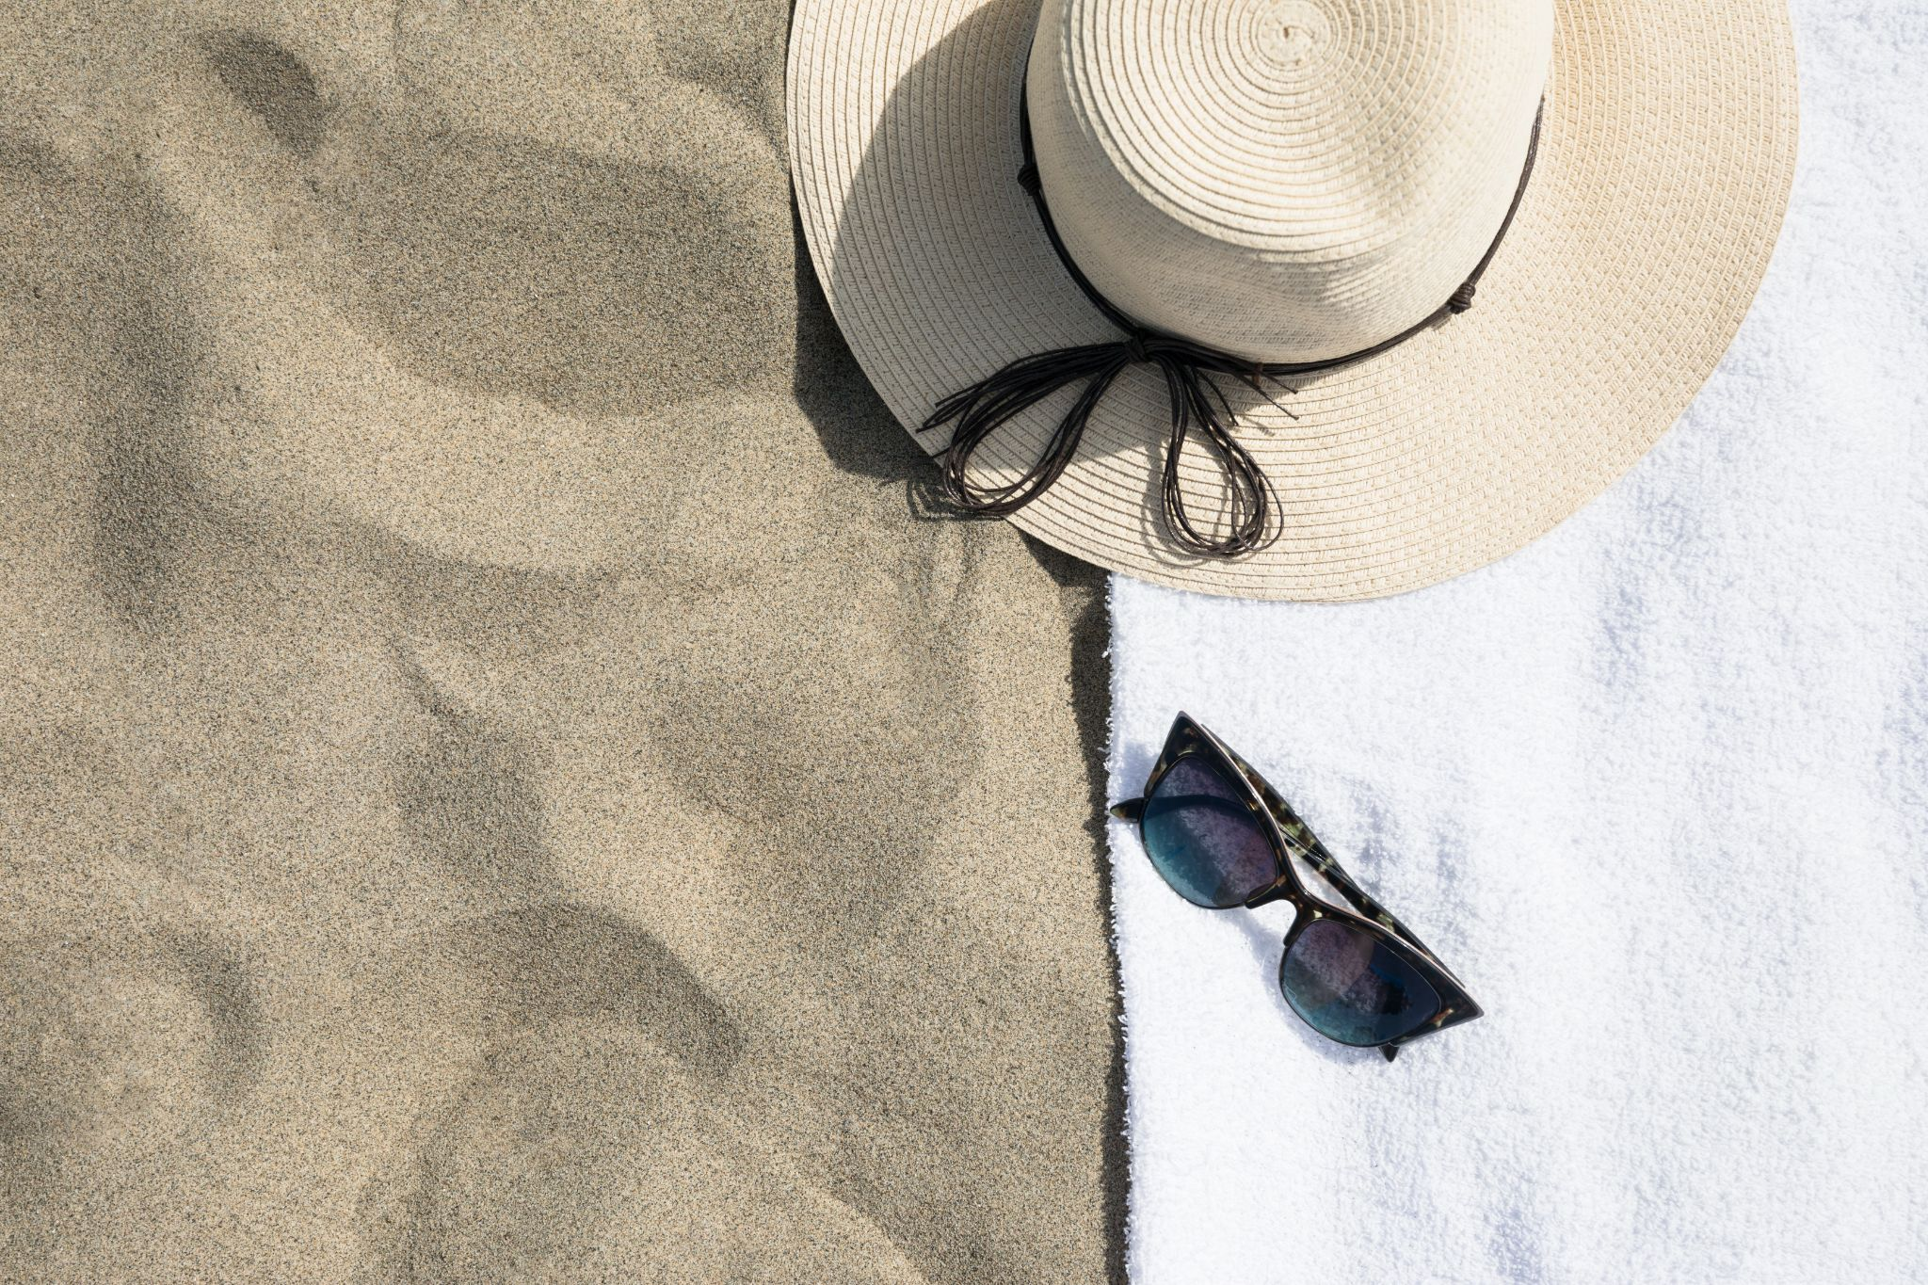
Listen
p.108

Slide 12
p.108
1-Where did the family go?
2-What did they do?
3-Who was the man that ran toward the family?
4-What did he say?
5-The pronoun he line 5 refers to:______
Rally coach

Slide 13
DIFFERENTIATION 2 MIN
Students 1:
How did the family protect themselves before they go?
Students 3:
Who are the characters?
Students 2:
Give evidence that the narrator is one of the characters?
Students 4:
True or false
The genre of the text is fable.( )

Slide 14
Critical Thinking
What would you do if you were in the same situation?
Buzz in

Slide 15
SUMMATIVE ASSESSMENT ( IRS )
1 MIN
The genre of the text is personal narrative:
1. True
2. False
The family should leave the beach because of :
  1. A hurricane
  2. hot weather
They shoud:
  1. Go back home.
  2. Find a shelter.

Slide 16
Closure
Write one thing you liked in today’s lesson
Mini boards

