Slide 1

Wednesday
20th November, 2024

Slide 2

Unit : Two / Reading: Three
Lesson : Reading / Hurricane!
Subject : English
Grade : Four A, B, C, D, E, F, G

Slide 3


Islamic Educational College Date : 20/11
Subject: English
Grade: 4
Unit:2
Lesson: Reading
Outcomes
01:00 minutes
Warm-Up
At the end of this lesson, students are expected to:
Identify the Genre of the text in hand
Read then answer comprehended questions
Pre-assessment
Presentation
Formative assessment
Feedback
Differentiation
Linking to life
Critical Thinking
Closure

Slide 4

Islamic Educational College Date : 20/11
Subject: English
Grade: 4
Unit: 2
Lesson: Reading
Outcomes
bear
famous
speed
aged
nation
01:00 minutes
Warm-Up
Pre-assessment
Presentation
Formative assessment
Feedback
Differentiation
Linking to life
Critical Thinking
Closure

Slide 5

Islamic Educational College Date : 20/11
Major:
Grade:
Unit:2
Lesson: Reading
Outcomes
02:00 minutes
One of the following is an example of a fictional genre:
Warm-Up
Pre-assessment
Presentation
1. Short story
Formative assessment
Feedback
2. Informational text
Differentiation
Linking to life
Critical Thinking
Summative assessment
IRS
Closure

Slide 6
Islamic Educational College Date : 20/11
Major:
Grade:
Unit:2
Lesson:Reading
Outcomes
02:00 minutes
One of the following is an example of a fictional genre:
Warm-Up
Pre-assessment
Presentation
1. Short story
Formative assessment
Feedback
2. Informational text
Differentiation
Linking to life
Critical Thinking
Summative assessment
Closure

Slide 7
Islamic Educational College Date : 20/11
Major:
Grade:
Unit:2
Lesson:Reading
Outcomes
02:00 minutes
One of the following is an element of fiction:
Warm-Up
Pre-assessment
Presentation
1. It is real
Formative assessment
Feedback
2. It is written for fun
Differentiation
Linking to life
Critical Thinking
Summative assessment
IRS
Closure

Slide 8
Islamic Educational College Date : 20/11
Major:
Grade:
Unit:2
Lesson: Reading
Outcomes
02:00 minutes
One of the following is an element of fiction:
Warm-Up
Pre-assessment
Presentation
1. It is real
Formative assessment
Feedback
2. It is written for fun
Differentiation
Linking to life
Critical Thinking
Summative assessment
Closure

Slide 9
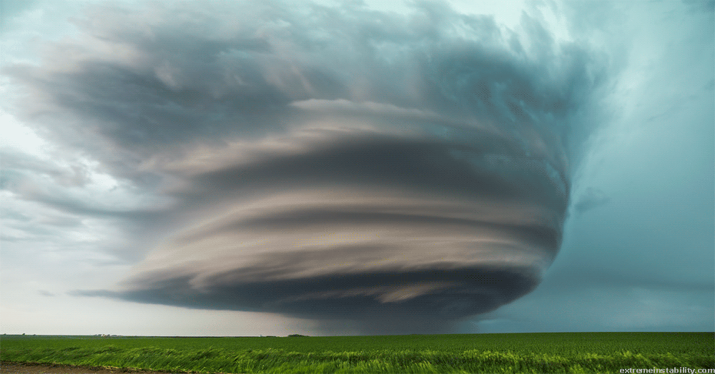
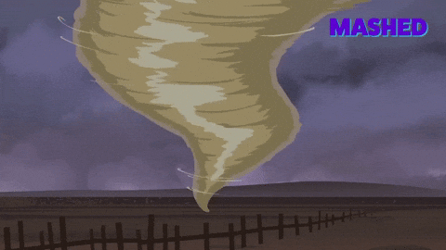
Islamic Educational College Date : 20/11
Subject: English
Grade: 4
Unit: 2
Lesson: Reading
Outcomes
Hurricane (noun):
05:00 minutes
Warm-Up
a storm with heavy wind and rain
Pre-assessment
Presentation
Formative assessment
Feedback
Differentiation
Linking to life
Critical Thinking
Closure

Slide 10
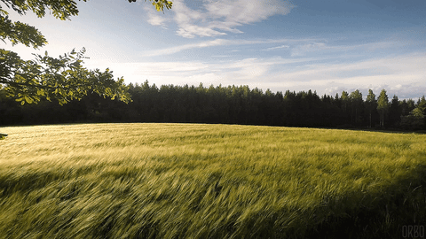
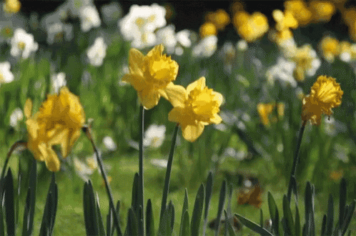
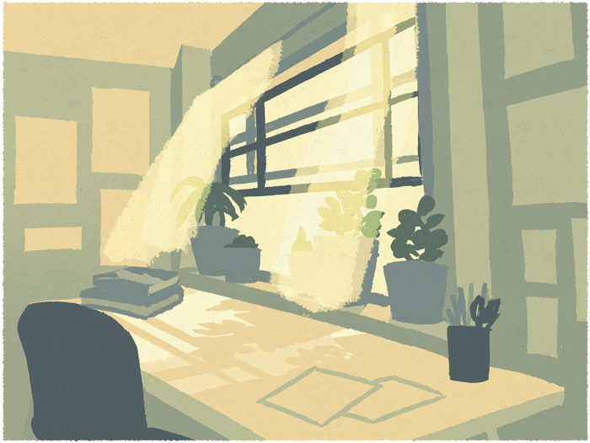
Islamic Educational College Date : 20/11
Subject: English
Grade: 4
Unit: 2
Lesson: Reading
Outcomes
Warm-Up
Pre-assessment
Presentation
Formative assessment
Feedback
Differentiation
Breeze (noun):
Linking to life
Critical Thinking
soft / light wind
Closure

Slide 11
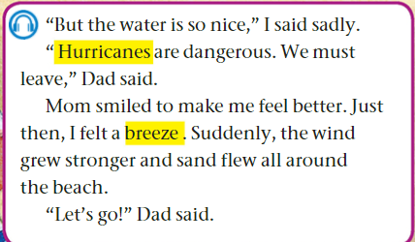

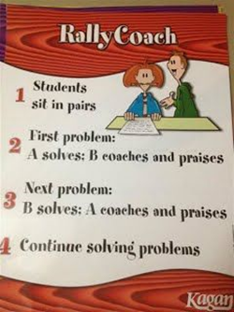
Islamic Educational College Date : 20/11
Subject:
Grade: 4
Unit: 2
Lesson: Reading
Outcomes
05:00 minutes
Warm-Up
Pre-assessment
Listen, Read
then answer:
Presentation
Formative assessment
Feedback
Differentiation
1-Describe hurricanes. _____________________________
2-What did mom do to comfort the boy? _______________
3-What happened suddenly? ________________________
4-What did dad say?_______________________________
5-Find a word that means a (light wind)_________________
Linking to life
Critical Thinking
Closure

Slide 12
Islamic Educational College Date : 20/11
Subject: English
Grade: 4
Unit: 2
Lesson: Reading
Outcomes
Warm-Up
Pre-assessment
1-Describe hurricane. __Big storm___
2-What did mom do to comfort the boy? ___She smiled______
3-What happened suddenly? __The wind grew stronger and sand flew all around the beach _
4-What did dad say?____Hurricanes are dangerous, we must leave____
5-Find a word that means a (light wind)____Breeze___
Presentation
Formative assessment
Feedback
Differentiation
Linking to life
Critical Thinking
Closure
Number : 1,2

Slide 13
Islamic Educational College Date : 20/11
Subject: English
Grade: 4
Unit: 2
Lesson: Reading
02:00 minutes
Outcomes
Students 1:
Give evidence that the narrator is one of the characters?
____________________
Students 3:
Why did dad say
“ We must leave now”? _________________
Warm-Up
Pre-assessment
Presentation
Formative assessment
Students 2:
How do moms play important roles in their children’s lives?
____________________
Students 4:
True or false
Hurricanes are safe and not dangerous.( )
Feedback
Differentiation
Linking to life
Critical Thinking
Closure
Random Pick

Slide 14

Islamic Educational College Date : 20/11
Subject: English
Grade: 4
Unit: 2
Lesson: Reading
Outcomes
01:00 minutes
Warm-Up
If you were one of the story characters,
how would you act?
Pre-assessment
Presentation
Formative assessment
Feedback
Differentiation
Linking to life
Critical Thinking
Closure
BUZZ IN

Slide 15

Islamic Educational College Date : 20/11
Subject: English
Grade: 4
Unit: 2
Lesson: Reading
Outcomes
02:00 minutes
Warm-Up
The family will stay in the beach
1. True
2. False
Dad said hurricanes are natural, no need to panic.
  1. True
  2. False
Pre-assessment
Presentation
Formative assessment
Feedback
Differentiation
Linking to life
Critical Thinking
Summative Assessment

Slide 16
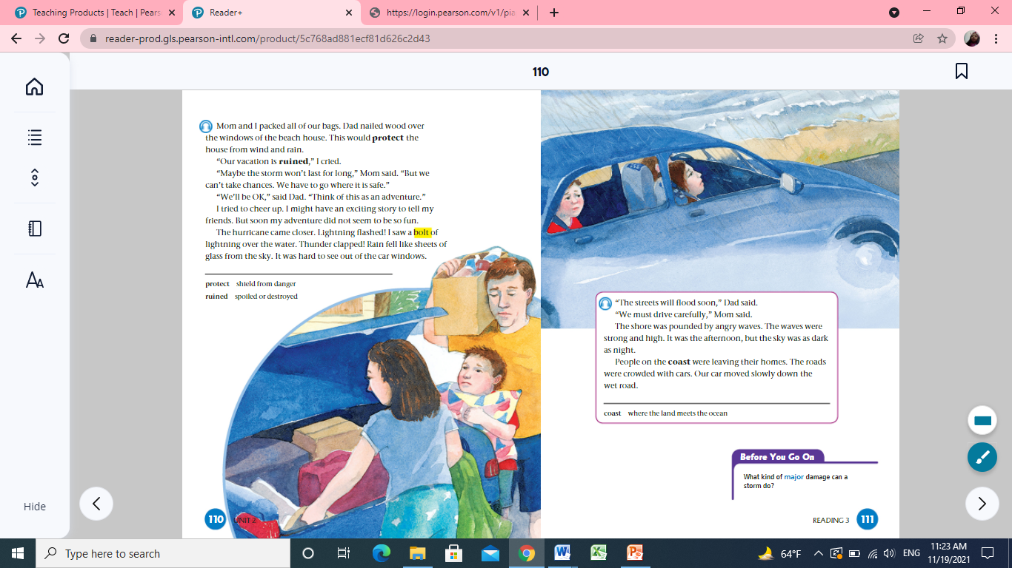
Look and say
p.110
What are they doing? Why?

Slide 17
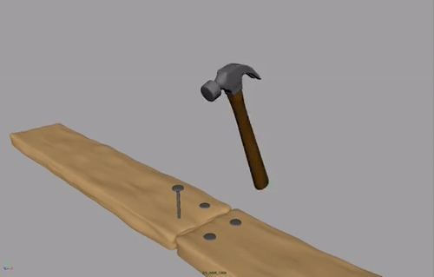
Nailed wood:

Slide 18
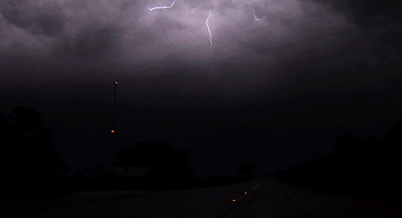
A bolt:
white line in the sky

Slide 19
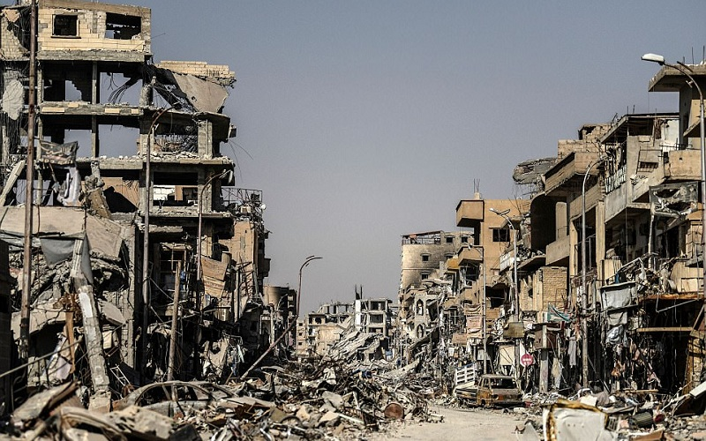
Ruined:
spoiled or destroyed

Slide 20
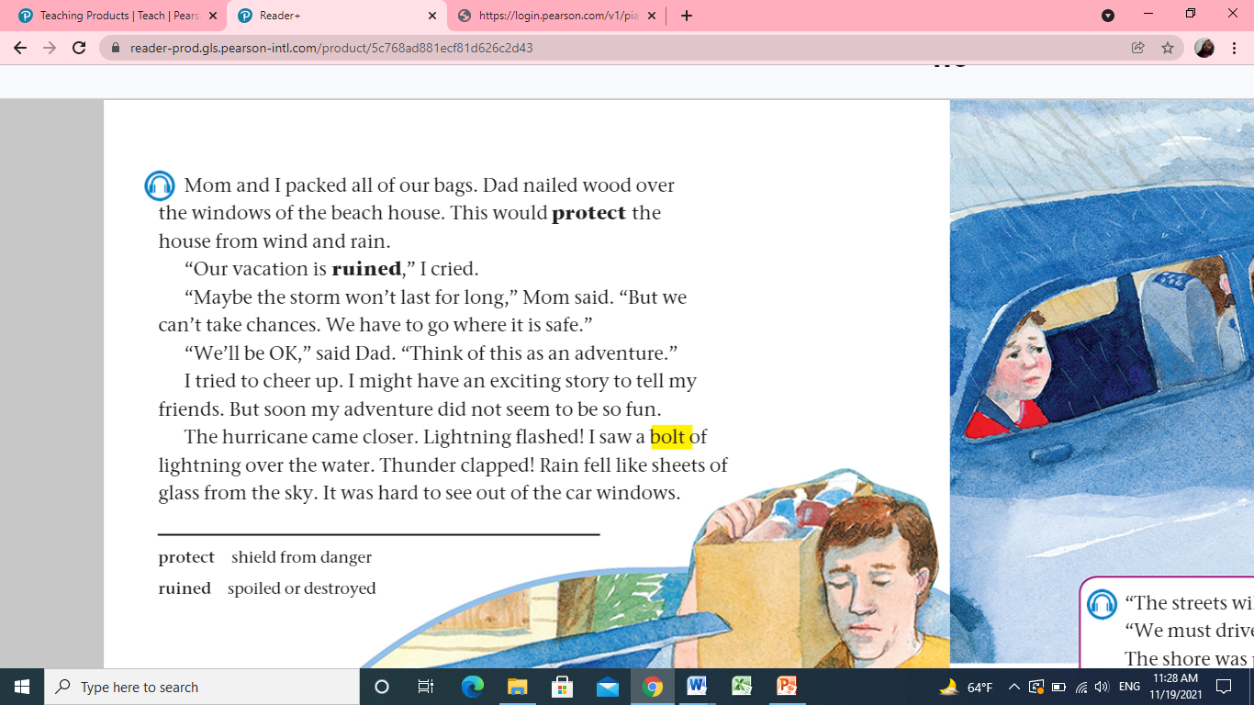
Islamic Educational College Date : 20/11
Subject:
Grade: 4
Unit: 2
Lesson: Reading
Outcomes
03:00 minutes
Warm-Up
Pre-assessment
Listen, Read
then answer:
Presentation
Formative assessment
Feedback
Differentiation
Linking to life
Critical Thinking
Closure

Slide 21
Islamic Educational College Date : 20/11
Subject:
Grade: 4
Unit: 2
Lesson: Reading
Outcomes
03:00 minutes
Warm-Up
1- What did Dad do to protect the house?
2-Describe the rain.
3-find a word that means destroyed.___________
Pre-assessment
Presentation
Formative assessment
Feedback
Differentiation
Linking to life
Critical Thinking
Closure

Slide 22
Islamic Educational College Date : 20/11
Subject: English
Grade: 4
Unit: 2
Lesson: Reading
02:00 minutes
Outcomes
Students 1:
Give evidence that the narrator is one of the characters?
____________________
Students 3:
The vacation was:
Reuind
amazing
Warm-Up
Pre-assessment
Presentation
Formative assessment
Students 2:
How do moms play important roles in their children’s lives?
____________________
Students 4:
True or false
The boy was happy.( )
Feedback
Differentiation
Linking to life
Critical Thinking
Closure
Random Pick

Slide 23
Islamic Educational College Date : 20/11
Subject: English
Grade: 4
Unit: 2
Lesson: Reading
Outcomes
01:00 minutes
Warm-Up
Can you imagine yourself in the middle of a hurricane, and how would you react?
Pre-assessment
Presentation
Formative assessment
Feedback
Differentiation
Linking to life
Critical Thinking
Closure
BUZZ IN

Slide 24
Islamic Educational College Date : 28/10
Subject: English
Grade: 4
Unit: 1
Lesson: Reading
Outcomes
02:00 minutes
Warm-Up
Pre-assessment
What did we learn today.
Presentation
Formative assessment
Feedback
Differentiation
Linking to life
Critical Thinking
Closure
Mini Boards

Slide 25

The End

