Slide 1

Sunday
24th November, 2024

Slide 2

Unit : Two / Reading: Three
Lesson : Reading / Hurricane!
Subject : English
Grade : Four A, B, C, D, E, F, G

Slide 3


Islamic Educational College Date : 24/11
Subject: English
Grade: 4
Unit:2
Lesson: Reading
Outcomes
01:00 minutes
Warm-Up
At the end of this lesson, students are expected to:
Identify the Genre of the text in hand
Read then answer questions
Pre-assessment
Presentation
Formative assessment
Feedback
Differentiation
Linking to life
Critical Thinking
Closure

Slide 4

Islamic Educational College Date : 24/11
Subject: English
Grade: 4
Unit: 2
Lesson: Reading
Outcomes
soil
value
iron
bottom
quite
01:00 minutes
Warm-Up
Pre-assessment
Presentation
Formative assessment
Feedback
Differentiation
Linking to life
Critical Thinking
Closure

Slide 5

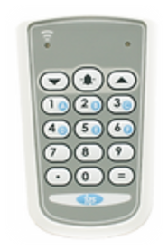
Islamic Educational College Date : 24/11
Subject : English
Grade:4
Unit:2
Lesson: Reading
Outcomes
One of the following is an example of a fictional genre:
01:00 minutes
Warm-Up
Pre-assessment
Presentation
1. Short story
Formative assessment
Feedback
2. Informational text
Differentiation
Linking to life
Critical Thinking
Summative assessment
IRS
Closure

Slide 6
Islamic Educational College Date : 24/11
Subject : English
Grade : 4
Unit:2
Lesson: Reading
Outcomes
One of the following is an example of a fictional genre:
Warm-Up
Pre-assessment
Presentation
1. Short story
Formative assessment
Feedback
2. Informational text
Differentiation
Linking to life
Critical Thinking
Summative assessment
Closure

Slide 7
Islamic Educational College Date : 24/11
Subject : English
Grade: 4
Unit:2
Lesson: Reading
Outcomes
01:00 minutes
One of the following is an element of a short story:
Warm-Up
Pre-assessment
Presentation
1. It is real
Formative assessment
Feedback
2. It deals with one subject or theme
Differentiation
Linking to life
Critical Thinking
Summative assessment
IRS
Closure

Slide 8
Islamic Educational College Date : 24/11
Subject:English
Grade:4
Unit:2
Lesson: Reading
Outcomes
One of the following is an element of a short story:
Warm-Up
Pre-assessment
Presentation
1. It is real
Formative assessment
Feedback
Differentiation
2. It deals with one subject or theme
Linking to life
Critical Thinking
Summative assessment
IRS
Closure

Slide 9
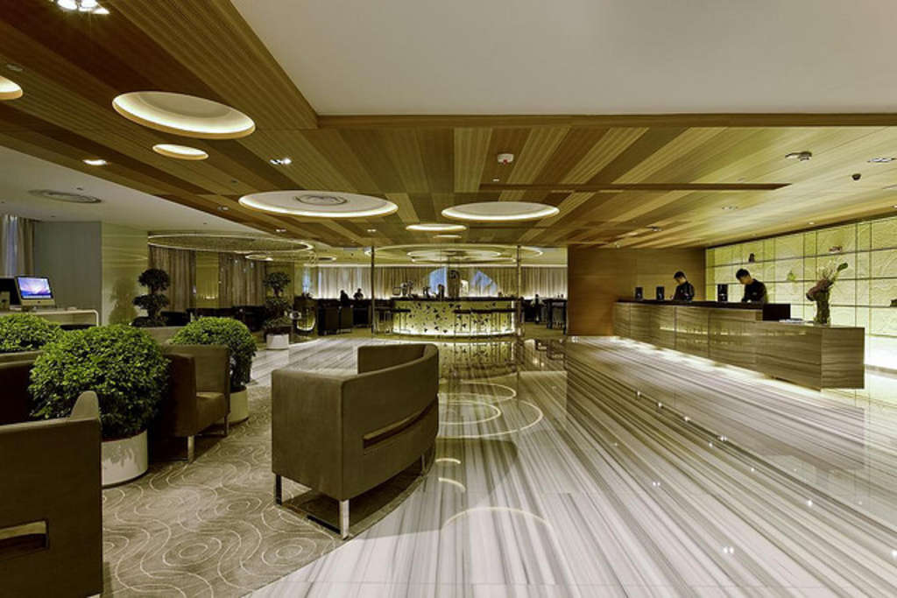
Islamic Educational College Date : 24/11
Subject: English
Grade: 4
Unit: 2
Lesson: Reading
Outcomes
Lobby (noun):
05:00 minutes
Warm-Up
a large reception area
Pre-assessment
Presentation
Formative assessment
Feedback
Differentiation
Linking to life
Critical Thinking
Closure

Slide 10
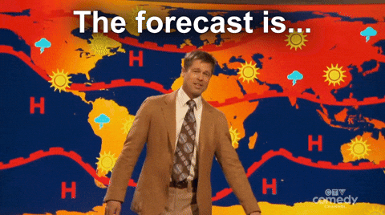
Islamic Educational College Date : 24/11
Subject: English
Grade: 4
Unit: 2
Lesson: Reading
Outcomes
Warm-Up
Pre-assessment
Presentation
Formative assessment
Feedback
Differentiation
Forecaster (noun):
Linking to life
Critical Thinking
The person who tells what the weather will be like
Closure

Slide 11
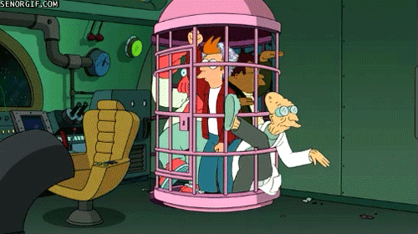
Islamic Educational College Date : 24/11
Subject: English
Grade: 4
Unit: 2
Lesson: Reading
Outcomes
Warm-Up
Pre-assessment
Presentation
Formative assessment
Feedback
Differentiation
trapped (adjective):
Linking to life
Critical Thinking
Not able to get out
Closure

Slide 12
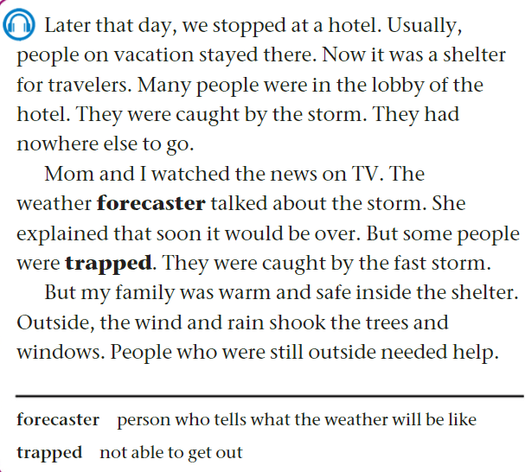

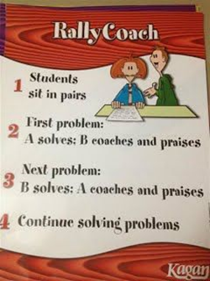

112
Islamic Educational College Date : 24/11
Subject:
Grade: 4
Unit: 2
Lesson: Reading
Outcomes
05:00 minutes
Warm-Up
Listen, Read
then answer:
Pre-assessment
Presentation
Formative assessment
Feedback
Differentiation
Linking to life
Critical Thinking
Closure

Slide 13
112
Islamic Educational College Date : 24/11
Subject: English
Grade: 4
Unit: 2
Lesson: Reading
Outcomes
1-Where did the family stop?
__They stopped at a hotel._______
2-Many people were in the lobby. Explain.
__It was a shelter for travelers who were caught by the storm because they had nowhere else to go. __
3-What did the weather forecaster talk about?
_She talked about the storm and that it would be over. _
4-Some people were trapped .Explain.
__They were caught by the fast storm.__
5-How was the weather outside?
__The wind and rain shook the trees and windows. __
6-The pronoun she line 7 refers to:
__The weather forecaster._
Warm-Up
Pre-assessment
Presentation
Formative assessment
Feedback
Differentiation
Linking to life
Critical Thinking
Closure
Students Number : (1,2)

Slide 14
Islamic Educational College Date : 24/11
02:00 minutes
Subject: English
Grade: 4
Unit: 2
Lesson: Reading
Outcomes
Student’s number | Task
4 Match: | The family stopped at a hotel False The weather was sunny True
3 Fill in the blank: | Many people were in the ___________.
2 | Describe the feeling of the boy now. __________________________________
1 | How did the hotel offer assistance to the travelers?__________________________
Warm-Up
Pre-assessment
Presentation
Formative assessment
Feedback
Differentiation
Linking to life
Critical Thinking
Closure
Random Pick

Slide 15
Islamic Educational College Date : 24/11
Subject: English
Grade: 4
Unit:2
Lesson: Reading
Outcomes
01:00 minutes
Warm-Up
What is the value that we may learn from this part of the story?
Pre-assessment
Presentation
Formative assessment
Feedback
Differentiation
Linking to life
Critical Thinking
Summative assessment
BUZZ IN
Closure

Slide 16

Islamic Educational College Date : 24/11
Subject: English
Grade: 4
Unit: 2
Lesson: Reading
Outcomes
01:00 minutes
Warm-Up
If you were the hotel owner,
what assistance you may offer?
Pre-assessment
Presentation
Formative assessment
Feedback
Differentiation
Linking to life
Critical Thinking
Closure
BUZZ IN

Slide 17

Islamic Educational College Date : 24/11
Subject: English
Grade: 4
Unit: 2
Lesson: Reading
Outcomes
02:00 minutes
Warm-Up
According to the text, it is important to hear the weather forecact before going out:
1. True 2. False
The hotel was a shelter for the family:
1. True 2. False
Pre-assessment
Presentation
Formative assessment
Feedback
Differentiation
Linking to life
Critical Thinking
Summative Assessment
Closure

Slide 18

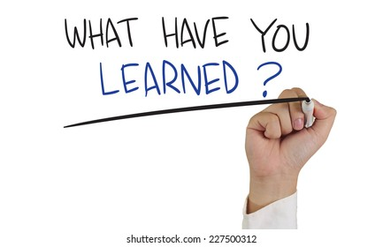
Islamic Educational College Date : 24/11
Subject : English
Grade : 4
Unit : 2
Lesson : Reading
Outcomes
Warm-Up
Pre-assessment
Presentation
Formative assessment
Feedback
Differentiation
Linking to life
Critical Thinking
Summative assessment
Closure

Slide 19

The End

