Slide 1
Writing
A friendly letter

Slide 2
Outcomes
Recognize parts of the letter
Write a letter

Slide 3
Warm up
rolled
either
jumped
metal
hope
1 Min I Random Pick

Slide 4
Pre-assessment
The Indentation should be before:
My Lovely Friend
I usually make friends easily, so I have a lot of friends. My favorite friend is Anna. Anna is a very beautiful and charming girl. She is kind and lovely. For me, friendship is the most important thing in the world, and I am proud to have such a loyal and helpful friend.
1
2
1 Min I IRS

Slide 5
Feedback
The Indentation should be before:
My Lovely Friend
I usually make friends easily, so I have a lot of friends. My favorite friend is Anna. Anna is a very beautiful and charming girl. She is kind and lovely. For me, friendship is the most important thing in the world, and I am proud to have such a loyal and helpful friend.
1
2

Slide 6
Parts of the letter
Greeting
Body
Closing
Signature
Heading
Presentation 15 min

Slide 7
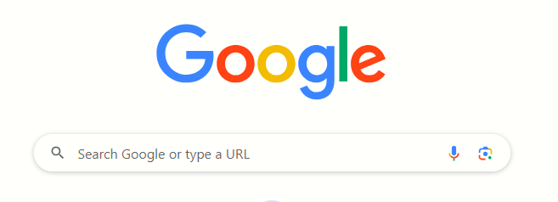
Search: The meaning of “letter”.
2 Min I BUZZ IN

Slide 8
Amman, Jordan
November 9th, 2025
Heading
The first part of a friendly letter is called the heading. The heading includes the writer’s address and the date. It is located at the top right of the page.

Slide 9
Amman, Jordan
November 9th, 2025
Heading
Dear Maria,
Greeting
The second part of the friendly letter is the greeting. It begins with a capital letter and ends with a comma. It is written on the top left of the page, after the heading.

Slide 10
Formative-assessment
Click on the correct greeting!
1. Dear Ahmad
2. Dear Ahmad,
IRS/1 MIN

Slide 11

Feedback
The greeting uses two capital
letters and a comma!
1. Dear Ahmad
2. Dear Ahmad,

Slide 12
We put what we want to say in the body of the letter. The body of the letter is in paragraph form. The first line of the paragraph is indented.
Body
I hope you are doing well. I wanted to tell you about a fun day I had at the zoo with my family. We saw so many amazing animals like lions, giraffes, and monkeys. My favorite part of the day was feeding the giraffes. They have such long necks and were so gentle. Have you had any fun days out recently? I miss you and hope to see you soon.

Slide 13
Heading
Amman, Jordan
November 9th, 2025
Dear Maria,
Greeting
Body
I hope you are doing well. I wanted to tell you about a fun day I had at the zoo with my family. We saw so many amazing animals like lions, giraffes, and monkeys. My favorite part of the day was feeding the giraffes. They have such long necks and were so gentle. Have you had any fun days out recently? I miss you and hope to see you soon.
Closing
Signature
Your friend,
Sara

Slide 14
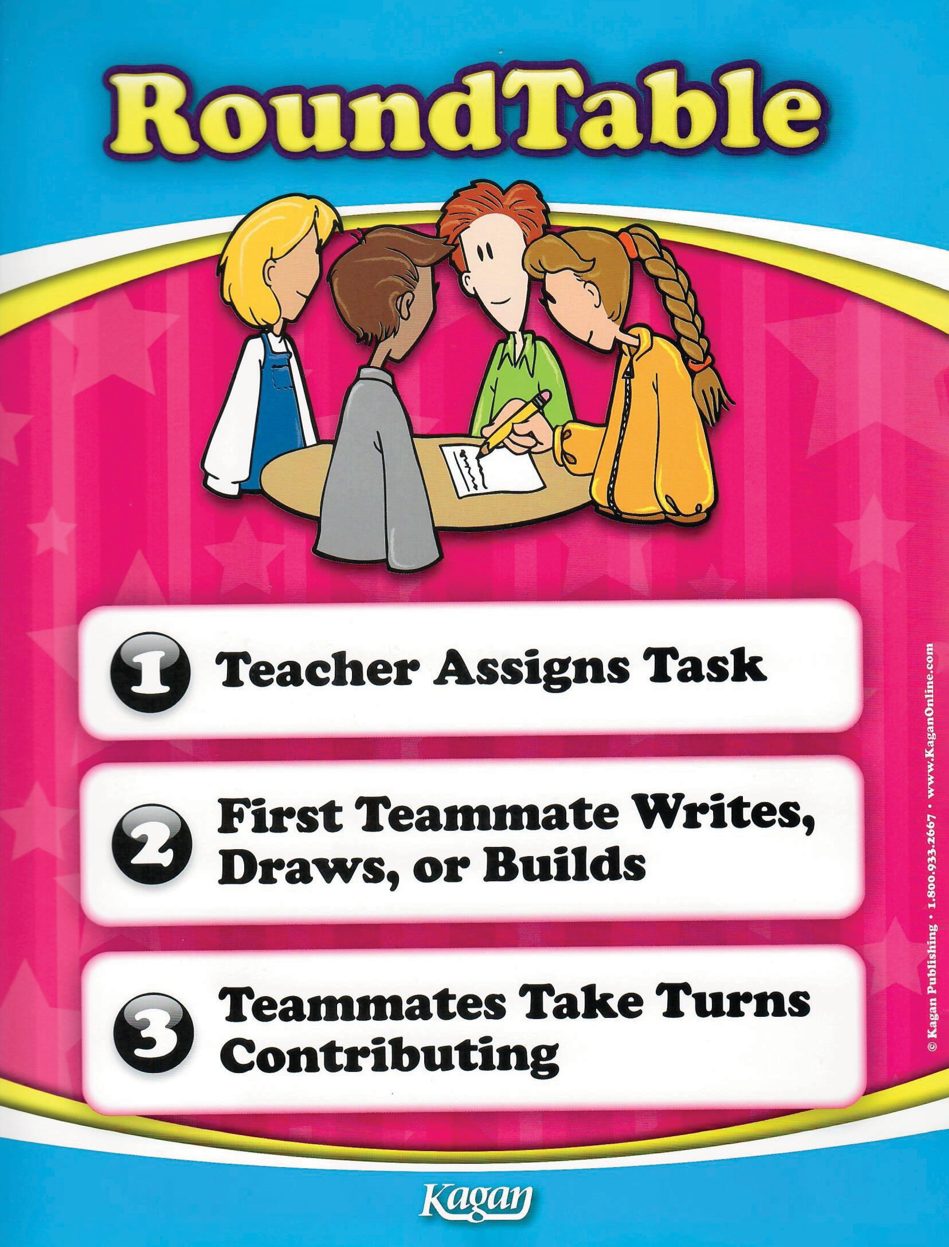

Group Work / 2 MIN
Mention parts of the letter :
1.
2.
3.
4.

Slide 15
Differentiation:
3 Min I BUZZ IN
Student’s number | Task
1 | Match: Dear Sami, Heading Amman, Jordan 11th Nov, 2024 Greeting
4 | Label each part: Amman, Jordan 11th Nov,2024 Dear Salma,
2 | Mention TWO parts of a letter. 1. 2.
3 | Write a Heading and Greeting (to whom you wish!).

Slide 16
Linking to life:
Bing Videos
What is the value that we can learn from this video?
1 Min I BUZZ IN

Slide 17
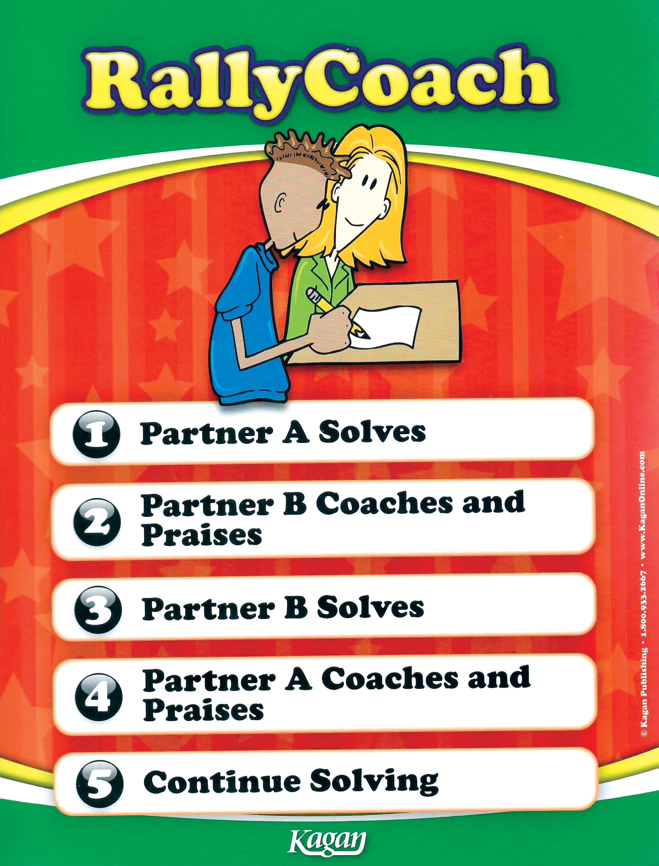
Application:
Write a letter to your mom apologizing for doing something wrong.
3 Min

Slide 18
Critical Thinking:
What alternatives for letters do we have nowadays?
1 Min I BUZZ IN

Slide 19
Summative Assessment
What is the correct way to start a friendly letter?
Dear Ahmad,
dear ahmad,
What is the main part of the letter called?
Greeting
Body
IRS / 2 MIN

Slide 20
Feedback:
What is the correct way to start a friendly letter?
Dear Ahmad,
dear ahmad,
What is the main part of the letter called?
Greeting
Body

Slide 21
Closure
Write one thing you remember to have when writing a letter
Mini-boards / 1 MIN

