Slide 1


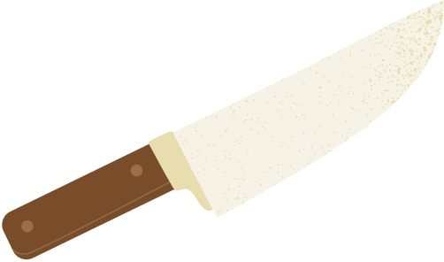



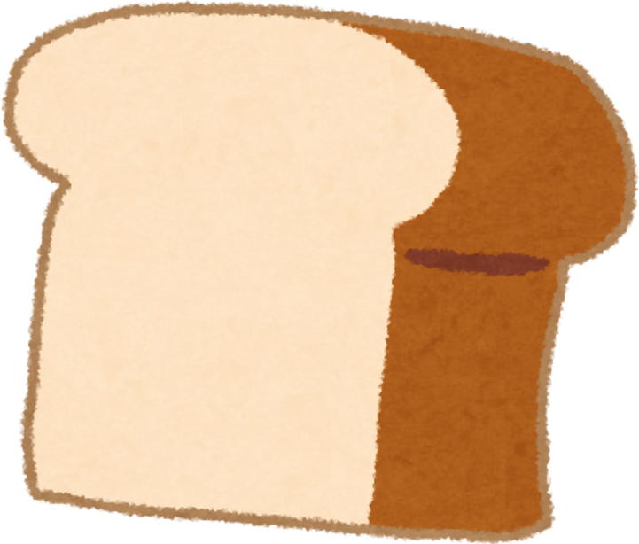
WRITING
A
RECIPE
Grade: Four/ Unit: Two / Major: English

Slide 2
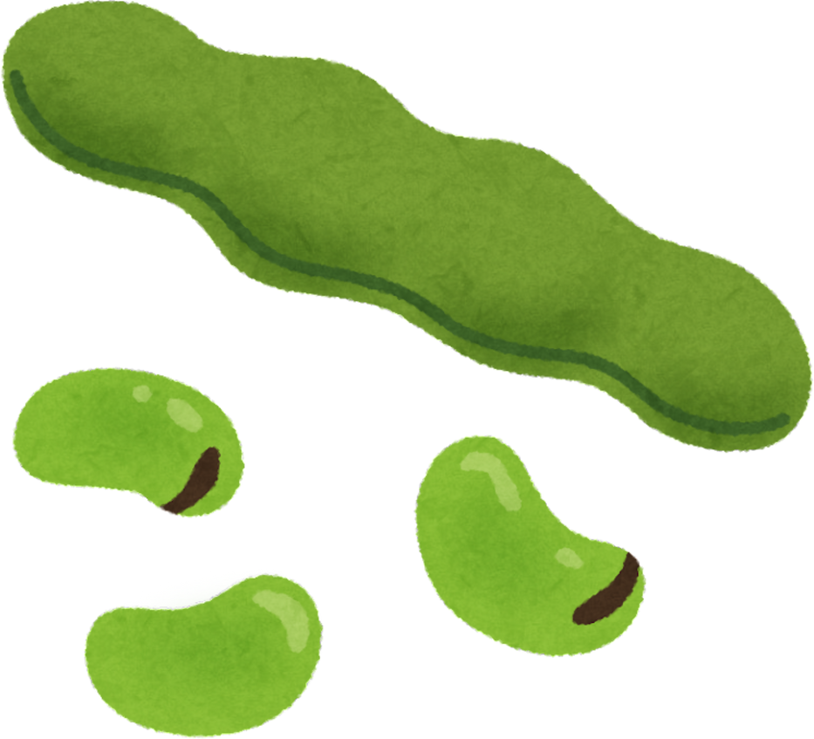

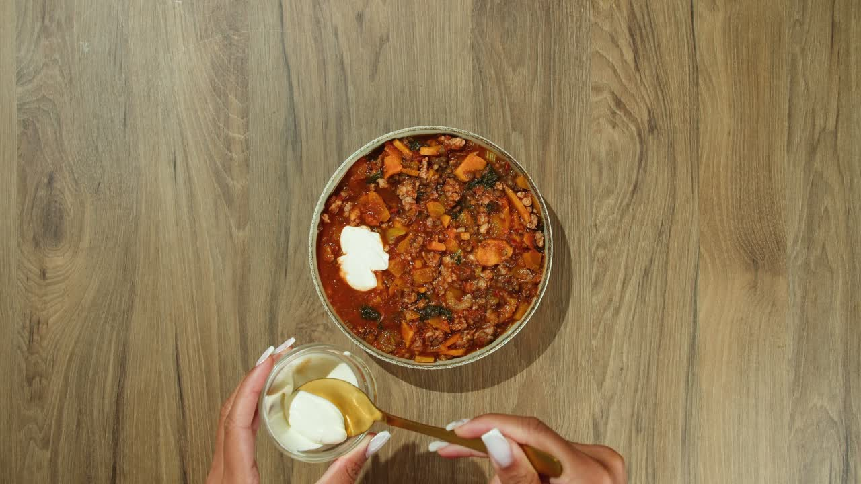
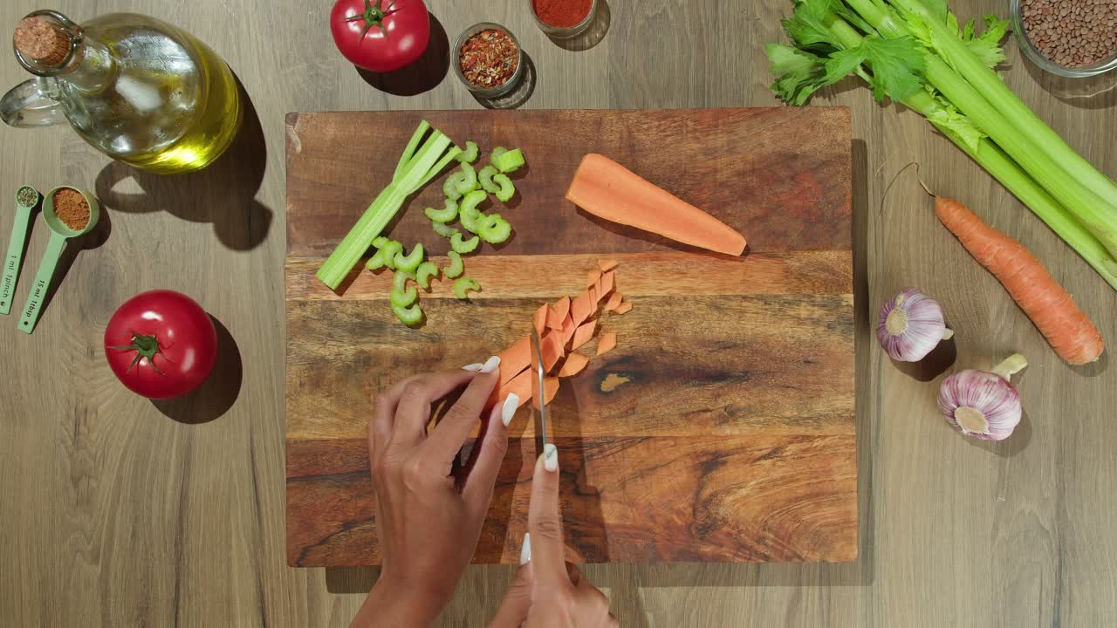

OUTCOMES:
01
02
03
Recognize what a recipe is
Identify cooking verbs and utensils
Start writing a recipe

Slide 3

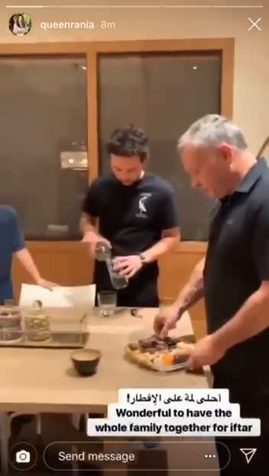
WARM-UP:

Slide 4




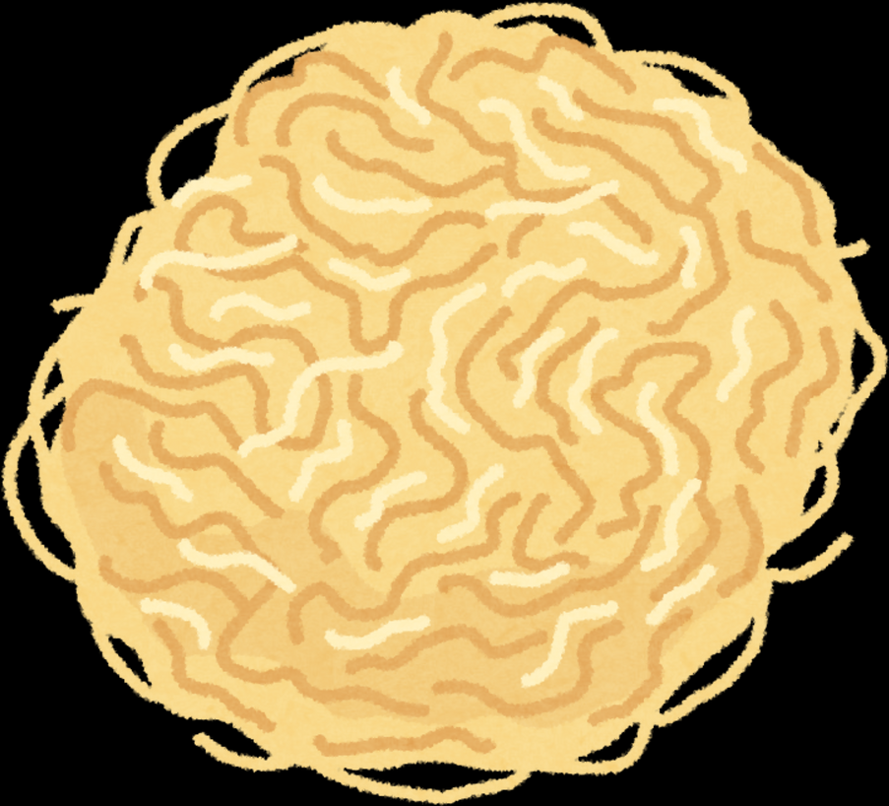

PRE-ASSESSMENT:
WE START THE IMPERATIVE SENTENCE WITH:
A NOUN
A VERB
AN ADJECTIVE
IRS

Slide 5
FEEDBACK:
WE START THE IMPERATIVE SENTENCE WITH:
A NOUN
A VERB
AN ADJECTIVE

Slide 6





WE ALL LOVE FOOD, BUT WHY IS IT IMPORTANT TO PREPARE OUR OWN FOOD???
Improve health
Reduce stress
Save money

Slide 7



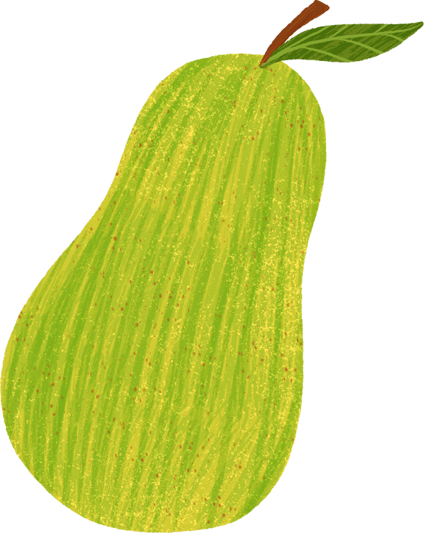

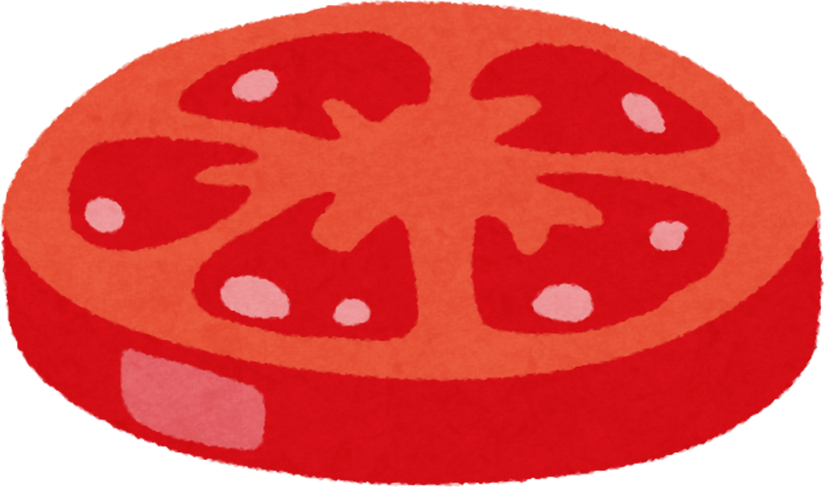

GOOGLE SEARCH......
SYNONYMS OF RECIPE

Slide 8


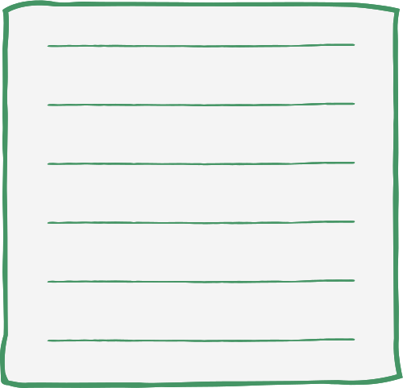
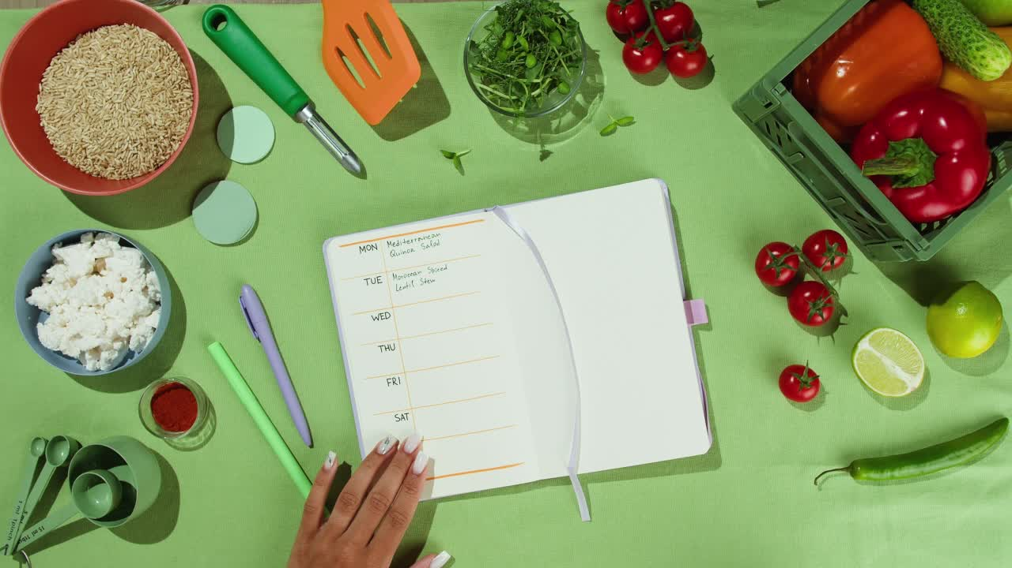

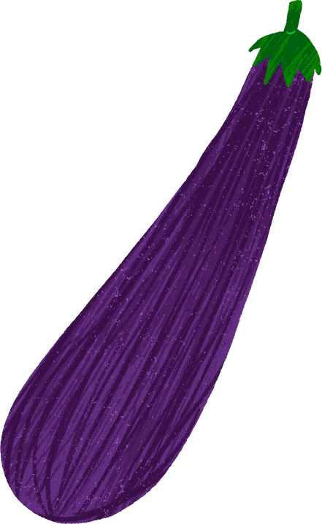
What is a recipe?
A recipe is a set of steps for preparing a dish
roll out the dough
spread the filling
cut it
bake it
brush the surface with cream

Slide 9



 | Time Order Transition Words
1
2
3
4

Slide 10
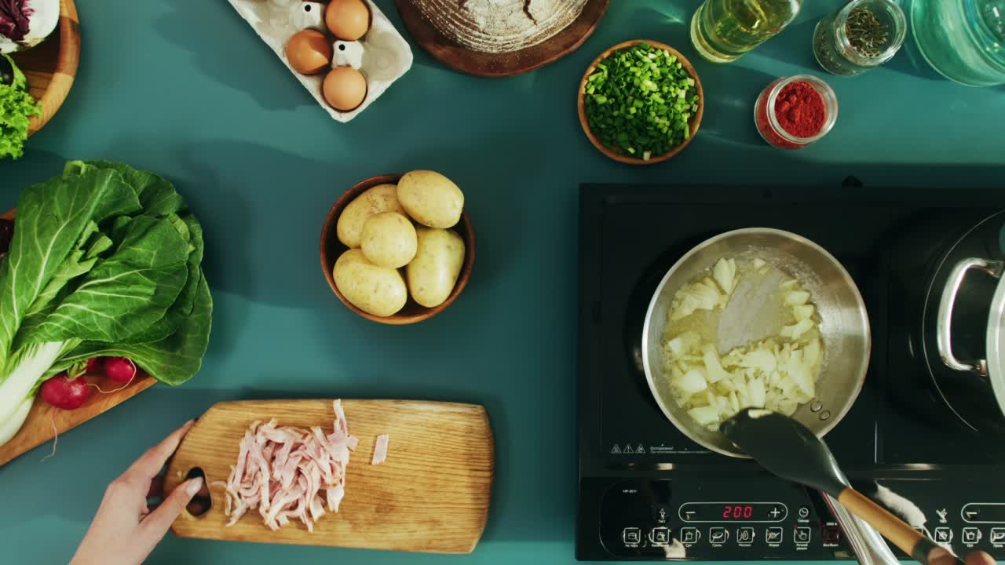
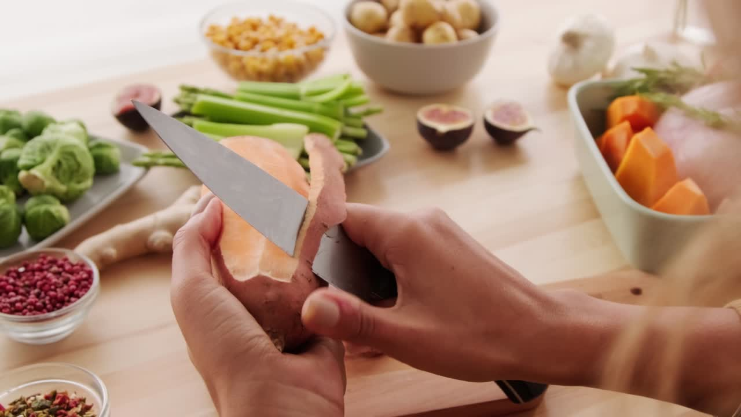
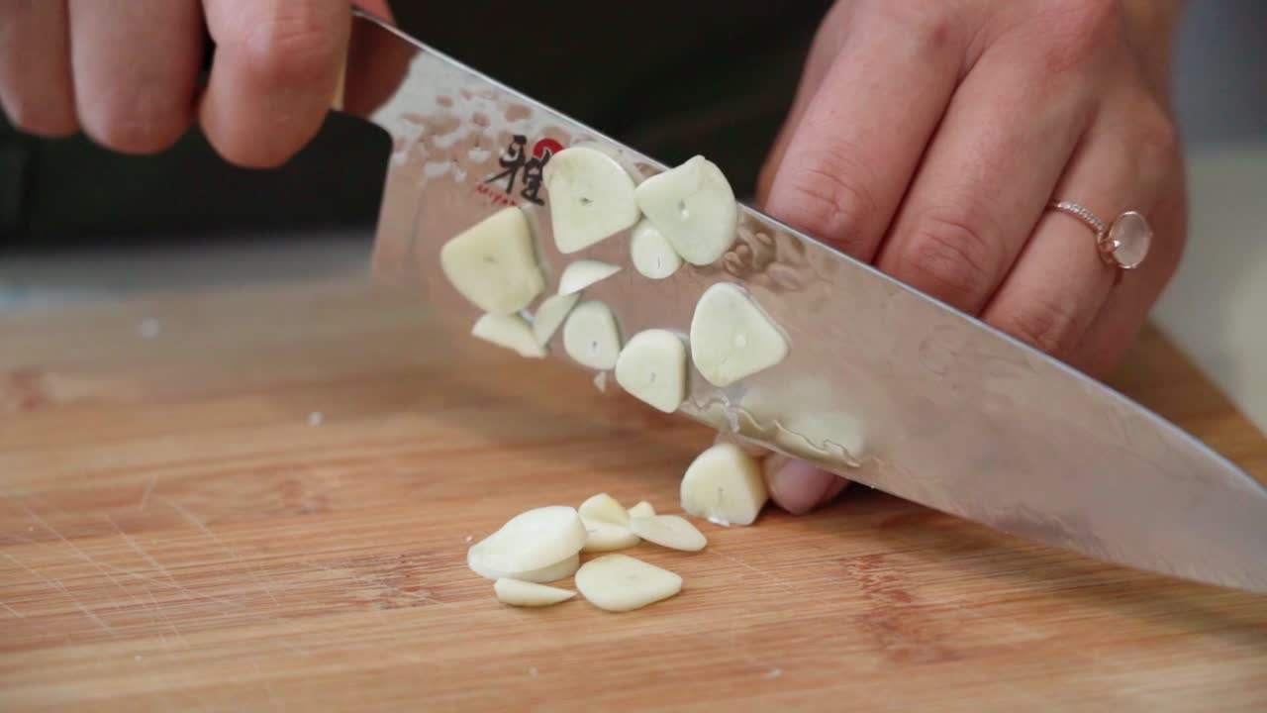
Cooking Verbs and Utensils

Slide 11
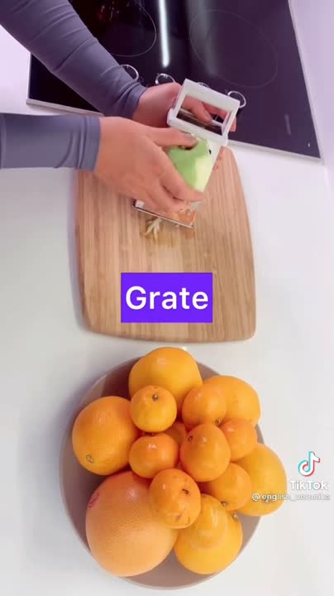


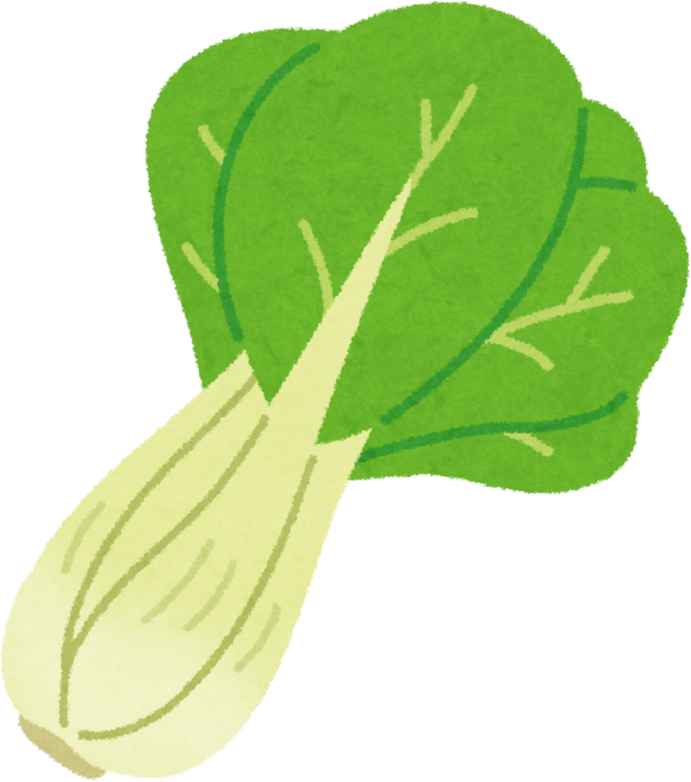
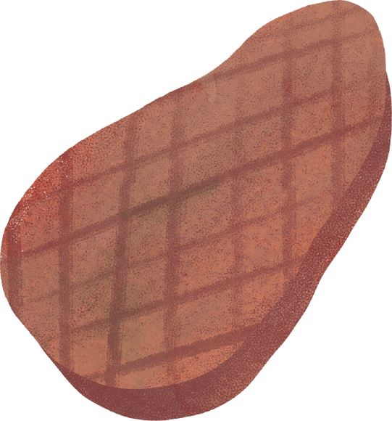
COOKING VERBS

Slide 12

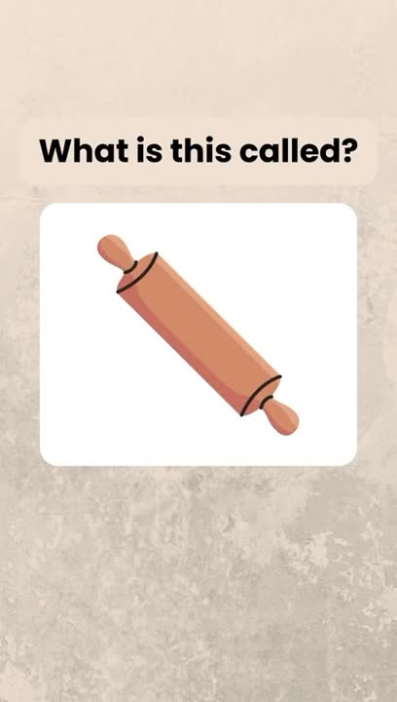

Utensils

Slide 13

1.Pick a catchy Title
3.Add the supporting details and don’t forget to use cooking verbs and time order transition words
WRITE A RECIPE
2. Choose a nice topic sentence
4. Wrap up your paragraph with an interesting conclusion

Slide 14
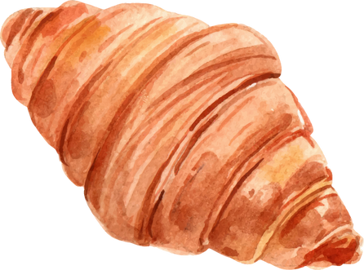
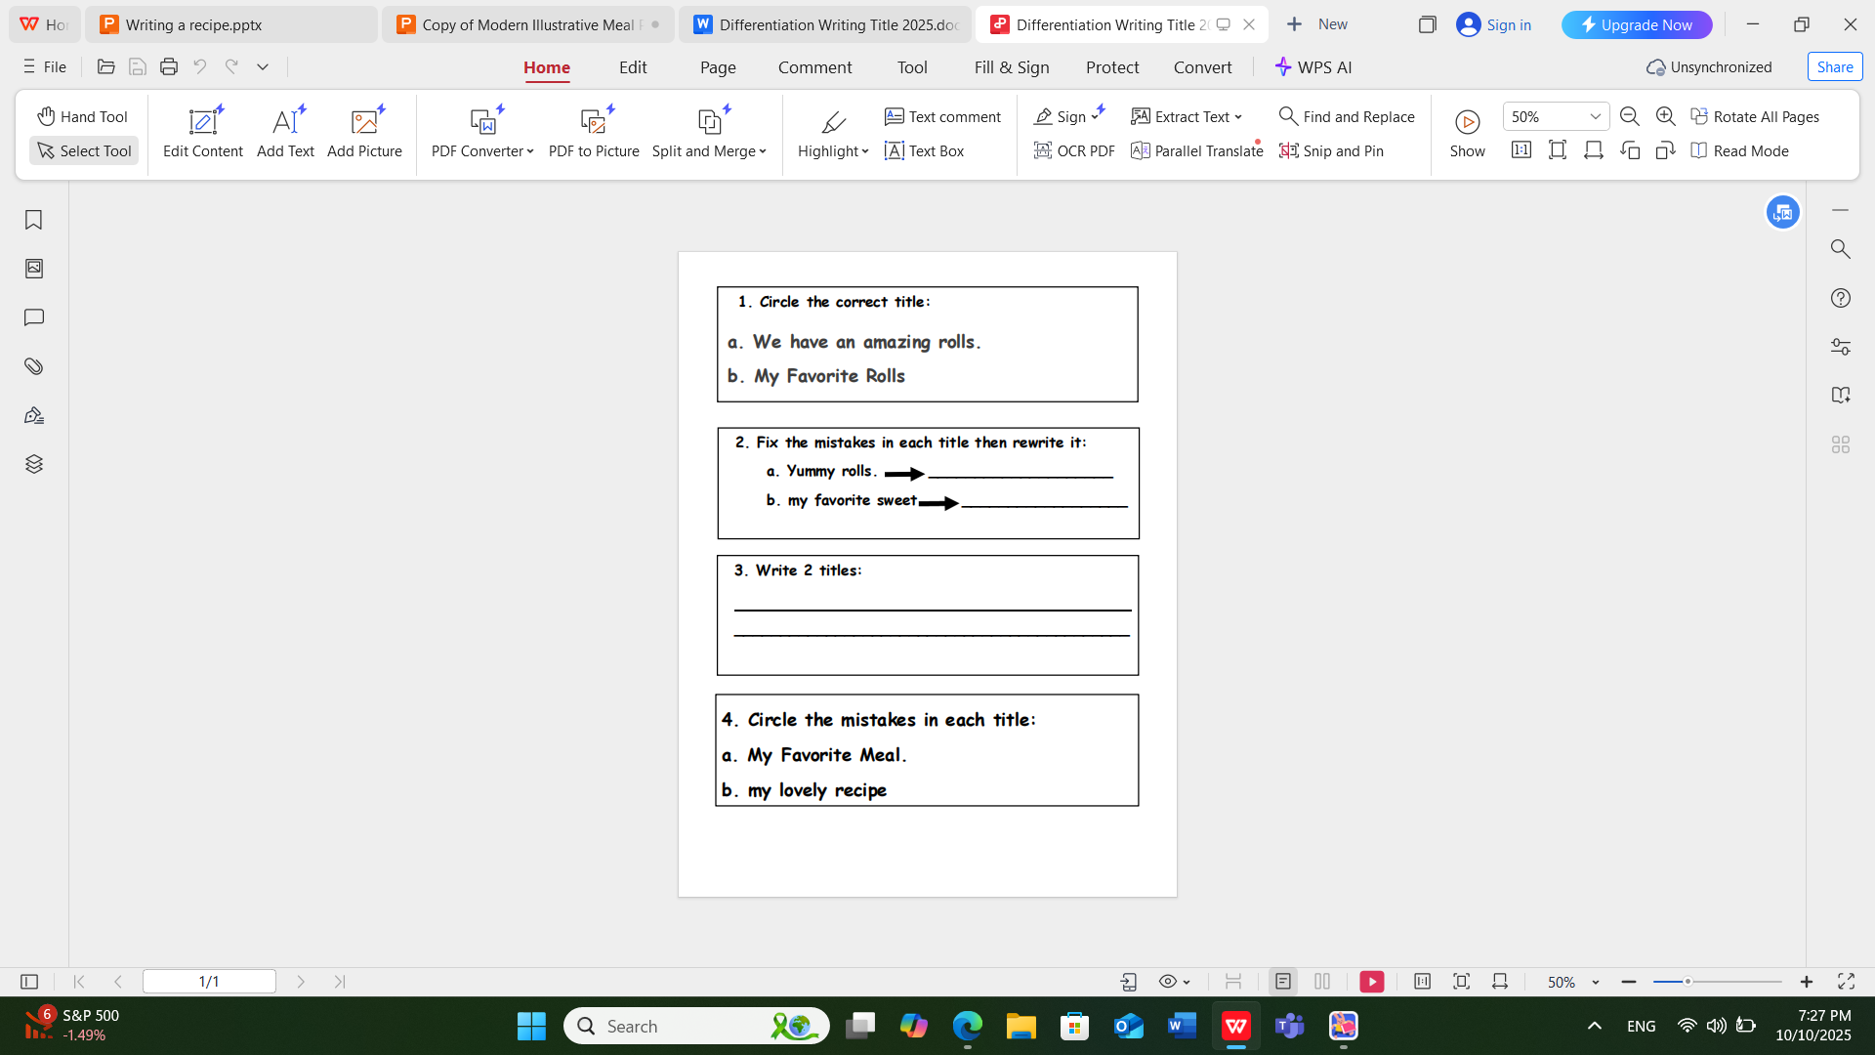
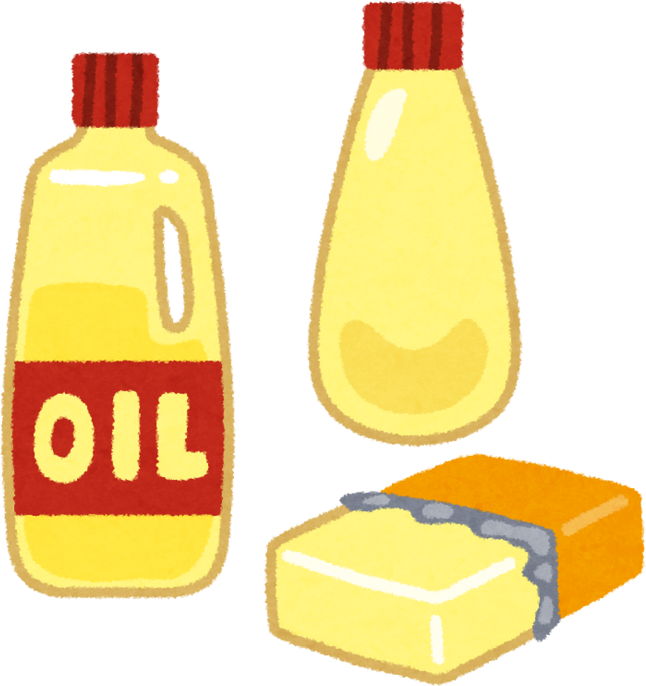
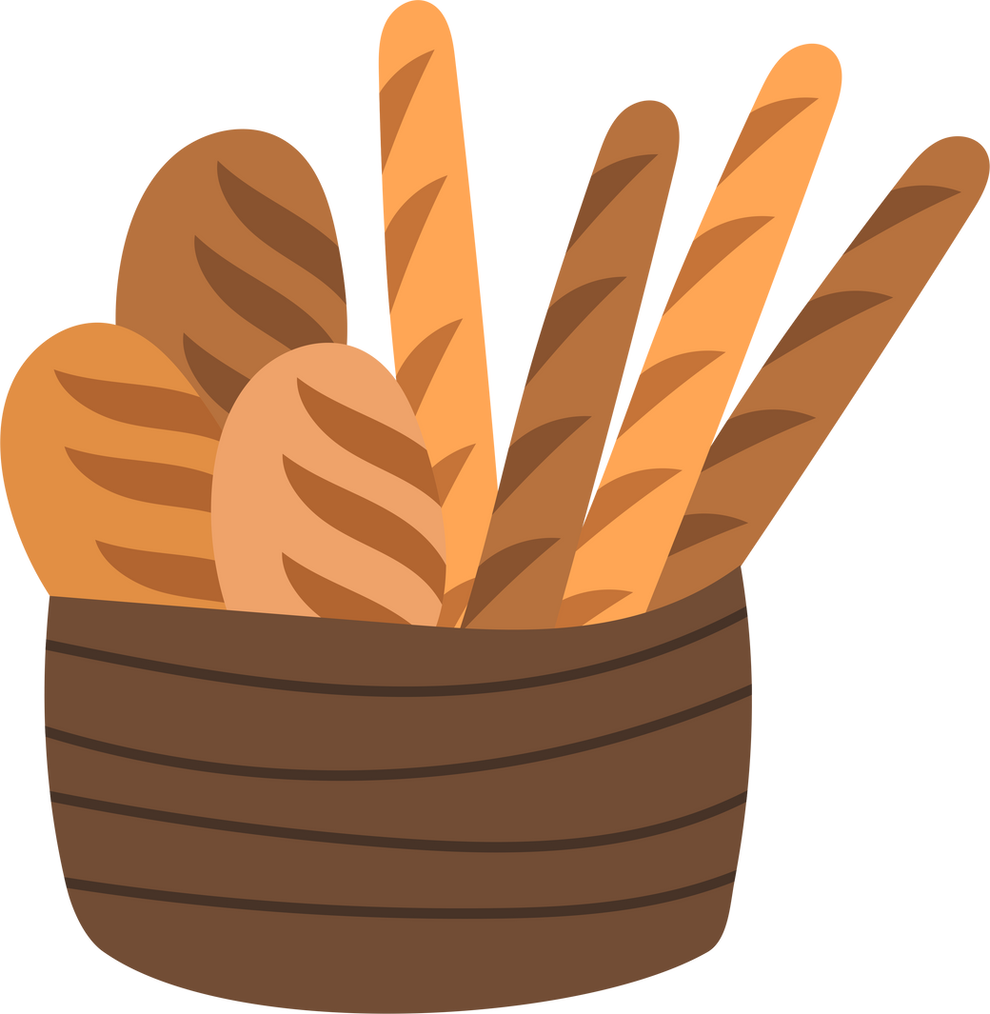
DIFFERENTIATION:

Slide 15
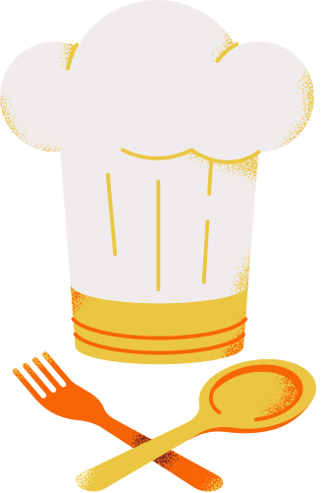

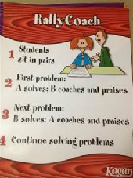
WRITE THE TITLE:
Centered
Catchy
Capitalized
No full stops
No verbs
FORMATIVE ASSESSMENT:

Slide 16
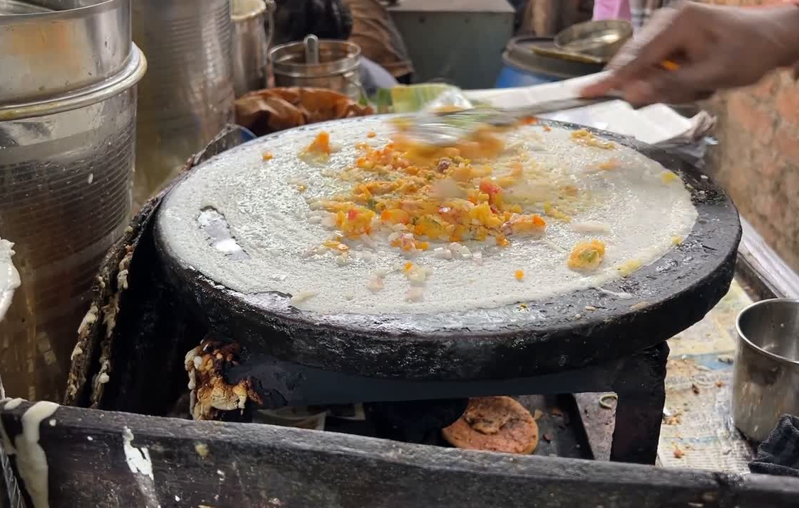
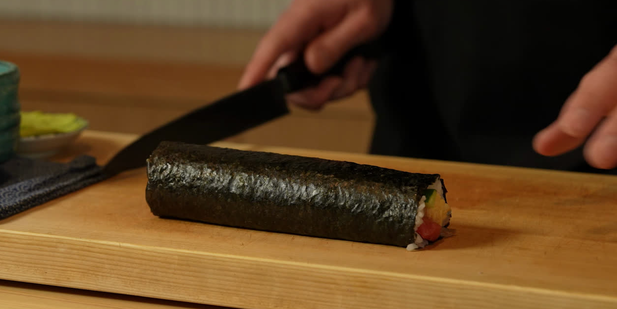
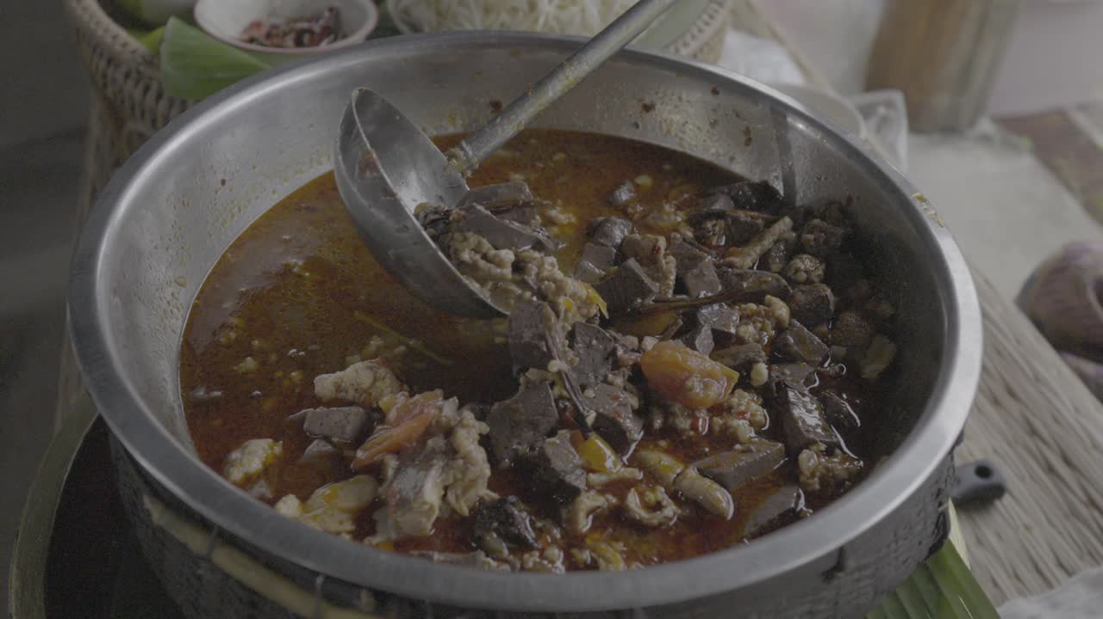
CRITICAL THINKING:
Do you think it is important to try food from different cultures?
BUZZ IN

Slide 17
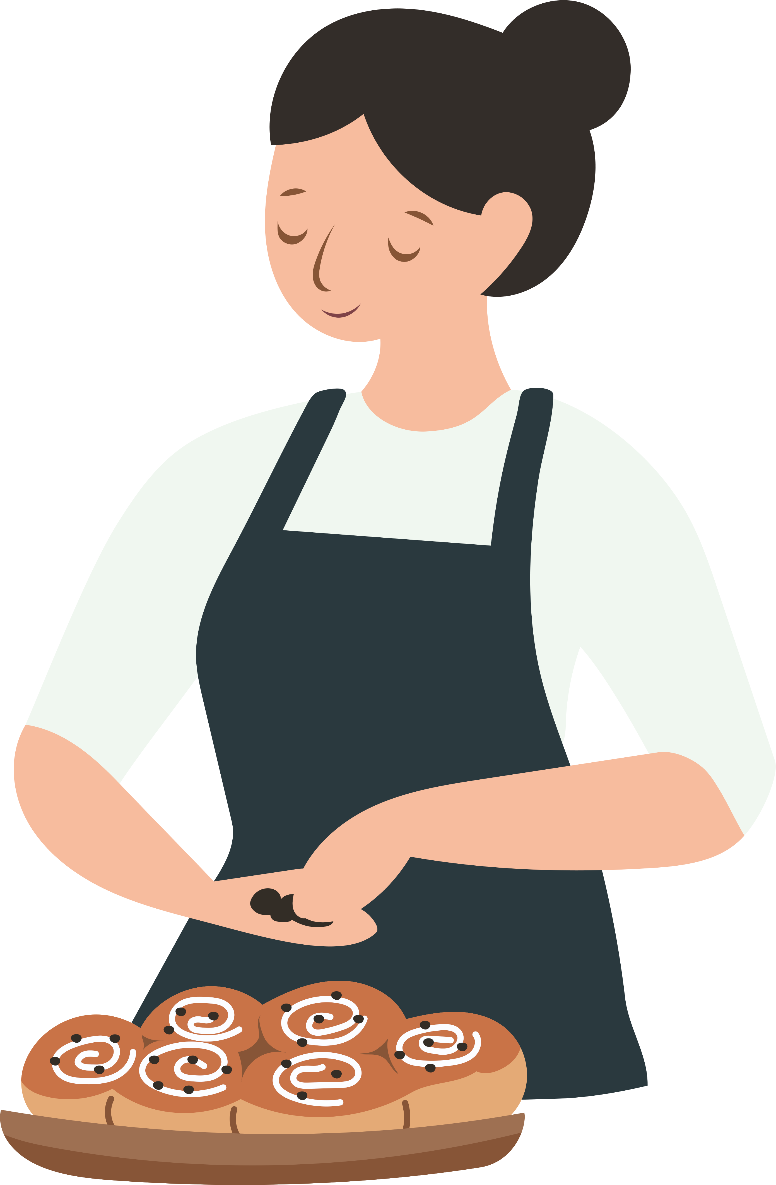



SUMMATIVE ASSESSMENT:
WHICH OF THESE TITLES IS CORRECT?
The Perfect Rolls
My favorite dish.
IRS

Slide 18
FEEDBACK:
WHICH OF THESE TITLES IS CORRECT?
The Perfect Rolls
My favorite dish.

Slide 19

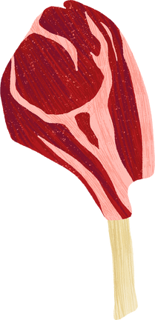

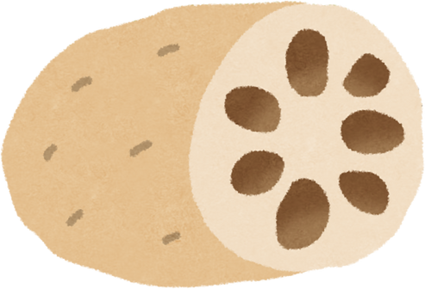
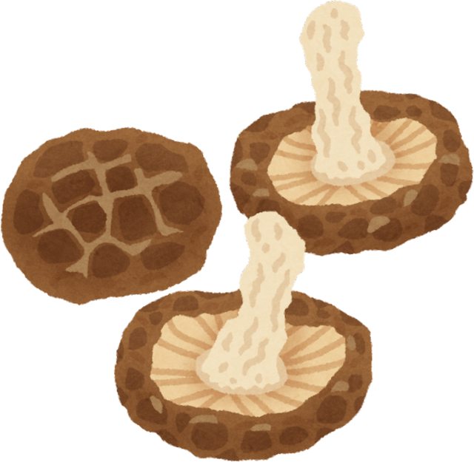
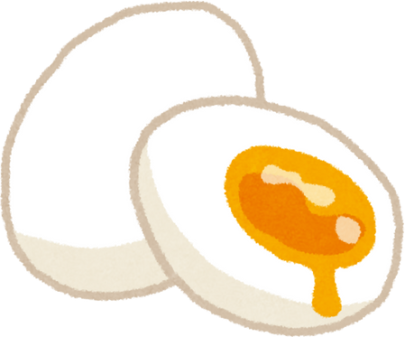
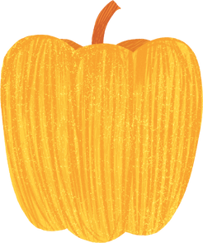
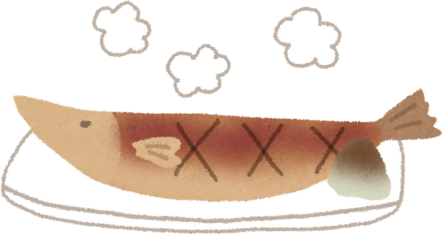

What did we learn?

Slide 20

HOMEWORK:
WRITE A LEMON JUICE RECIPE

Slide 21



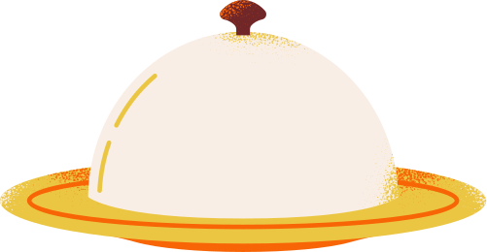


THANK YOU

