Slide 1
Hurricane

Slide 2
Objectives
Identify the new genre
1.
Read and Answer text based questions
2.
3.
Value being responsible

Slide 3


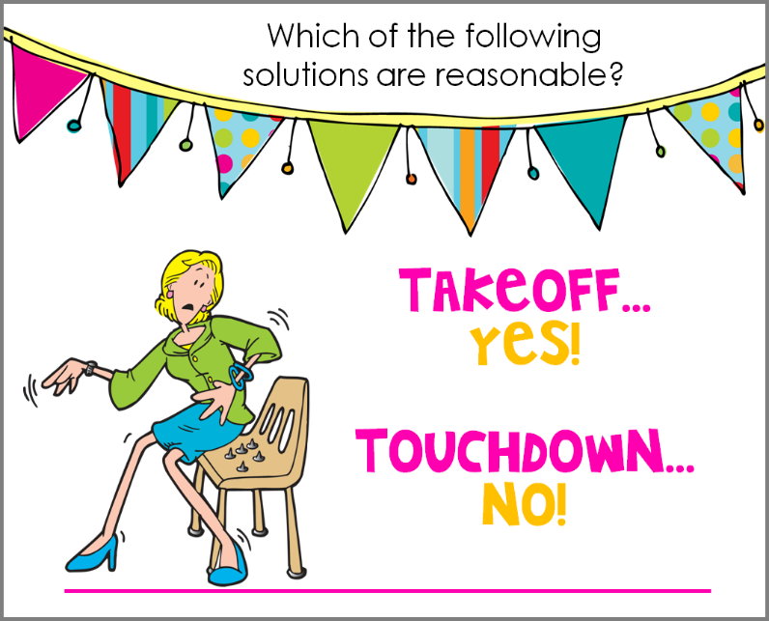
Islamic Educational College Date :
Subject: English
Grade: 4
Unit: 5
Lesson: Grammar
Outcomes
01:00 minutes
- Hurricane is a strong storm with a heavy wind and rain.
- “Hurricane” is a verb.
Warm-Up
Pre-assessment
Presentation
Formative assessment
Feedback
Differentiation
Linking to life
Critical Thinking
True/ False
Summative Assessment
Closure

Slide 4
PRE- Assessment The text is: 1-Fiction 2-Non-Fiction

Slide 5
PRE- Assessment The text is: 1-Fiction 2-Non-Fiction

Slide 6

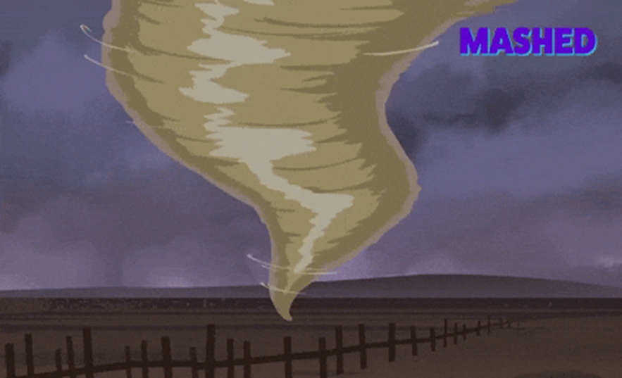
Answer
Hurricane
Authentic

Slide 7
Real Life Application:
Do you think it is important to know the weather before going on a picnic, Why?
Random pick

Slide 8
What is the genre? Open p.(108)
1-It is made up piece of writing that didn’t really happen
2-It focuses on a single theme or a subject
3-It has limited numbers of characters
Short Story
Short Story Features:
It is a brief fictional narrative text. 2. It focuses on a single theme.
3. It has a few characters and a setting (place and time).

Slide 9
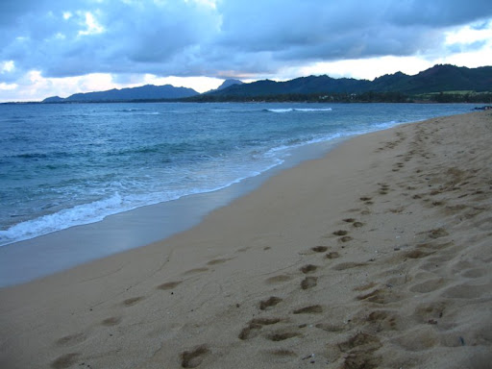
Shore

Slide 10
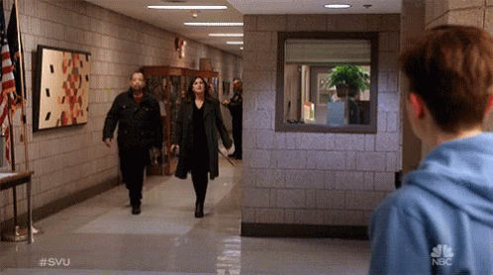
Approaching: moving nearer

Slide 11
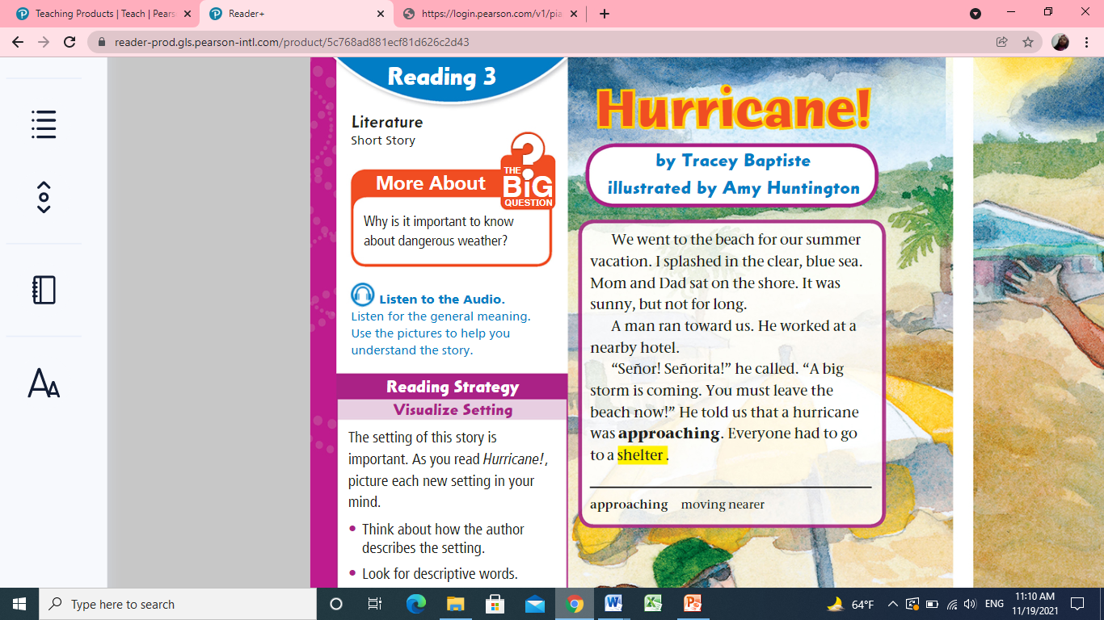


Listen
p.108

Slide 12

p.108
p.108
1-What is the genre?___________________
2-Where did the family go?________________
3-What did they do? ______________________
4-Who was the man that ran toward the family? ______________________________________
5-What did he say? _________________
6-The pronoun he line 5 refers to: ________________
7- Write two clues that tells where the story take place ___________________________________
Rally coach

Slide 13
Listen
p.108

Slide 14
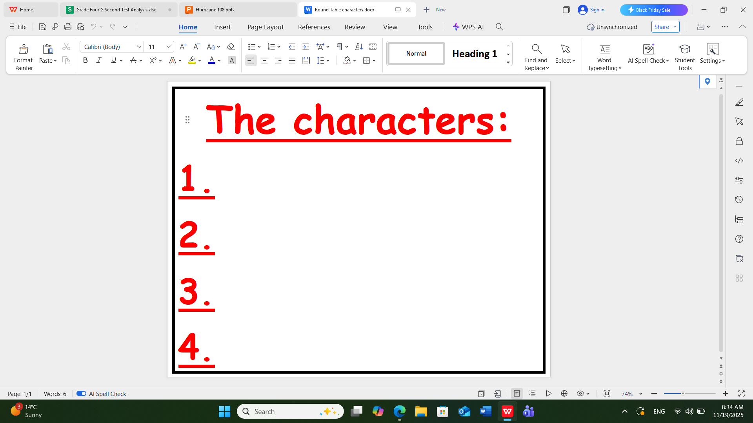

Slide 15
DIFFERENTIATION 2 MIN
Students 4:
The setting of the text is:
1. Forest
2. Beach
3. Home
Students 2:
Who are the characters?
Students 3:
Give evidence that the narrator is one of the characters?
Students 1:
True or false
The genre of the text is fable.( )

Slide 16
Critical Thinking
What would you do if you were in the same situation?
Buzz in

Slide 17
SUMMATIVE ASSESSMENT ( IRS )
1 MIN
The genre of the text is informational text:
1. True 2. False
The family should leave the beach because of :
1. A hurricane 2. hot weather
They should:
1. Go back home. 2. Find a shelter.

Slide 18
SUMMATIVE ASSESSMENT ( IRS )
1 MIN
The genre of the text is informational text:
1. True 2. False
The family should leave the beach because of :
1. A hurricane 2. hot weather
They should:
1. Go back home. 2. Find a shelter.

Slide 19
Closure
Write one thing you liked in today’s lesson
Random pick

Slide 20
Homework
Check the IEC App
Mini boards

