Slide 1

Thursday
20th November, 2024

Slide 2

Unit : Two / Reading: Three
Lesson : Reading / Hurricane!
Subject : English
Grade : Four A, B, C, D, E, F, G

Slide 3


Islamic Educational College Date : 20/11
Subject: English
Grade: 4
Unit:2
Lesson: Reading
Outcomes
01:00 minutes
Warm-Up
At the end of this lesson, students are expected to:
Identify the Genre of the text in hand
Read then answer comprehended questions
Pre-assessment
Presentation
Formative assessment
Feedback
Differentiation
Linking to life
Critical Thinking
Closure

Slide 4
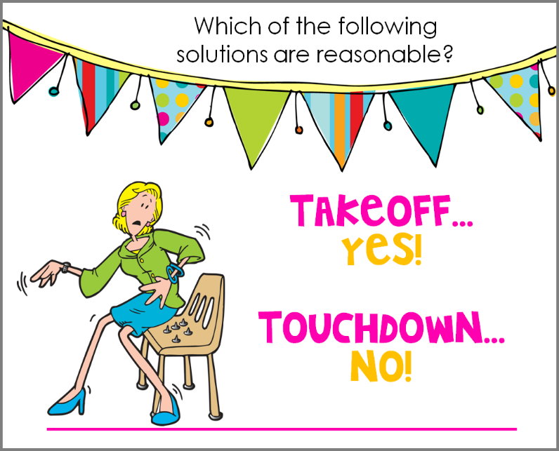
Islamic Educational College Date :
Subject: English
Grade: 4
Unit: 5
Lesson: Grammar
Outcomes
01:00 minutes
- Hurricane is a strong storm with a heavy wind and rain.
- “Hurricane is a verb.
Warm-Up
Pre-assessment
Presentation
Formative assessment
Feedback
Differentiation
Linking to life
Critical Thinking
True/ False
Summative Assessment
Closure

Slide 5
PRE- Assessment
What is the genre of the text?
1-Fable
2- short story

Slide 6
Pre- assessment/ Feedback
What is the genre of the text?
1-Fable
2- short story

Slide 7
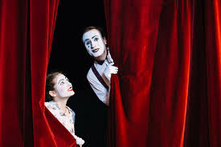
Warm up
Silent Acting Challenge
2 minutes

Slide 8
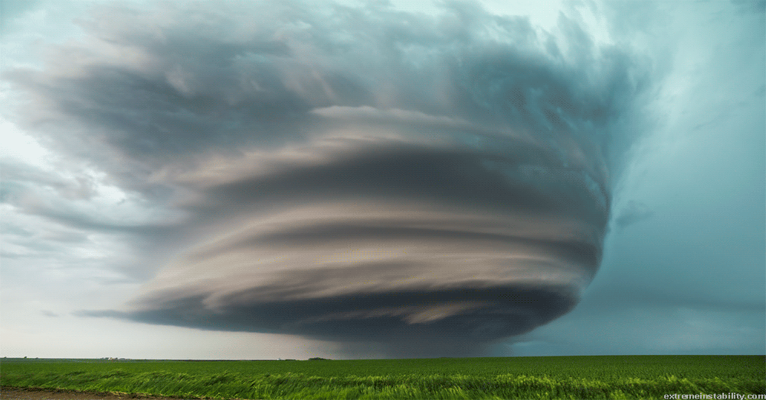
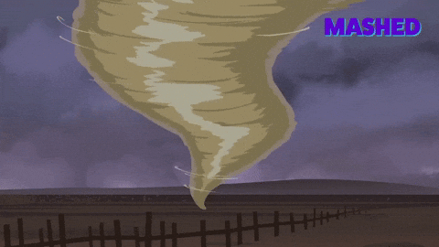

Islamic Educational College Date : 20/11
Subject: English
Grade: 4
Unit: 2
Lesson: Reading
Outcomes
Hurricane (noun):
05:00 minutes
Warm-Up
a storm with heavy wind and rain
Pre-assessment
Presentation
Formative assessment
Feedback
Differentiation
Linking to life
Critical Thinking
Closure

Slide 9


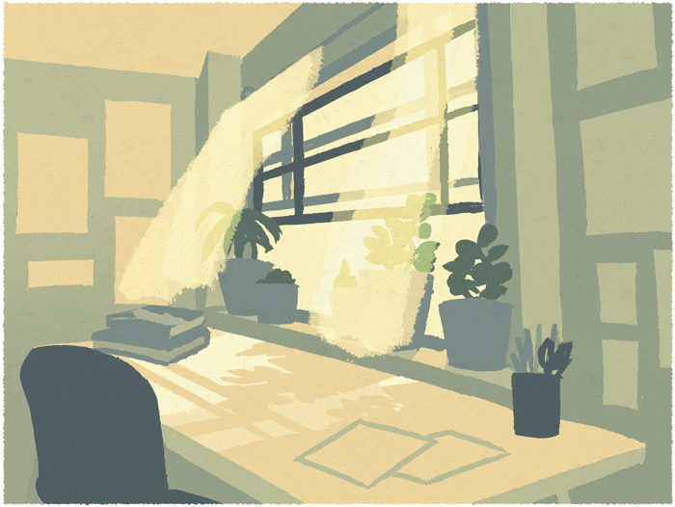
Islamic Educational College Date : 20/11
Subject: English
Grade: 4
Unit: 2
Lesson: Reading
Outcomes
Warm-Up
Pre-assessment
Presentation
Formative assessment
Feedback
Differentiation
Breeze (noun):
Linking to life
Critical Thinking
soft / light wind
Closure

Slide 10
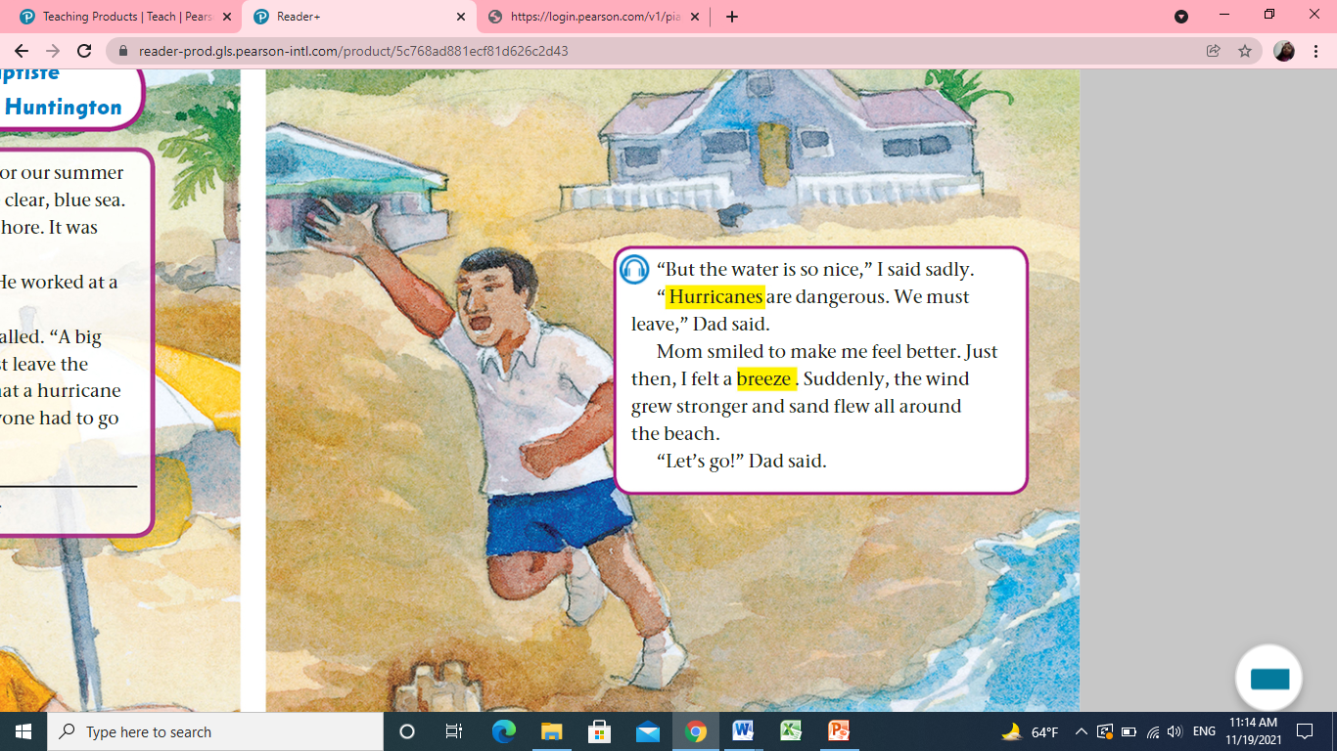

Islamic Educational College Date : 20/11
Subject:
Grade: 4
Unit: 2
Lesson: Reading
Outcomes
05:00 minutes
Warm-Up
Pre-assessment
Listen, Read
Presentation
Formative assessment
Feedback
Differentiation
Linking to life
Critical Thinking
Closure

Slide 11

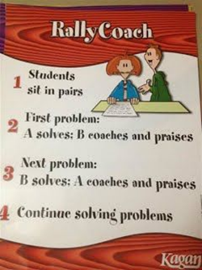
Islamic Educational College Date : 20/11
Subject:
Grade: 4
Unit: 2
Lesson: Reading
Outcomes
05:00 minutes
Warm-Up
Pre-assessment
Listen, Read
then answer:
Presentation
Formative assessment
Feedback
Differentiation
1-Describe hurricanes. _____________________________
2-What did mom do to comfort the boy? _______________
3-What happened suddenly? ________________________
4-What did dad say?_______________________________
5-Find a word that means a (light wind)_________________
Linking to life
Critical Thinking
Closure

Slide 12

Islamic Educational College Date : 20/11
Subject: English
Grade: 4
Unit: 2
Lesson: Reading
Outcomes
01:00 minutes
Warm-Up
If you were one of the story characters,
how would you act?
Pre-assessment
Presentation
Formative assessment
Feedback
Differentiation
Linking to life
Critical Thinking
Closure
BUZZ IN

Slide 13
Islamic Educational College Date : 20/11
Subject: English
Grade: 4
Unit: 2
Lesson: Reading
Outcomes
Warm-Up
Pre-assessment
1-Describe hurricane. __Big storm___
2-What did mom do to comfort the boy? ___She smiled______
3-What happened suddenly? __The wind grew stronger and sand flew all around the beach _
4-What did dad say?____Hurricanes are dangerous, we must leave____
5-Find a word that means a (light wind)____Breeze___
Presentation
Formative assessment
Feedback
Differentiation
Linking to life
Critical Thinking
Closure
Number : 1,2

Slide 14
Islamic Educational College Date : 20/11
Subject:
Grade: 4
Unit: 2
Lesson: Reading
Outcomes
05:00 minutes
Warm-Up
The dad said
1.We must leave
2.We must stay
Pre-assessment
Presentation
Formative assessment
Feedback
Differentiation
Linking to life
Critical Thinking
Closure

Slide 15
Islamic Educational College Date : 20/11
Subject:
Grade: 4
Unit: 2
Lesson: Reading
Outcomes
05:00 minutes
Warm-Up
The dad said
1.We must leave
2.We must stay
Pre-assessment
Presentation
Formative assessment
Feedback
Differentiation
Linking to life
Critical Thinking
Closure

Slide 16
Islamic Educational College Date : 20/11
Subject: English
Grade: 4
Unit: 2
Lesson: Reading
02:00 minutes
Outcomes
Students 3:
Give evidence that the narrator is one of the characters?
____________________
Students 2:
Why did dad say
“ We must leave now”? _________________
Warm-Up
Pre-assessment
Presentation
Formative assessment
Students 4: Circle:
The mom tried to
1.Comfort the boy
2.Feed the boy
____________________
Students 4:
True or false
Hurricanes are safe and not dangerous.( )
Feedback
Differentiation
Linking to life
Critical Thinking
Closure
Random Pick

Slide 17

Islamic Educational College Date : 20/11
Subject: English
Grade: 4
Unit: 2
Lesson: Reading
Outcomes
02:00 minutes
Warm-Up
The family will stay in the beach
1. True
2. False
Dad said hurricanes are natural, no need to panic.
  1. True
  2. False
Pre-assessment
Presentation
Formative assessment
Feedback
Differentiation
Linking to life
Critical Thinking
Summative Assessment

Slide 18
Homework
Check the IEC App
Mini boards

Slide 19
Closure
Write one thing you liked in today’s lesson
Random pick

Slide 20
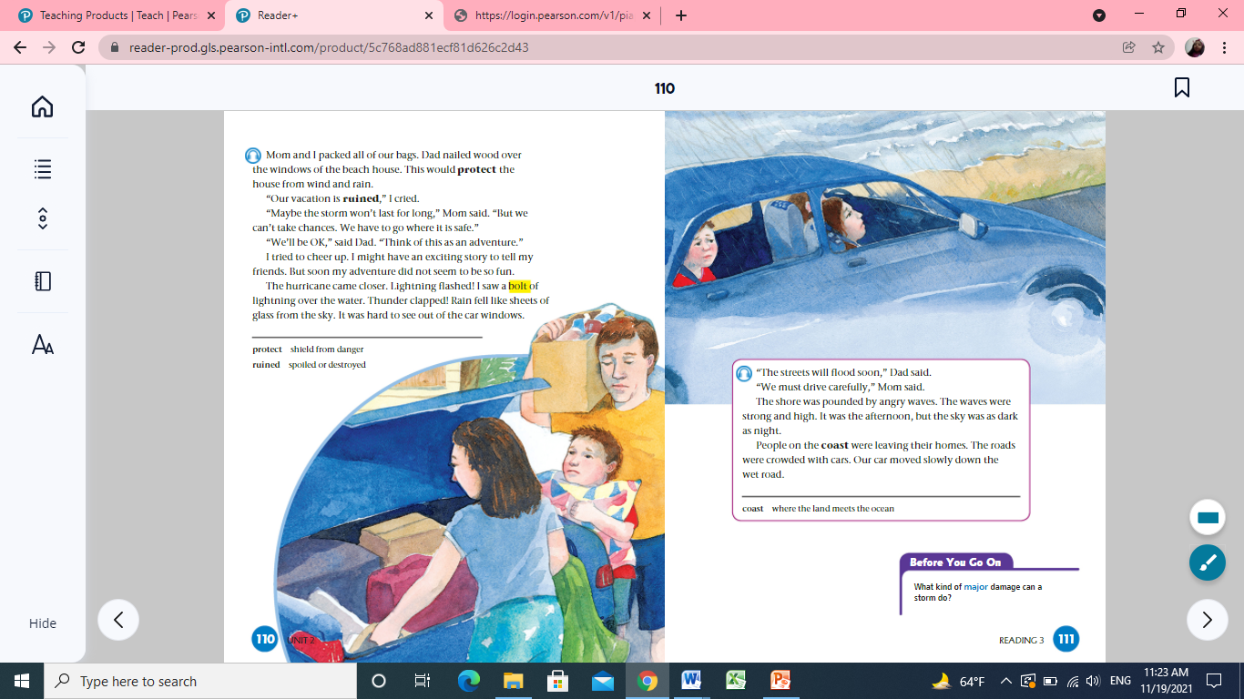
Look and say
p.110
What are they doing? Why?

Slide 21
Sunday
23th November, 2025

Slide 22
Islamic Educational College Date :
Subject: English
Grade: 4
Unit: 5
Lesson: Grammar
Outcomes
01:00 minutes
- Hurricane is a strong storm with a heavy wind and rain.
- “Hurricane is a verb.
Warm-Up
Pre-assessment
Presentation
Formative assessment
Feedback
Differentiation
Linking to life
Critical Thinking
True/ False
Summative Assessment
Closure

Slide 23
PRE- Assessment
What is the genre of the text?
1-Fable
2- short story

Slide 24
Pre- assessment/ Feedback
What is the genre of the text?
1-Fable
2- short story

Slide 25
Warm up
Silent Acting Challenge
2 minutes

Slide 26
ROUND TABLE
The characters
1
2
3
4
Buzz in

Slide 27
Islamic Educational College Date : 20/11
Subject: English
Grade: 4
Unit: 2
Lesson: Reading
Outcomes
Warm-Up
Pre-assessment
Presentation
Formative assessment
Feedback
Differentiation
Breeze (noun):
Linking to life
Critical Thinking
soft / light wind
Closure

Slide 28
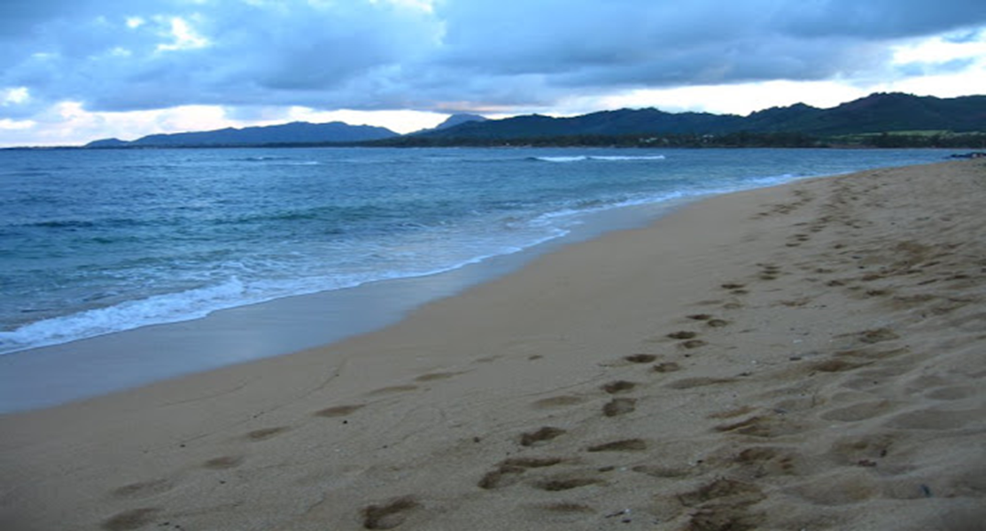
Real life application/Buzz in
What activities can you do at the shore?

Slide 29
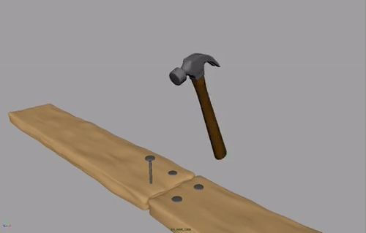
Nailed wood:

Slide 30
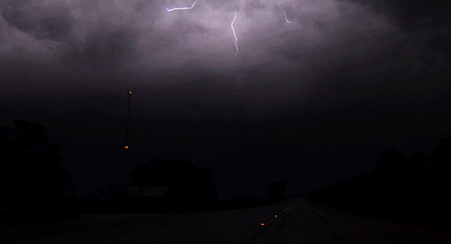
A bolt:
white line in the sky

Slide 31
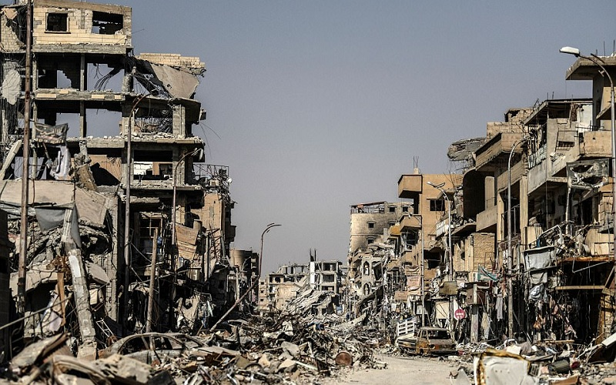
Ruined:
spoiled or destroyed

Slide 32
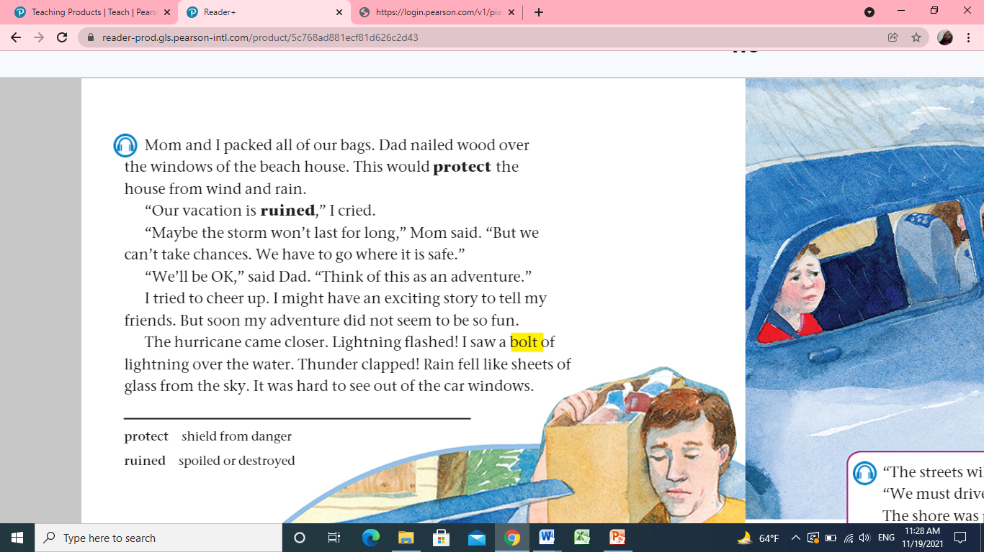
Islamic Educational College Date : 20/11
Subject:
Grade: 4
Unit: 2
Lesson: Reading
Outcomes
03:00 minutes
Warm-Up
Pre-assessment
Listen, Read
then answer:
Presentation
Formative assessment
Feedback
Differentiation
Linking to life
Critical Thinking
Closure

Slide 33
Islamic Educational College Date : 20/11
Subject:
Grade: 4
Unit: 2
Lesson: Reading
Outcomes
03:00 minutes
Warm-Up
1- What did Dad do to protect the house?
2-Describe the rain.
3-find a word that means destroyed.___________
Pre-assessment
Presentation
Formative assessment
Feedback
Differentiation
Linking to life
Critical Thinking
Closure

Slide 34
FORMATIVE Assessment\
IRS
The family should leave the beach because
1.a friend
2.a hurricane

Slide 35
Islamic Educational College Date : 20/11
Subject: English
Grade: 4
Unit: 2
Lesson: Reading
02:00 minutes
Outcomes
Students 1:
Give evidence that the narrator is one of the characters?
____________________
Students 3:
The vacation was:
Reuind
amazing
Warm-Up
Pre-assessment
Presentation
Formative assessment
Students 2:
How do moms play important roles in their children’s lives?
____________________
Students 4:
True or false
The boy was happy.( )
Feedback
Differentiation
Linking to life
Critical Thinking
Closure
Random Pick

Slide 36
Islamic Educational College Date : 20/11
Subject: English
Grade: 4
Unit: 2
Lesson: Reading
Outcomes
01:00 minutes
Warm-Up
Can you imagine yourself in the middle of a hurricane, and how would you react?
Pre-assessment
Presentation
Formative assessment
Feedback
Differentiation
Linking to life
Critical Thinking
Closure
BUZZ IN

Slide 37
Islamic Educational College Date : 20/11
Subject: English
Grade: 4
Unit: 2
Lesson: Reading
Outcomes
02:00 minutes
Warm-Up
The family will stay in the beach
1. True
2. False
Dad said hurricanes are natural, no need to panic.
  1. True
  2. False
Pre-assessment
Presentation
Formative assessment
Feedback
Differentiation
Linking to life
Critical Thinking
Summative Assessment

Slide 38
Islamic Educational College Date : 28/10
Subject: English
Grade: 4
Unit: 1
Lesson: Reading
Outcomes
02:00 minutes
Warm-Up
Pre-assessment
What did we learn today.
Presentation
Formative assessment
Feedback
Differentiation
Linking to life
Critical Thinking
Closure
Mini Boards

Slide 39

The End

