Slide 1

Monday
24th November, 2025

Slide 2

Unit : Two / Reading: Three
Lesson : Reading / Hurricane!
Subject : English
Grade : Four A, B, C, D, E, F, G

Slide 3


Islamic Educational College Date : 21/11
Subject: English
Grade: 4
Unit:2
Lesson: Reading
Outcomes
01:00 minutes
Warm-Up
At the end of this lesson, students are expected to:
Identify the Genre of the text in hand
Read then answer questions
Pre-assessment
Presentation
Formative assessment
Feedback
Differentiation
Linking to life
Critical Thinking
Closure

Slide 4
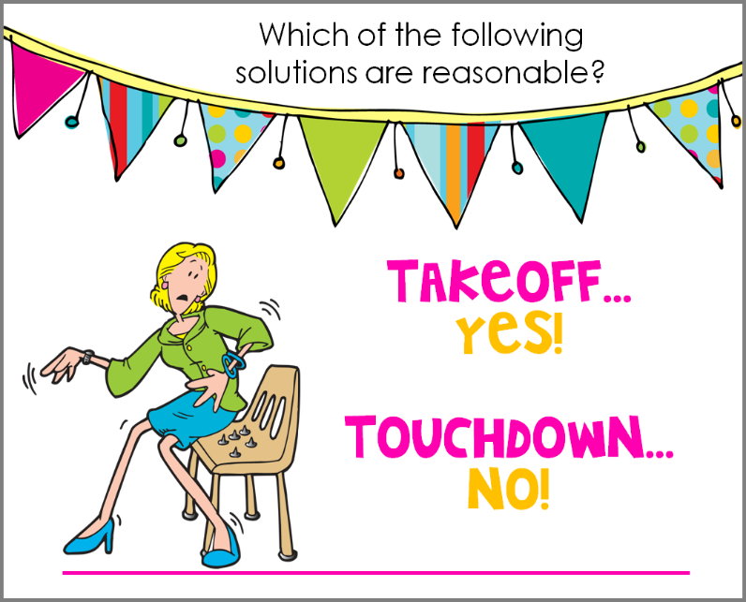
Islamic Educational College Date :
Subject: English
Grade: 4
Unit: 5
Lesson: Grammar
Outcomes
01:00 minutes
- Hurricane is a strong storm with a heavy wind and rain.
- “Hurricane is a verb.
Warm-Up
Pre-assessment
Presentation
Formative assessment
Feedback
Differentiation
Linking to life
Critical Thinking
True/ False
Summative Assessment
Closure

Slide 5
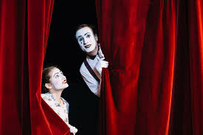
Warm up
Silent Acting Challenge
2 minutes

Slide 6


Islamic Educational College Date : 21/11
Major:
Grade:
Unit:2
Lesson: Reading
Outcomes
One of the following is an example of a fictional genre:
01:00 minutes
Warm-Up
Pre-assessment
Presentation
1. Short story
Formative assessment
Feedback
2. Informational text
Differentiation
Linking to life
Critical Thinking
Summative assessment
IRS
Closure

Slide 7
Islamic Educational College Date : 21/11
Major:
Grade:
Unit:2
Lesson: Reading
Outcomes
One of the following is an example of a fictional genre:
Warm-Up
Pre-assessment
Presentation
1. Short story
Formative assessment
Feedback
2. Informational text
Differentiation
Linking to life
Critical Thinking
Summative assessment
Closure

Slide 8
Islamic Educational College Date : 21/11
Major:
Grade:
Unit:2
Lesson: Reading
Outcomes
01:00 minutes
One of the following is an element of a short story:
Warm-Up
Pre-assessment
Presentation
1. It is real
Formative assessment
Feedback
2. It has a few characters
Differentiation
Linking to life
Critical Thinking
Summative assessment
IRS
Closure

Slide 9
Islamic Educational College Date : 21/11
Major:
Grade:
Unit:2
Lesson: Reading
Outcomes
One of the following is an element of a short story:
Warm-Up
Pre-assessment
Presentation
1. It is real
Formative assessment
Feedback
2. It has a few characters
Differentiation
Linking to life
Critical Thinking
Summative assessment
IRS
Closure

Slide 10
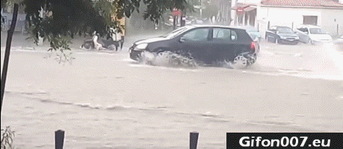

Islamic Educational College Date : 21/11
Subject: English
Grade: 4
Unit: 2
Lesson: Reading
Outcomes
Flood (noun):
05:00 minutes
Warm-Up
a large amount of water
Pre-assessment
Presentation
Formative assessment
Feedback
Differentiation
Linking to life
Critical Thinking
Closure

Slide 11
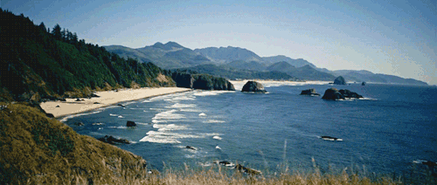
Islamic Educational College Date : 21/11
Subject: English
Grade: 4
Unit: 2
Lesson: Reading
Outcomes
Warm-Up
Pre-assessment
Presentation
Formative assessment
Feedback
Differentiation
Coast (noun):
Linking to life
Critical Thinking
The part of the land near the sea
Closure

Slide 12
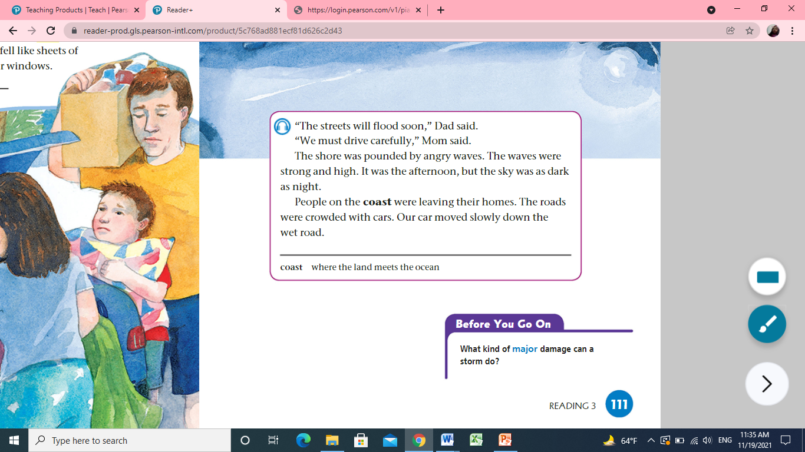
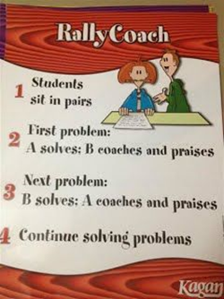


Islamic Educational College Date : 21/11
Subject:
Grade: 4
Unit: 2
Lesson: Reading
Outcomes
05:00 minutes
Warm-Up
Pre-assessment
Listen, Read
then answer:
Presentation
Formative assessment
Feedback
Differentiation
Linking to life
Critical Thinking
Closure

Slide 13
Islamic Educational College Date : 21/11
Subject: English
Grade: 4
Unit: 2
Lesson: Reading
Outcomes
Warm-Up
1-How was the shore?
_The shore was pounded by angry waves._
2-Describe the waves.
__The waves were strong and high.___
3-Talk about the people and the streets.
Pre-assessment
Presentation
Formative assessment
Feedback
Differentiation
Linking to life
Critical Thinking
Closure
Students Number : (1,2)

Slide 14
Islamic Educational College Date : 21/11
02:00 minutes
Subject: English
Grade: 4
Unit: 2
Lesson: Reading
Outcomes
Student’s number | Task
4 Match: | Beach Time Daytime Place
3 Circle | People on the coast were leaving their homes ( True/ False)
3 | What do you think will happen next based on the events so far?
2 | How can you tell that the genre of this text is a short story?
Warm-Up
Pre-assessment
Presentation
Formative assessment
Feedback
Differentiation
Linking to life
Critical Thinking
Closure
Random Pick

Slide 15
Islamic Educational College Date : 21/11
Major:English
Grade:Four
Unit:2
Lesson: Reading
Outcomes
01:00 minutes
Warm-Up
What is the value that we may learn from this short story?
Pre-assessment
Presentation
Formative assessment
Feedback
Differentiation
Linking to life
Critical Thinking
Summative assessment
BUZZ IN
Closure

Slide 16

Islamic Educational College Date : 21/11
Subject: English
Grade: 4
Unit: 2
Lesson: Reading
Outcomes
01:00 minutes
Warm-Up
If you were one of the story characters,
how would you act?
Pre-assessment
Presentation
Formative assessment
Feedback
Differentiation
Linking to life
Critical Thinking
Closure
BUZZ IN

Slide 17

Islamic Educational College Date : 21/11
Subject: English
Grade: 4
Unit: 2
Lesson: Reading
Outcomes
02:00 minutes
Warm-Up
According to the text, hurricanes are safe:
1. True
2. False
Dad was driving very fast:
  1. True
  2. False
Pre-assessment
Presentation
Formative assessment
Feedback
Differentiation
Linking to life
Critical Thinking
Summative Assessment
Closure

Slide 18


Islamic Educational College Date : 21/11
Major:English
Grade:Four
Unit:2
Lesson:Reading
Outcomes
Warm-Up
Pre-assessment
Presentation
Formative assessment
Feedback
Differentiation
Linking to life
Critical Thinking
Summative assessment
Closure

Slide 19

The End

