Slide 1

Wednesday
12th November, 2025

Slide 2

Unit : Two / Reading: Three
Lesson : Key Words
Subject : English
Grade : Four A, B, C, D, E, F, G

Slide 3


Islamic Educational College Date : 3/11
Subject: English
Grade: 4
Unit:2
Lesson: Key Words
Outcomes
01:00 minutes
Warm-Up
At the end of this lesson, students are expected to:
Recognize the meaning of new words
Use the new words in different contexts
Pre-assessment
Presentation
Formative assessment
Feedback
Differentiation
Linking to life
Critical Thinking
Summative Assessment
Closure

Slide 4
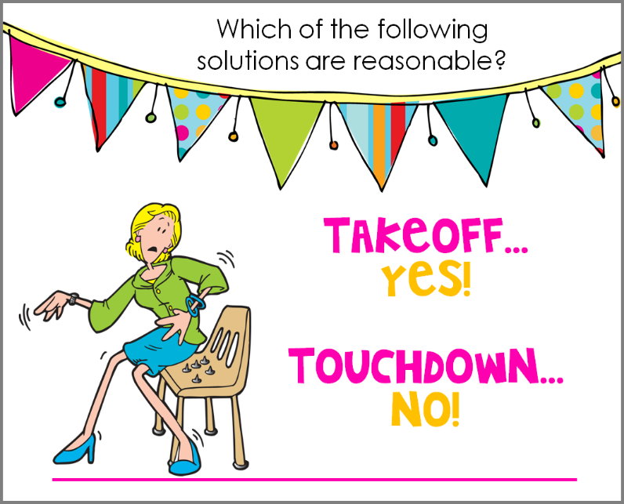
Islamic Educational College Date :
Subject: English
Grade: 4
Unit: 5
Lesson: Grammar
Outcomes
01:00 minutes
-The last part in the friendly letter is the heading..
- The main part in the friendly letter is the body.
Warm-Up
Pre-assessment
Presentation
Formative assessment
Feedback
Differentiation
Linking to life
Critical Thinking
True/ False
Summative Assessment
Closure

Slide 5
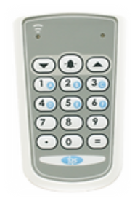
Islamic Educational College Date :
Subject: English
Grade: 4
Unit: 5
Lesson: Grammar
Outcomes
01:00 minute
Warm-Up
Click on the correct signature!
Pre-assessment
Presentation
1. Dear Ahmad
Formative assessment
Feedback
2. Sara
Differentiation
Linking to life
Critical Thinking
Summative Assessment
IRS
Closure

Slide 6

Islamic Educational College Date :
Subject: English
Grade: 4
Unit: 5
Lesson: Grammar
Outcomes
Warm-Up
Pre-assessment
1. Dear Ahmad
Presentation
Formative assessment
2. Sara
Feedback
Differentiation
Linking to life
Critical Thinking
Summative Assessment
Closure

Slide 7
Presentation 3 students/ Random pick
https://wordwall.net/resource/166259/english/nouns-and-adjectives-remember-a-noun-is-a-name-of-a
Random pick
Authentic

Slide 8
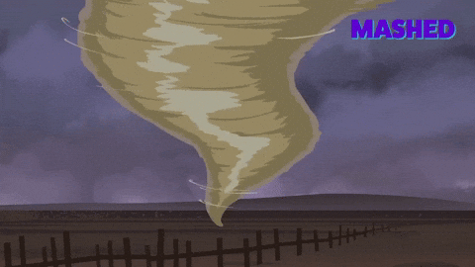

Islamic Educational College Date : 3/11
Subject: English
Grade: 4
Unit: 2
Lesson: Key Words
Outcomes
02:00 minutes
Look at the picture then give a sentence to describe it.
Warm-Up
Pre-assessment
Presentation
Formative assessment
Feedback
Differentiation
Linking to life
Critical Thinking
Summative Assessment
Closure

Slide 9

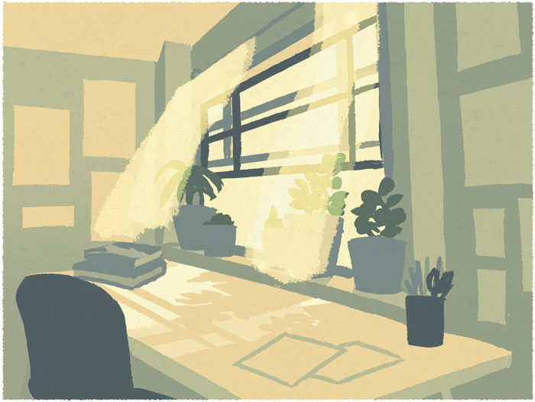

Islamic Educational College Date : 3/11
Subject: English
Grade: 4
Unit: 2
Lesson: Key Words
Outcomes
05:00 minutes
Warm-Up
Pre-assessment
Presentation
Formative assessment
Feedback
Breeze (noun):
soft / light wind
Differentiation
Linking to life
We felt a breeze on our faces while walking on the beach.
Critical Thinking
Summative Assessment
Closure

Slide 10
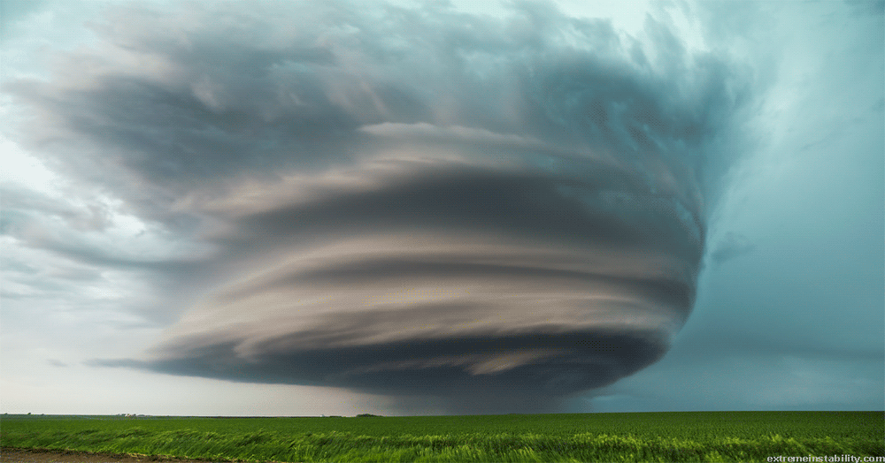
Islamic Educational College Date : 3/11
Subject: English
Grade: 4
Unit: 2
Lesson: Key Words
Outcomes
Hurricane (noun):
05:00 minutes
Warm-Up
a storm with heavy wind and rain
Pre-assessment
Presentation
Formative assessment
On the coast of Florida, a hurricane reaches land almost every year.
Feedback
Differentiation
Linking to life
Critical Thinking
Summative Assessment
Closure

Slide 11


Answer
Hurricane
Authentic

Slide 12
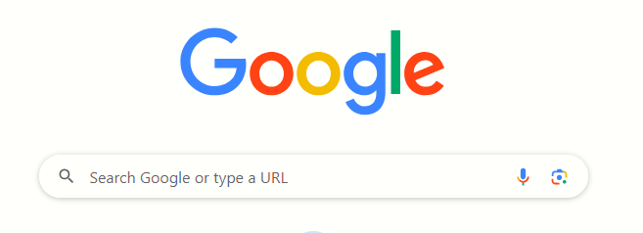
02:00 minutes
Search: The synonym of “hurricane”.

Slide 13
Islamic Educational College Date : 3/11
Subject: English
Grade: 4
Unit: 2
Lesson: Key Words
Outcomes
01:00 minutes
Warm-Up
Can you imagine yourself in the middle of a hurricane, and how would you react?
Pre-assessment
Presentation
Formative assessment
Feedback
Differentiation
Linking to life
Critical Thinking
Summative Assessment
BUZZ IN
Closure

Slide 14
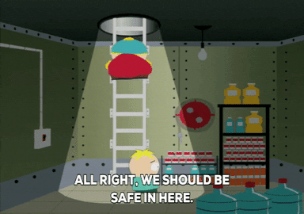
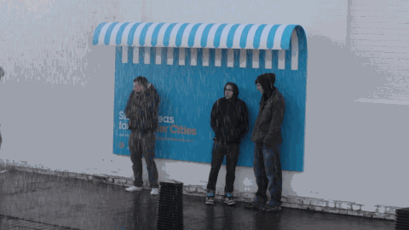
Islamic Educational College Date : 3/11
Subject: English
Grade: 4
Unit: 2
Lesson: Key Words
Outcomes
05:00 minutes
Warm-Up
Pre-assessment
Presentation
Formative assessment
Feedback
Shelter (noun):
a safe place
Differentiation
Linking to life
Our school was used as a shelter after the storm.
Critical Thinking
Summative Assessment
Closure

Slide 15
Islamic Educational College Date : 3/11
Subject: English
Grade: 4
Unit: 2
Lesson: Key Words
Outcomes
01:00 minutes
Warm-Up
Why do you think preparing shelters is necessary?
Pre-assessment
Presentation
Formative assessment
Feedback
Differentiation
Linking to life
Critical Thinking
Summative Assessment
Closure

Slide 16
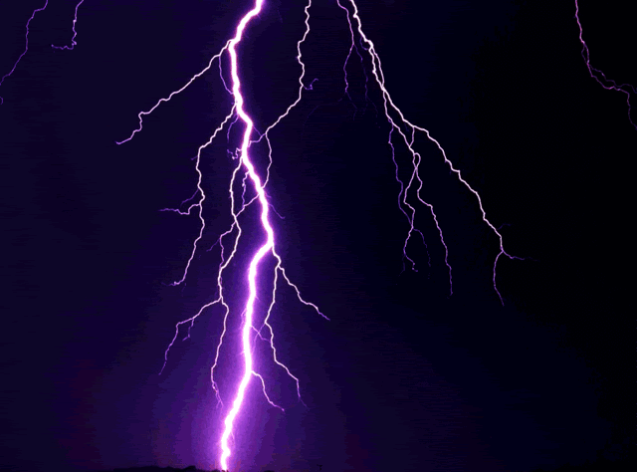
Islamic Educational College Date : 3/11
Subject: English
Grade: 4
Unit: 2
Lesson: Key Words
Outcomes
05:00 minutes
Warm-Up
Pre-assessment
Presentation
Formative assessment
Feedback
Bolt (noun):
a quick flash
Differentiation
Linking to life
A bolt of lightning looks like a white line in the sky.
Critical Thinking
Summative Assessment
Closure

Slide 17

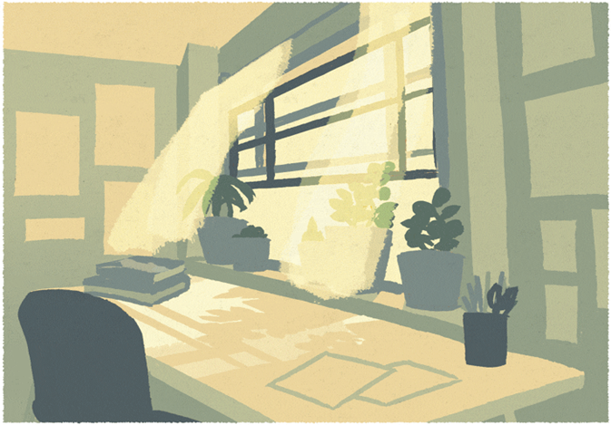
Mini board /2 min
hurricane
(noun)
shelter
(noun)
Breeze
(noun)
Each students will give a sentence using one of the following words.
Authentic

Slide 18
Islamic Educational College Date :
Subject: English
Grade: 4
Unit: 5
Lesson: Grammar
Outcomes
01:00 minute
Warm-Up
The word that means a quick flash is :
Pre-assessment
Presentation
1. hurricane
Formative assessment
Feedback
Differentiation
2. Bolt
Linking to life
Critical Thinking
Summative Assessment
IRS
Closure

Slide 19

Islamic Educational College Date :
Subject: English
Grade: 4
Unit: 5
Lesson: Grammar
Outcomes
01:00 minute
Warm-Up
The word that means a quick flash is :
Pre-assessment
Presentation
1. hurricane
Formative assessment
Feedback
Differentiation
2. Bolt
Linking to life
Critical Thinking
Summative Assessment
IRS
Closure

Slide 20
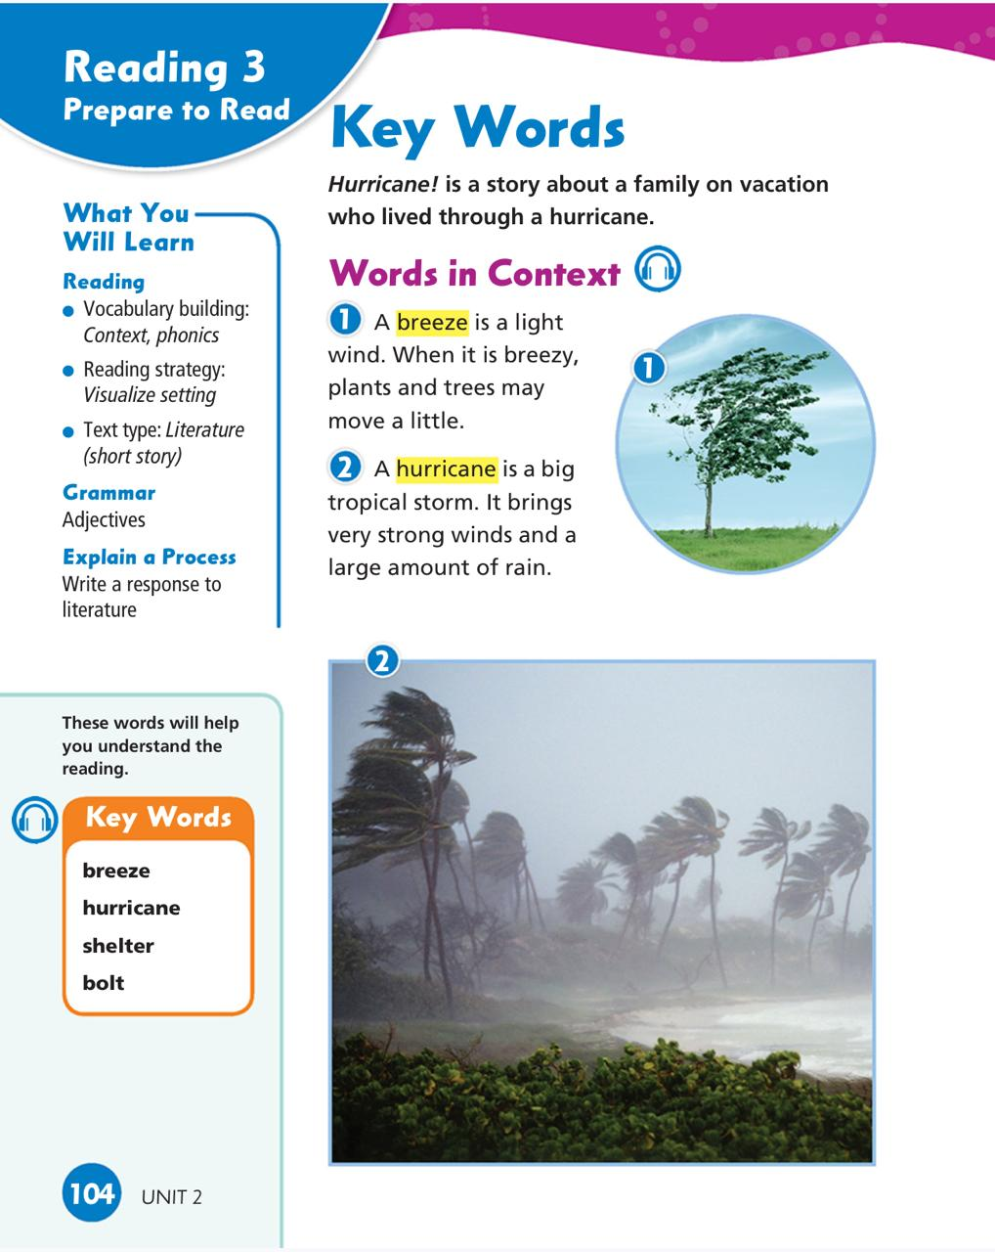
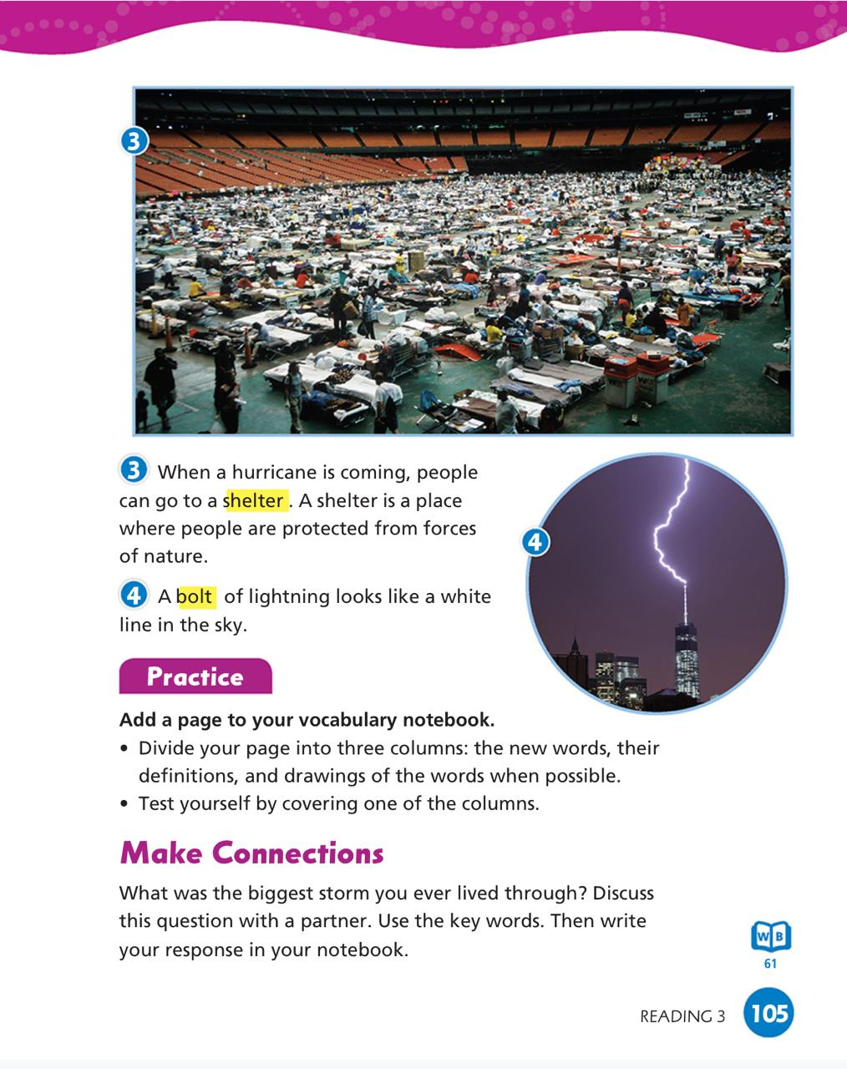

Islamic Educational College Date : 3/11
Subject: English
Grade: 4
Unit: 2
Lesson: Key Words
Outcomes
03:00 minutes
Warm-Up
Pre-assessment
Presentation
Formative assessment
Feedback
Differentiation
Linking to life
Critical Thinking
Summative Assessment
Closure

Slide 21
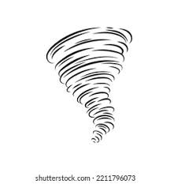
DIFFERENTIATION I 2 MIN
Students 3:
1.Use the following words in 2 meaningful sentences:
shelter - bolt
________________________________________________________________________________________________
Students 4:
Fill in the blanks with the correct word:
Bolt/ breeze/ shelter
1-A …………………………….is a light wind
2-A …………………….. is a place where people are protected from forces of nature.
Students 2:
Choose the correct answer:
We can hide in shelters .
( verb \ Noun \Adjective)
2. I can feel the breeze.
( verb \ Noun \Adjective)
Students 1: .
This picture shows (shelter/ hurricane)

Slide 22

Islamic Educational College Date :
Subject: English
Grade: 4
Unit: 5
Lesson: Grammar
Outcomes
01:00 minute
Warm-Up
Which one of the following
Words means a safe place?
Pre-assessment
Presentation
Formative assessment
1. shelter.
Feedback
Differentiation
2. bolt
Linking to life
Critical Thinking
Summative Assessment
Closure

Slide 23
Islamic Educational College Date :
Subject: English
Grade: 4
Unit: 5
Lesson: Grammar
Outcomes
01:00 minute
Warm-Up
Which one of the following
Words means a safe place?
Pre-assessment
Presentation
Formative assessment
1. shelter.
Feedback
Differentiation
2. bolt
Linking to life
Critical Thinking
Summative Assessment
Closure

Slide 24
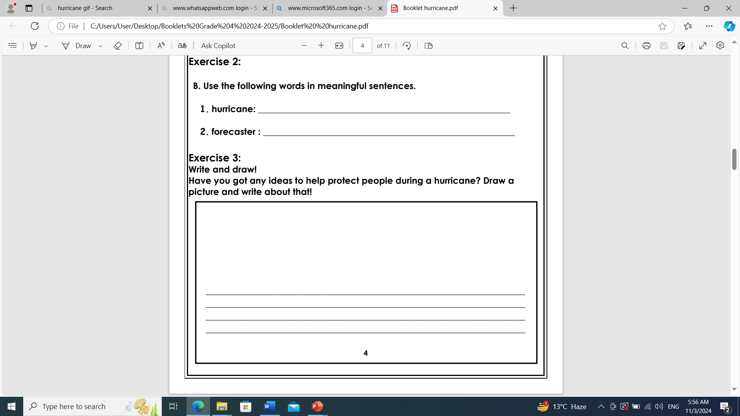
Islamic Educational College Date : 3/11
Subject: English
Grade: 4
Unit: 2
Lesson: Key Words
Outcomes
02:00 minutes
Warm-Up
Pre-assessment
Presentation
Formative assessment
Feedback
Differentiation
Linking to life
Critical Thinking
Summative Assessment
Closure

Slide 25
H.W Check the IEC APP to solve the worksheet

Slide 26
Islamic Educational College Date : 3/11
Subject: English
Grade: 4
Unit: 2
Lesson: Key Words
Outcomes
02:00 minutes
Warm-Up
Pre-assessment
Presentation
What did you learn?
Formative assessment
Feedback
Differentiation
Linking to life
Critical Thinking
Summative Assessment
Random pick
Closure

