Slide 1

Monday
25th November, 2024

Slide 2

Unit : Two / Reading: Three
Lesson : Reading / Hurricane!
Subject : English
Grade : Four A, B, C, D, E, F, G

Slide 3


Islamic Educational College Date : 24/11
Subject: English
Grade: 4
Unit:2
Lesson: Reading
Outcomes
01:00 minutes
Warm-Up
At the end of this lesson, students are expected to:
Identify the Genre of the text in hand
Read then answer questions
Pre-assessment
Presentation
Formative assessment
Feedback
Differentiation
Linking to life
Critical Thinking
Closure

Slide 4
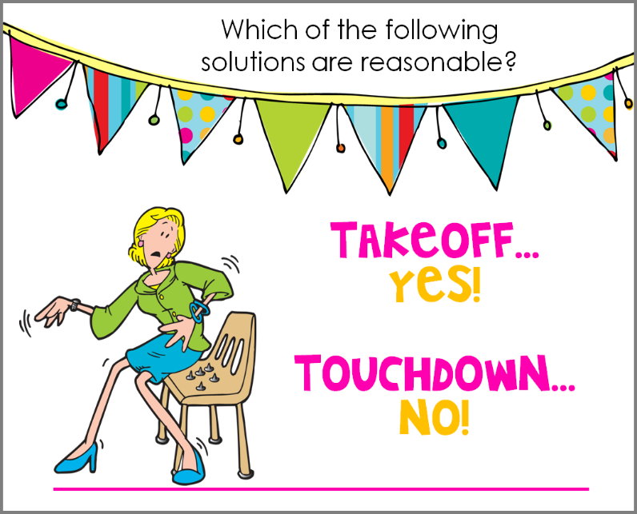
Islamic Educational College Date :
Subject: English
Grade: 4
Unit: 5
Lesson: Grammar
Outcomes
01:00 minutes
- Hurricane is a strong storm with a heavy wind and rain.
- “Hurricane is a verb.
Warm-Up
Pre-assessment
Presentation
Formative assessment
Feedback
Differentiation
Linking to life
Critical Thinking
True/ False
Summative Assessment
Closure

Slide 5

Islamic Educational College Date : 24/11
Subject: English
Grade: 4
Unit: 2
Lesson: Reading
Outcomes
soil
value
iron
bottom
quite
01:00 minutes
Warm-Up
Pre-assessment
Presentation
Formative assessment
Feedback
Differentiation
Linking to life
Critical Thinking
Closure

Slide 6

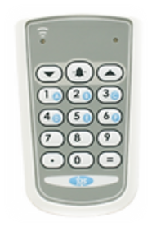
Islamic Educational College Date : 24/11
Subject : English
Grade:4
Unit:2
Lesson: Reading
Outcomes
One of the following is an example of a fictional genre:
01:00 minutes
Warm-Up
Pre-assessment
Presentation
1. Short story
Formative assessment
Feedback
2. Informational text
Differentiation
Linking to life
Critical Thinking
Summative assessment
IRS
Closure

Slide 7
Islamic Educational College Date : 24/11
Subject : English
Grade : 4
Unit:2
Lesson: Reading
Outcomes
One of the following is an example of a fictional genre:
Warm-Up
Pre-assessment
Presentation
1. Short story
Formative assessment
Feedback
2. Informational text
Differentiation
Linking to life
Critical Thinking
Summative assessment
Closure

Slide 8
Islamic Educational College Date : 24/11
Subject : English
Grade: 4
Unit:2
Lesson: Reading
Outcomes
01:00 minutes
One of the following is an element of a short story:
Warm-Up
Pre-assessment
Presentation
1. It is real
Formative assessment
Feedback
2. It deals with one subject or theme
Differentiation
Linking to life
Critical Thinking
Summative assessment
IRS
Closure

Slide 9
Islamic Educational College Date : 24/11
Subject:English
Grade:4
Unit:2
Lesson: Reading
Outcomes
One of the following is an element of a short story:
Warm-Up
Pre-assessment
Presentation
1. It is real
Formative assessment
Feedback
Differentiation
2. It deals with one subject or theme
Linking to life
Critical Thinking
Summative assessment
IRS
Closure

Slide 10
ROUND TABLE
The characters
1
2
3
4
Buzz in

Slide 11
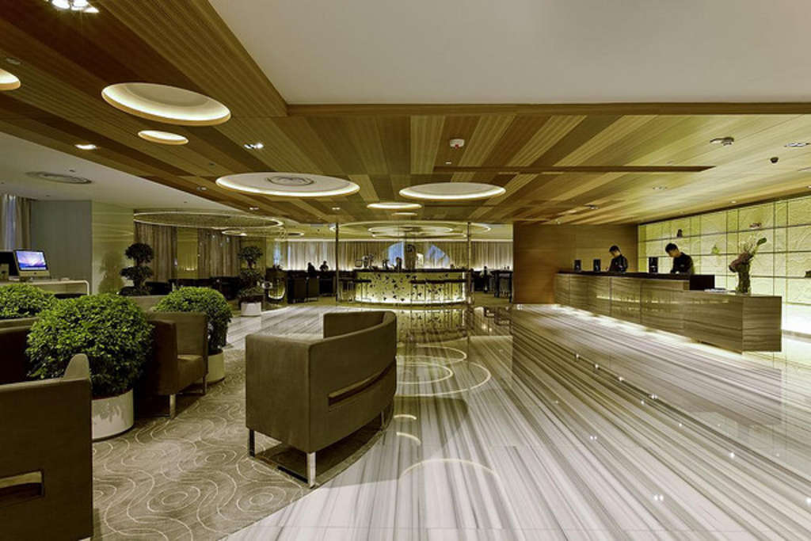
Islamic Educational College Date : 24/11
Subject: English
Grade: 4
Unit: 2
Lesson: Reading
Outcomes
Lobby (noun):
05:00 minutes
Warm-Up
a large reception area
Pre-assessment
Presentation
Formative assessment
Feedback
Differentiation
Linking to life
Critical Thinking
Closure

Slide 12
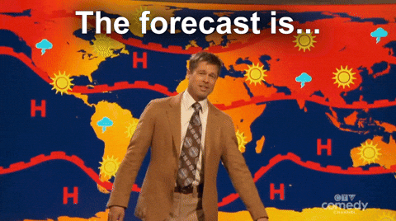
Islamic Educational College Date : 24/11
Subject: English
Grade: 4
Unit: 2
Lesson: Reading
Outcomes
Warm-Up
Pre-assessment
Presentation
Formative assessment
Feedback
Differentiation
Forecaster (noun):
Linking to life
Critical Thinking
The person who tells what the weather will be like
Closure

Slide 13
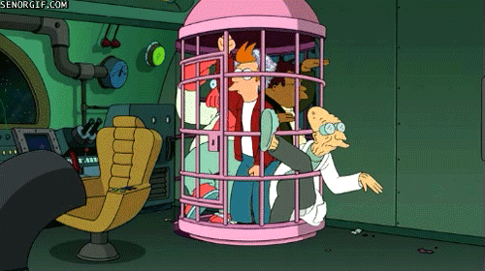
Islamic Educational College Date : 24/11
Subject: English
Grade: 4
Unit: 2
Lesson: Reading
Outcomes
Warm-Up
Pre-assessment
Presentation
Formative assessment
Feedback
Differentiation
trapped (adjective):
Linking to life
Critical Thinking
Not able to get out
Closure

Slide 14
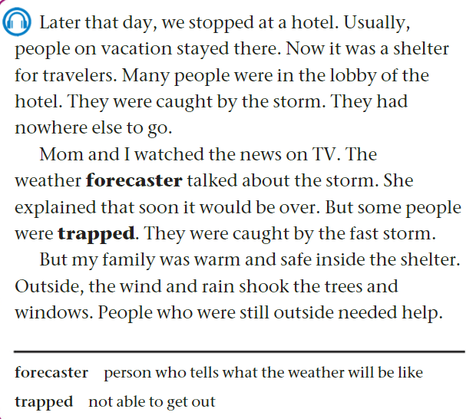

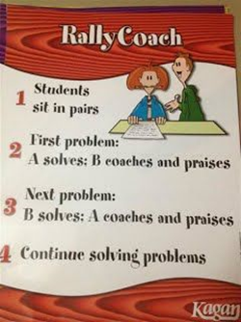

112
Islamic Educational College Date : 24/11
Subject:
Grade: 4
Unit: 2
Lesson: Reading
Outcomes
05:00 minutes
Warm-Up
Listen, Read
then answer:
Pre-assessment
Presentation
Formative assessment
Feedback
Differentiation
Linking to life
Critical Thinking
Closure

Slide 15
112
Islamic Educational College Date : 24/11
Subject: English
Grade: 4
Unit: 2
Lesson: Reading
Outcomes
1-Where did the family stop?
__They stopped at a hotel._______
2-Many people were in the lobby. Explain.
__It was a shelter for travelers who were caught by the storm because they had nowhere else to go. __
3-What did the weather forecaster talk about?
_She talked about the storm and that it would be over. _
4-Some people were trapped .Explain.
__They were caught by the fast storm.__
5-How was the weather outside?
__The wind and rain shook the trees and windows. __
6-The pronoun she line 7 refers to:
__The weather forecaster._
Warm-Up
Pre-assessment
Presentation
Formative assessment
Feedback
Differentiation
Linking to life
Critical Thinking
Closure
Students Number : (1,2)

Slide 16

Islamic Educational College Date : 25/11
Subject: English
Grade: 4
Unit: 2
Lesson: Reading
Outcomes
02:00 minutes
Warm-Up
According to the text, it is important to hear the weather forecact before going out:
1. True
2. False
The hotel was a shelter for the family:
  1. True
  2. False
Pre-assessment
Presentation
Formative assessment
Feedback
Differentiation
Linking to life
Critical Thinking
Summative Assessment
Closure

Slide 17
Islamic Educational College Date : 25/11
02:00 minutes
Subject: English
Grade: 4
Unit: 2
Lesson: Reading
Outcomes
Student’s number | Task
1 Match: | The family stopped at a hotel False The weather was sunny True
4 Fill in the blank: | Many people were in the ___________ Lobby/ house
2 | Describe the feeling of the boy now. __________________________________
3 | How did the hotel offer assistance to the travelers?__________________________
Warm-Up
Pre-assessment
Presentation
Formative assessment
Feedback
Differentiation
Linking to life
Critical Thinking
Closure
Random Pick

Slide 18
Islamic Educational College Date : 24/11
Subject: English
Grade: 4
Unit:2
Lesson: Reading
Outcomes
01:00 minutes
Warm-Up
What is the value that we may learn from this part of the story?
Pre-assessment
Presentation
Formative assessment
Feedback
Differentiation
Linking to life
Critical Thinking
Summative assessment
BUZZ IN
Closure

Slide 19

Islamic Educational College Date : 24/11
Subject: English
Grade: 4
Unit: 2
Lesson: Reading
Outcomes
01:00 minutes
Warm-Up
If you were the hotel owner,
what assistance you may offer?
Pre-assessment
Presentation
Formative assessment
Feedback
Differentiation
Linking to life
Critical Thinking
Closure
BUZZ IN

Slide 20
Islamic Educational College Date : 24/11
Subject: English
Grade: 4
Unit: 2
Lesson: Reading
Outcomes
02:00 minutes
Warm-Up
According to the text, it is important to hear the weather forecact before going out:
1. True
2. False
The hotel was a shelter for the family:
  1. True
  2. False
Pre-assessment
Presentation
Formative assessment
Feedback
Differentiation
Linking to life
Critical Thinking
Summative Assessment
Closure

Slide 21

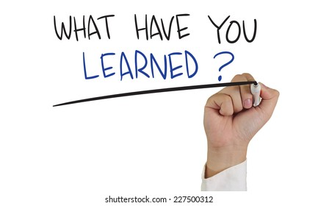
Islamic Educational College Date : 24/11
Subject : English
Grade : 4
Unit : 2
Lesson : Reading
Outcomes
Warm-Up
Pre-assessment
Presentation
Formative assessment
Feedback
Differentiation
Linking to life
Critical Thinking
Summative assessment
Closure

Slide 22

The End

