Slide 1
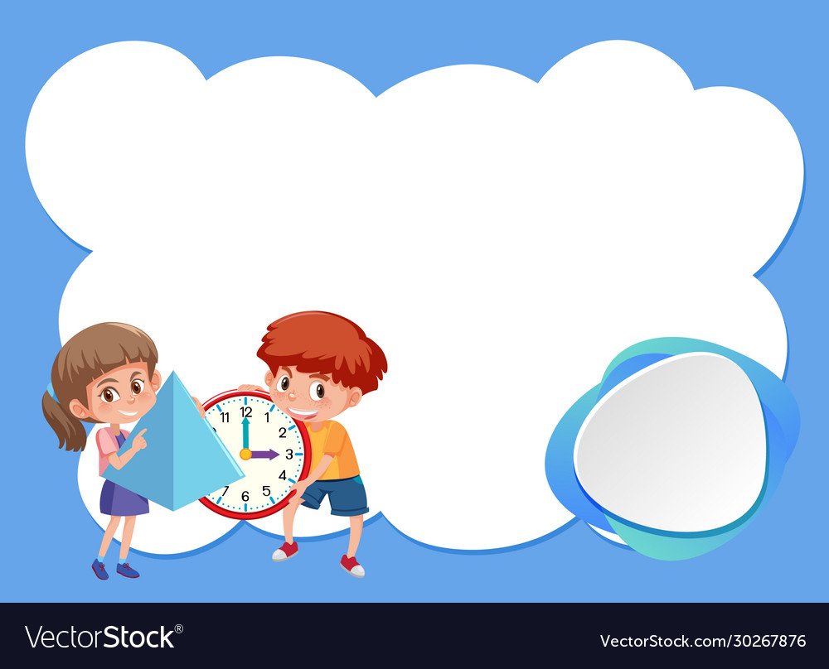
Monday
25th November, 2024

Slide 2

Unit : Two / Reading: Three
Lesson : Reading / Hurricane!
Subject : English
Grade : Four A, B, C, D, E, F, G

Slide 3


Islamic Educational College Date : 25/11
Subject: English
Grade: 4
Unit:2
Lesson: Reading
Outcomes
01:00 minutes
Warm-Up
At the end of this lesson, students are expected to:
Identify the Genre of the text in hand
Read then answer questions
Pre-assessment
Presentation
Formative assessment
Feedback
Differentiation
Linking to life
Critical Thinking
Closure

Slide 4

Islamic Educational College Date : 25/11
Subject: English
Grade: 4
Unit: 2
Lesson: Reading
Outcomes
soil
value
iron
bottom
quite
01:00 minutes
Warm-Up
Pre-assessment
Presentation
Formative assessment
Feedback
Differentiation
Linking to life
Critical Thinking
Closure

Slide 5


Islamic Educational College Date : 25/11
Subject : English
Grade: 4
Unit:2
Lesson: Reading
Outcomes
One of the following is an example of a fictional genre:
01:00 minutes
Warm-Up
Pre-assessment
Presentation
1. Short story
Formative assessment
Feedback
2. Informational text
Differentiation
Linking to life
Critical Thinking
Summative assessment
IRS
Closure

Slide 6
Islamic Educational College Date : 25/11
Subject: English
Grade: 4
Unit:2
Lesson: Reading
Outcomes
One of the following is an example of a fictional genre:
Warm-Up
Pre-assessment
Presentation
1. Short story
Formative assessment
Feedback
2. Informational text
Differentiation
Linking to life
Critical Thinking
Summative assessment
Closure

Slide 7
Islamic Educational College Date : 25/11
Subject : English
Grade: 4
Unit:2
Lesson: Reading
Outcomes
01:00 minutes
One of the following is an element of a short story:
Warm-Up
Pre-assessment
Presentation
1. It is real
Formative assessment
Feedback
2. It deals with one subject or theme
Differentiation
Linking to life
Critical Thinking
Summative assessment
IRS
Closure

Slide 8
Islamic Educational College Date : 25/11
Subject : English
Grade: 4
Unit:2
Lesson: Reading
Outcomes
One of the following is an element of a short story:
Warm-Up
Pre-assessment
Presentation
1. It is real
Formative assessment
Feedback
Differentiation
2. It deals with one subject or theme
Linking to life
Critical Thinking
Summative assessment
IRS
Closure

Slide 9
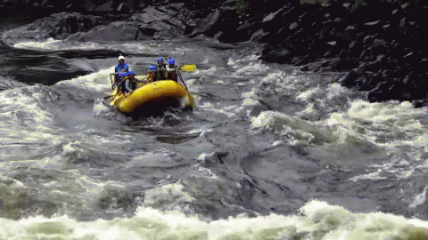
Islamic Educational College Date : 25/11
Subject: English
Grade: 4
Unit: 2
Lesson: Reading
Outcomes
raft (noun):
05:00 minutes
Warm-Up
an inflatable rubber / floating platform
Pre-assessment
Presentation
Formative assessment
Feedback
Differentiation
Linking to life
Critical Thinking
Closure

Slide 10
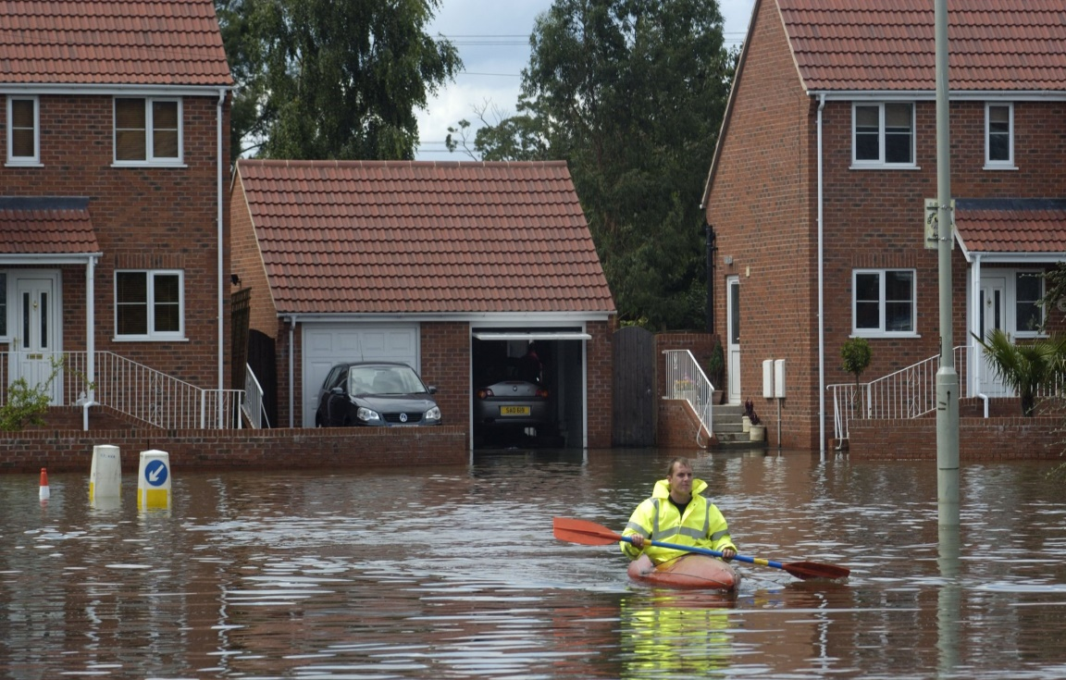
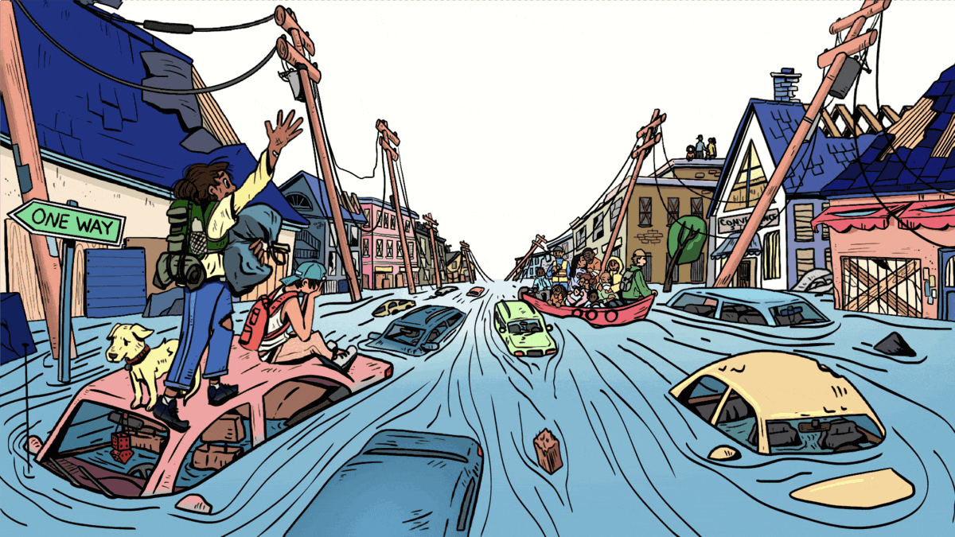
Islamic Educational College Date : 25/11
Subject: English
Grade: 4
Unit: 2
Lesson: Reading
Outcomes
flooded (adjective):
05:00 minutes
Warm-Up
covered in water
Pre-assessment
Presentation
Formative assessment
Feedback
Differentiation
Linking to life
Critical Thinking
Closure

Slide 11
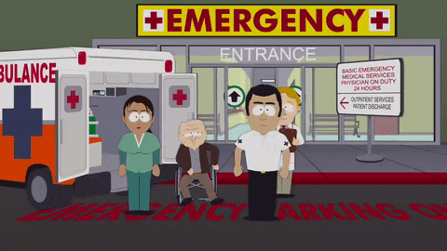
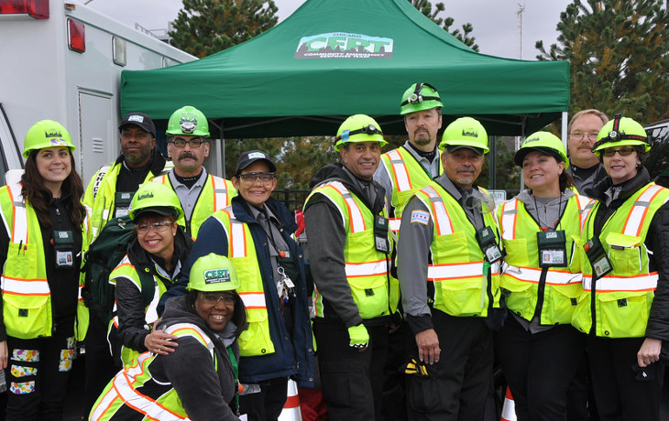
Islamic Educational College Date : 25/11
Subject: English
Grade: 4
Unit: 2
Lesson: Reading
Outcomes
Warm-Up
Pre-assessment
Presentation
Formative assessment
Feedback
Differentiation
Emergency team (noun):
Linking to life
Critical Thinking
group of people who are ready to help
Closure

Slide 12
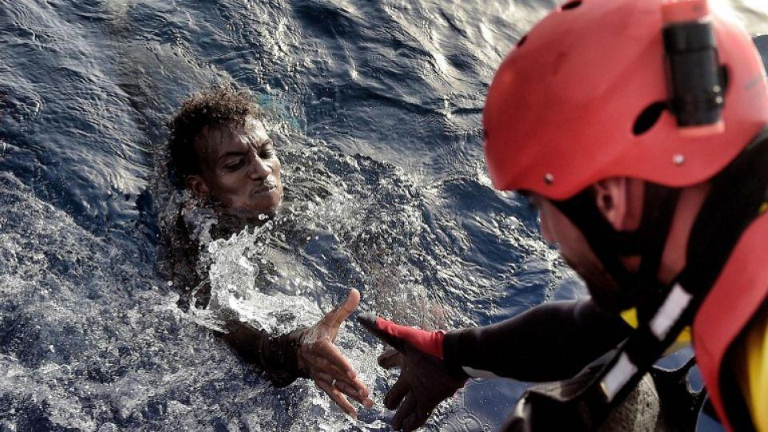
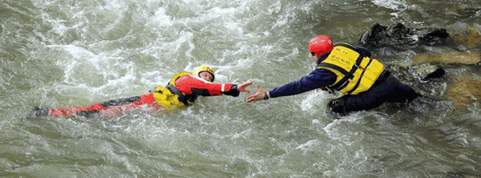
Islamic Educational College Date : 25/11
Subject: English
Grade: 4
Unit: 2
Lesson: Reading
Outcomes
Warm-Up
Pre-assessment
Presentation
Formative assessment
Feedback
Differentiation
Linking to life
rescued (verb):
Critical Thinking
Closure
save someone from danger

Slide 13
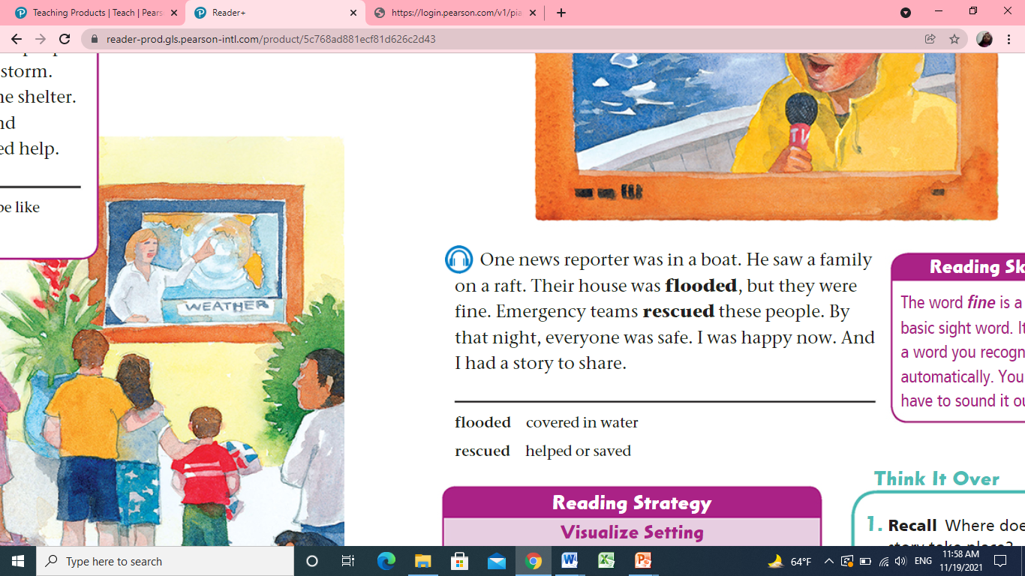

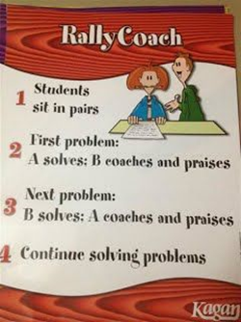

113
Islamic Educational College Date : 25/11
Subject: English
Grade: 4
Unit: 2
Lesson: Reading
Outcomes
05:00 minutes
Warm-Up
Listen, Read
then answer:
Pre-assessment
Presentation
Formative assessment
Feedback
Differentiation
Linking to life
Critical Thinking
Closure

Slide 14
113
Islamic Educational College Date : 25/11
Subject: English
Grade: 4
Unit: 2
Lesson: Reading
Outcomes
1- What did the news reporter see ?
___ He saw a family on a raft. __
2-Why were the family on a raft?
___ Their house was flooded. __
3-Who rescued the people?
___ The emergency team. ____
4-How did the boy feel at the end of the story? __ He was happy. __
Warm-Up
Pre-assessment
Presentation
Formative assessment
Feedback
Differentiation
Linking to life
Critical Thinking
Closure
Students Number : (1,2)

Slide 15
Islamic Educational College Date : 25/11
02:00 minutes
Subject: English
Grade: 4
Unit: 2
Lesson: Reading
Outcomes
Student’s number | Task
4 Match: | Hurricanes are dangerous False At the end the boy was sad True
3 Fill in the blank: | The family was on a ____________.
2 | Who rescued the family? __________________________________
1 | Write a different end for this story. __________________________________
Warm-Up
Pre-assessment
Presentation
Formative assessment
Feedback
Differentiation
Linking to life
Critical Thinking
Closure
Random Pick

Slide 16
Islamic Educational College Date : 25/11
Subject: English
Grade: Four
Unit:2
Lesson: Reading
Outcomes
01:00 minutes
Warm-Up
Search for hurricane names on Google.
Pre-assessment
Presentation
Formative assessment
Feedback
Differentiation
Linking to life
Critical Thinking
Summative assessment
BUZZ IN
Closure

Slide 17

Islamic Educational College Date : 25/11
Subject: English
Grade: 4
Unit: 2
Lesson: Reading
Outcomes
01:00 minutes
Warm-Up
Do you think it is possible to witness hurricanes in Jordan, if yes how would you act?
Pre-assessment
Presentation
Formative assessment
Feedback
Differentiation
Linking to life
Critical Thinking
Closure
BUZZ IN

Slide 18

Islamic Educational College Date : 25/11
Subject: English
Grade: 4
Unit: 2
Lesson: Reading
Outcomes
02:00 minutes
Warm-Up
The emergancy teams rescued the family:
1. True 2. False
The boy is the narrator of the story:
1. True 2. False
Pre-assessment
Presentation
Formative assessment
Feedback
Differentiation
Linking to life
Critical Thinking
Summative Assessment
Closure

Slide 19
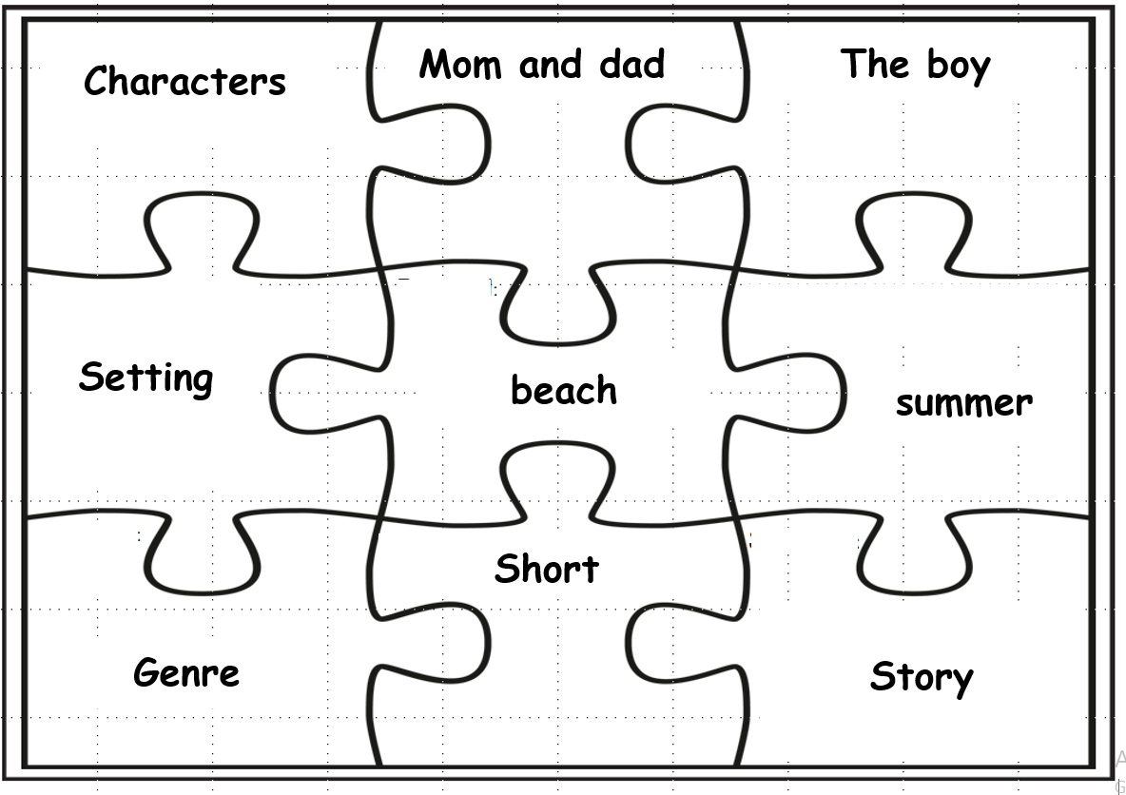
Notes:
Extra Activity you may use as a group work.

Slide 20
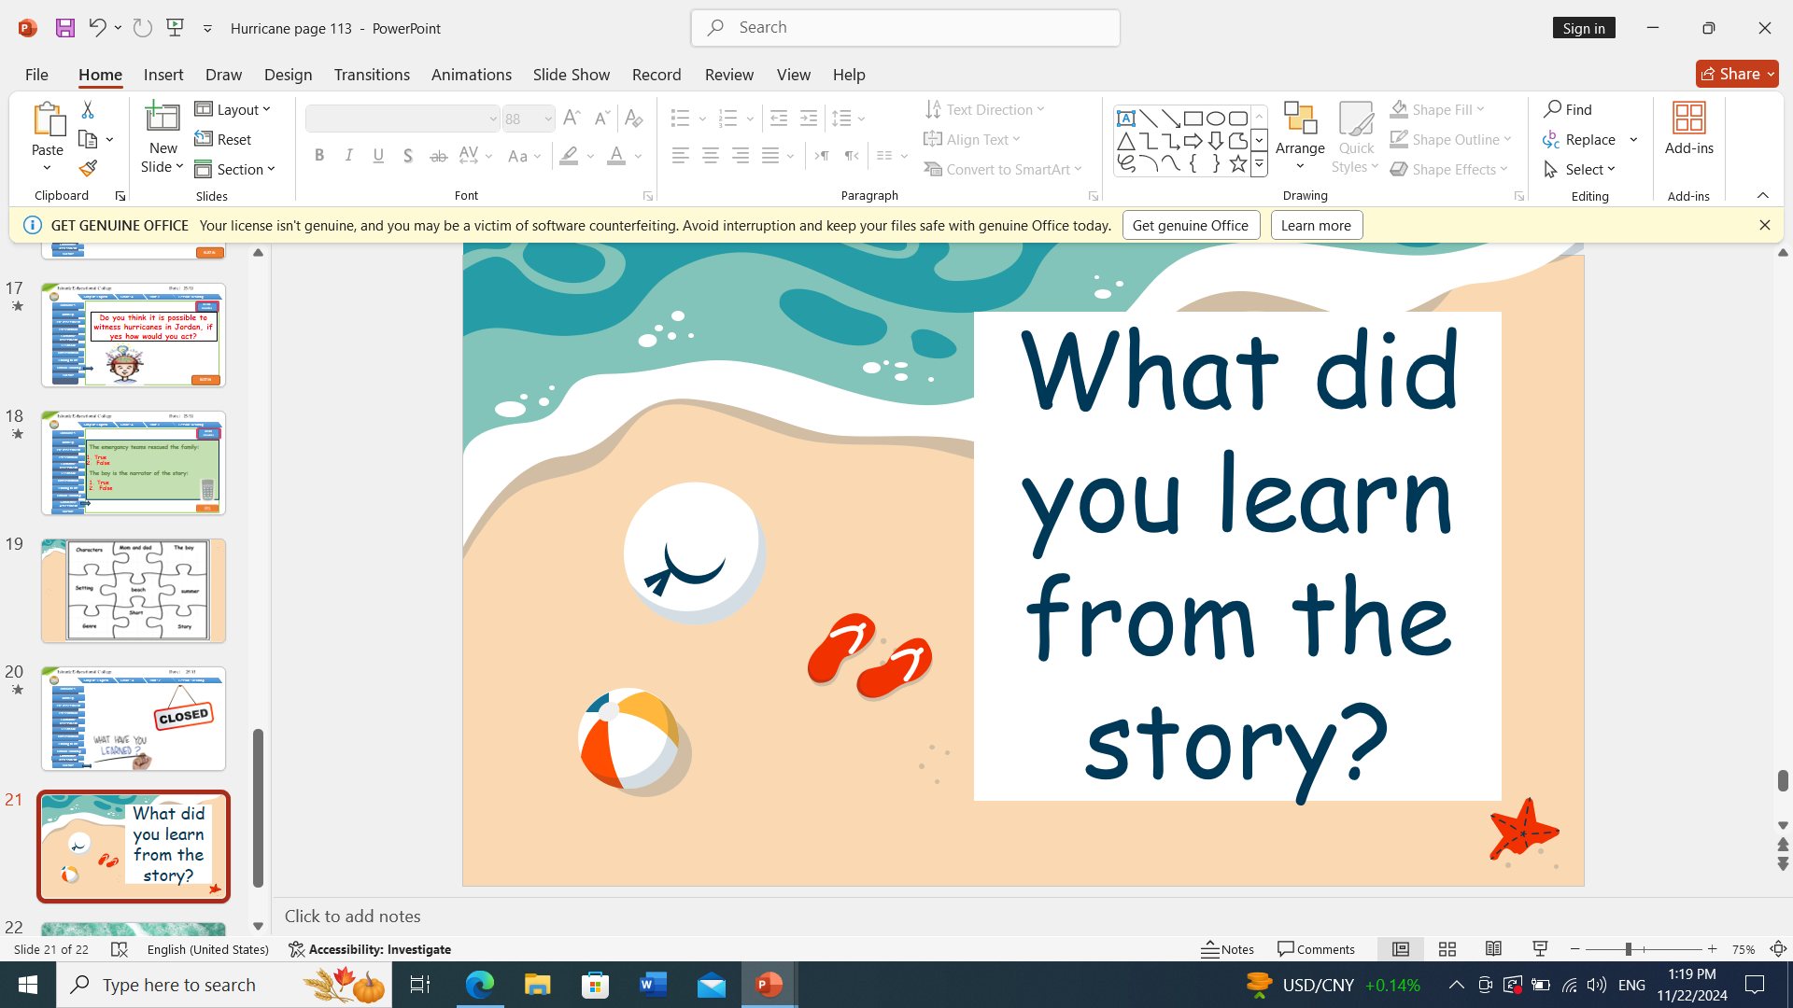

Islamic Educational College Date : 25/11
Subject : English
Grade : 4
Unit : 2
Lesson : Reading
Outcomes
Warm-Up
Pre-assessment
Presentation
Formative assessment
Feedback
Differentiation
Linking to life
Critical Thinking
Summative assessment
Closure

Slide 21

The End

