Slide 1

Monday
17th November, 2025

Slide 2

Unit : Two / Reading: Three
Lesson : Key Words
Subject : English
Grade : Four A, B, C, D, E, F, G

Slide 3


Islamic Educational College Date : 3/11
Subject: English
Grade: 4
Unit:2
Lesson: Key Words
Outcomes
01:00 minutes
Warm-Up
At the end of this lesson, students are expected to:
Recognize the meaning of new words
Use the new words in different contexts
Pre-assessment
Presentation
Formative assessment
Feedback
Differentiation
Linking to life
Critical Thinking
Summative Assessment
Closure

Slide 4
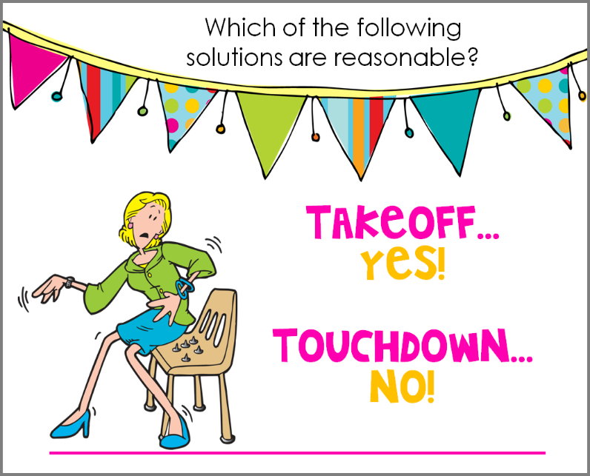
Islamic Educational College Date :
Subject: English
Grade: 4
Unit: 5
Lesson: Grammar
Outcomes
01:00 minutes
-The Shelter is a safe place.
- “Bolt” is a verb.
Warm-Up
Pre-assessment
Presentation
Formative assessment
Feedback
Differentiation
Linking to life
Critical Thinking
True/ False
Summative Assessment
Closure

Slide 5
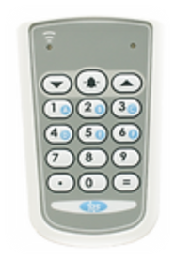
Islamic Educational College Date :
Subject: English
Grade: 4
Unit: 5
Lesson: Grammar
Outcomes
01:00 minute
Warm-Up
The word that means a quick flash is :
Pre-assessment
Presentation
1. hurricane
Formative assessment
Feedback
Differentiation
2. Bolt
Linking to life
Critical Thinking
Summative Assessment
IRS
Closure

Slide 6

Islamic Educational College Date :
Subject: English
Grade: 4
Unit: 5
Lesson: Grammar
Outcomes
01:00 minute
Warm-Up
The word that means a quick flash is :
Pre-assessment
Presentation
1. hurricane
Formative assessment
Feedback
Differentiation
2. Bolt
Linking to life
Critical Thinking
Summative Assessment
IRS
Closure

Slide 7
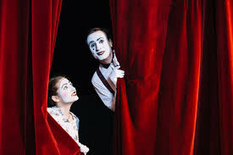
Warm up
Silent Acting Challenge
2 minutes

Slide 8
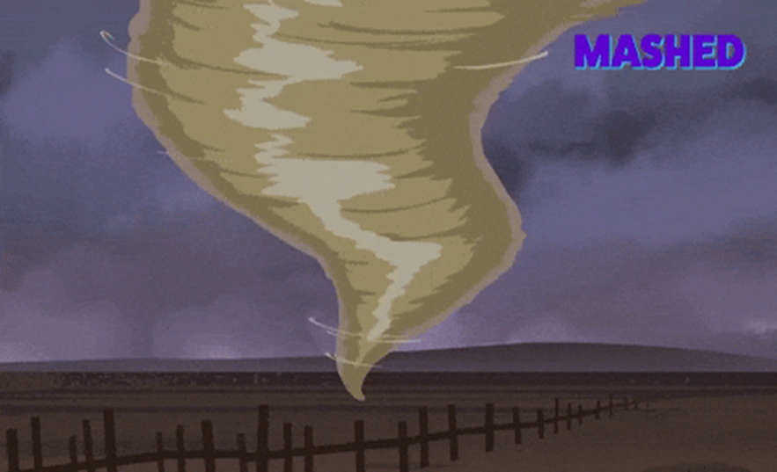

Answer
Hurricane
Authentic

Slide 9


Islamic Educational College Date : 3/11
Subject: English
Grade: 4
Unit: 2
Lesson: Key Words
Outcomes
02:00 minutes
Look at the picture then give a sentence to describe it.
Warm-Up
Pre-assessment
Presentation
Formative assessment
Feedback
Differentiation
Linking to life
Critical Thinking
Summative Assessment
Closure

Slide 10
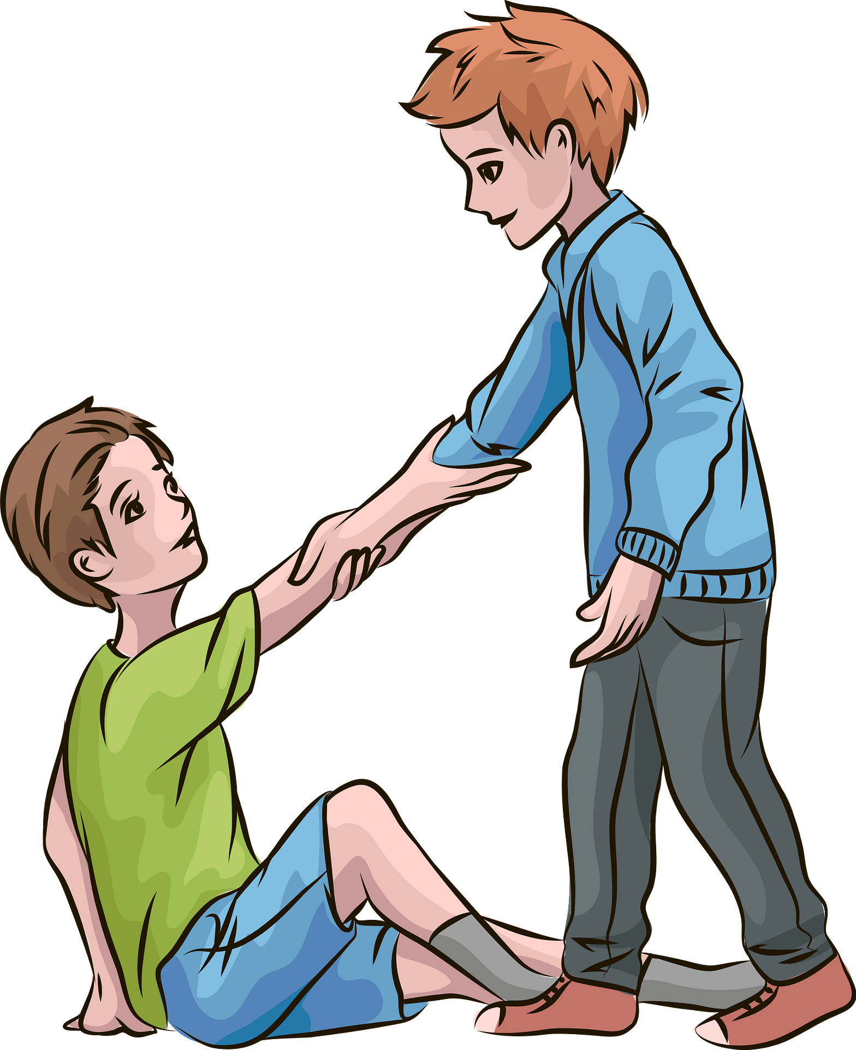

Islamic Educational College Date : 5/11
Subject: English
Grade: 4
Unit: 2
Lesson: Academic Words
Outcomes
assistance (noun):
05:00 minutes
Warm-Up
help / support
Pre-assessment
Presentation
Formative assessment
What kind of assistance can you offer someone?
Feedback
Differentiation
Linking to life
Critical Thinking
Summative Assessment
Closure

Slide 11

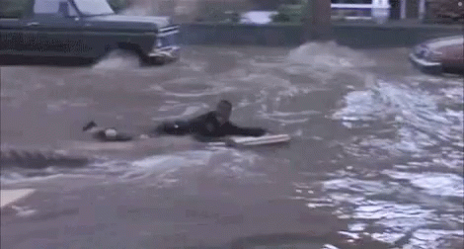
Islamic Educational College Date : 5/11
Subject: English
Grade: 4
Unit: 2
Lesson: Academic Words
Outcomes
impact (noun):
05:00 minutes
Warm-Up
a strong effect
Pre-assessment
Presentation
Formative assessment
The flood had a big impact on the town.
Feedback
Differentiation
Linking to life
Critical Thinking
Summative Assessment
Closure

Slide 12
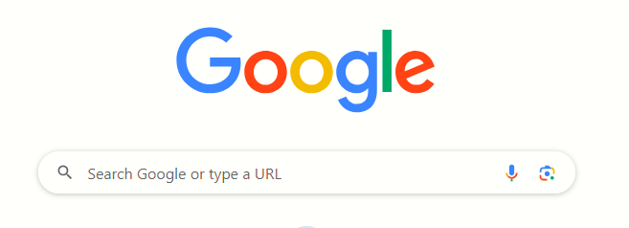
02:00 minutes
Search: The synonym of “major”.

Slide 13
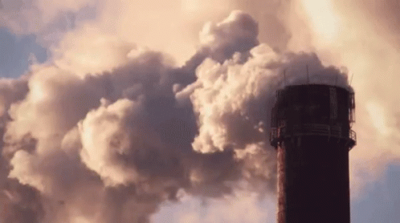
Islamic Educational College Date : 5/11
Subject: English
Grade: 4
Unit: 2
Lesson: Academic Words
Outcomes
major (Adjective):
05:00 minutes
Warm-Up
Pre-assessment
big / very important / serious
Presentation
Formative assessment
Air pollution is a major global problem.
Feedback
Differentiation
Linking to life
Critical Thinking
Summative Assessment
Closure

Slide 14
Islamic Educational College Date : 5/11
Subject: English
Grade: 4
Unit: 2
Lesson: Academic Words
Outcomes
01:00 minutes
Warm-Up
How can a small action have a big impact on someone else's day? Can you think of a time when you saw this happen?
Pre-assessment
Presentation
Formative assessment
Feedback
Differentiation
Linking to life
Critical Thinking
Summative Assessment
BUZZ IN
Closure

Slide 15
Islamic Educational College Date : 5/11
Subject: English
Grade: 4
Unit: 2
Lesson: Academic Words
Outcomes
01:00 minutes
Warm-Up
Can you think of a situation where something was majorly important in your life?
Pre-assessment
Presentation
Formative assessment
Feedback
Differentiation
Linking to life
Critical Thinking
Summative Assessment
Closure

Slide 16
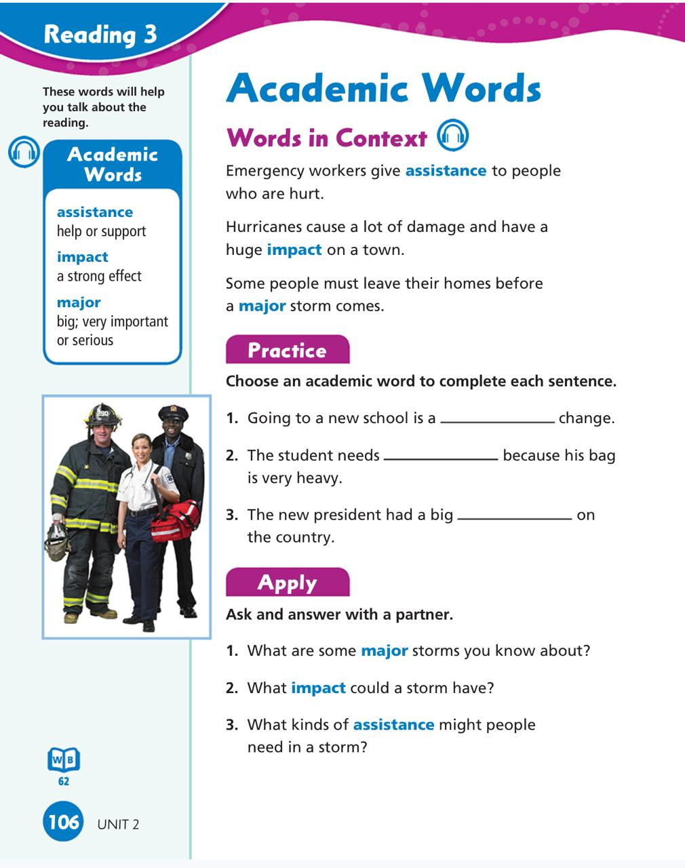

Islamic Educational College Date : 5/11
Subject: English
Grade: 4
Unit: 2
Lesson: Academic Words
Outcomes
03:00 minutes
Warm-Up
Pre-assessment
Presentation
Formative assessment
Feedback
Differentiation
Linking to life
Critical Thinking
Summative Assessment
Closure

Slide 17
Linking to life:
Bing Videos
What is the value that we can learn from this video?
1 Min I BUZZ IN

Slide 18
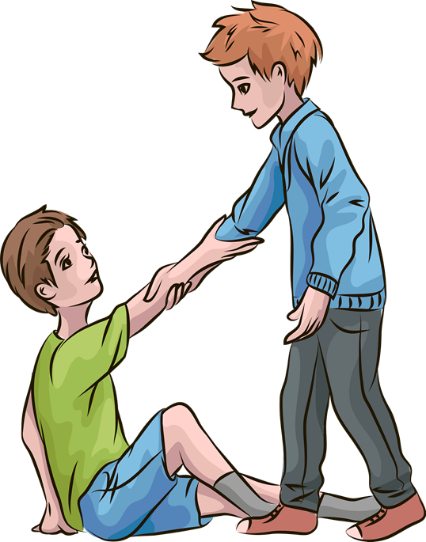


Mini board /2 min
impact
(noun)
major
(adjective
assistance
(noun)
Use the words in correct sentences
Authentic

Slide 19
Islamic Educational College Date :
Subject: English
Grade: 4
Unit: 5
Lesson: Grammar
Outcomes
01:00 minute
Warm-Up
The word that means very important is :
Pre-assessment
Presentation
1. impact
Formative assessment
Feedback
Differentiation
2. major
Linking to life
Critical Thinking
Summative Assessment
IRS
Closure

Slide 20
Islamic Educational College Date :
Subject: English
Grade: 4
Unit: 5
Lesson: Grammar
Outcomes
01:00 minute
Warm-Up
The word that means very important is :
Pre-assessment
Presentation
1. impact
Formative assessment
Feedback
Differentiation
2. major
Linking to life
Critical Thinking
Summative Assessment
IRS
Closure

Slide 21
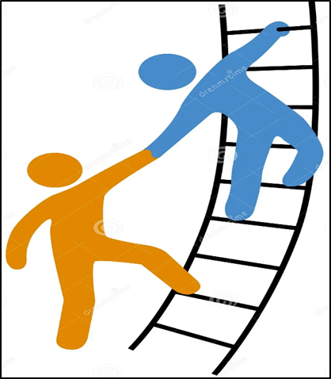
DIFFERENTIATION I 2 MIN
Students 3:
1.Use the following words in 2 meaningful sentences:
assistance - major
________________________________________________________________________________________________
Students 4:
Fill in the blanks with the correct word:
assistance/ impact/ shelter
-The teachers offered him some_____________
- Pollution is a ___________ problem.
Students 2:
Choose the correct answer:
We have a major problem.
( verb \ Noun \Adjective)
2. I think I need some assistance.
( verb \ Noun \Adjective)
Students 1: .
This picture shows (impact/ assistance)

Slide 22

Islamic Educational College Date :
Subject: English
Grade: 4
Unit: 5
Lesson: Grammar
Outcomes
01:00 minute
Warm-Up
Which one of the following
Words means a strong effect?
Pre-assessment
Presentation
Formative assessment
1. major.
Feedback
Differentiation
2. impact
Linking to life
Critical Thinking
Summative Assessment
Closure

Slide 23
Islamic Educational College Date :
Subject: English
Grade: 4
Unit: 5
Lesson: Grammar
Outcomes
01:00 minute
Warm-Up
Which one of the following
Words means a strong effect?
Pre-assessment
Presentation
Formative assessment
1. major.
Feedback
Differentiation
2. impact
Linking to life
Critical Thinking
Summative Assessment
Closure

Slide 24
H.W
Check the IEC APP to solve the worksheet

Slide 25
Islamic Educational College Date : 3/11
Subject: English
Grade: 4
Unit: 2
Lesson: Key Words
Outcomes
02:00 minutes
Warm-Up
Pre-assessment
Presentation
What did you learn?
Formative assessment
Feedback
Differentiation
Linking to life
Critical Thinking
Summative Assessment
Random pick
Closure

