Slide 1
The Star Llama

Slide 2
LET’S BEGIN WITH THE END IN MIND
By the end of today's class, students will: ​
1- Identify the genre
2-listen to the fable
3- answer comprehension questions
4- Value feeling with others and help others.

Slide 3
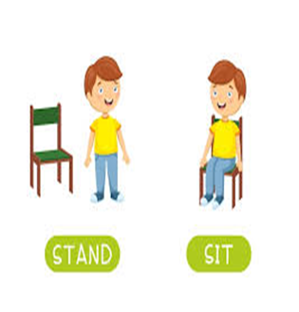

Warm up
What is the genre of the text?
If it is fable take off.
If it is informational text touch down

Slide 4
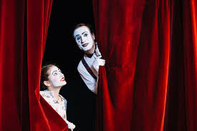
Warm up
Silent Acting Challenge
2 minutes

Slide 5
Pre- ASSESSMENT I IRS I
1 MIN
The meaning of the word occur is______________
1) playful
2) to happen
Authentic

Slide 6
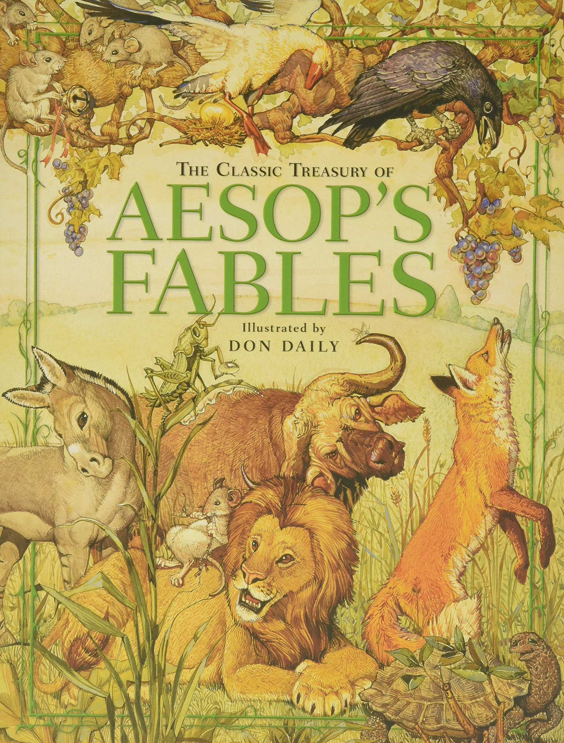
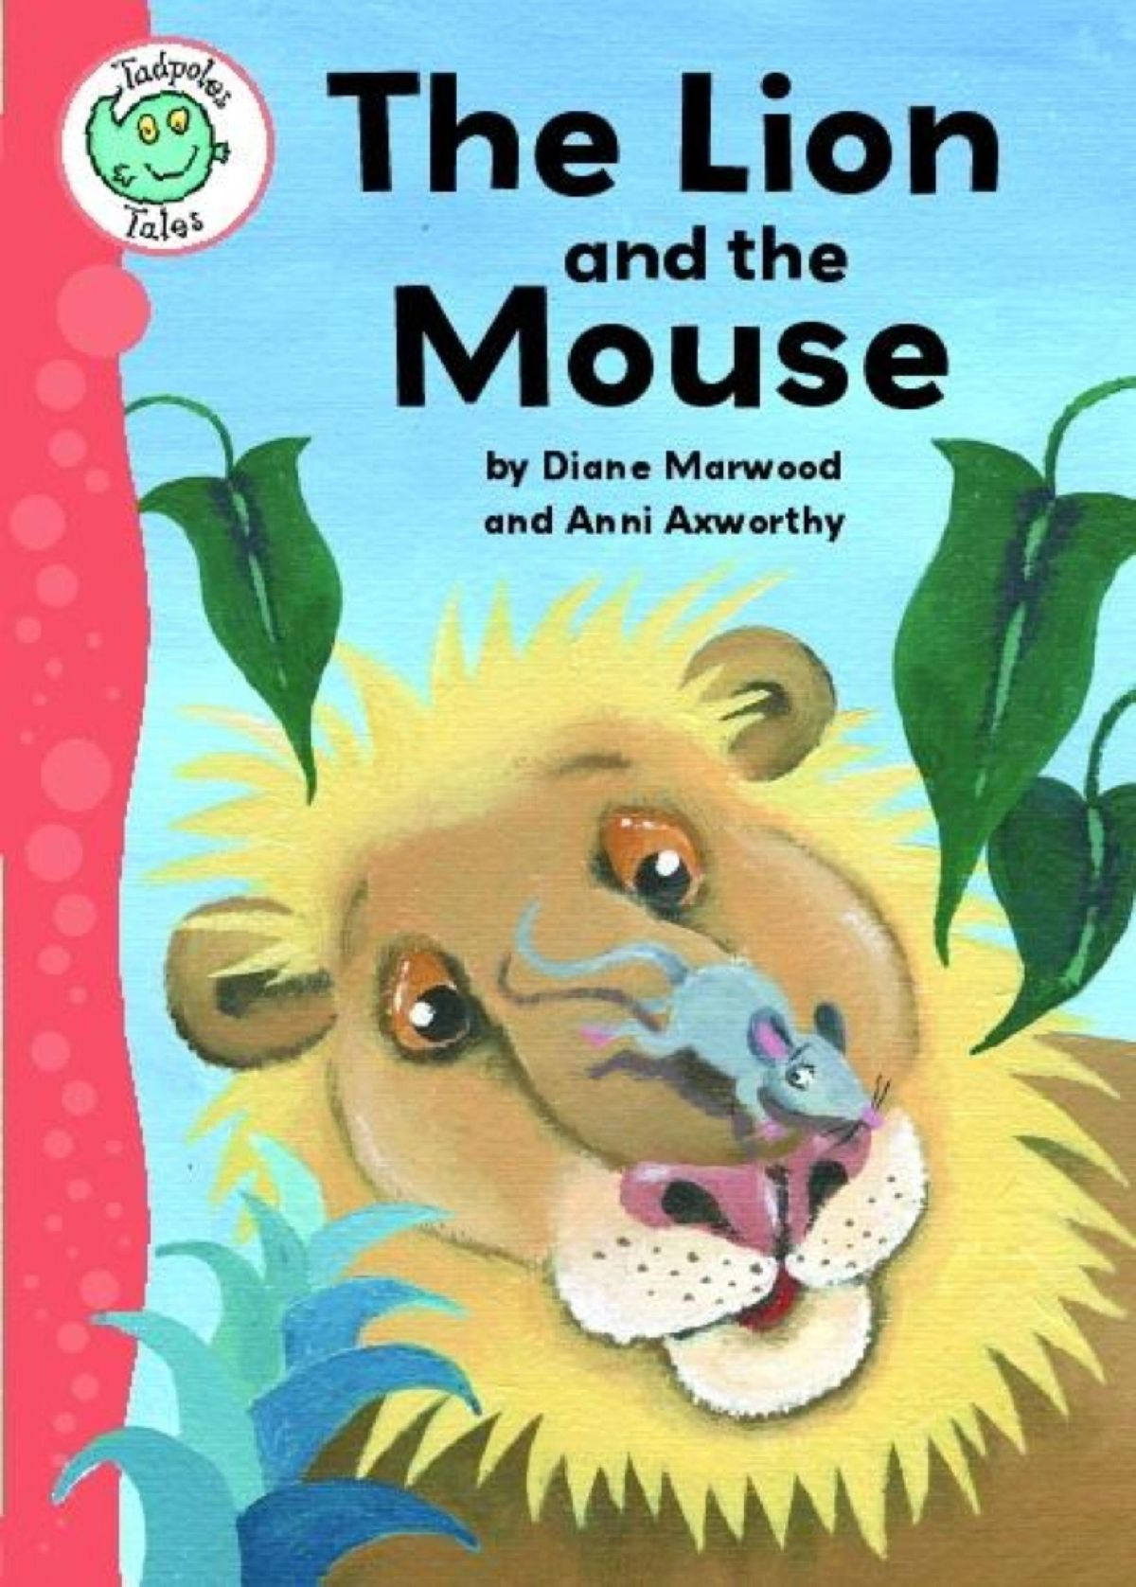
Revision /What is a Fable?
Task 1:
1- Look at the pictures and describe what do you see?

Slide 7
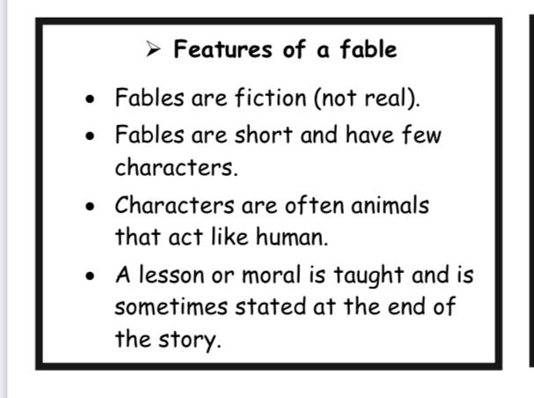
A Fable is:
a short fictional story that teaches a lesson. The characters are often animals.

Slide 8
https://www.facebook.com/reel/1791151711388654

Slide 9
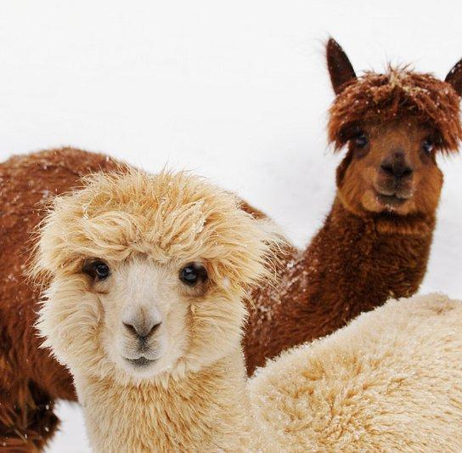
Task 3: Build Vocabulary
Llama
(noun)
Example
I saw a llama in the zoo.
Meaning
South American animal with thick hair like wool and a long neck.

Slide 10
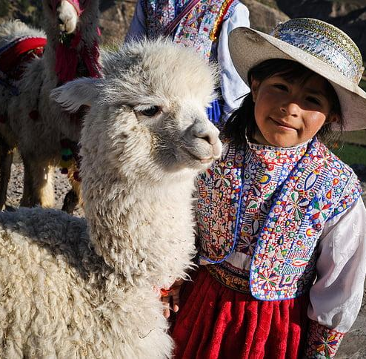
Task 3: Build Vocabulary
Inca
(noun)
Example
Most Inca people were farmers and looked for llamas
Meaning
A person from an ancient culture in the Andes mountains in South America.

Slide 11
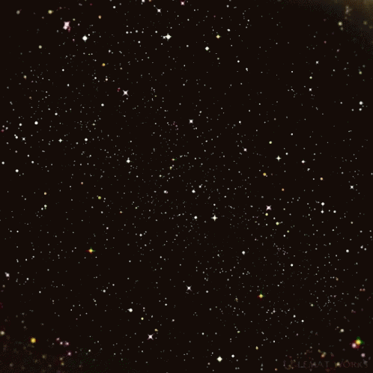
Task 3: Build Vocabulary
Starry
(adj)

Slide 12

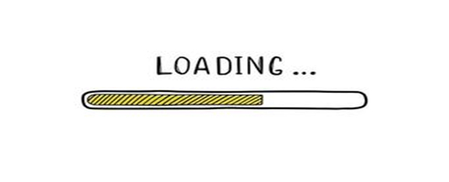
Find a synonym of the word starry
.
Authentic

Slide 13
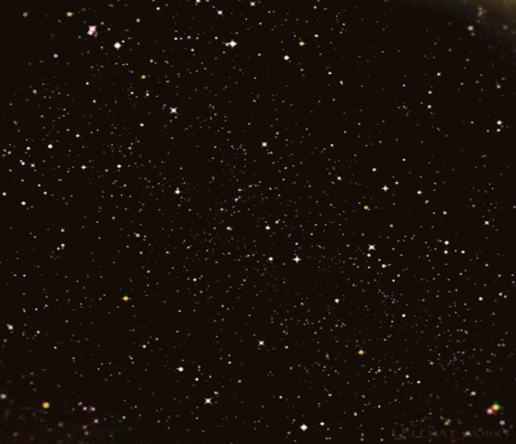
starry
Answer
Authentic

Slide 14


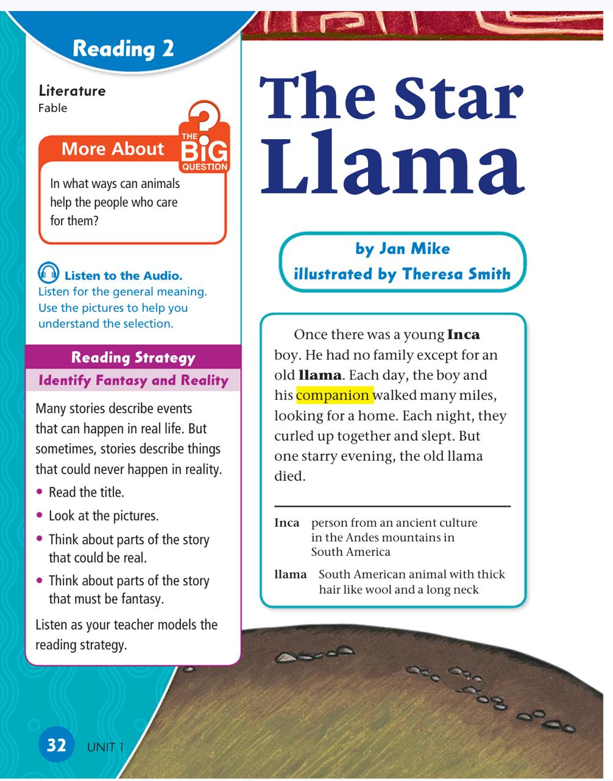

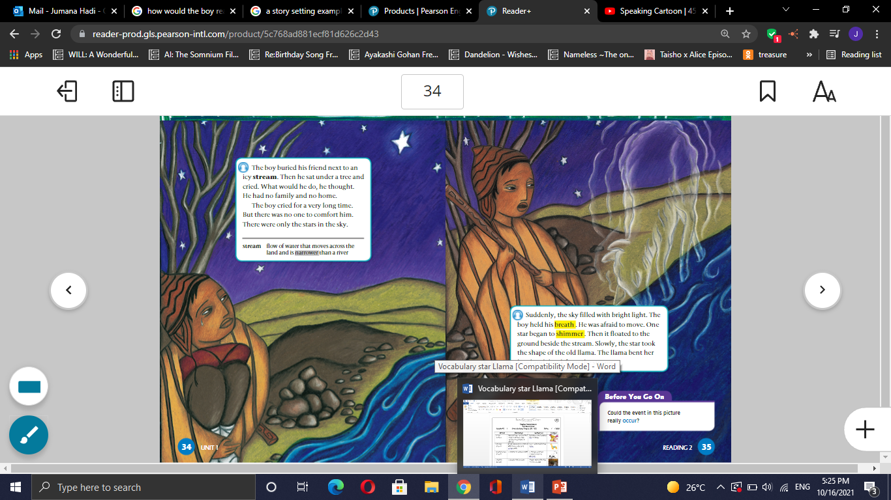

Islamic Educational College Date :
Subject: English
Grade: 4
Unit: 1
Lesson: Reading 2
Outcomes
05:00 minutes
Warm-Up
Open your book p.32
Write the day and the date
Pre-assessment
Presentation
Formative assessment
Feedback
Differentiation
Linking to life
Critical Thinking
Summative Assessment
Closure

Slide 15
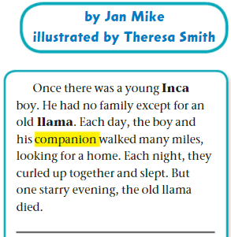

Formative assessment l Rally Coach l 3 mins​
Read and answer:
1- Who are the main characters?
2- Describe the relationship between the boy and the Llama.
3- Describe the setting /time
of the story.
4- In your opinion, why did the llama die?

Slide 16
Islamic Educational College Date : 31/10
Subject:
Grade: 4
Unit: 1
Lesson: Reading 2
Outcomes
03:00 minutes
Warm-Up
The Inca boy has a big family .
1. True 2. False
Read
then answer:
Pre-assessment
Presentation
Formative assessment
Feedback
Differentiation
Linking to life
Critical Thinking
Summative Assessment
IRS
Closure

Slide 17
Islamic Educational College Date : 31/10
Subject: English
Grade: 4
Unit: 1
Lesson: Reading 2
Outcomes
02:00 minutes
Warm-Up
The Inca boy has a big family .
1. True 2. False
Pre-assessment
Presentation
Formative assessment
Feedback
Differentiation
Linking to life
Critical Thinking
Summative Assessment
Closure

Slide 18
Critical thinking/ Buzz in / 1 min
1
How would the death of the llama affect the boy?

Slide 19
DIFFERENTIATION I 2 MIN
Students 3:
How can you tell that the text is fable?________________________________________________
Students 2:
What is the genre?
_____________________
Students 1:
The Inca boy and the star llama are _______________
(Companions/ enemies)
Students 4:
True or False
The genre of the text is an informational text._____

Slide 20
Real Life Application and Value
Bing Videos
What is the value that we can learn from this video?

Slide 21
SUMMATIVE ASSESSMENT I IRS I
1 MIN
The genre of the text is an informational text. 1. True 2. False
The inca boy is the main character of the story.
1. True 2. False
There’s a bond between the boy and the llama
1. True 2. False

Slide 22
Home work
Check the IEC APP
+Practice reading
p.32

Slide 23
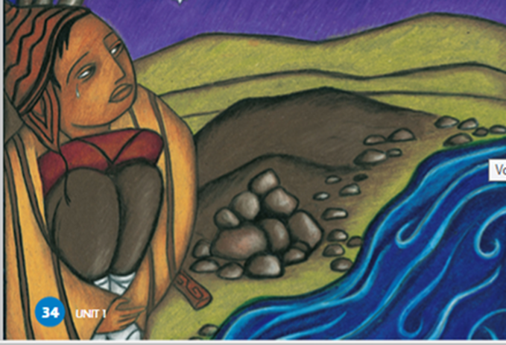
Closure- 1 min
What did you learn?
Mini-Boards

Slide 24
Look and say.
Page 34 I 1 minute

Slide 25
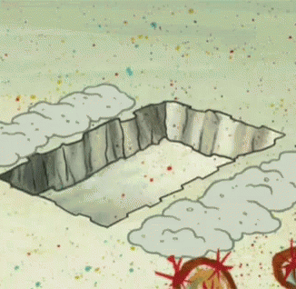
Task : Build Vocabulary
bury
(verb)
Example
Meaning

Slide 26
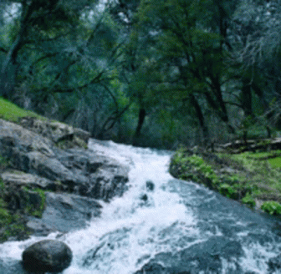
Task : Build Vocabulary
stream
(noun)
Example
There were little fish in the stream
Meaning
a small narrow river

Slide 27
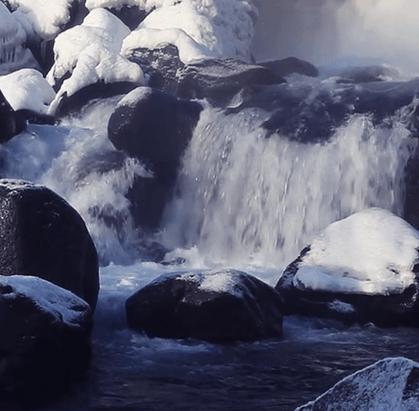
Task : Build Vocabulary
Icy stream
(noun)

Slide 28
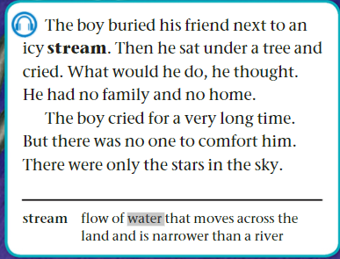
Page 34 I 1 minute
Listen

Slide 29
Formative assessment l Rally Coach l 3 mins​
Read and answer
Where did the boy bury the llama?
Why was the inca boy so sad?
The boy has no family and no home. Why? What happened to his family?

Slide 30
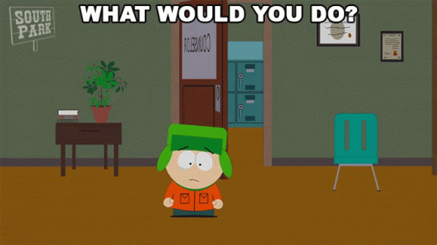
What would you do if you were in his shoes?

Slide 31
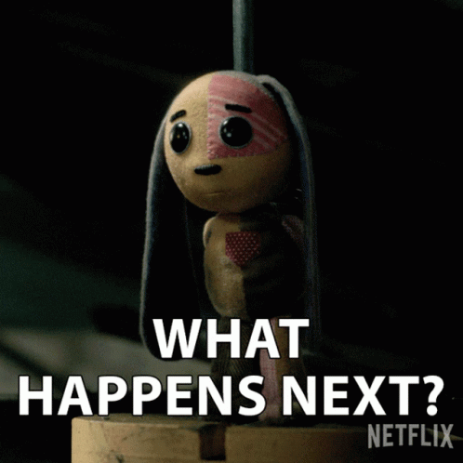
What do you think will happen next?

Slide 32
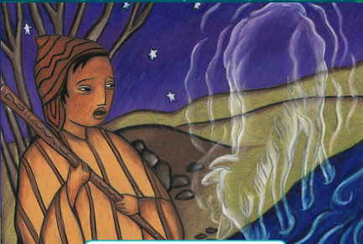
Look and say.
Page 35 I 1 minute

Slide 33
DIFFERENTIATION I 2 MIN
Students 1:
Compare: How is the llama’s role in the story similar to a pet’s role in your life?
Students 3:
Where did the boy find the place to bury the llama?
What happened to the boy's family?
Students 2:
Why do you think the Inca boy was so sad when he lost the llama?
Students 4:
True or false
The boy had many friends who helped him bury the llama.
The Inca boy was happy because he had a new home.

Slide 34
SUMMATIVE ASSESSMENT I IRS I
1 MIN
The boy buried his friend next to an icy stream. 1. True 2. False
The boy cried for a very long time.
1. True 2. False
The boy had no family and no home.
1. True 2. False

Slide 35
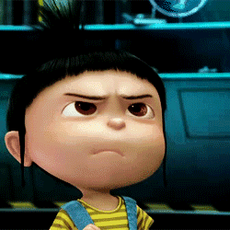
Task : Build Vocabulary
Hold breath
(verb)

Slide 36
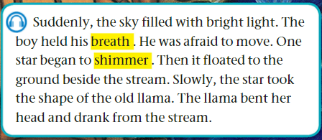
Page 35 I 1 minute
Listen:

Slide 37
Formative assessment l Rally Coach l 2 mins​
Read and answer:
1- Why was the boy afraid?
2- What happened to the star?
3- How did the llama appear again?

Slide 38
DIFFERENTIATION I 2 MIN
Students 1:
Compare the transformation of the star to a llama to another story where something changes form. How are they alike?
Students 3:
What happened to the star after it began to shimmer?
How did the llama appear again?
Students 2:
Why was the boy afraid to move?
Students 4:
True or false
The star floated to the ground beside the stream.
The llama did not drink from the stream.

Slide 39
SUMMATIVE ASSESSMENT I IRS I
1 MIN
The star transformed (took the shape) into a young llama. 1. True 2. False
The boy ran away when he saw the star floating to the ground.
1. True 2. False
The boy was very happy.
1. True 2. False

Slide 40
CLOSURE I 1 MIN
Choose a word you learnt today and write a sentence.
Mini-Boards

