Slide 1






Grammar
Imperatives
Unit 2
Time: 40 minutes

Slide 2
Objectives
Students will be able to :
1. Identify sentences as commands.
2. Write imperative sentences.

Slide 3

hg
Warm up 3 Min

Slide 4
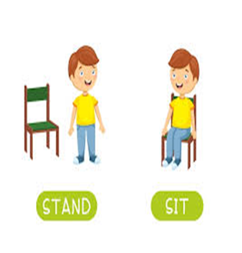
If the sentence is correct "take off" (stand up). If the sentence is not correct"touch down" (sit down).
1.We can put full stop (.) in the title.
2-We start the topic sentence with capital letter.
Responsibility
Take off/ Touch down

Slide 5
Pre- assessment/ IRS
-Choose the conclusion sentence.
1.My Favorite Teacher
2. she doesn’t just teach from books. She tells us to be good people and to be kind to our friends.
3. I love my teacher.

Slide 6
https://wordwall.net/resource/79277413/copy-of-identifying-nouns-and-verbs
Random pick

Slide 7
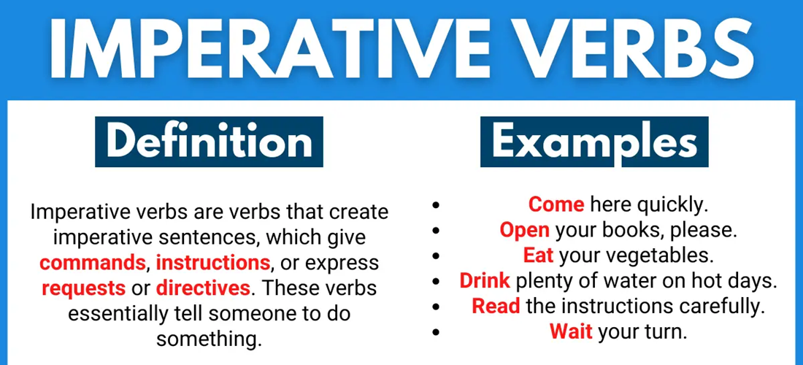
Presentation
What are imperative verbs?

Slide 8
How can we make imperative sentence?
To make an imperative sentence, use the base form of a verb + the object of the verb.
Verb Object
close the door
Ex: Open the window.

Slide 9
Negative imperative
To make a negative imperative Do not or Don’t + the base form of a verb + the object of the verb.
Examples:
1.Don’t take a bath or shower.
2. Do not play in the class.

Slide 10

1. Imperative sentences start with ( noun/ verb).
2. Imperative sentences ( order/ information ).
Task/ 2 Min

Slide 11
1. Imperative sentences start with a ( noun/ verb).
2. Imperative sentences are ( order/ information ).
Feedback

Slide 12
Critical thinking
Imagine you are a robot. What kind of imperatives would you need to follow?
Buzz in

Slide 13
Formative assessment
To make negative imperative we use ( doesn't / don’t ).
1.Doesn’t
2. Don’t

Slide 14

Look at the photo and make an imperative sentence
Real life application
Mini board

Slide 15
Real life application]
If you were a teacher what classroom instructions would you give.
Mini board

Slide 16
Differentiation/ 2 MIN
Student 3
Student 2
-Fill in the blanks with the correct form of negative imperative.
1- …………………… soda. (drink)
2- ………………….. football . (play)
1.Write two sentences using imperative verbs.
………………………………………………………………………………………………….…
Student 4
Choose the correct answer:
1- Don’t/ Doesn’t get out.
2- stop/ stops smoking.
Student 1
-Circle the imperative verb:
1- Get out of bed.
2- Eat your breakfast.

Slide 17
Summative assessment/ IRS
The correct imperative sentence
They stop talking
Stop talking

Slide 18
Summative assessment Circle the imperative sentences.
1. Do not close the door.
2. Turn off the lights after use..
3. I always brush my teeth before I go to bed.
4. She doesn’t like eating pizza.
5. Call me when you get back.

Slide 19
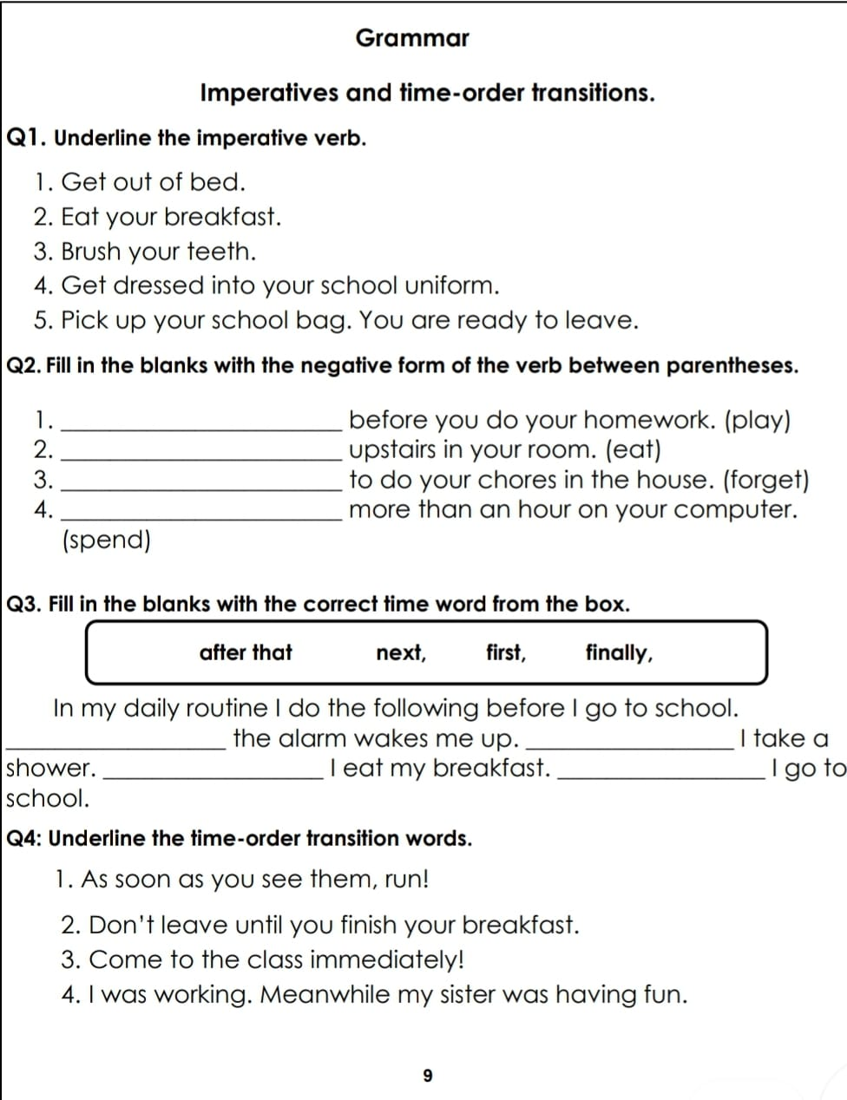
Open your booklet page 21

Slide 20
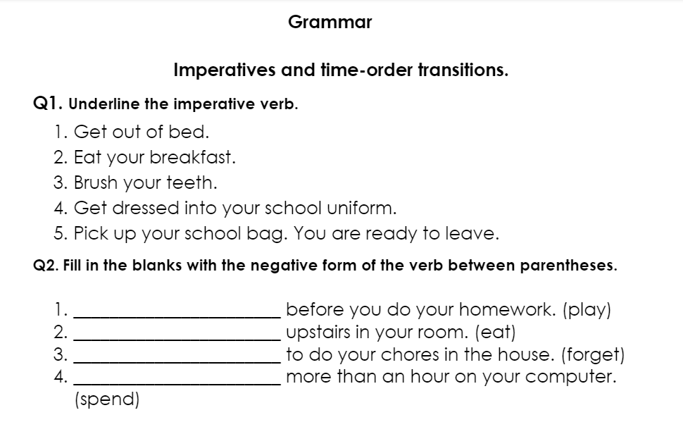
Don’t play
Don’t eat
Don’t forget
Don’t spend

Slide 22
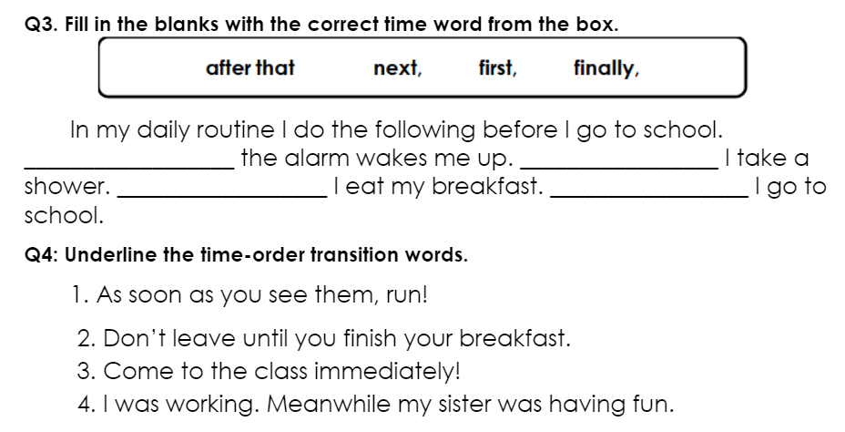
First
Next
After that
Finally

Slide 23
Closure
What did you learn

