Slide 1

Present simple/ Regular verbs Negative/ interrogative Unit 1
GRADE 4 40 minutes

Slide 2
Identify the present simple tense (affirmative/ negative/ Question). Identify subject – verb agreement. Outcomes 1-Identify the present simple tense (negative/ Question). 2-Form negative sentences / Questions using present simple tense.

Slide 3
Warm up/ Let’s play
https://wordwall.net/resource/25606559/adult-esl/simple-present-affirmative

Slide 4

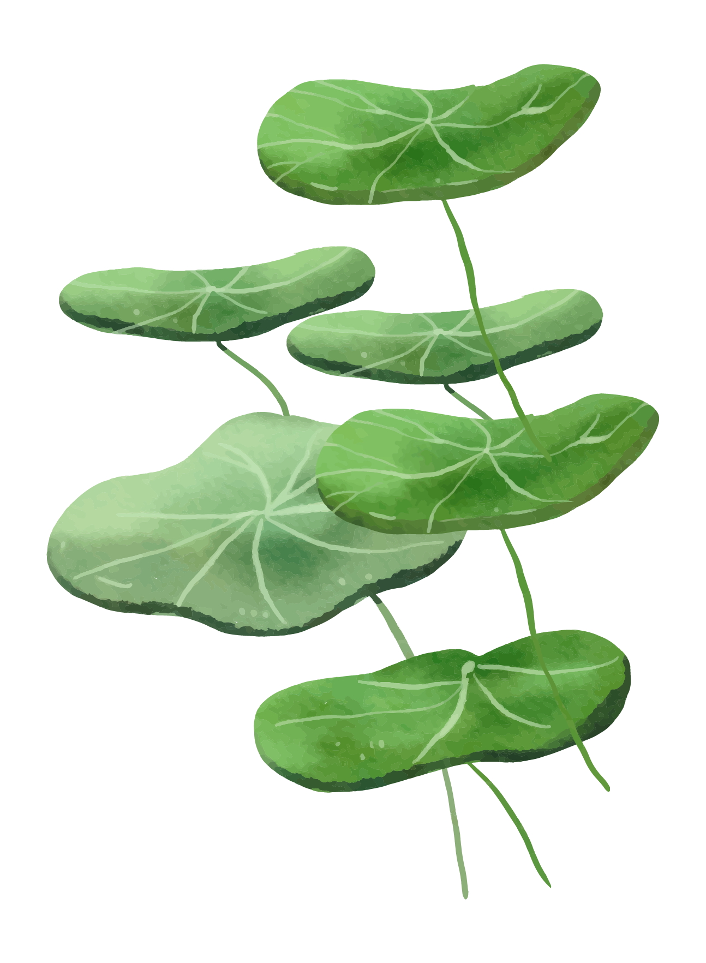
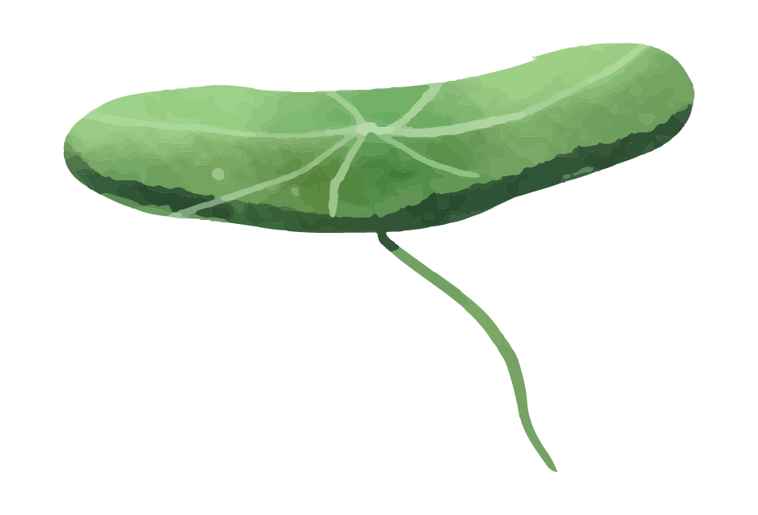
Warm up Listen to the song https://www.youtube.com/watch?v=_oEAdz3MAj0

Slide 5
Pre- assessment
Fill in the spaces with the correct form of the verb using the present simple:
1.They( play) ……………………… football every weekend.
_{1. Play 2. plays}
_{2.Samer (live) ………………………} here.
1. Live 2. lives
IRS/ 2min

Slide 6
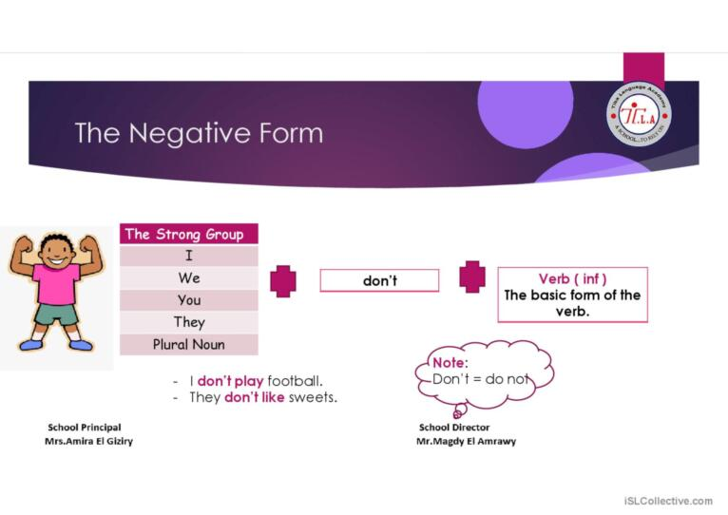
Presentation
To form negative statements with regular verbs
We use don’t and doesn’t

Slide 7
He
She + doesn’t + infinitive verb
It
Singular nouns
Ex: Laila doesn’t clean her bedroom.
He doesn’t do his homework.
The cat doesn’t walk well.

Slide 8
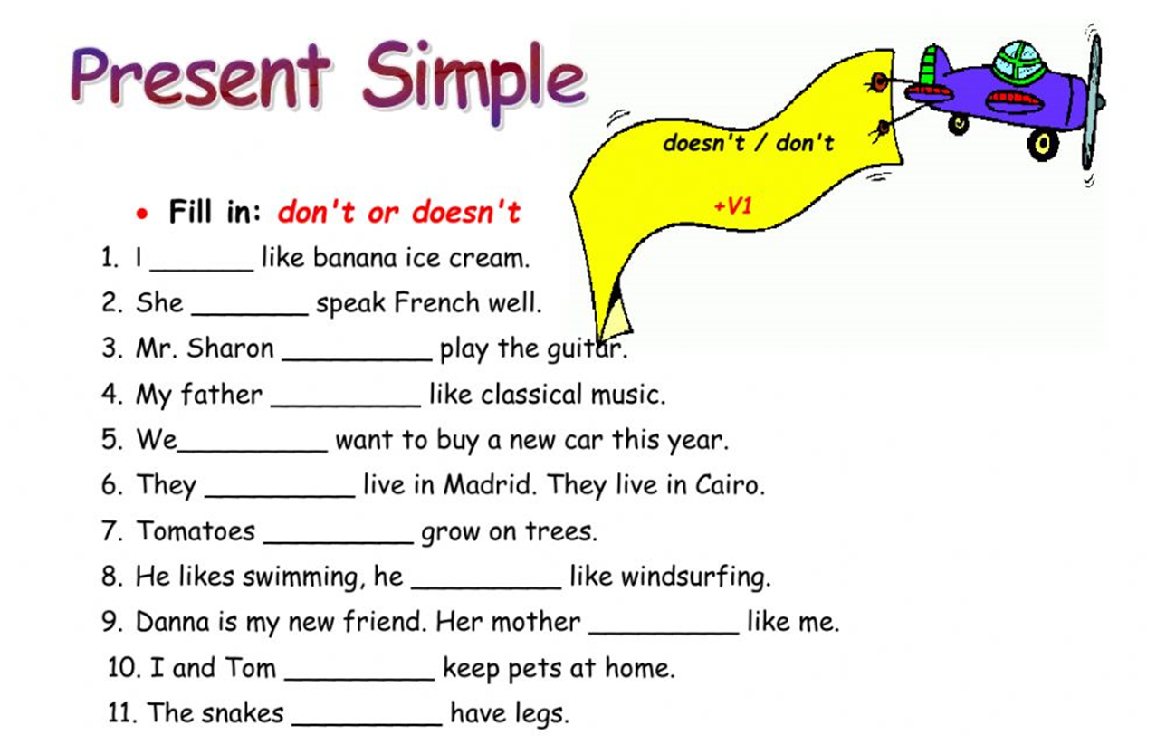
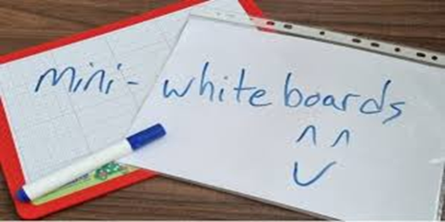
Formative assessment (3 minutes)
Random pick

Slide 9

Feedback
don’t
doesn’t
doesn’t
doesn’t

Slide 10
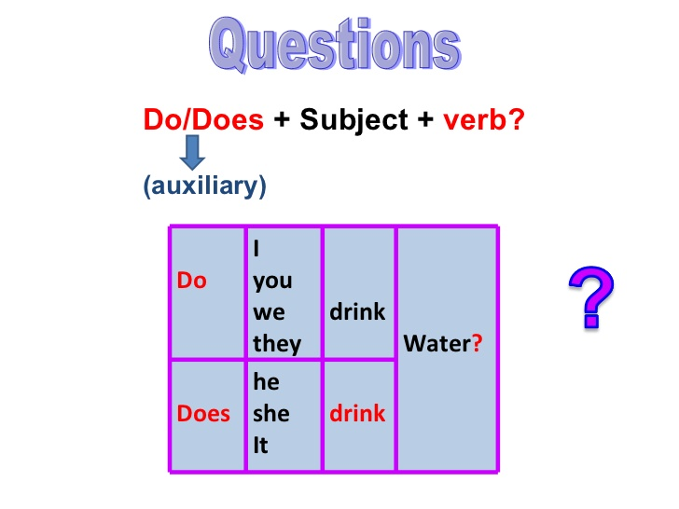
Interrogative
You can enter a subtitle here if you need it

Slide 11
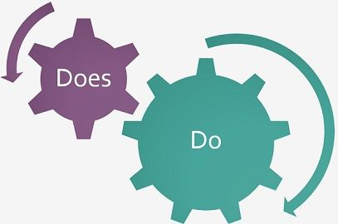
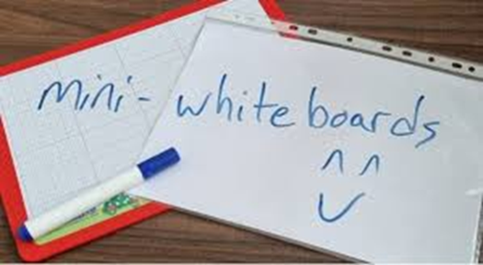
Formative assessment
Fill in the balnks : (Do/ Does)
1- _________ they shout in the classroom?
2- _________ you like pizza?
3- _________ she study English?
4- _________ Laila do her homework?
( 2 minutes)

Slide 12
feedback
Fill in the balnks : (Do/ Does)
1- _____Do____ they shout in the classroom?
2- _____Do____ you like pizza?
3- _____Does____ she study English?
4- ____Does_____ Laila do her homework?
( 2 minutes)

Slide 13
Differentiation/ 5 minutes
-Fill in the blank : (don’t/ doesn’t)
1- They _____ play tennis.
2- Ali and Mais ____ like chocolate.
-Write two sentences using (don’t/ doesn’t)
1-
2-
03
04
-Change the sentence into negative:
-Sally studies English everyday.
……………………………………………………………..
-Circle the correct answer:
(Do/ Does)
1-_____ Ahmad take care of his brother?
2- ______ they have their lunch?
02
01

Slide 14
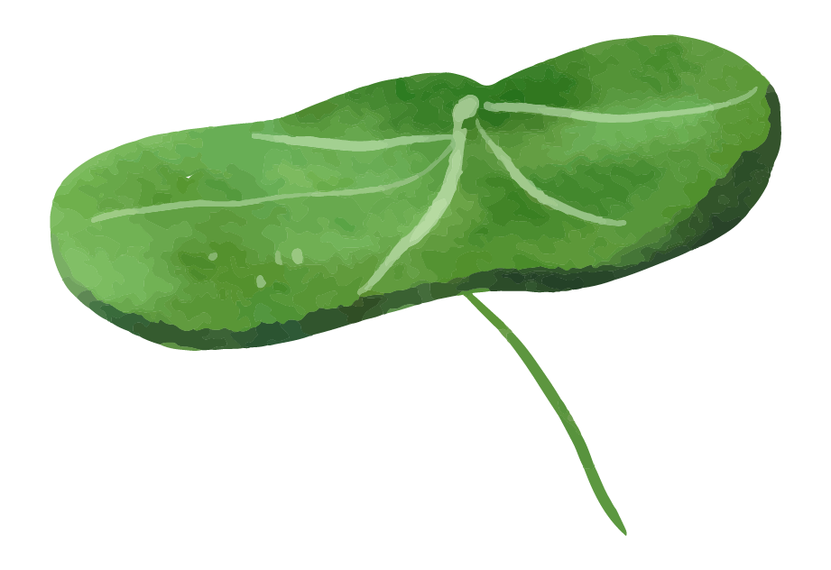
Open your booklet page 9 and solve the questions.
Summative assessment/ 3 minutes

Slide 15
Critical thinking/ 30 seconds
-
Think of a reason why don’t we wear summer clothes in winter.
(use simple present tense)
Buzz in

Slide 16
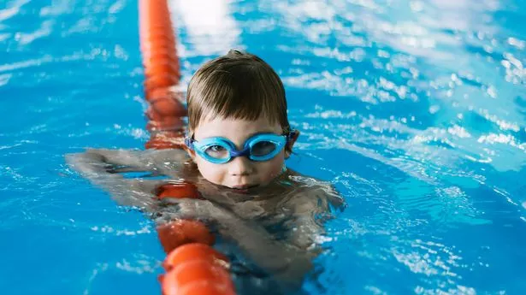
Closure /2 minutes
- Look at the photo and form a sentence from what did you learn.
Random pick

