Slide 1




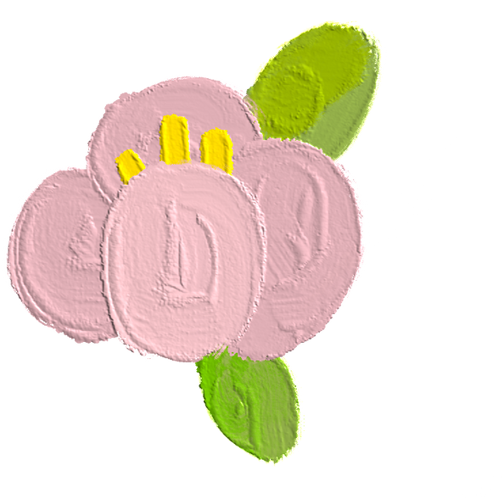

Short
Vowels

Slide 2

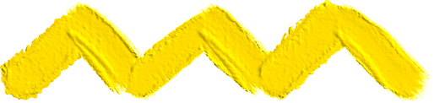


Outcomes:
Let’s begin with the end in mind
1- Distinguish between consonants and vowels.
2- Identify words with the pattern cvc.

Slide 3




Lead in (Linking to life):
  Our Value For Today:
Bing Videos

Slide 4




Pre-Assessment:
How many vowels do we have in English? Write them.

Slide 5
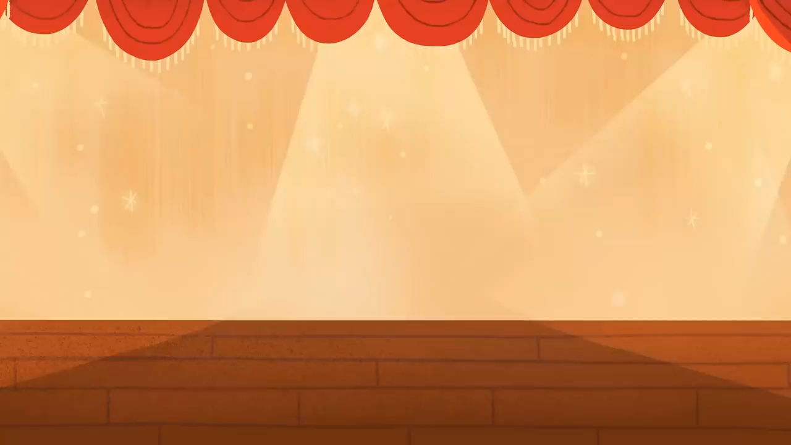

Slide 6
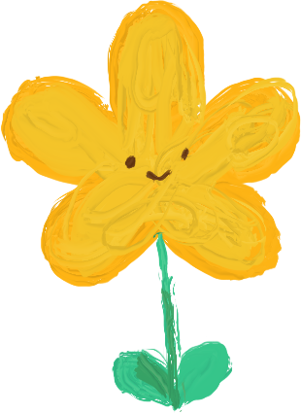
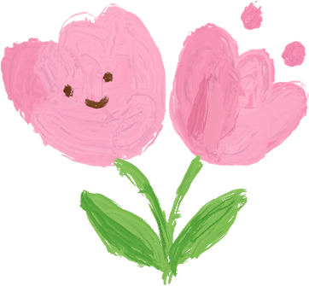



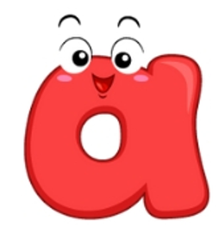


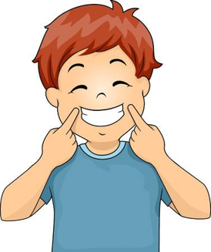


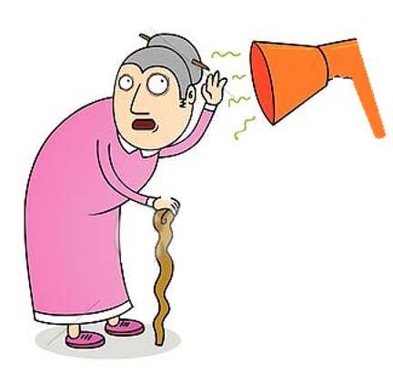

Slide 7

Find the word using the letters given.
w
s
i
a
p
g
n
n
b
m
e
t
w
e
b

Slide 8

Find the word using the letters given.
Reveal Answer
a
g
e
i
c
r
b
u
o
r
p
h
r
u
g

Slide 9

Find the word using the letters given.
Reveal Answer
e
a
g
b
s
m
l
i
o
f
n
p
l
o
g
l
o
g

Slide 10

Find the word using the letters given.
Reveal Answer
s
h
i
b
m
g
n
e
o
f
u
t
f
i
n

Slide 11
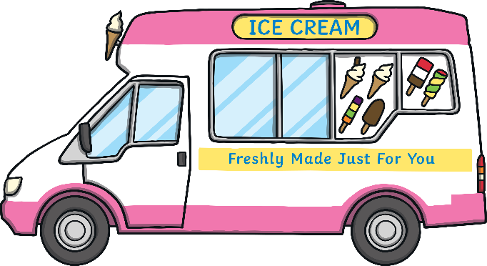
Find the word using the letters given.
Reveal Answer
v
t
e
a
m
f
b
i
o
d
n
s
v
a
n
v
a
n

Slide 12

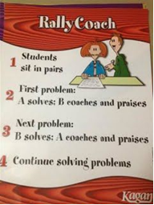
Formative Assessment:
Read the following words then answer:
a | e | i | o | u
sat hat | red get | sit kit | fox not | cub pup
1-How many vowels are in each word?
2-Where is the vowel located?
3-How many consonants are there?

Slide 13

A word is likely to have a
short vowel sound when:
1- It has a single vowel.
2- The vowel has a single consonant before and after it.

Slide 14


Critical Thinking:
I am a citrus fruit, I am round, you can squeeze me to have a refreshing juice, who am I ?

Slide 15
Critical Thinking:
I am an animal. My name starts with (h) and ends with (n), I am a bird but I can’t fly!
who am I?

Slide 16
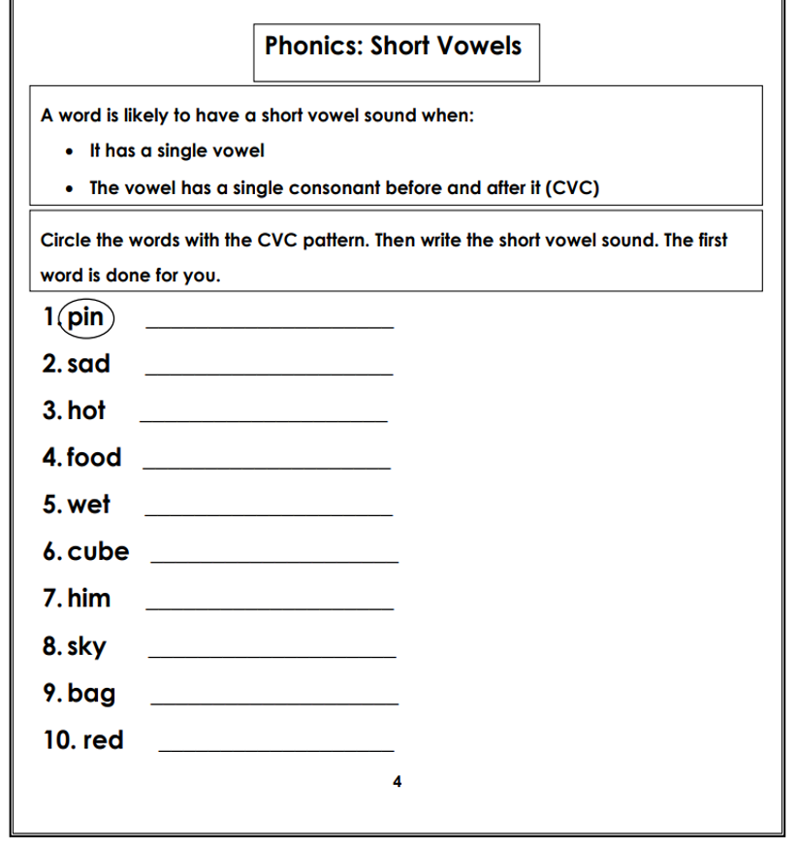



Summative Assessment:

Slide 17




Slide 18
1. Tho word « sun » has :
Short o
Short a
A
B
Short u
Short e
C
D
200 $ .
100 $ .
Reveal all Answers
End

Slide 19

End Game

Slide 20


Exit ticket:
I hop to the shop.
hop and shop have a short vowel just like:
1.run
2.got

Slide 21
Thank
You

