Slide 1
Present simple/ Regular verbs
Affirmative
GRADE 4
Unit 1
40 minutes

Slide 2
Outcomes
identify the present simple tense (affirmative )
form sentences using affirmative present simple tense.
Value responsibility.
The students are expected to:

Slide 3

Warm up/ 2 min
Silent acting challenge
“a verb”

Slide 4


Pre- assessment+ Real life application
What do you do every day?

Slide 5
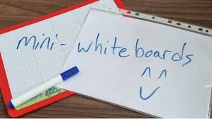
Pre- assessment
Underline the verbs in each sentence:
(each student chosses two sentences)
1-I wake up at 8.
2-I play football with my friends.
3-I eat my lunch at 3 pm.
4-I watch TV.
5-I sleep at 9 pm.

Slide 6
Presentation
We use the present simple to talk about:
_{Habits}
_{Facts(general truths)}
Repeated actions or unchanging situations.

Slide 7
Presentation
Examples:
_{I drink milk every morning.}
_{I go to IEC School.}
Water boils at 100 degrees Celsius.

Slide 8
Critical thinking
1-Compare between column one and column two.
2-What do you notice?
1-We play football 1- She drinks milk
2-They go to school 2-Salma cleans her room
3-Ali and Ahmad read 3- John watches Tv.
stories .
4-I do my homework. 4- He studies early.
Buzz in (2 minutes)

Slide 9
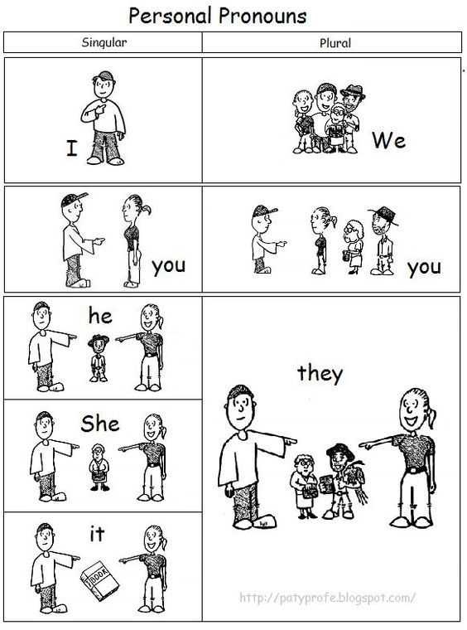
Presentation

Slide 10

Formative assessment
Change the following subjects with suitable pronouns.
I – you – we – they – he – she- it
My sister _______________
Tom and I _______________
My bike _______________
Mohammed _______________
Sally and Omar _______________
The cats _______________
Rally coach 2 min

Slide 11
Feedback
Change the following subjects with suitable pronouns.
I – you – we – they – he – she- it
My sister __she_________
Tom and I ____we________
My bike ___it___________
Mohammed __he__________
Sally and Omar ___they________
The cats ___they_________

Slide 12
Presentation
Examples:
_{I drink milk every morning.}
_{I go to IEC School.}
Water boils at 100 degrees Celsius.

Slide 13
We add –s or -es to the verb if there is:
1- He / She / It.(3rd person singular)
Ex: He plays football.
It finishes at 11 pm.
2- A singular subject.
Ex: My cat drinks milk

Slide 14
We add –es to the verb
-If the verb ends with (x, s, z, sh, ch, ss)
Ex: Watch – watches / miss – misses
Who wants to give more examples?

Slide 15

The –y rules.
1- If the verb ends with –y and before the –y there is a vowel we only add –s
Play: plays
Pay: pays

Slide 16
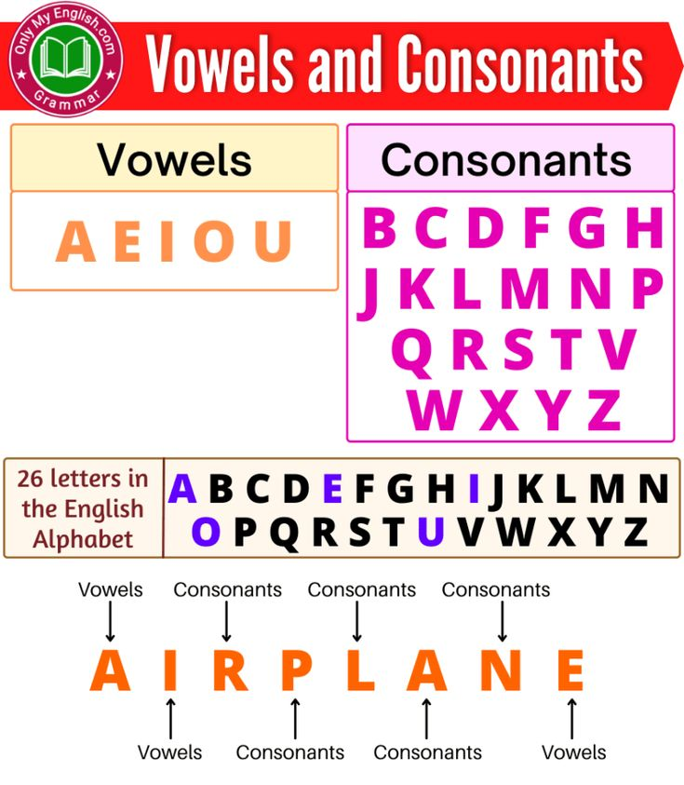
The –y rules.
2-If the word ends with a consonant + y we change the "y" into "i" and add –es
_{study –} _{studies.}
Carry: carries
Cry: cries

Slide 17
Plural subjects/ (I- we –you – they)
Plural subjects/ (I- we –you – they) + V1……
EX: 1-The boys play football every week.
2- I like pizza.
3- We sleep at 8:00 pm.

Slide 18
Formative assessment (Rally coach 1-2 Min)
Fill in the blank with the correct form of the verb using the present simple:
1.They( play) ……………………… football every weekend.
_{2.Samer (live) ………………………} here.

Slide 19
Differentiation/ 3 MIN
03
02
04
01
-Fill in the blanks with the correct form of simple present (affirmative)
1- Laila …………………… milk everyday. (drink)
2- I always ………………….. Football. (play)
1.Write two sentences using simple present (affirmative)
1- with singular subject …………………………………………….............…
2- with plural subject ………………………………………………………..
-IF the form of the verb is correct write (True) and if it is not correct write (False.)
1- Sally gos to school daily.
2- They always watch T.V.
-Circle the correct form of the simple present verb:
1- She ( eat / eats) a lot.
2- The baby ( crys/ cries) everyday.

Slide 20
Summative assessment/ Buzz in
Open your booklet page 9.
Solve the questions
5 minutes

Slide 21
Closure/ 1 MIN
-Which type of affirmative did you prefer ?
a)With singular pronouns
b)With plural pronouns

