Slide 1

Sunday
27th October, 2024

Slide 2

Unit : One / Reading: Two
Lesson : Reading / The Star Llama!
Subject : English
Grade : Four A, B, C, D, E, F, G

Slide 3


Islamic Educational College Date : 27/10
Subject: English
Grade: 4
Unit:1
Lesson: Reading
Outcomes
01:00 minutes
Warm-Up
At the end of this lesson, students are expected to:
Read then answer questions about the text and predict what will happen next
Pre-assessment
Presentation
Formative assessment
Feedback
Differentiation
Linking to life
Critical Thinking
Closure

Slide 4

Islamic Educational College Date : 27/10
Subject: English
Grade: 4
Unit: 1
Lesson: Reading
Outcomes
Wonder
General
Square
Solve
Million
03:00 minutes
Warm-Up
Pre-assessment
Presentation
Formative assessment
Feedback
Differentiation
Linking to life
Critical Thinking
Closure

Slide 5
Islamic Educational College Date : 27/10
Subject: English
Grade: 4
Unit: 1
Lesson: Reading
Outcomes
02:00 minutes
Warm-Up
Pre-assessment
Use your mini boards to write the GENRE of our text:
Presentation
Formative assessment
Feedback
Differentiation
Linking to life
Critical Thinking
Closure
Mini Boards

Slide 6
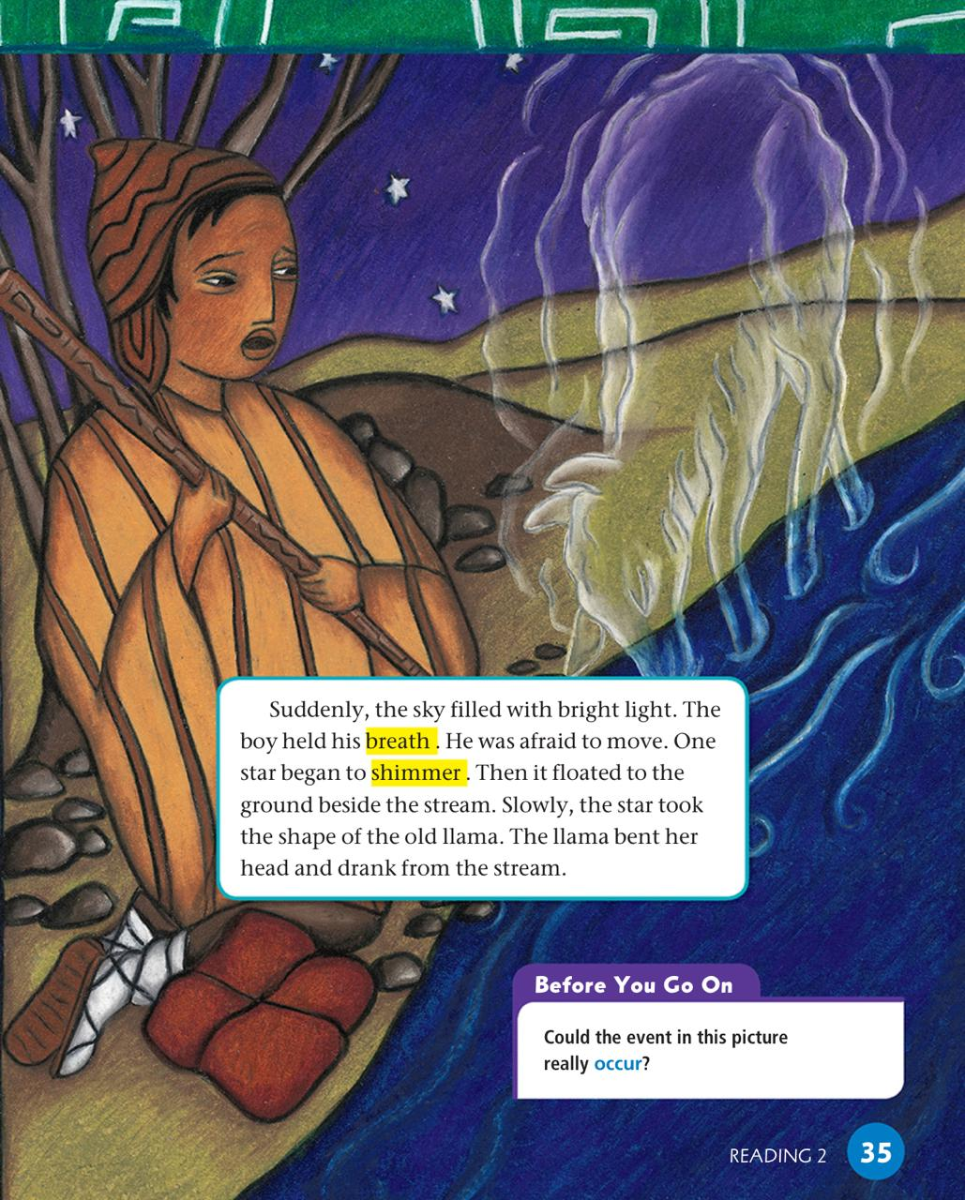

Islamic Educational College Date : 27/10
Subject: English
Grade: 4
Unit: 1
Lesson: Reading
Outcomes
05:00 minutes
Warm-Up
Pre-assessment
Presentation
Formative assessment
Feedback
Differentiation
Linking to life
Critical Thinking
Closure

Slide 7
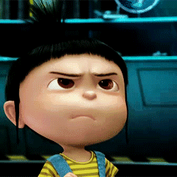
Build Vocabulary
Hold breath
(verb)
Act it out

Slide 8
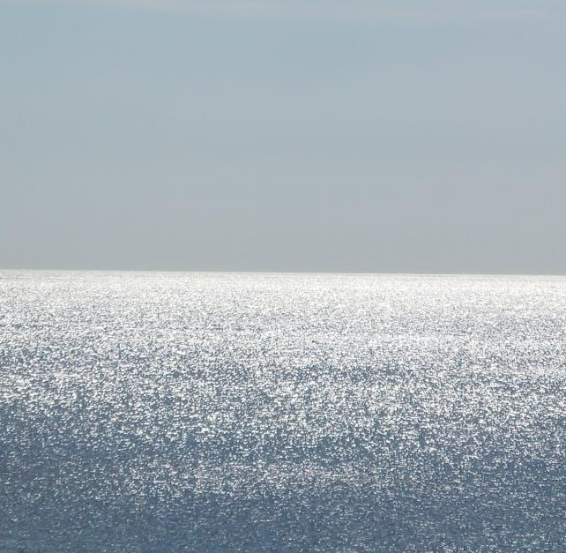
Shimmer
(Verb)
Example
The sea shimmers in the sunlight.
Meaning
to shine with a soft light

Slide 9
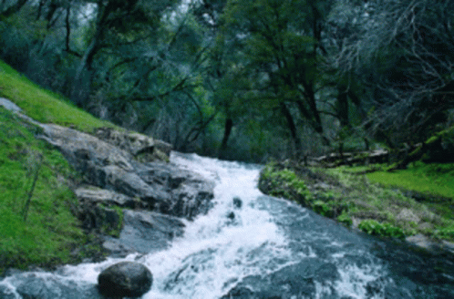
Stream
Answer

Slide 10
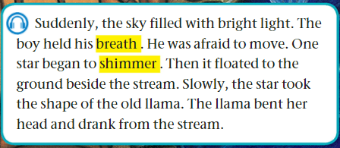
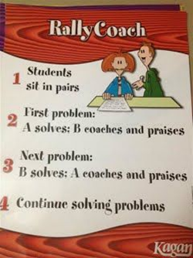
Islamic Educational College Date : 27/10
Subject:
Grade: 4
Unit: 1
Lesson: Reading
Outcomes
03:00 minutes
Warm-Up
Read
then answer:
Pre-assessment
Presentation
Formative assessment
Feedback
Differentiation
1- Why was the boy afraid?
2- What happened to the star?
Linking to life
Critical Thinking
Closure

Slide 11
Islamic Educational College Date : 27/10
Subject: English
Grade: 4
Unit: 1
Lesson: Reading
Outcomes
02:00 minutes
Warm-Up
Pre-assessment
1- Why was the boy afraid?
2- What happened to the star?
Presentation
Formative assessment
Feedback
Differentiation
Linking to life
Critical Thinking
Closure
Number : 1

Slide 12
Islamic Educational College Date : 27/10
Subject: English
Grade: 4
Unit: 1
Lesson: Reading
02:00 minutes
Outcomes
Students 1:
What could happen next?
Students 3:
Fill in the blank:
The boy was …………… .
The star began to ……………. .
Warm-Up
Pre-assessment
Presentation
Formative assessment
Feedback
Students 2:
Describe the star using your own words?
Students 4:
( Circle the correct answer)
The star floated to the ground beside the ……
a. sea b. stream
Differentiation
Linking to life
Critical Thinking
Closure
Random Pick

Slide 13

Islamic Educational College Date : 27/10
Subject: English
Grade: 4
Unit: 1
Lesson: Reading
Outcomes
01:00 minutes
Warm-Up
Pre-assessment
Presentation
Formative assessment
Feedback
Could the event in the picture really occur?
Differentiation
Linking to life
Critical Thinking
Google the meaning of the word (occur).
Closure

Slide 14
Islamic Educational College Date : 27/10
Subject: English
Grade: 4
Unit: 1
Lesson: Reading
Outcomes
01:00 minutes
Warm-Up
How would you act if you were in the boy’s shoes?
Pre-assessment
Presentation
Formative assessment
Feedback
Differentiation
Linking to life
Critical Thinking
Closure
BUZZ IN

Slide 15

Islamic Educational College Date : 27/10
Subject: English
Grade: 4
Unit: 1
Lesson: Reading
Outcomes
02:00 minutes
Warm-Up
The boy ran away when he saw the star floating to the ground.
1. True 2. False
The boy was very happy.
1. True 2. False
Pre-assessment
Presentation
Formative assessment
Feedback
Differentiation
Linking to life
Critical Thinking
Summative Assessment

Slide 16
Islamic Educational College Date : 27/10
Subject: English
Grade: 4
Unit: 1
Lesson: Reading
Outcomes
05:00 minutes
Warm-Up
Pre-assessment
Presentation
Formative assessment
Feedback
Differentiation
Linking to life
Critical Thinking
Closure

Slide 17
Build Vocabulary
Hold breath
(verb)
Act it out

Slide 18
Shimmer
(Verb)
Example
The sea shimmers in the sunlight.
Meaning
to shine with a soft light

Slide 19
Stream
Answer

Slide 20
Islamic Educational College Date : 27/10
Subject:
Grade: 4
Unit: 1
Lesson: Reading
Outcomes
03:00 minutes
Warm-Up
Read
then answer:
Pre-assessment
Presentation
Formative assessment
Feedback
Differentiation
1- What shape did the star take?
2- What did the star llama do?
Linking to life
Critical Thinking
Closure

Slide 21
Islamic Educational College Date : 27/10
Subject: English
Grade: 4
Unit: 1
Lesson: Reading
Outcomes
02:00 minutes
Warm-Up
Pre-assessment
1- What shape did the star take?
2- What did the star llama do?
Presentation
Formative assessment
Feedback
Differentiation
Linking to life
Critical Thinking
Closure
Number : 1

Slide 22
Islamic Educational College Date : 27/10
Subject: English
Grade: 4
Unit: 1
Lesson: Reading
02:00 minutes
Outcomes
Students 1:
What could happen next?
Students 3:
Fill in the blank:
The boy was …………… .
The star began to ……………. .
Warm-Up
Pre-assessment
Presentation
Formative assessment
Feedback
Students 2:
Describe the star using your own words?
Students 4:
( Circle the correct answer)
The star floated to the ground beside the ……
a. sea b. stream
Differentiation
Linking to life
Critical Thinking
Closure
Random Pick

Slide 23
Islamic Educational College Date : 27/10
Subject: English
Grade: 4
Unit: 1
Lesson: Reading
Outcomes
01:00 minutes
Warm-Up
Pre-assessment
Presentation
Formative assessment
Feedback
Differentiation
Linking to life
Name your best companion.
Google the meaning of the word (companion).
Critical Thinking
Closure

Slide 24
Islamic Educational College Date : 27/10
Subject: English
Grade: 4
Unit: 1
Lesson: Reading
Outcomes
01:00 minutes
Warm-Up
Why do you think the llama returned to the boy as a star?
Pre-assessment
Presentation
Formative assessment
Feedback
Differentiation
Linking to life
Critical Thinking
Closure
BUZZ IN

Slide 25
Islamic Educational College Date : 27/10
Subject: English
Grade: 4
Unit: 1
Lesson: Reading
Outcomes
02:00 minutes
Warm-Up
The star transformed (took the shape) into a llama. 1. True 2. False
The text is a non- fiction text:
1. True
2. False
Pre-assessment
Presentation
Formative assessment
Feedback
Differentiation
Linking to life
Critical Thinking
Summative Assessment

Slide 26
Islamic Educational College Date : 27/10
Subject: English
Grade: 4
Unit: 1
Lesson: Reading
Outcomes
02:00 minutes
Warm-Up
Pre-assessment
Choose a word you learnt today and write a sentence.
Presentation
Formative assessment
Feedback
Differentiation
Linking to life
Critical Thinking
Closure

