Slide 1

Monday

Slide 2

Unit : One / Reading: Two
Lesson : Reading / The Star Llama!
Subject : English
Grade : Four A, B, C, D, E, F, G

Slide 3


Islamic Educational College Date : 27/10
Subject: English
Grade: 4
Unit:1
Lesson: Reading
Outcomes
01:00 minutes
Warm-Up
At the end of this lesson, students are expected to:
Read then answer questions about the text and predict what will happen next
Pre-assessment
Presentation
Formative assessment
Feedback
Differentiation
Linking to life
Critical Thinking
Closure

Slide 4

Islamic Educational College Date : 27/10
Subject: English
Grade: 4
Unit: 1
Lesson: Reading
Outcomes
Wonder
General
Square
Solve
Million
03:00 minutes
Warm-Up
Pre-assessment
Presentation
Formative assessment
Feedback
Differentiation
Linking to life
Critical Thinking
Closure

Slide 5
Islamic Educational College Date : 27/10
Subject: English
Grade: 4
Unit: 1
Lesson: Reading
Outcomes
02:00 minutes
Warm-Up
Pre-assessment
Which shape did the star that fell from the sky take?
Presentation
Formative assessment
Feedback
Differentiation
Linking to life
Critical Thinking
Closure
Mini Boards

Slide 6
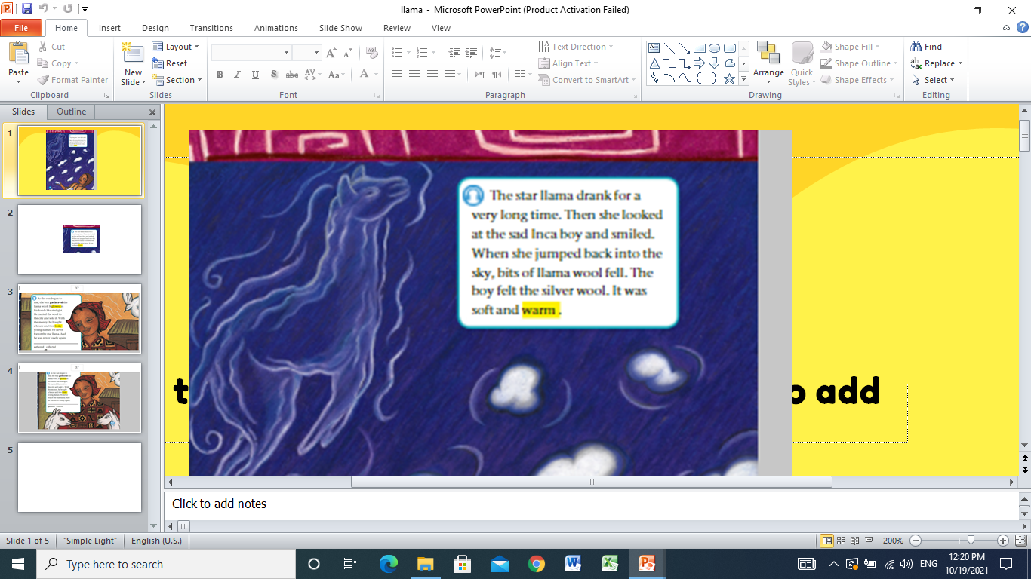

Islamic Educational College Date : 27/10
Subject: English
Grade: 4
Unit: 1
Lesson: Reading
Outcomes
05:00 minutes
Warm-Up
Pre-assessment
Presentation
Formative assessment
Feedback
Differentiation
Linking to life
Critical Thinking
Closure

Slide 7
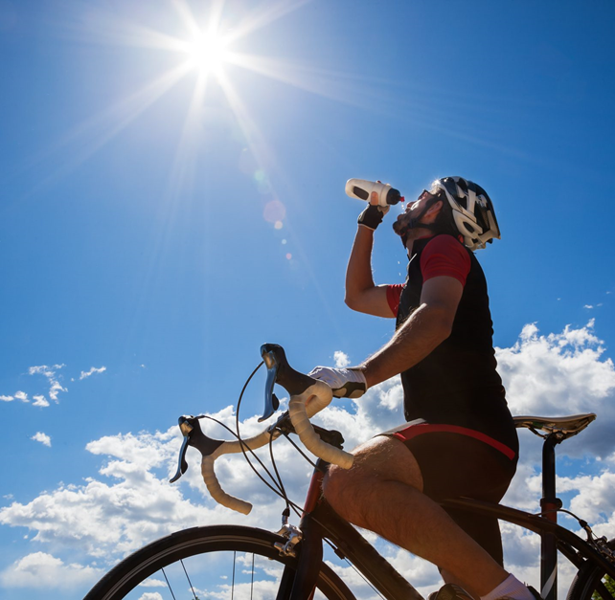

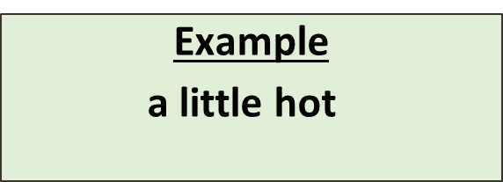
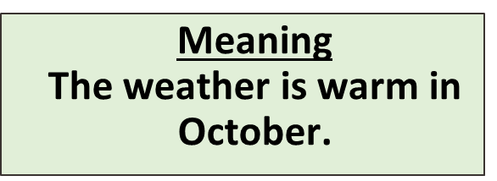
Build Vocabulary

Slide 8
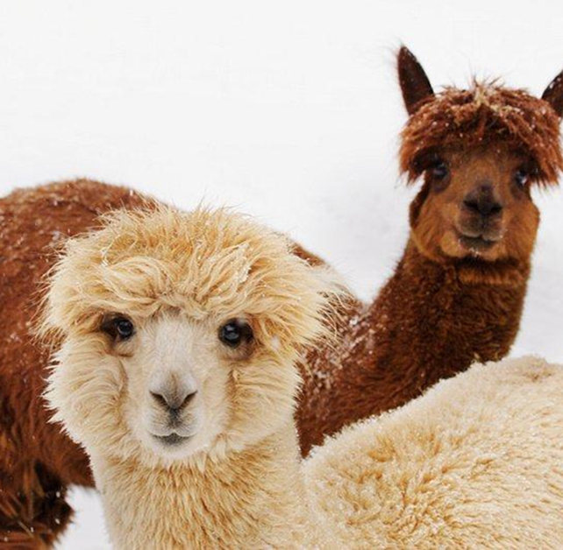

Llama
Answer

Slide 9
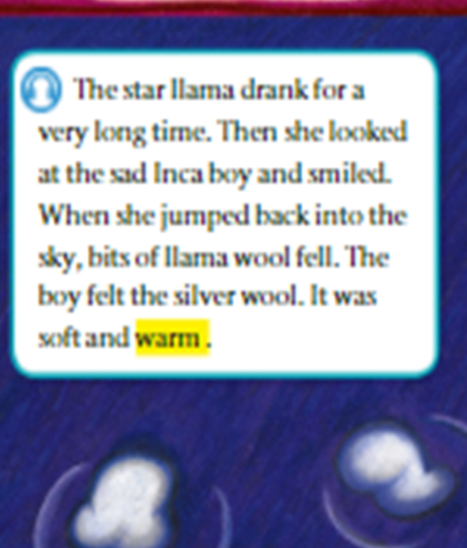
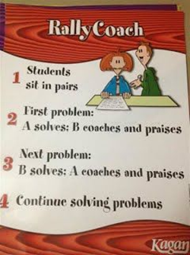
Islamic Educational College Date : 27/10
Subject:
Grade: 4
Unit: 1
Lesson: Reading
Outcomes
03:00 minutes
Warm-Up
Read
then answer:
Pre-assessment
Presentation
Formative assessment
Feedback
Differentiation
1- What happened when the llama jump to sky?
2- Describe the wool?
Linking to life
Critical Thinking
Closure

Slide 10
Islamic Educational College Date : 27/10
Subject: English
Grade: 4
Unit: 1
Lesson: Reading
Outcomes
02:00 minutes
Warm-Up
Pre-assessment
1- What happened when the llama jump to sky?
2- Describe the wool?
Presentation
Formative assessment
Feedback
Differentiation
Linking to life
Critical Thinking
Closure
Number : 1

Slide 11
Islamic Educational College Date : 27/10
Subject: English
Grade: 4
Unit: 1
Lesson: Reading
02:00 minutes
Outcomes
Students 1:
How would the boy feel if the star wouldn’t take the shape of the llama?
Students 3:
When the star llama looked at the sad Inca boy she ……………..
Warm-Up
Pre-assessment
Presentation
Formative assessment
Feedback
Students 2:
How did the wool feel?
Students 4:
The Inca boy felt the silver wool. ( True/ False)
Differentiation
Linking to life
Critical Thinking
Closure
Random Pick

Slide 12
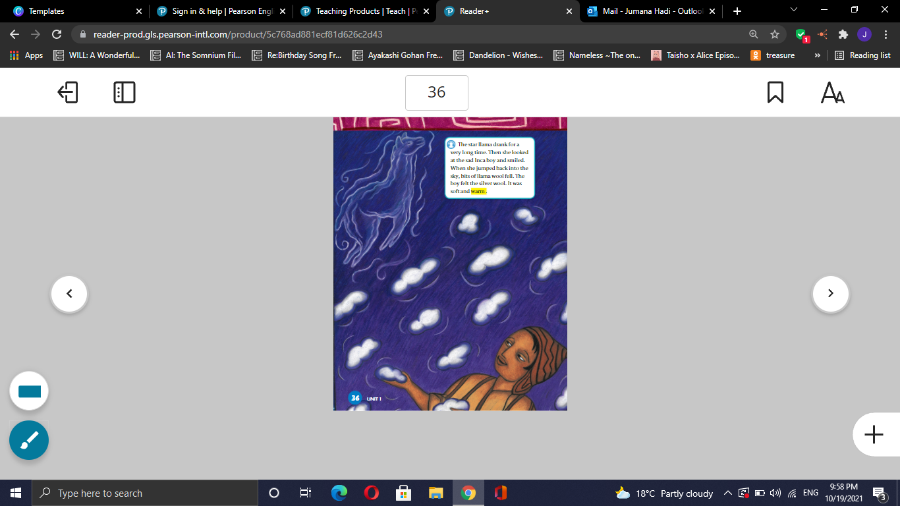
Islamic Educational College Date : 27/10
Subject: English
Grade: 4
Unit: 1
Lesson: Reading
Outcomes
01:00 minutes
Warm-Up
Pre-assessment
Presentation
Formative assessment
Feedback
Could the event in the picture really occur?
Differentiation
Linking to life
Critical Thinking
Google the meaning of the word (occur).
Closure

Slide 13
Islamic Educational College Date : 27/10
Subject: English
Grade: 4
Unit: 1
Lesson: Reading
Outcomes
01:00 minutes
Warm-Up
What will happen if something fell from the sky on your head?
Pre-assessment
Presentation
Formative assessment
Feedback
Differentiation
Linking to life
Critical Thinking
Closure
BUZZ IN

Slide 14

Islamic Educational College Date : 27/10
Subject: English
Grade: 4
Unit: 1
Lesson: Reading
Outcomes
02:00 minutes
Warm-Up
-The inca boy was sad when the star llama fell.
1. True
2. False
- The boy felt the silver wool.
  1. True
  2. False
Pre-assessment
Presentation
Formative assessment
Feedback
Differentiation
Linking to life
Critical Thinking
Summative Assessment

Slide 15
Islamic Educational College Date : 27/10
Subject: English
Grade: 4
Unit: 1
Lesson: Reading
Outcomes
02:00 minutes
Warm-Up
Pre-assessment
Choose a word you learnt today and write a sentence.
Presentation
Formative assessment
Feedback
Differentiation
Linking to life
Critical Thinking
Miniboard
Closure

Slide 16
Islamic Educational College Date : 27/10
Subject: English
Grade: 4
Unit: 1
Lesson: Reading
Outcomes
05:00 minutes
Warm-Up
Pre-assessment
Presentation
Formative assessment
Feedback
Differentiation
Linking to life
Critical Thinking
Closure

Slide 17
Build Vocabulary

Slide 18
Llama
Answer

Slide 19
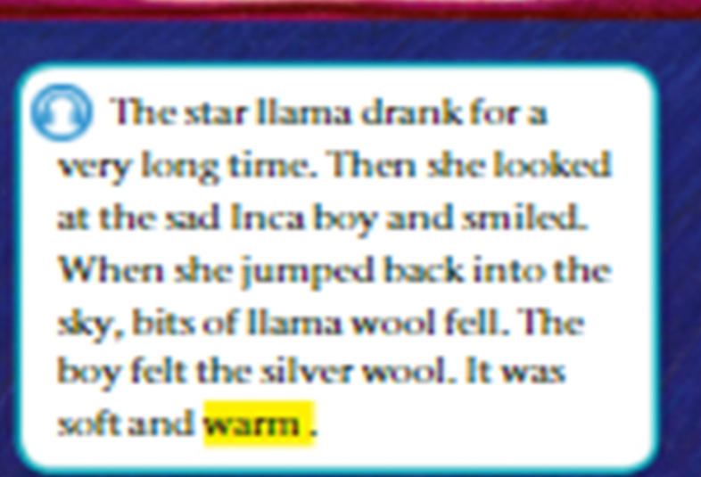
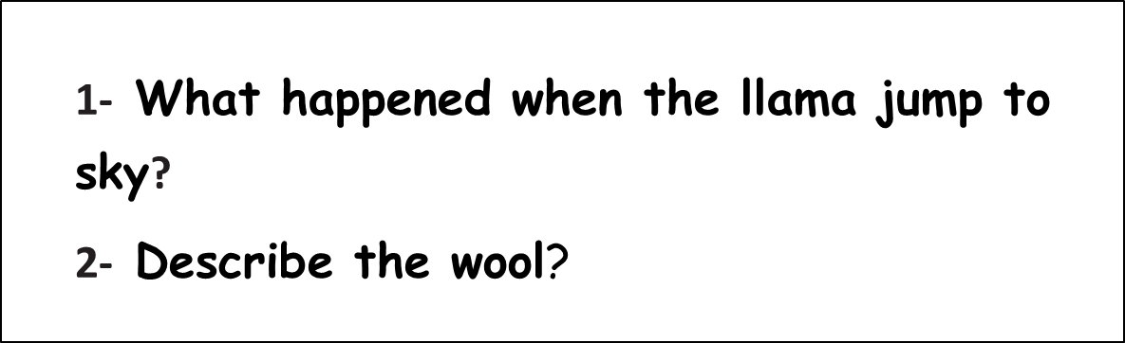
Islamic Educational College Date : 27/10
Subject:
Grade: 4
Unit: 1
Lesson: Reading
Outcomes
03:00 minutes
Warm-Up
Read
then answer:
Pre-assessment
Presentation
Formative assessment
Feedback
Differentiation
Linking to life
Critical Thinking
Closure

Slide 20
Islamic Educational College Date : 27/10
Subject: English
Grade: 4
Unit: 1
Lesson: Reading
Outcomes
02:00 minutes
Warm-Up
Pre-assessment
Presentation
Formative assessment
Feedback
Differentiation
Linking to life
Critical Thinking
Closure
Number : 1

Slide 21
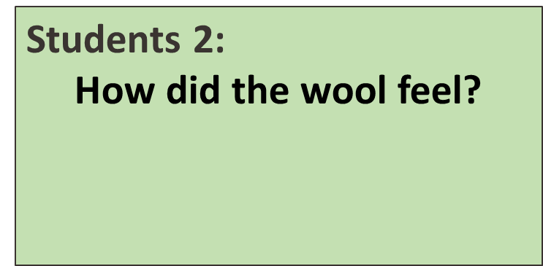
Islamic Educational College Date : 27/10
Subject: English
Grade: 4
Unit: 1
Lesson: Reading
02:00 minutes
Outcomes
Warm-Up
Students 1:
How would the boy feel if the star wouldn’t take the shape of the llama?
Students 3:
When the star llama looked at the sad Inca boy she ……………..
Pre-assessment
Presentation
Formative assessment
Feedback
Students 4:
The Inca boy felt the silver wool. ( True/ False)
Differentiation
Linking to life
Critical Thinking
Closure
Random Pick

Slide 22
Islamic Educational College Date : 27/10
Subject: English
Grade: 4
Unit: 1
Lesson: Reading
Outcomes
01:00 minutes
Warm-Up
Pre-assessment
Presentation
Formative assessment
Feedback
Could the event in the picture really occur?
Differentiation
Linking to life
Critical Thinking
Google the meaning of the word (occur).
Closure

Slide 23
Islamic Educational College Date : 27/10
Subject: English
Grade: 4
Unit: 1
Lesson: Reading
Outcomes
01:00 minutes
Warm-Up
What will happen if something fell from the sky on your head?
?
Pre-assessment
Presentation
Formative assessment
Feedback
Differentiation
Linking to life
Critical Thinking
Closure
BUZZ IN

Slide 24
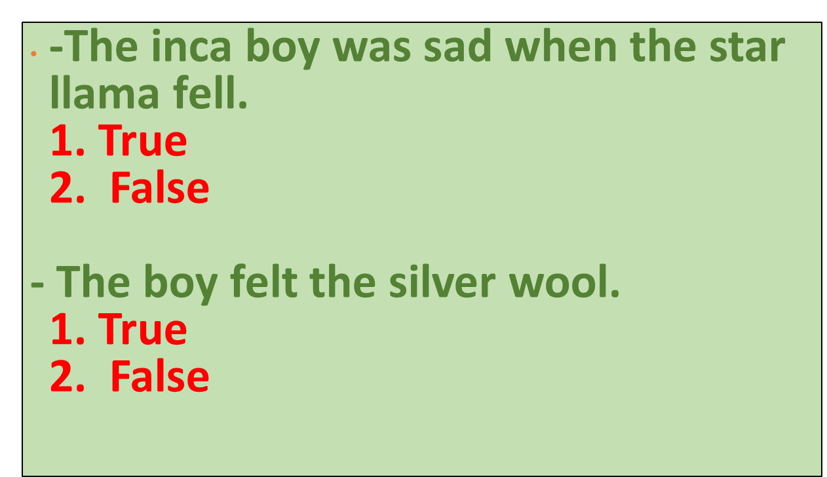
Islamic Educational College Date : 27/10
Subject: English
Grade: 4
Unit: 1
Lesson: Reading
Outcomes
02:00 minutes
Warm-Up
Pre-assessment
Presentation
Formative assessment
Feedback
Differentiation
Linking to life
Critical Thinking
Summative Assessment

Slide 25
Islamic Educational College Date : 27/10
Subject: English
Grade: 4
Unit: 1
Lesson: Reading
Outcomes
02:00 minutes
Warm-Up
Pre-assessment
Choose a word you learnt today and write a sentence.
Presentation
Formative assessment
Feedback
Differentiation
Linking to life
Critical Thinking
Miniboard
Closure

Slide 26
HomeWork:
-Write three sentences in your copy notebook using the word that you learnt.

